Slide 1
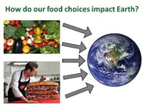
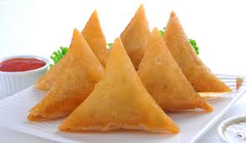
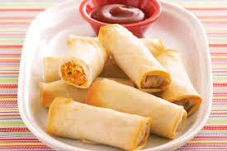
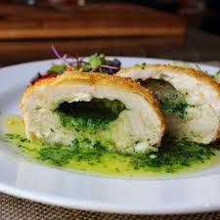
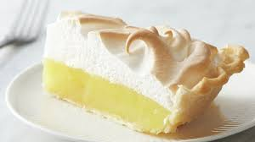
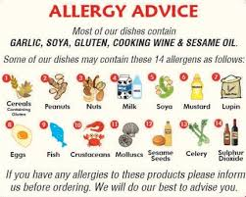
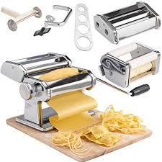
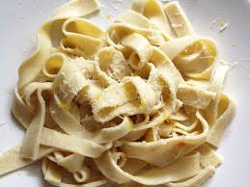
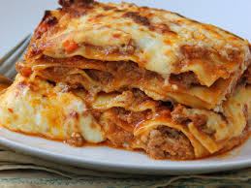
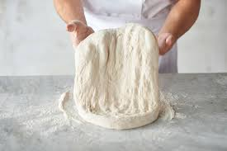
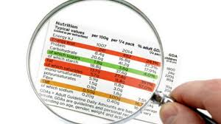
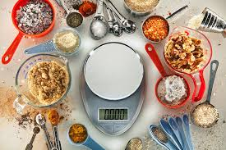
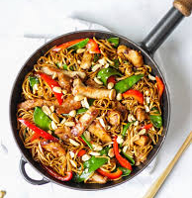
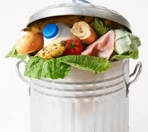
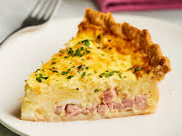
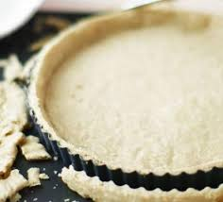
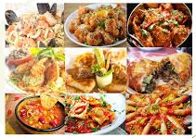
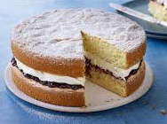
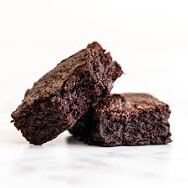
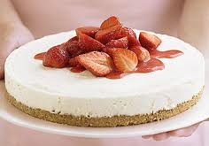
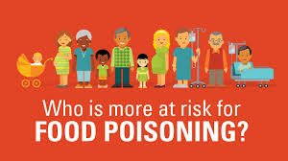
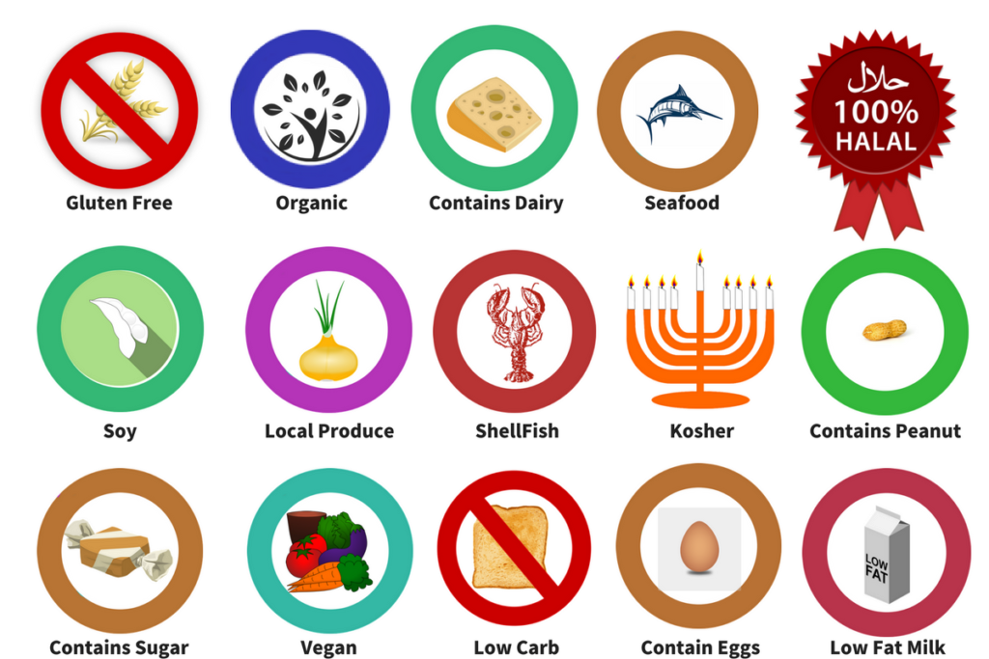
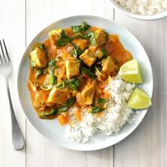
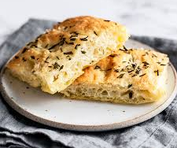
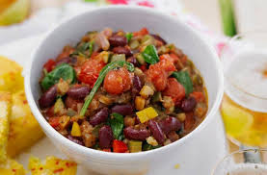
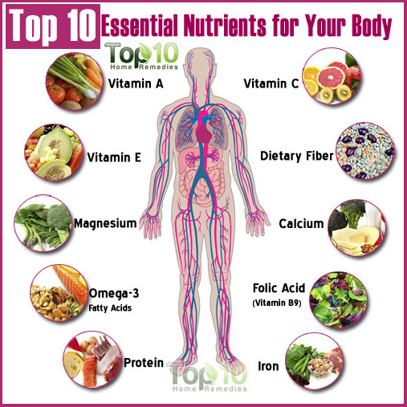
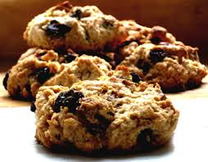
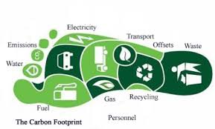
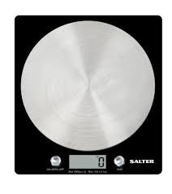
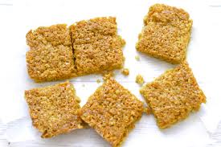
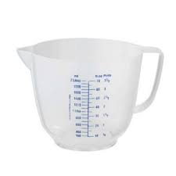
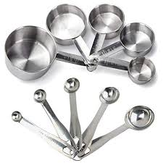
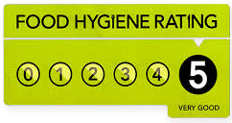
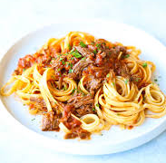
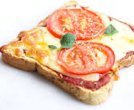
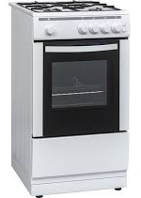
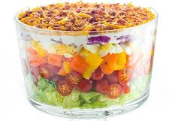
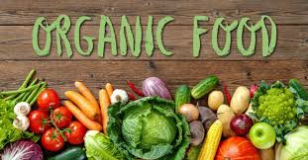
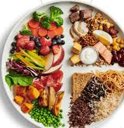
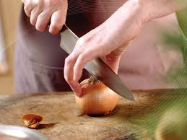
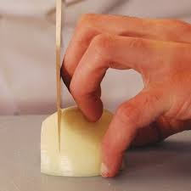
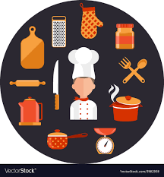
Representation PRACTICAL
Hospitality and Catering KS4 Curriculum Journey
UNIT 1 - Theory
Mixed skilled practical's
Practical exam AC3.1 AC3.2 AC3.3 AC3.4 AC3.5
UNIT 1 - Theory
LO1 –LO5
Exam June
CA
AC 2.4
AC 1.2
AC2.3
AC 1.3
AO5: Developing Hospitality and Catering businesses
AC4.4 common types of food poisoning
AC 1.1
AC 1.4
AC3.1- AC3.5
Mock Practical
AC2.3
Theory AC2.2
Explain how dishes address environmental issues
AC2.1
11
Theory AC 3.5 Use food safety practices
Mock CA
Exam
LO1 (AC1.1-1.3)
The environment in which hospitality and catering providers operate
Viennese finger biscuits/ Cinnamon buns
Chicken Tikka & Naan
Puff pastry
Pasta/filled pasta/Chicken portioning/Ballotine
AO4: Food Hygiene legislation
Terms 5 & 6
PRACTICALS: MEALS (how food can cause ill health)
Theory AC2.1 Explain factors to consider when proposing dishes for a menu
AO2:
Hospitality business design
LO3 – Controlled unit
Terms 3 & 4
AC 2.4
Evaluate:
What makes a good food product? How can you improve your skills? What is the origin of the ingredients used?
AO3:
Dietary groups in society and nutritional requirements
PRACTICALS: PASTRY PRODUCTS
AC4.5
The symptoms of food induced ill health
AO1:
The Hospitality and Catering industry and job roles
AC4.3
Food safety legislation
CA practical exam
Theory AC3.2
Assure quality of commodities to be used in food preparation
Theory AC3.1
Techniques in preparation of commodities
Meringe
Chicken Kiev
AC 1.2
Theory AC 3.4 Complete dishes using presentation techniques
Spring Rolls/Samosas
Skills: stir frying, wrapping, rolling, deep frying or baking
AC 2.1
AC 2.2
AC 2.4
Year 11
Terms 1 & 2
Mock CA
Terms 5 & 6
Allergies
AC4.1 food related causes of ill health
AC 3.3 Use techniques in cooking of commodities
AC 2.3
Fresh Pasta and sauces
Lasagne
Calzone
AC4.2
The role and responsibilities of the Environmental Health Officer
Sponge Cake
Scaling up/down of recipes
Stir Fry
Food waste
Quiche
Pastry
Multicultural foods
Choux buns
Brownies
AC 1.4
AC 1.3
Dough making skills
AC 1.1
Special Diets
Curry and
Rice
Function of nutrients in the body
Doughnuts
Healthy alternatives
Rising agents
Focaccia Bread
Vegetable Chilli
Rock Buns
4Cs
Terms 3 & 4
Fibre, Water
Food miles carbon foot print
Introduction into
Food health, hygiene and food from around the World
Costing of recipes
Seasonal Foods
Flap Jack
Understanding of measurement units and equipment
Year 10
Pasta Ragu
Terms 1 & 2
Healthy eating
- A balanced diet
Carbohydrates, FATS
Eat-well plate
Chopping techniques
Introduction into
Food preparation,
health and hygiene
Dough making skills
Pizza
How to use the large equipment safetly
Layered Salad
Notes:
Curriculum Journey overview:
Key to be used to highlight either: key skills running throughout every year or Assessment objectives to show how your curriculum is building knowledge, skills and understanding
Where there are cross curricular IT links please identify in italics.

