Slide 1





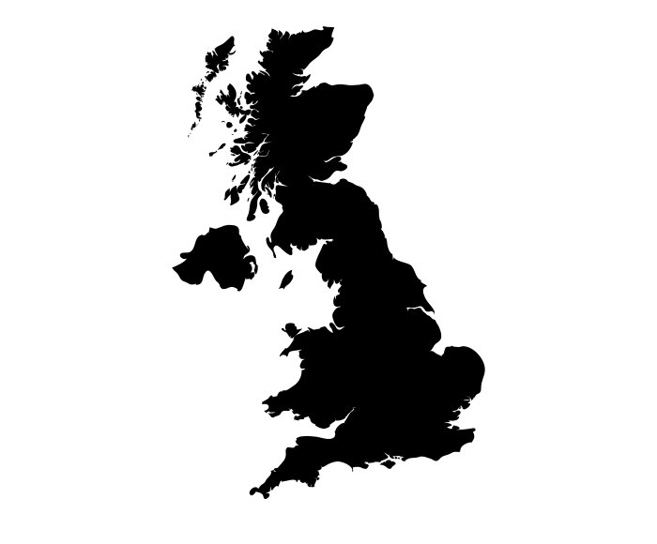













Geography Learning Journey
Where are areas of surplus and deficit located globally?
Revision
People and the biosphere
Uk’s evolving human landscape
Uk’s evolving physical landscape
YEAR
11
Consuming energy resources
Forests under threat
Geographical investigation
Challenges of an urbanising world
Hazardous earth
YEAR
10
Development dynamics
Local area study: Grimsby
Climate Change
River Ganges: From source to mouth
Cold Environments
Aid or trade?
International organisations and natural disasters
YEAR
Made in China
9
Planets natural resources
Flooding in the UK
The Northern Powerhouse
Africa: A continent of Contrasts
UK’s Physical landscape
Migration and the UK
YEAR
8
The Amazon rainforest
Around the word in 40 days
Restless Earth
YEAR
7
Global fashion industry
Weather, climate and biomes
‘ Geography is the subject which holds the key to our future. ’ MICHAEL PALIN

