Slide 1
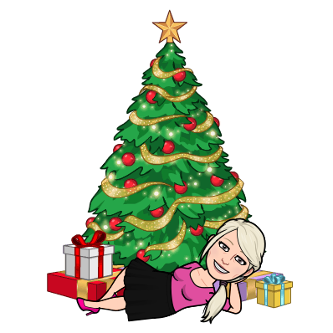
Learning Journey Y10 HSC Sept - Feb
Introduction to Health and Social Care
RO 33 Supporting individuals through life events
The Journey Starts
There are 3 topics to be taught followed by an NEA assessment. You will have deadlines to meet and this work will form 30% of your final grade.
All students to complete 2 units by May
Of Year 10
Plagiarism, Referencing, Command Words, NEA work.
Year 10
Half Term one
Intro to HSC
RO33
Topic 1
Topic 1: Life Stages
Look at 5 different life stages, factors affecting growth and development and PIES.
Topic 3
Topic 2
Topic 2: Impacts of life events
Assessment Task
Look at expected and unexpected events and their impacts.
Task 1a
/6
Task 1
This is internally marked, but externally moderated. The task changes each year so you need to get it right first time.
Term 3a
You will be set a task on growth and development through a life stage, this can be any of the 5 studied.
Topic 3
Topic 3: Sources of support
Topic 2
Task 1 /15
Half term two
Look at the roles of practitioners, informal carers, practitioners meeting needs and personalized support.
Task 2a
Task 2a /24
Task 3 /12
You will be set a task on life events and sources of support for individuals. In this task you will need to interview a real person.
Task 1b /18
RO35 Health Promotion Campaigns
There are 4 topics to be taught followed by an NEA assessment and Health Promotion Fayre. This forms 30% of your final mark.
Task 2b /21
Task 4 /12
Task 2b
Half Term 3
RO33
/60
RO35
Topic 1
Half Term
Task 2 /12
You will be set a task on researching and recommending support to meet individual needs, this may be on a local or national level.
End of RO33
Topic 1: Current Public Health issues and impact on society
Topic 4
Your work will be assessed and a mark recorded with the exam board.
RO35
/60
Look at what makes a healthy society, current challenges, organisations and current campaigns and benefits.

Slide 2
Learning Journey Y10 HSC Feb - July
The Journey Continues
Topic 2: Factors influencing health and wellbeing
Topic 4: Deliver and evaluate a health promotion campaign
You are well on the way now, have banked 1 unit and onto the final NEA unit.
You will look at health and wellbeing, lifestyle choices, education and access to healthcare, hygiene and mental health, barriers to support
You will look at how to introduce, deliver, evaluate and gain feedback on your campaign.
Assessment Task
This is internally marked, but externally moderated. The task changes each year so you need to get it right first time.
Half Term 4
Topic 2
Topic 3
Topic 4
Task 1a
/6
Half term 5
Topic 3: Plan and create a health promotion campaign.
Task 1a
Task 1b
You will be set a task on a public health challenge and campaign.
Task 1b /18
You will be set a task to produce information on a specific health promotion campaign.
You will look at Aims, timescales, communication and delivery of a campaign.
Task 4
You will be set a task to evaluate your own performance at the health promotion fayre.
Task 4 /12
Task 3 /12
Task 2 /12
Task 2
RO35
/60
You will be set a task to write a plan for your campaign.
End of RO35
Your work will be assessed and a mark recorded with the exam board.
Task 3
You will deliver your campaign at the a heath promotion fayre.
WORK SENT OFF
May 15th External Moderation
All work has to have been posted off to the exam board for this date. After this your marks will be confirmed.
RO32
Topic 1
Half term 6
Topic 1
Topic 2
END OF Y10
RO32: Principles of Care in HSC settings
Topic 1: Rights of individuals in HSC
Topic 2: Person- centred values
There are 4 topics to be taught followed by an external examination assessment, this exam will form 40% of your final grade.
You will look at types of care settings, the rights of individuals and the benefits of maintaining rights and meeting the needs of service users.
You will look at how person centred values are applied by service providers, The 6 C’s of care, examples of application in HSC settings and the benefits of these approaches to service users and providers.

