Slide 1
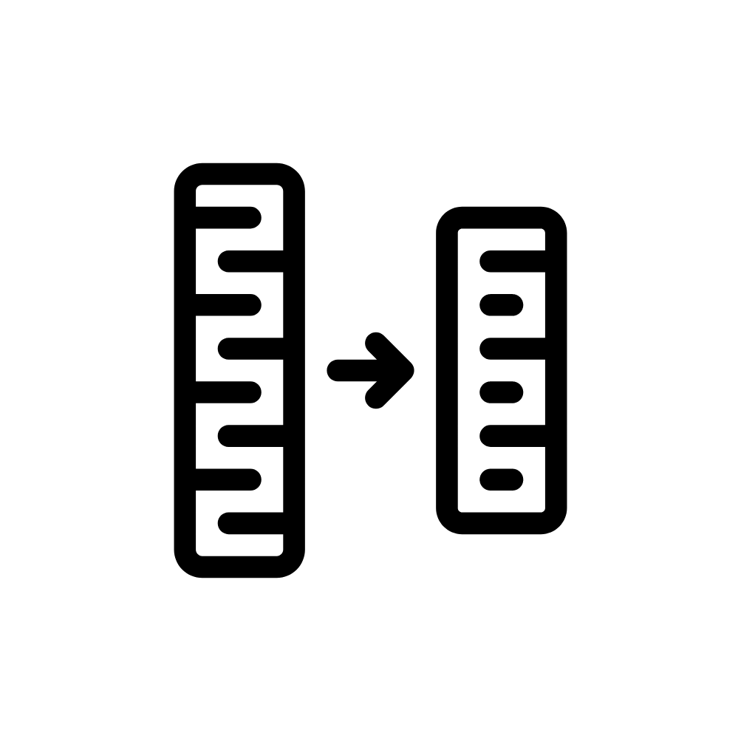
History Learning Journey
Where are areas of surplus and deficit located globally?
Revision
Conflict and tension in Asia
YEAR
11
Migration, Empires and the people
Elizabethan England
America: Inequality and Opportunity
YEAR
10
The rise of dictators
The Holocaust
Democracy in Germany
WW2
Protests through time
YEAR
WW1
9
Suffragists and Suffragettes
Age of revolution
Why did WW1 start?
Cromwell and the return of the King
British Empire
Industrial Revolution
YEAR
8
Slave Trade
Tudors
Anglo Saxon England
YEAR
7
English Civil War
Medieval Realms
‘Those who do not learn history are doomed to repeat it.’ George Santayana

