Slide 1
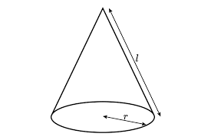
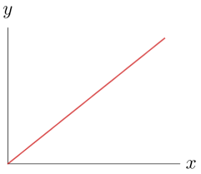
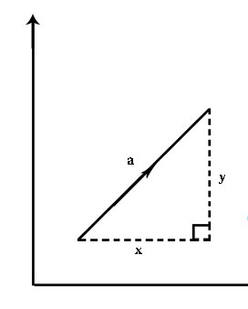
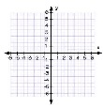
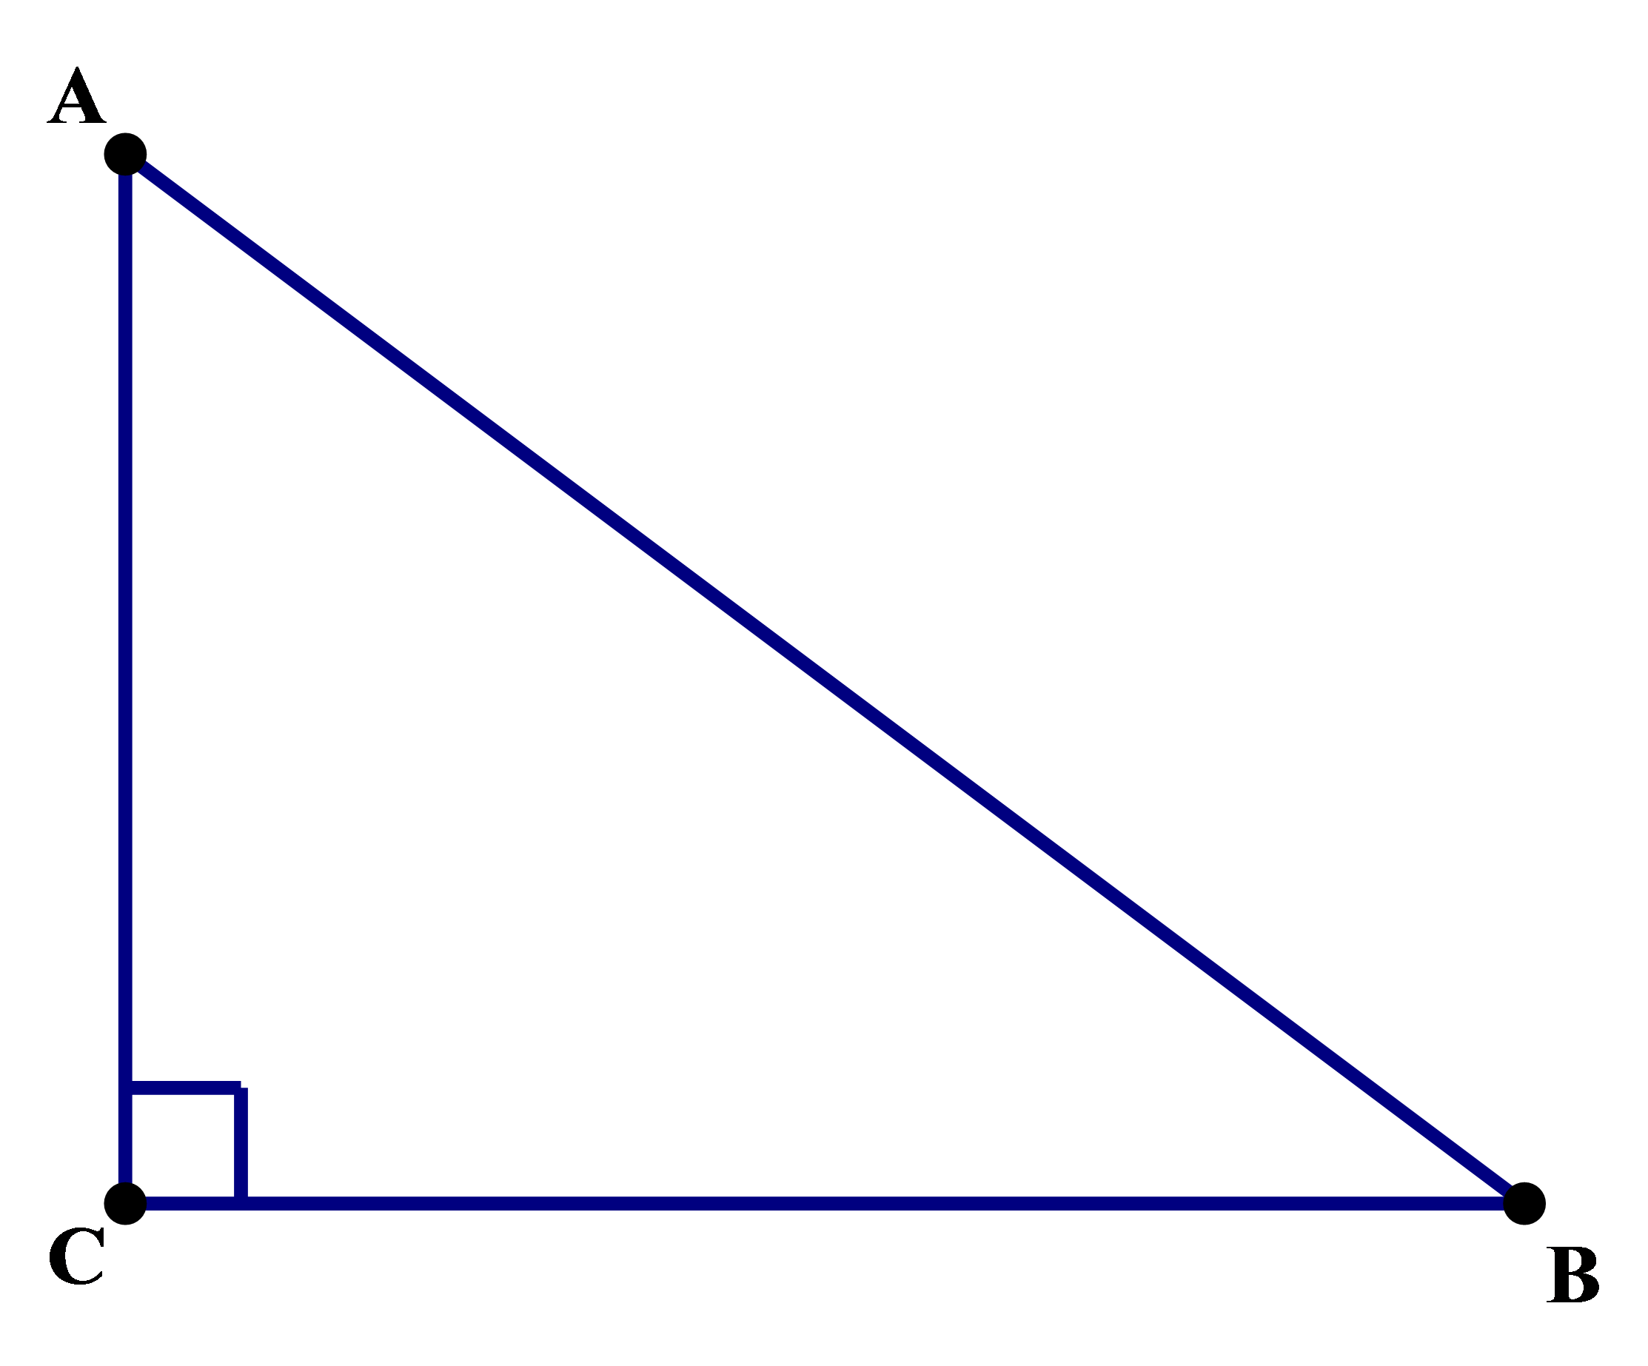
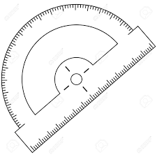
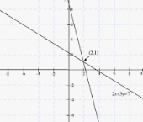
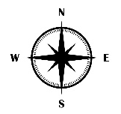
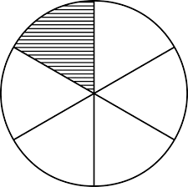
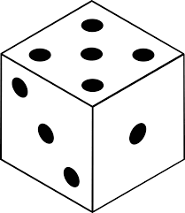
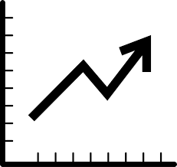
f⁻¹(x)
X
8
a = b
Direct / inverse proportion
Functions / Transformation
Fractions
Proof
Revision
3D Shapes and Similarity
Further Education
Maths
Learning
Journey
7,10,13,16,19
Bearings, Construction and Loci
½
a:b = 3:2
Quadratics 2
Sequences
Collecting and Representing Data
½
Percentage and Interest
Ratio and Fractions
Probability
Year
11
Vectors
Graphs
2.5 x 10³
10³
Standard Form
Growth and Decay
2x + 3y < 4
Indices
Trigonometry 2
Equations and Inequalities
Circles 2
Surds
Year
10
Simultaneous Equations 3
Similarity and Enlargement
3:2
Quadratics
Trigonometry
Ratio Review
Pythagoras’ Theorem
Construction, Congruence and Loci
Angle Review
Simultaneous equations 2
2x + 3y
Simultaneous equations 1
Algebra
Review
Angles in Polygons
Bearings
Circles and Composite Shapes
Volume and Surface Area of Prisms
Year
9
Fractions and Percentages
Sets and Venns
Bivariate Data
Probability
Univariate Data
3:2
Accuracy and Estimation
Forming and Solving Inequalities
7,10,13,16,19
Real Life Graphs
Ratio Review
Linear Graphs
Forming and Solving Equations
Sequences
Direct and Inverse Proportion
Year
8
Area and Perimeter of 2D Shapes
Transforming 2D Figures
2,3,5,7,11
Co-ordinates
Prime Factor Decomposition
Comparing Fractions
All Operations Acting on Fractions
Constructing Triangles and Quadrilaterals
Classifying 2D Shapes
Percentage
(²÷×±)
3:2
Positive and Negative Numbers
Order of Operations
Factors and Multiples
Axioms and Arrays
Place Value
Ratio and Proportion
Year
7
Angles
Equations and Inequalities
2x + 3y < 4

