Slide 1
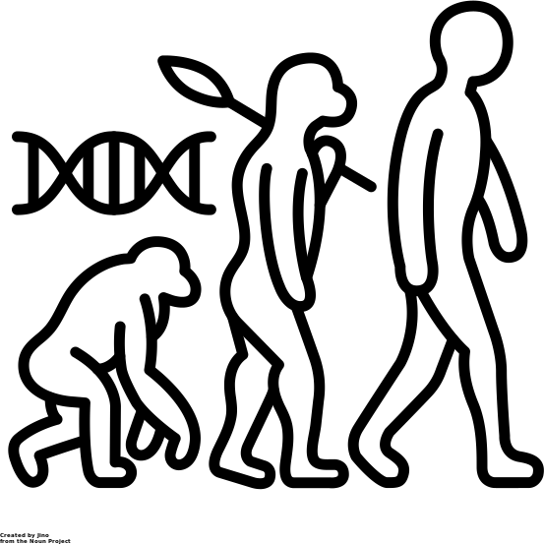
Science Learning Journey
PE1
Electric motors,
Density
Specific latent heat
PE1
Hooke’s law, Work done & energy transfer
CE1
D-T & V-T Graphs,
F=ma
CE1
Development of the periodic table & the atom
CE1
Waste water treatment, LCA’s
CE1
Reversible reactions, equilibrium, Moles
BE1
Disease, Genetic engineering, Drug discovery, Vaccinations
BE1
Photosynthesis, homeostasis, controlling blood glucose
PC2
Electromagnetic waves
CC2
Carbon footprint, Global warming & Climate change
CC2
Atmosphere & atmospheric pollutants
PC2
Nuclear Radiation
PC2
Waves
CC2
Rates of reaction
BC2
Transpiration, diffusion, Carbon & water cycle
BC1
Respiration, menstrual cycle & the Endocrine system
CC1
Metal extraction, polymers & alloys
BC2
Deforestation
CF2
Exothermic & endothermic reactions
CF2
Neutralisation, Salts & metal extraction
CF2
Classification, Biodiversity & adaptations
PF2
Speed, velocity & acceleration
PF2
Newton’s laws
BC1
Digestion & enzymes
BC1
The Heart, Blood &The Lungs
BC1
The Nervous system & reaction time
CC1
States of matter & bonding
CC1
Electrolysis
PC1
Electricity
BC2
Genetic inheritance
CF2
Hydrocarbons, fractional distillations & cracking
PC1
Renewable & non-renewable energy
BF2
Evolution, natural selection & fossils
BF2
Cancer
BF2 Disease
PF1
Specific heat capacity
PF1
Magnets & electromagnetism
PF1 Energy & efficiency
CF1 Chromatography & pure substances
CF1
Atomic structure
BF1
Cells &
reproduction
Ceramics, composites & polymers
Extracting
metals
Reactivity series
BF2
Classification, Biodiversity & adaptations
KS4
Catalysts
Reflection/refraction
Colours & the eye
Water waves
Introduction to science
Data
Gradients on graphs
Repeatability & reproducibility
Errors
Standard form
Percentages
Uncertainty
Industrial chemistry
Diffusion
Exothermic & endothermic reactions
Light waves
Density
Sound waves
Developing drugs
Addiction support worker
Health, fitness & non-communicable disease
Measuring fitness
Wireless technology
Antibiotics
Issues with smoking & drinking
Sports participation
Reaction time
Effects of exercise
on the body
Misuse & addiction
Pablo Escobar case study
Legally prescribed
drugs
What are drugs?
Year
9
Drugs in sport
Properties & types of waves
Aerobic & anaerobic respiration
Energy loss through radiation
Heart &
blood vessels
Non-renewable energy
Burning fuels
Effect of carbon on the environment
Power
Sports science
Lungs
Conductors
Insulators
Power
Efficiency
Power
Geothermal
Hydroelectric
Solar & wind
Renewable energy
Skeletal system & joints
Blood splatter analysis
Fingerprinting
Graphs
Significant figures
Anomalies
Introduction to science
Handwriting analysis
Chromatography
Pure substances
DNA
Forensic evidence
Forensic science
Inherited disorders
Variables
Flame testing
Time since death
Natural selection, extinction & evolution
Variation & adaptation
Genetic diagrams
Mean, mode & median
Hereditary & inheritance
Structure of the Earth
The rock cycle
Carbon cycle & composition of the atmosphere
Journey to the moon
Satellites &
The ISS
The Big Bang & life on the star
Environmental sciences
History of DNA
Astrophysics
Formation of rocks
The solar system
Day, Night & seasons
Food chains
Interdependence
Biodiversity
Animal testing
Pollution
History of cosmetics
How colours are made.
Distillation
Neutralisation
Acids & alkalis
Qualities of cosmetics
Formulations
Cosmetic science
Year
8
Edible experiments
Uses of gut bacteria & yeast
Food Additives
Digestive system
Emulsions
Electrical
engineering
Nutrient groups
Food tests
Contraception & STI’s
Recovery position
Unicellular
organisms & their uses
Energy stores & transfers
Current & potential difference
Series & parallel circuits
Resistance
Magnets
Electromagnets
Static electricity
Food scientist
Balanced diet
Deficiency diseases
Puberty
Maritime Futures
Link with Healing manor to understand how the molecular Gastronomy industry and Science work together.
Gestation & birth
Medicine
DT Graphs
Hooke’s law
Rollercoaster engineering
Scientific methods
and variables
Graph drawing
Introduction to Science
Metals & acids
Metals & non-metals
Chemical reactions
Separation techniques
Moments
Speed
Friction
Forces
The periodic table
Investigating solubility
Diffusion & Brownian motion
The reproductive system
Solids, liquids & gases
Introduction to Science
Lab Safety
Equipment and Measurements
Microbiology
Plant and animal cell structure
Specialised cells
HSW: Using microscopes
Pollination, seed dispersal and fertilisation
Adaptation of a leaf
Photosynthesis
Chemical engineering
The atom
Elements, compounds & mixtures
Year
7
Introduction to Science

