Slide 1
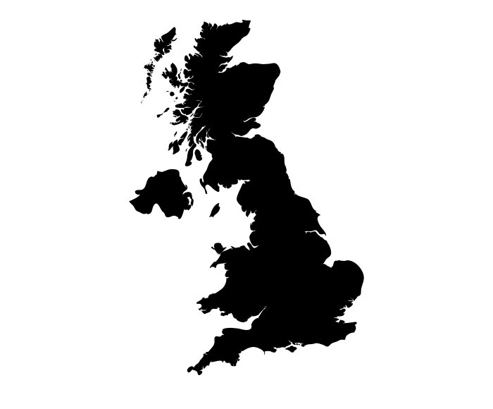
UK Geography
Our changing physical world
Expanding populations
Extreme environments
Economy
Globalisation
Climate change
Inequality
Biomes
Urbanisation
Weather
World issues
Plate tectonics
Revision
Next steps

