Slide 1
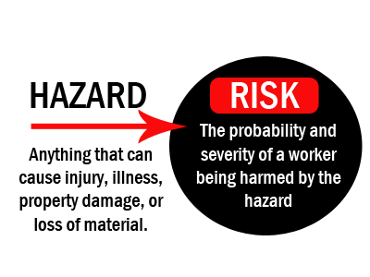
Component 1A – Understanding engineering sectors, products and organizations.
What is engineering?
Engineering offers such a broad range of definitions which can be divided up into many disciplines and sub-disciplines.
4 main engineering disciplines
Interconnections in engineering
Mechanical engineering studies the design, manufacture and use of machines.
An engineering in the automotive sector will have to understand:
Mechanical engineering – engines & structural components
Electrical engineering studies the practical applications of electricity and magnetism.
Maintenance engineering – maintain and service machines and repair equipment
Computer engineering – supports all disciplines, looking after computer hardware
Electronics engineering – controlling mechanical systems for the engine
Civil engineering studies the design, planning & construction of large scale structures
Engineering Organizations
Research & Development is carried out to improve existing products or develop idea for new products. This is typically in the early stages of the product.
Chemical engineering studies the processes and equipment needed to manufacture chemical products on a large scale
Large
Large engineering companies produce across more than one engineering sector. They have more than 250 employees. Typically household name products.
Other engineering sectors
Aerospace
Engineer
Nuclear
Engineer
Biomedical
Engineer
Big data
Engineer
Environmental
Engineer
SME
SME stands for Small & Medium engineering enterprises. They operate much smaller scale and have fewer than 250 employees. Local companies, less known products.
Component 1B – Explore engineering skills through design process.
Criteria for an engineering design brief
Design & make process
Physical requirements
Aesthetics
Size
Function
Performance requirements
1. Define the problem – Clearly define what the problem is. What you are wanting to create or recreate.
2. Develop possible solutions – Brainstorming and seeking ideas from others. Trying to be as innovative as possible.
Initial design proposal
Design Production
3. Choose a solution – Analyse and compare the solutions through the criteria list. Will it suit the customer as required?
KISS
Keep
It
Simple
Stupid
4. Design and model the solution – Produce design sketches and drawings, including lists of materials and equipment.
5. Evaluate the outcome – carry out product testing and meet the requirements
Generic work skills
Creative Thinking
WHERE
Solution
HOW
Behaviour
Attitude
Limitations
WHEN
WHY
Collaborative skills
Working relationships
Respect for others
WHAT
WHO

Slide 2
Component 2A – Understand materials, components and processes for a given engineered product
Characteristics of engineering materials
Engineering Materials
Machinability - Machinability indicates how the material responds to the cutting process.
Workability - Workability indicates how the material responds to forming processes without defects being formed. Durability - Durability indicates how the material withstands wear, pressure or damage.
Ferrous Metals
- Ferrous metals CONTAIN iron. This means they have a greater magnetic property compared to other materials.
Examples of Ferrous metals
Mild steel
Is an alloy of iron and carbon
Cast Iron
Heavily used prior to steel discovery
Stainless Steel
Is an alloy of steel. Contains iron & carbon
Characteristics of engineering materials
Proprietary components. Eg Rivet, nut and bolt, screw, mechanical fixings, electronic components, such as resistors, capacitors, fuses, diodes. A propriety component is a standard component which can be purchased and applied to suit a range of manufacturing/fixing/assembly processes.
Characteristics of components. Eg Permanent/semi permanent, sizes/ dimensions, surface roughness, values, fixing methods.
Characteristics refers to the function, purpose or properties of a component.
Non-Ferrous Metals
- Non-Ferrous metals DO NOT contain iron. This means they have a lower magnetic property compared to other materials
Characteristics of engineering materials
Cutting. Eg Drilling, sawing, filing and shearing.
The action of cutting a material.
Shaping. Eg Turing and milling.
The action of shaping a material by removing material.
Forming. Eg Forging, casting, extruding, moulding, folding , bending
The action of manufacturing something to have a specific shape or form.
Joining. Eg Fastening, bonding, soldering, brazing.
The action of connecting or combining 2 materials together.
Examples of Non-Ferrous metals
Titanium
Strong, lightweight, corrosion resistant
Aluminium
Corrosion resistant, good conductor
Copper
Corrosion resistant, good conductor
Properties of engineering materials
STRENGTH
Strength is the materials ability to resist stress & strain
Tensile strength = Load each cross-sectional area can carry before failing
Tension = The materials ability to stretch before failing
Shear force = can be seen as metal scissors cutting through paper
Compression = Tends to squash/shorten the material being subjected to that force
Thermosetting Polymers
- Do not melt when heat us applied and cannot be reformed by applying heat
Examples of Thermosetting polymers
Phenol-formaldehyde
Also known as Phenolic Resin
Polyimides
Thermal stability & good chemical resistant
Polyurethane
Can either be rigid or flexible components
HARDNESS
The materials resistance to wear, abrasion and indentation.
Hard materials are typically brittle and difficult to cut.
Thermoforming Polymers
- Thermoforming polymers can often be softened by heating and then be remoulded.
Examples of Thermoforming polymers
TOUGHNESS
The materials resistance to sudden impact or shock loading.
Hammers are made to be tough so that they do not break or shatter on impact
Polyethylene
Highly ductile, tough and flexible
Polypropylene
Tough, flexible polymer which is usually welded
Acrylic
Strong, rigid and transparent polymer

Slide 3
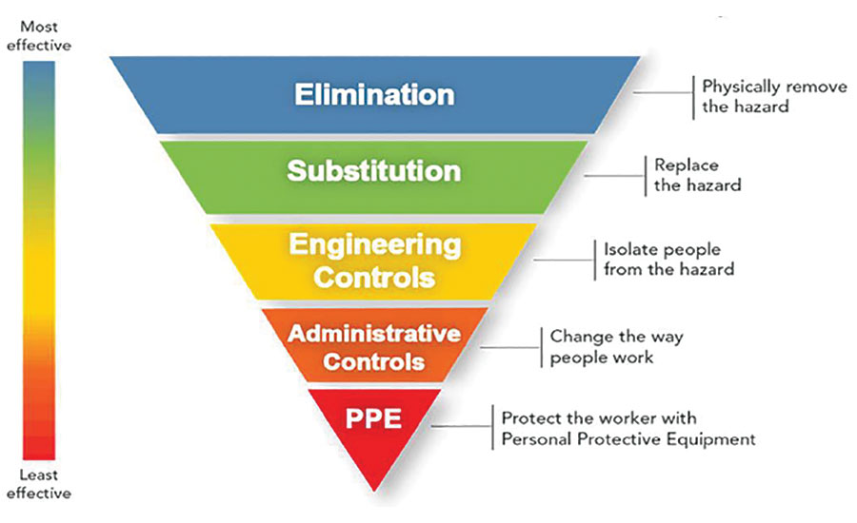
Component 2B – Investigate a given engineered product using disassembly techniques
Measurement skills
Observing features
Diameter
Is the measurement through the centre of the circle from edge to edge
Visual Features
Using eye sight to identify what the product is for
Colour
What does the colour of the product tell us
Surface Features
What are the surface features you can see?
Degradation
Does it show any sign of wear & tear
Linear dimensions
Refers to the length, width and thickness of an object or a component
Mass
Estimate the mass?
Identification marks
Are there any ID marks on the component
Consideration
Size & Mass
Safe working
Risk Assessments
1 . Identify the hazards in the work place
Provide base for drawing
Provide base for design & manufacturing
Determine what the product/service will do
Must specify the maximum & minimum sizes as well as the mass
3 – Evaluate the risk and adopt control measures
2 – Decide who might be harmed and how
2 – Decide who might be harmed and how
Implications of standards & legislations
Product life & reliability
4 – Record significant findings
5 – Review assessment when needed
Manufacturer must abide by the country’s standards and legislations.
PDS
What is the expected lifespan of the product
Do the components involved meet this requirement
Semi-permanent fixing – Can be taken apart and reassembled
Key steps used to complete a successful disassembly.
Economics & making considerations
Performance, Function & service requirements
Permanent fixing – Are a 1 time fixing, once removed they can not be re used
Disassembly techniques
Take before, during and after pictures
Developmental costs, manufacturing costs, logistics, overheads & marketing
How well does the product perform, can it compete against other products, does it suit the target market
Make step by step notes
Non-reusable consumables - this is a consumable which, once it has been used and taken off, it cannot be re-used and a new one is needed.
Use correct tools & PPE
Component 2C – Plan the manufacture of and safely reproduce/ inspect/ test a given engineered component
Engineering production plan example
Operations/ Processes | Tools and equipment | Materials | Health & safety | Inspection, testing and quality standards | Comments
Selecting material | Metal ruler | 76mm length, 50mm width and 10mm thick, Bright drawn mild steel. | Sharpe edges | I checked it against an engineer's drawing of the product and then I checked all the tools where the correct tools to use for that process. | When I had completed a step, I asked another person to check my work.
Cutting material with band saw | Metal ruler Bandsaw | 76mm length, 50mm width and 10mm thick, Bright drawn mild steel. | Specific training on the bandsaw. Sharpe edges | I checked that I knew how to use the bandsaw correctly and safely. I checked I had the correct PPE on. | I asked for help when using the band saw as I wasn’t full sure how to use the band saw.
Checklist when producing a product
Choosing suitable tools
Safe preparation and cleaning down
Correct PPE
Identifying risks & hazards
Use of observation & recording techniques
Comparisons of existing work

