Slide 1
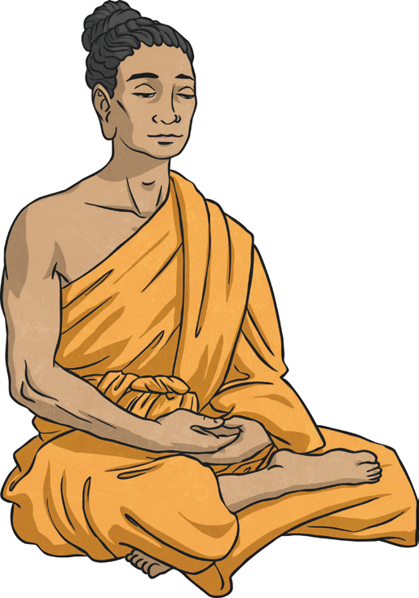
Buddhism KO
Key Vocabulary
Buddha | The teacher and creator of Buddhism.
Meditate | When Buddhists close their eyes and breathe deeply, trying to empty their minds of thoughts.
Enlightenment | Breaking the Buddhist cycle of rebirth and reaching Nirvana.
Eightfold Path | The rules laid out by Buddha which will lead to Nirvana.
Dharmachakra | ‘The Wheel of Dharma’.
Nirvana | Perfect peace with no suffering.
The Buddha
There are no gods in Buddhism. It was created by a man called Siddhartha Gautama, who was born into a noble family. He lived a sheltered early life, but when he was older he went out into the world and saw that sickness, age and death come to everyone. After seeing this, Gautama meditated and found the answer to life. This made him the Buddha. This was called enlightenment and the Buddha decided to teach others how to reach it.
Buddhists live by five rules:
Never take the life of a living creature.
Do not steal.
Be faithful to your partner.
Do not lie.
Do not drink alcohol.
Buddhism originated in Northeast India and now has followers from all over the world. The Dharmachakra is a
symbol used in Buddhism.
Dukkha | Samudaya | Nirodha | Magga
Everyone suffers in life. | The cause of suffering is a craving for things and wanting to control things. | To end the suffering, life must be lived one day at a time. You must also let go of cravings. | To end the suffering for good, people must follow the Eightfold Path created by Buddha.

Slide 2
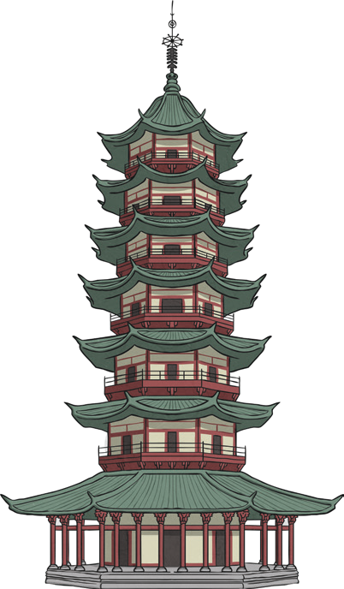
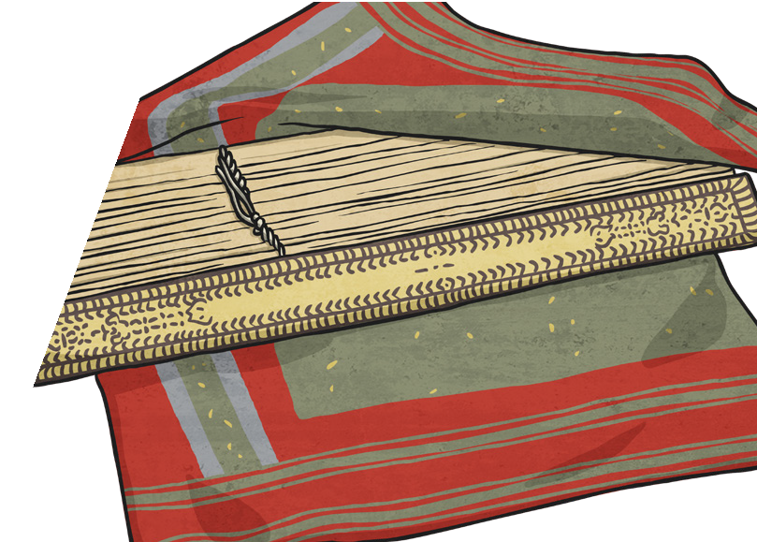
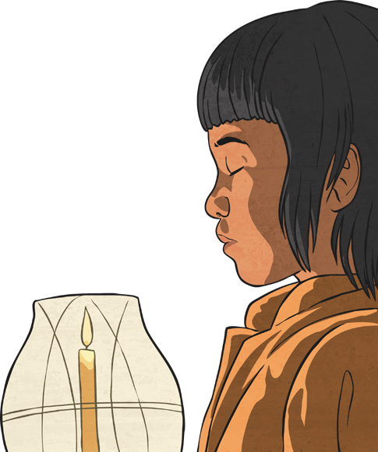
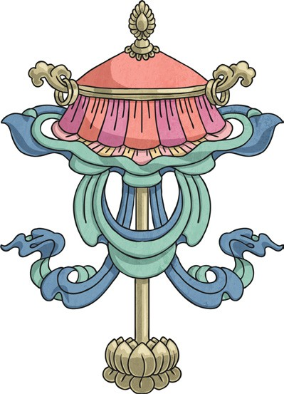
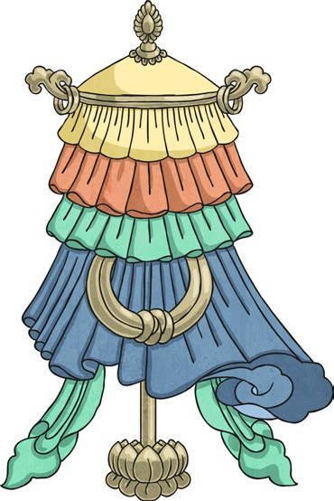
Buddhism KO
Key Vocabulary
puja | The Buddhist act of worship.
shrine | A special place that is linked with a holy object or person
Wesak | Important Buddhist festival when Buddhists try to clear their minds of negative thoughts.
Dhvaja | Buddhist symbol meaning ‘spiritual victory’, often popular with warriors.
Chattra | Buddhist symbol meaning ‘parasol’, a protection from suffering.
Special Shrines
Buddhists can worship from home or at a temple, which are built in a variety of shapes. Buddhists worship by sitting on the floor, making sure their feet face away from any image of Buddha. Their head and body face the image of Buddha. This is called puja. Buddhists chant to show their love for Buddha and make offerings of flowers and incense at shrines.
Holy Books
When the Buddha died, people
thought it would be a good idea to write down what Buddha said and thought. 500 Buddhist Monks met to check the content of his teachings. The teachings were then passed down by word of mouth for around 400 years, before being written down.
The Buddhist teachings are called ‘Pali Canon’ and the ‘Sanskrit Canon’.
Wesak is an important Buddhist festival celebrating the Buddha’s birthday.
Chattra
Dhvaja

