Slide 1
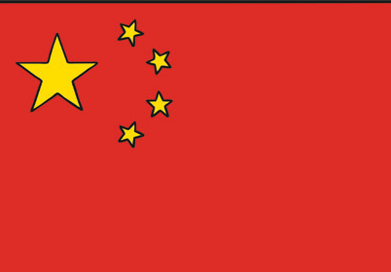
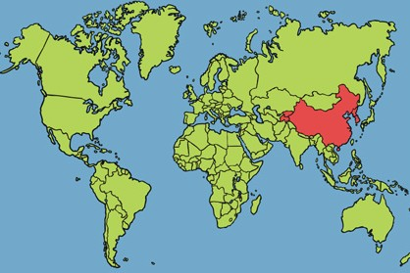
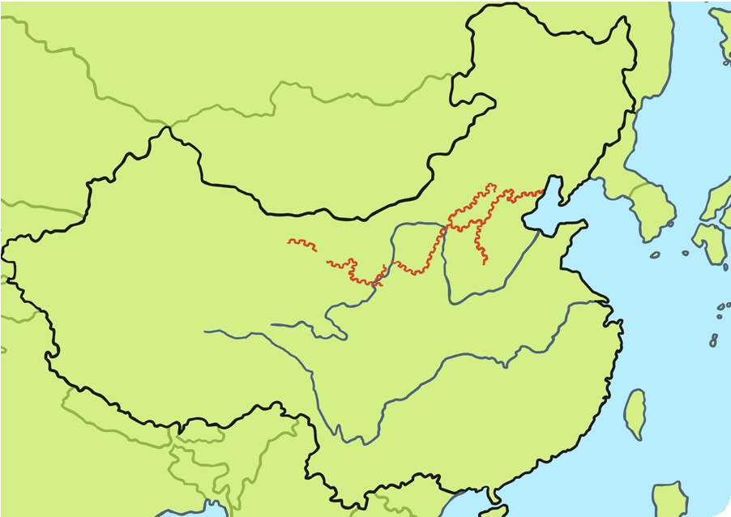
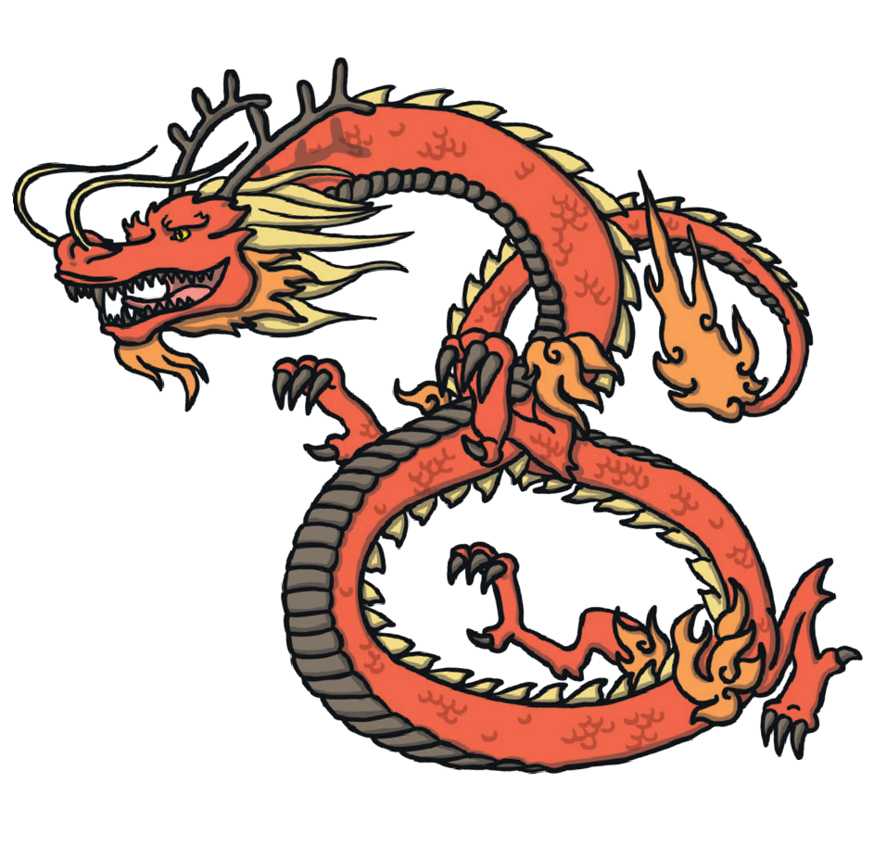
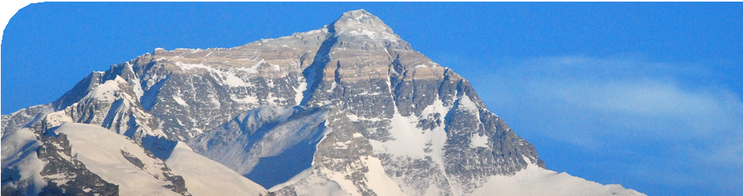
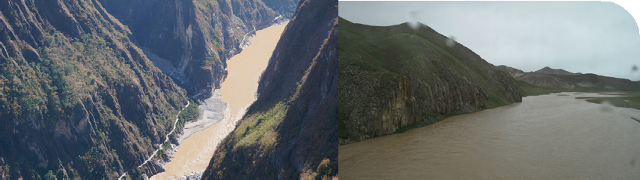
China Knowledge organiser
Where Is China?
Known as the People’s Republic of China.
Located in east Asia.
The capital city is Beijing.
Key Vocabulary
agriculture | Farming.
climate | What the weather is like over a long period of time.
culture | The ‘way of life’ of a country or group of people, e.g. tradition, dress, language, religion.
human-made | Built by humans.
landmarks | Important objects or features of the landscape.
livestock | Farm animals kept by humans, e.g. cows.
population | The number of people living there.
weather | The conditions outside on a given day, including temperature and rainfall.
Shanghai, is the largest city.
One of the world’s biggest countries.
More people live in China than any other country in the world.
It has a population of over 1.3 billion!
Main language spoken is Mandarin.
Great Wall of China
CHINA
Yellow River
Beijing
Shanghai Yangtze River
Himalayan Mountains
Mount Everest (8850m) is
the highest of the Himalayan mountains, lying on the border between China, Tibet and Nepal.
The Yangtze River is the third- longest river in the world.
The Yellow River is the sixth- longest river in the world.
Chinese New Year
A very important part of Chinese culture is celebrating Chinese New Year. Celebrated all over the world in late January or early February, it celebrates the earth coming back to life and the beginning of the growing cycle.

Slide 2
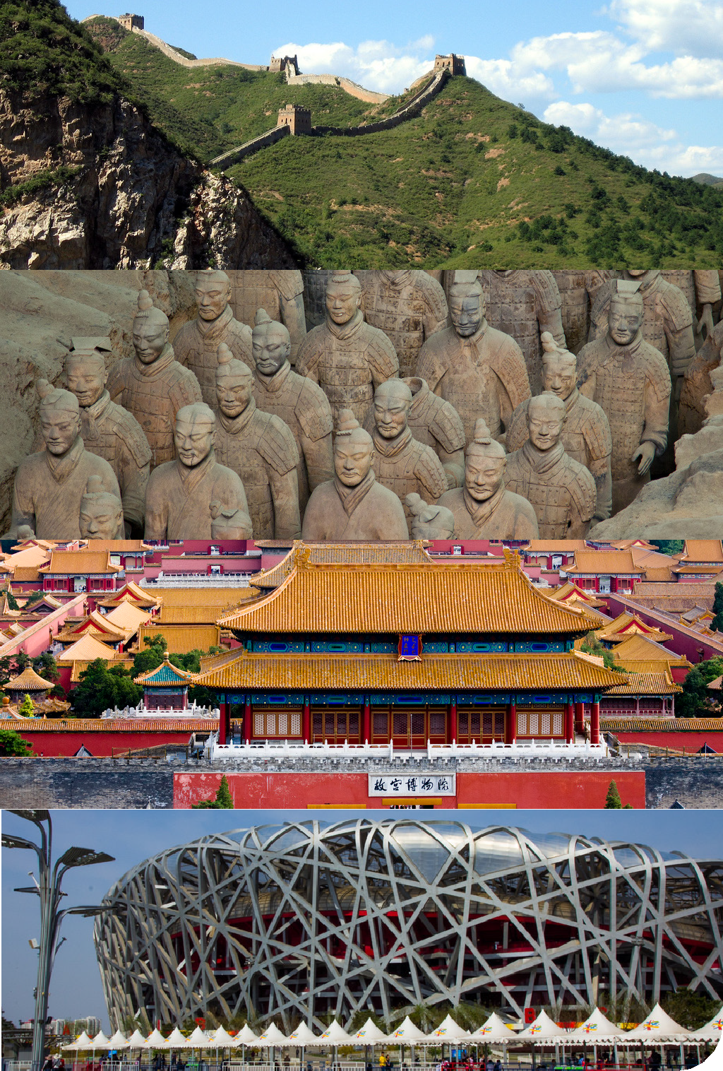
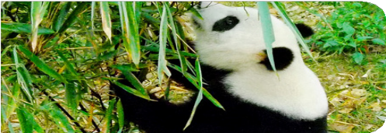
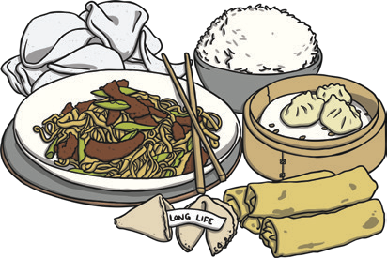
Key Landmarks in China
Weather and Climate - The weather and temperatures are very different across the country.
The Great Wall of China is one of the wonders of the world! The longest human-made structure, it is more than 5000 miles long.
The climate varies from warm tropical weather (in the south) to subarctic (as low as -30°C in the north).
In summer, most areas are hot and rainy.
The Terracotta Army is part of a burial tomb built for the first emperor of China. There are over 8000 life-size statues of soldiers.
There are dry seasons and wet monsoons (a seasonal wind that brings heavy rainfall).
In winter, most areas are
cold and dry.
The Forbidden City or Forbidden Palace is in Beijing, it used to be where emperors of China lived and ruled.
The famous giant panda, found only in China.
Beijing National Stadium (the Bird’s Nest), site of the Summer Olympics 2008.
School |  | Farming | Food
 | Go to school between age 3½ to 15. Around 35 pupils per class. Attend 5 or 6 days a week. Most lesson time spent on English and maths. | Very important part of rural Chinese life. Many people work in agriculture or with livestock. One of the largest producers of rice, wheat, soya beans, sugar and tea. | An important part of Chinese culture. People usually eat with chopsticks. Dim sum, which is lots of small dishes, is popular in China.

Slide 3
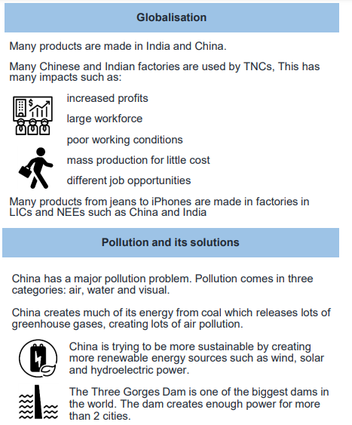
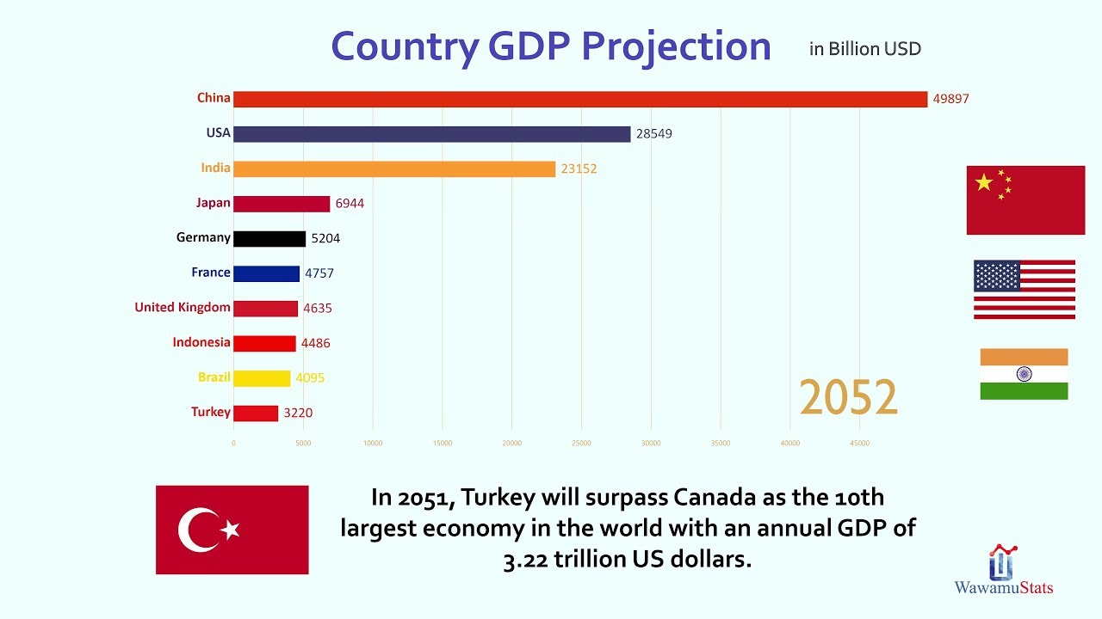
How has China changed over time?
China was not officially a colony – but colonial powers (e.g. Britain) used Beijing for trade.​
In 1948, China became a communist country run by Chairman Mao.​
Mao banned foreign companies from China and wanted to concentrate on farming.​
Workers were sent away from the cities to work on the farms. Beijing went into decline.​
In 1978, China launched an ‘open door’ policy – foreign companies were allowed back to invest in China. ​
This created jobs and wealth. China developed quickly.

Slide 4
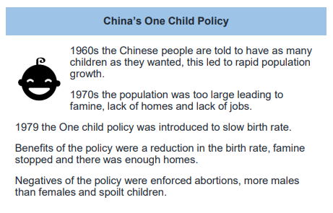
Rural to Urban migration push factors | Rural to Urban migration Pull Factors
Lack of employment opportunity | Could earn 10x more in the city
Corrupt government officials | Far more job opportunities available
Not enough land to farm | Could send extra money home to family
Lack of modern amenities like running water | Better chance at a higher quality of life.
Lack of access to affordable healthcare
Problems with mass migration in China:
Public services are over capacity such as schools and hospitals.
People cannot get access to emergency care because of the overcapacity in hospitals
Air pollution has dramatically risen because of the increase in population and therefor vehicle usage.
Slum settlements are developing because there are not enough homes to house the mass influx of people.
Due to the number of low skilled low wage farmers moving to the cities, wages have fallen dramatically for people with existing jobs as a result of the competition.

