Slide 1
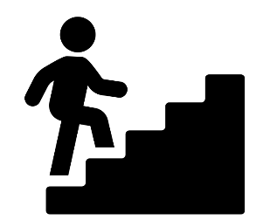
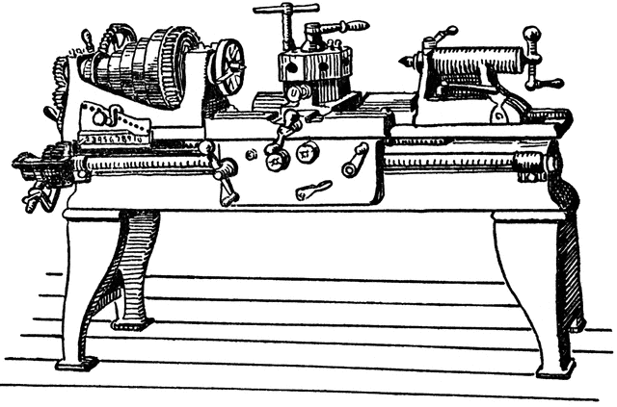
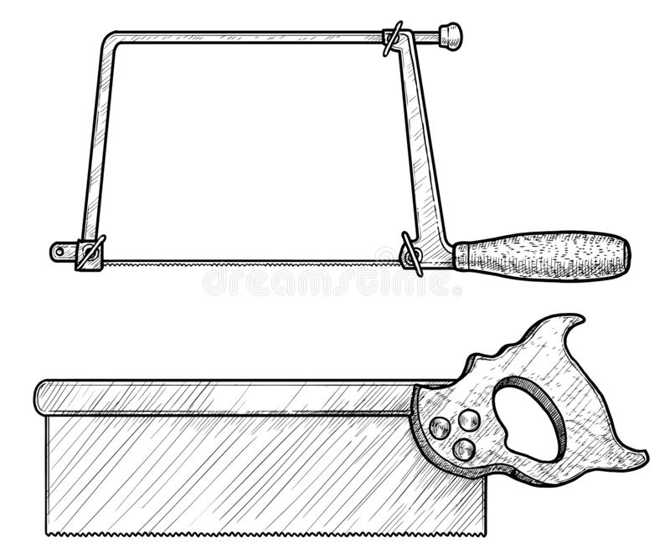
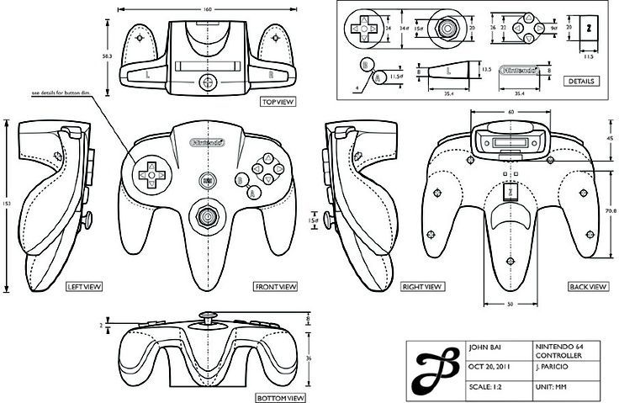
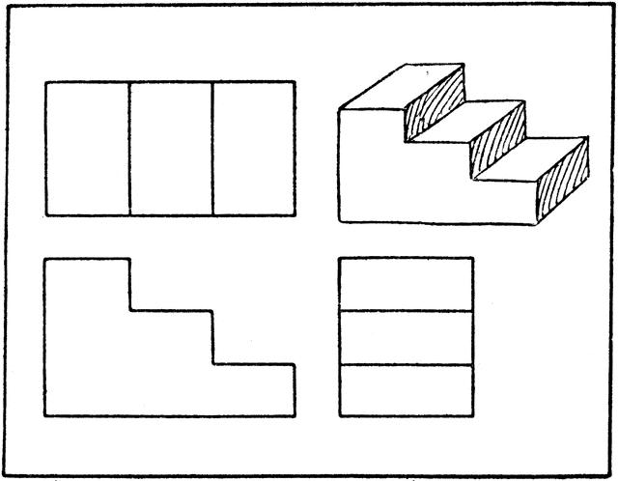
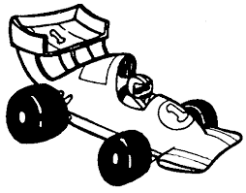
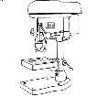
Level 1/2 ENGINEERING
AC1.2 identify features of engineered products that meet requirements of a brief
AC4.1 use engineering processes in production of engineered products
AC2.1 identify resources required
AC1.1 interpret engineering drawings
AC3.1 develop creative ideas for engineered products
LO2 understand properties of engineering materials
AC1.3 describe how engineered products function
AC1.1 identify features that contribute to the primary function of engineered products
LO1 understand effects of engineering achievements
AC3.1 use tools in production of engineering products
AC1.2 interpret engineering information
AC3.3 produce design specifications
AC2.1 draw engineering design solutions
FINAL
EXAM
EXAM REVISION
NEA Producing engineering products
NEA Engineering design
YEAR
11
LO4 be able to solve engineering problems
LO3 know forming processes of engineering materials
AC4.2 evaluate quality of engineered products
AC3.2 use equipment in production of engineering products
AC2.2 sequence required activities
AC3.2 evaluate options for design solutions
AC2.2 communicate design idea
Refining knowledge learnt and practical skills to ensure detailed understanding of the designing, making and the Engineering sector
Soldering circuits
Using a lathe - Knurling
Accuracy in an orthographic drawing?
What is a creative design?
Accuracy in an isometric drawing?
LO1 understand effects of engineering achievements
LO2 understand properties of engineering materials
Understanding electronic components
Computer design
EXAM REVISION
Engineering manufacture
Understanding a circuit drawing
Materials in Engineering.
Use of CAD
Using a lathe – Knurling and facing off
Developing orthographic drawings
LO3 know forming processes of engineering materials
LO4 be able to solve engineering problems
Materials for a engineering purpose
Engineering design for a client
Using a Tenon saw, hack saw and plane.
Stock material sizes
Cutting and filing steel & aluminum
Anthropometrics in design
What is an Isometric drawing?
What is an orthographic drawing?
YEAR
10
Desk tidy
Engineering manufacture - toolkit
Interpreting engineering drawings
Developing your skills in the workshop, improving problem solving skills and awareness of different customer needs. Enhancing awareness of the sector as a whole.
Creative designing in engineering
What is an orthographic & isometric drawing?
Producing a lap joint
Tolerance in manufacture
Interpreting engineering drawings
Evaluating and comparing products
Engineering materials - timbers
Strength testing materials
Movement of sound waves
Interpreting an engineering drawing
Using a belt sander
Using a coping saw
9
YEAR
Boat - maritime
Using a jig
Using a pillar drill with a forstener bit
What is an orthographic drawing?
Creative designing
Developing a prototype.
Product analysis using ACCESS FMM
Engineering design
Review of the Workshop:
Health and Safety
Work in more depth on projects, honing your practical skills, improving your resilience & problem solving whilst developing independence in the workshop.
What is an Isometric drawing?
Evaluating and comparing products
Materials in electronic components
Engineering developments and achievements
What is a creative design?
What is Computer Aided Design (CAD)?
Tolerance in manufacture
Using a bench hook and Tenon saw
What is an orthographic drawing?
YEAR
8
Wind powered car
What is an Engineering drawing?
What is a specification?
Marking out materials
Experience a wide range of fun and exciting projects that teach you valuable skills in the workshop, understanding different materials and how they work.
Using a pillar drill
Bird house
YEAR
Numeracy in measurements and distance travelled.
7
Creating a quality finish to an Engineered product
Using a belt sander
Using a bench hook and Tenon saw
Identify/ describe/ explain ideas
Introduction to the Workshop:
Health and Safety
What is aerodynamics?
Baseline Assessment:
What do you already know about DT?

