Slide 1
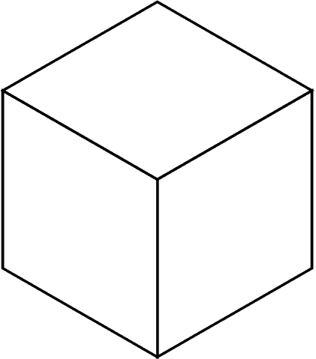
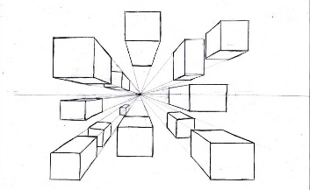
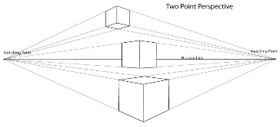
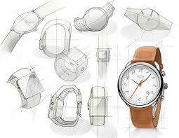
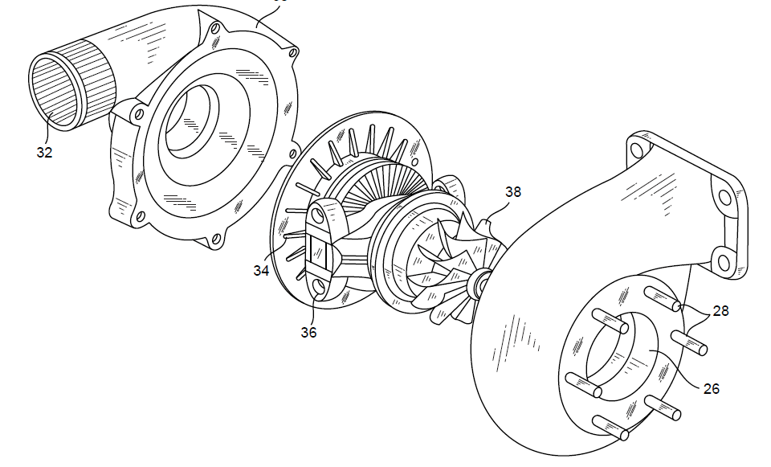
Briefs, Specifications, ideas and development
Technique | Description/ notes | Diagram
Orthographic Projection/ Working Drawings | Includes “Front”, “Plan” and “End” 2D Views, and often an Isometric 3D View Standardised method for scale, dimensions and line types Great for manufacturing
Isometric | Common 3D sketching method Can be drawn free-hand or using isometric paper and ruler Angles are at 30 degrees Great for seeing most of the products
1-Point Perspective | A 3D drawing method Often used by interior designers and architects Gives drawings depth Only uses 1 vanishing point
2-Point Perspective | Used for 3D designs Exaggerates the 3D effect Objects can be drawn above of below the horizon line but must go to the 2 vanishing points
Annotated Drawings/ Free and Sketches | Quick and easy way of getting ideas down Range of ideas can be seen Annotation helps explain designs further
Exploded View | Helps see a final design of a product and all it’s parts Can see where all the parts fit Great for manufacturers
Design Briefs
A Design Brief is the statement of how you will solve the Design Problem It will often include:
Constraints/ limitations
What the product is
Materials/processes
Any key information you know
Design Specifications
A Design Specification is a list of requirements your product has to meet in order to be successful
It is also useful for evaluation. If your product hasn’t met the Spec then it gives you a starting point for improvements.
Aesthetics | What the product looks like? Style? Colour Scheme? Design Movement?
Customer | Who would buy it? (Age, gender, socio-economic, personality) How does the design appeal to them?
Cost | How much will it cost? (min-max) Why?
Environment | Where will it be used? Why? How will you make it suitable?
Safety | How is it safe? How will it be checked? Why must it be safe?
Size | What is the maximum or minimum size? Why?
Function | What does the product do? What features make it do that function well? How is it unique from similar products?
Materials | What is it made from? Why?
Manufacture | How might it be made? Why? What scale of production? Why?
Modelling and Development
Modelling and development are key to testing and improving products
This can be done physically using materials like; card, foam, clay, man-made boards or virtually in CAD
Modelling helps the designer get feedback from the customer, check aesthetics, function, sizes and even materials and production methods and change them if needed

