Slide 1
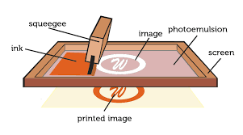
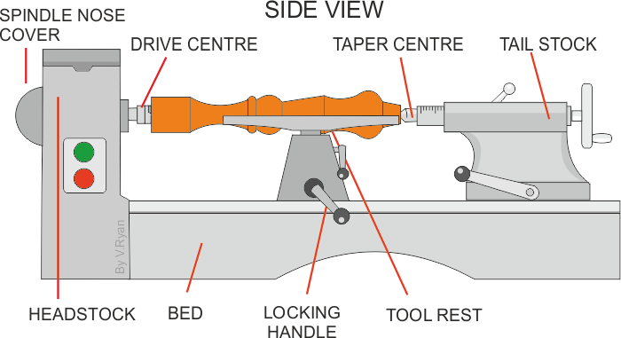
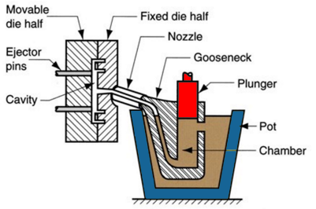
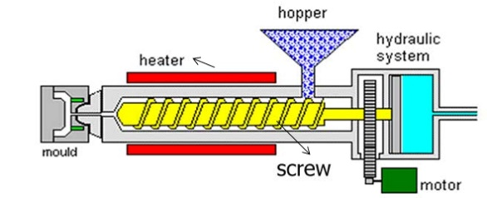
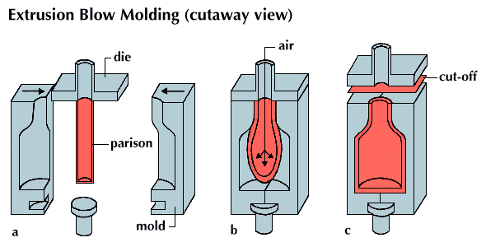
Production Processes
Name of Process | Diagram | Material | Products Made | Key info
Screen-printing |  | Papers and Textiles | Posters, signs and t-shirts | Screen printing places paint on top of a screen. The screen has a stencil embedded in it, so when the paint is passed across it the desired shape is printed underneath. Good process in one-off and batch production as often done by hand
Offset Lithography |  | Papers and card (thin, flexible plastics) | Posters, newspapers, plastics bags | Rollers containing the colours and water go onto the plate cylinder. The water stops the colours sticking to certain places, creating the shape. The shape is transferred between rollers and onto the material. Can be used at batch and mass production
Lathe Turning |  | Wood and metal | Chair legs, baseball bats )(cylindrical items) | Material is placed between the tail stock and the headstock and spun at high speed. The material is then cut using specialist tools (either by hand or my automated machinery) to the desired shape. Can be used in one-off and batch production
Die Casting |  | Metal | Car parts, engine components, etc | Molten metal is poured into a chamber and a plunger forces the metal through the nozzle into the mould. Unlike sand casting, the mould is reusable. Good process for both one-of and batch production
Injection Moulding |  | Plastics | Chairs, toys, etc | Plastic granules are poured into the hopper and onto the screw. The screw moves the material towards the heater where it turns into a liquid. The liquid is then forced into the mould, cooled and released. Great process for mass production as it makes 100s+ of products at once, to a identical standard.
Blow Moulding |  | Plastics | Plastic bottles | A Plastic parison is heated and put into the mould. The parison is then filled with air (like blowing up a balloon) and is forced to fit the mould shape. It is then cooled and then released. This is a great process for mass producing bottles.

