Slide 1
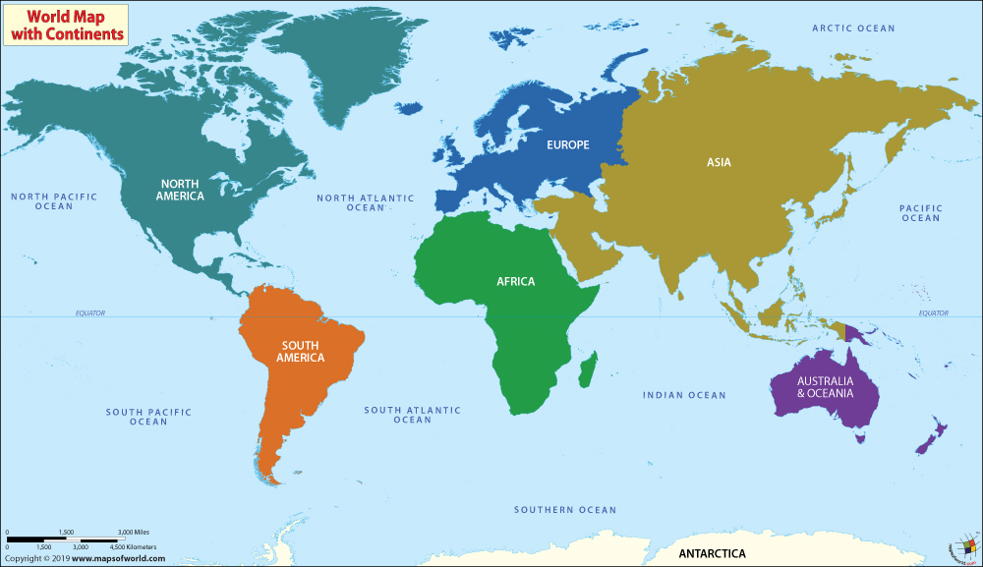
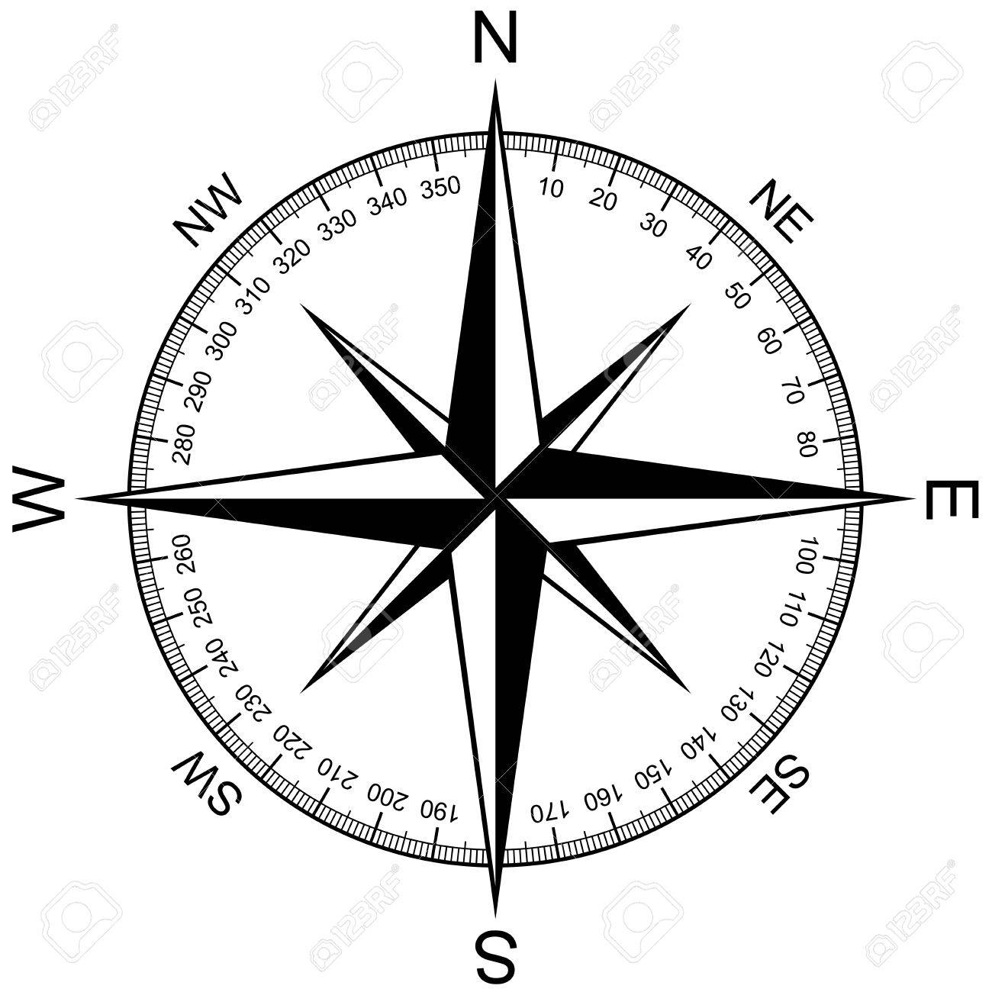
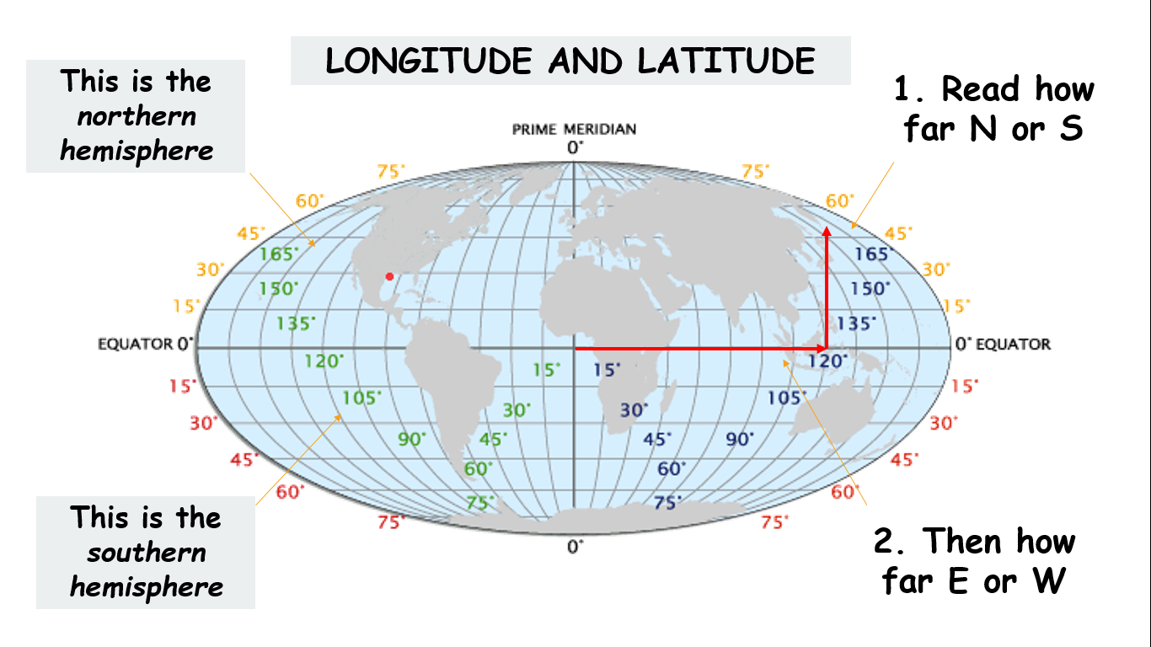
1. The World
What does the world look like?
Talk like a geographer: a compass shows direction on a map or in real life.
Remember the points with this pneumonic: Never Eat Shredded Wheat
How do I describe places on a world map?
CLOCK
Continent
Longitude / latitude
Oceans / seas
Countries (nearby)
Knowledge (about location!).

Slide 2
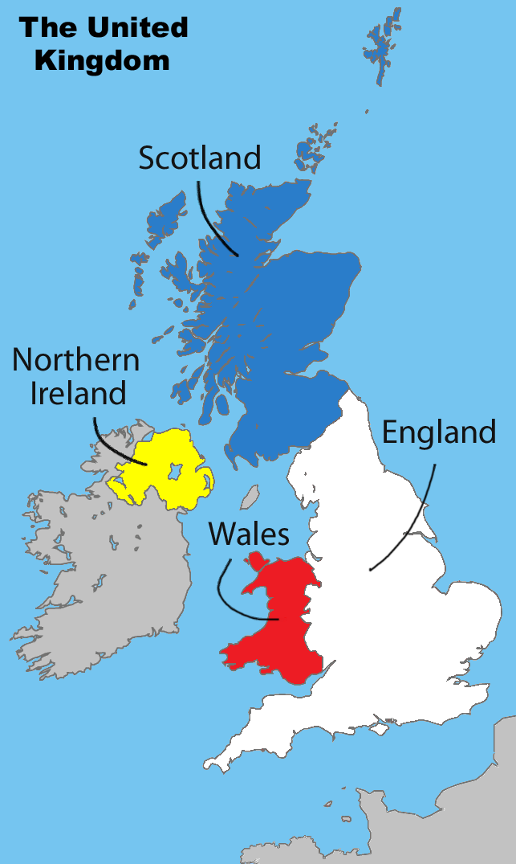
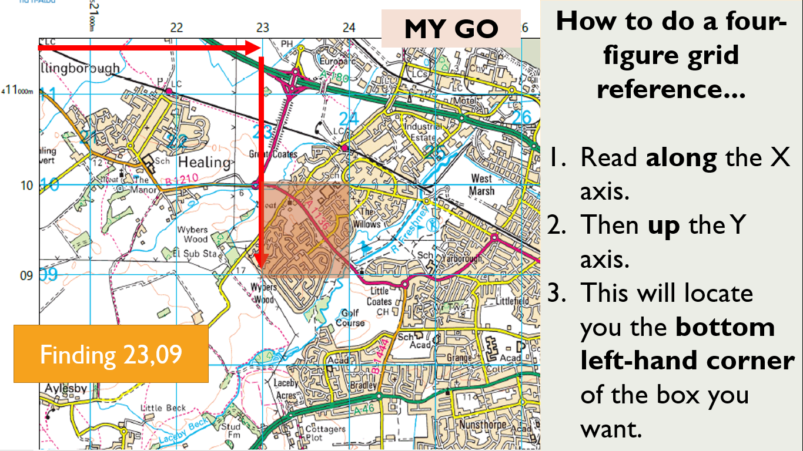
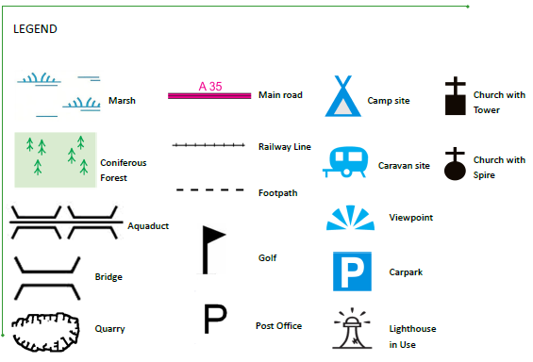
2. The UK
What does the UK look like?
Grimsby is found in the United Kingdom (UK).
But the UK is a little bit complicated...
It is split into four nations:
England.
Scotland.
Wales.
Northern Ireland.
Each nation has its own capital (e.g. Scotland – Edinburgh) but the capital city of the UK is London. This is where the UK government sits in the Houses of Parliament.
How do I do a four-figure grid reference?
Talk like a geographer:
Remember to use compass directions when describing places on a map. Symbols can also be useful as reference points – see the icons to the right.

Slide 3
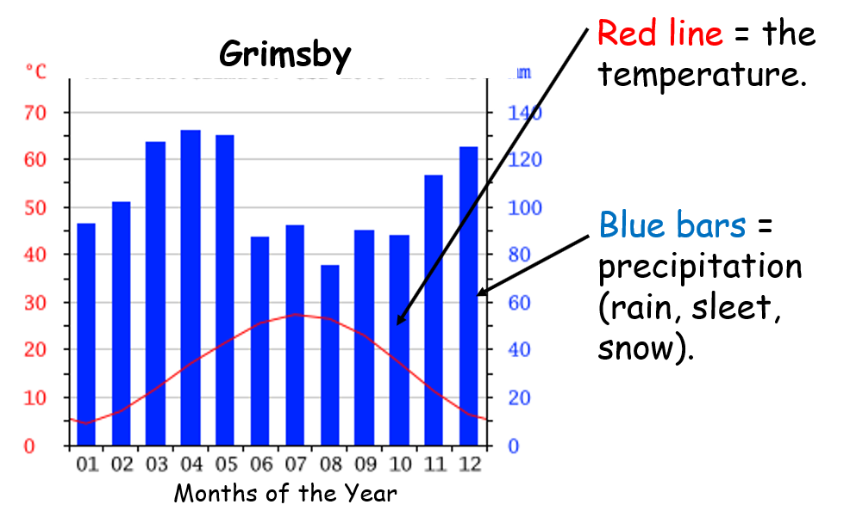
3. Hot? Cold? Wet? Dry?
Temperature = how hot or cold it is.
Precipitation = rain, sleet or snow.
Vegetation = plants, trees bushes.
Arid = dry (no rainfall) with little to no vegetation.
Humid = lots of water vapour in the atmosphere.
Aka: hot, sticky weather.
Reading a climate graph
Talk like a geographer
Use GSE to describe a graph...
Generally,
Specifically,
Exceptions include:
What is the difference between weather and climate?
Weather is the condition of the atmosphere at a particular place over a short period of time. E.g. temperature, rainfall today.
Climate is the condition of the atmosphere in a place over a long period of time… e.g. Spain has a hot climate, England has a wet climate.

Slide 4
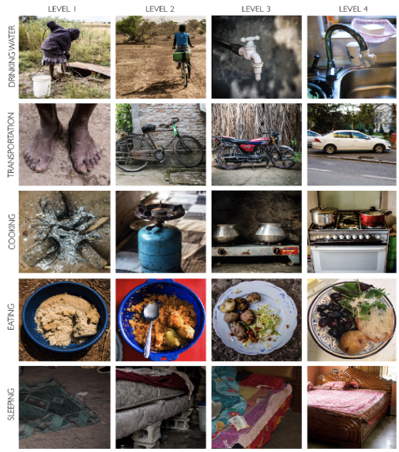
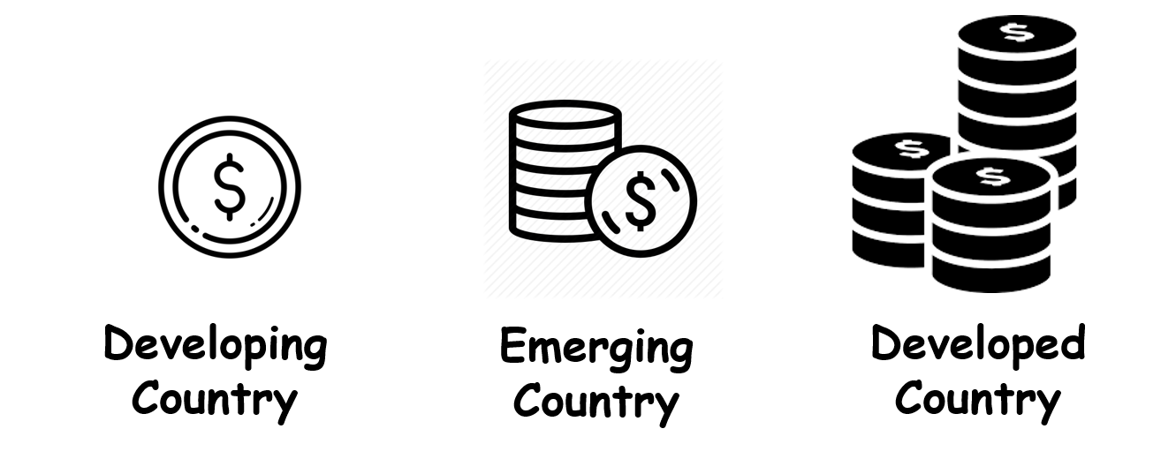
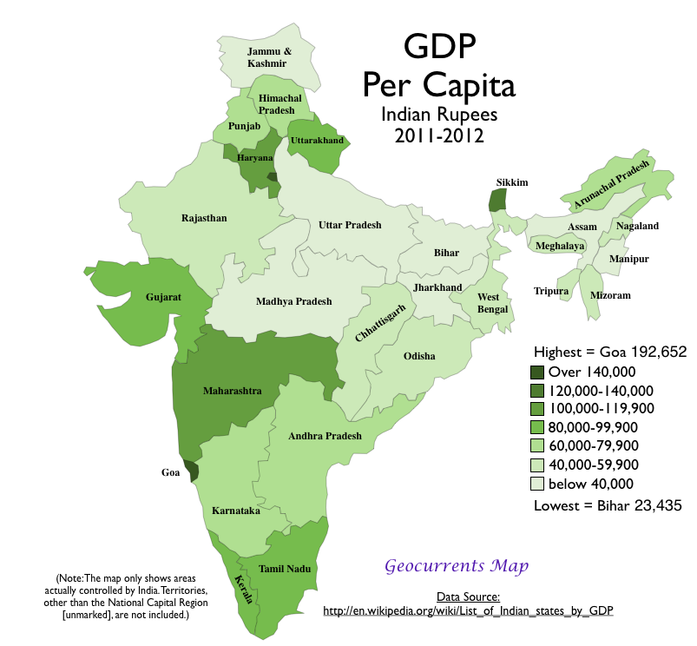
4. Rich? Poor?
How do we classify rich and poor?
The world is divided into three types of country:
Think like a geographer:
BUT Not everyone in a developing country is poor nor is everyone in a developed country rich. We can rank individual families on ‘Levels’ as seen to the right.
Measuring quality of life
Average Income = how much money a person earns.
Life Expectancy = how long the average person lives for.
Literacy Rates = what percentage of adults can read and write.
Talk like a geographer
Use GSE to describe a graph...
Generally, the richest states are in the south-west.
Specifically, the richest state is Goa on the western coast.
Exceptions include: Karnataka in the south-west with a low average income.

