Slide 1
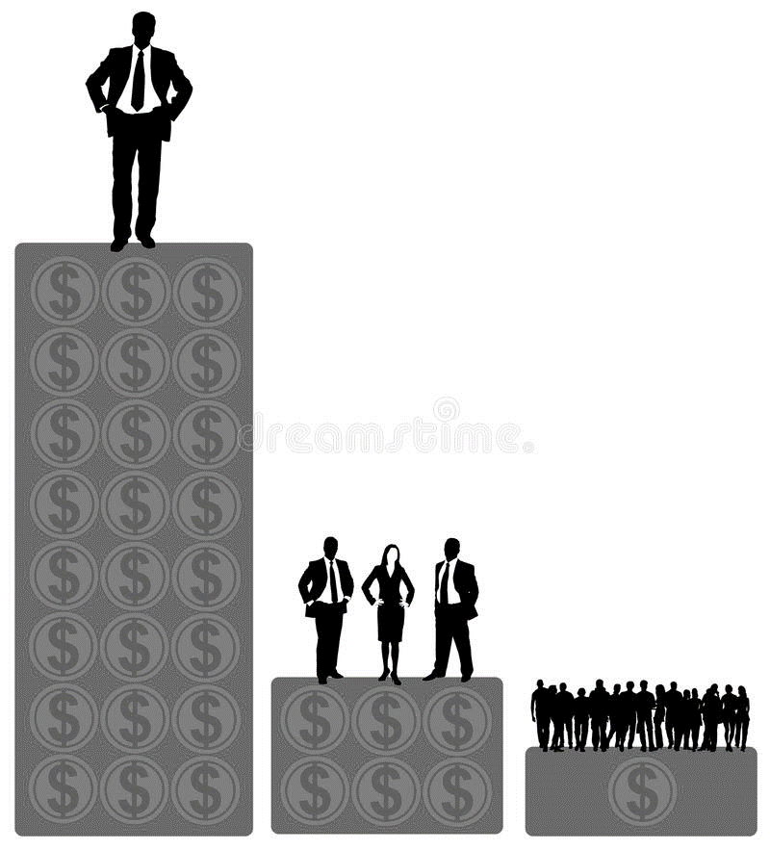
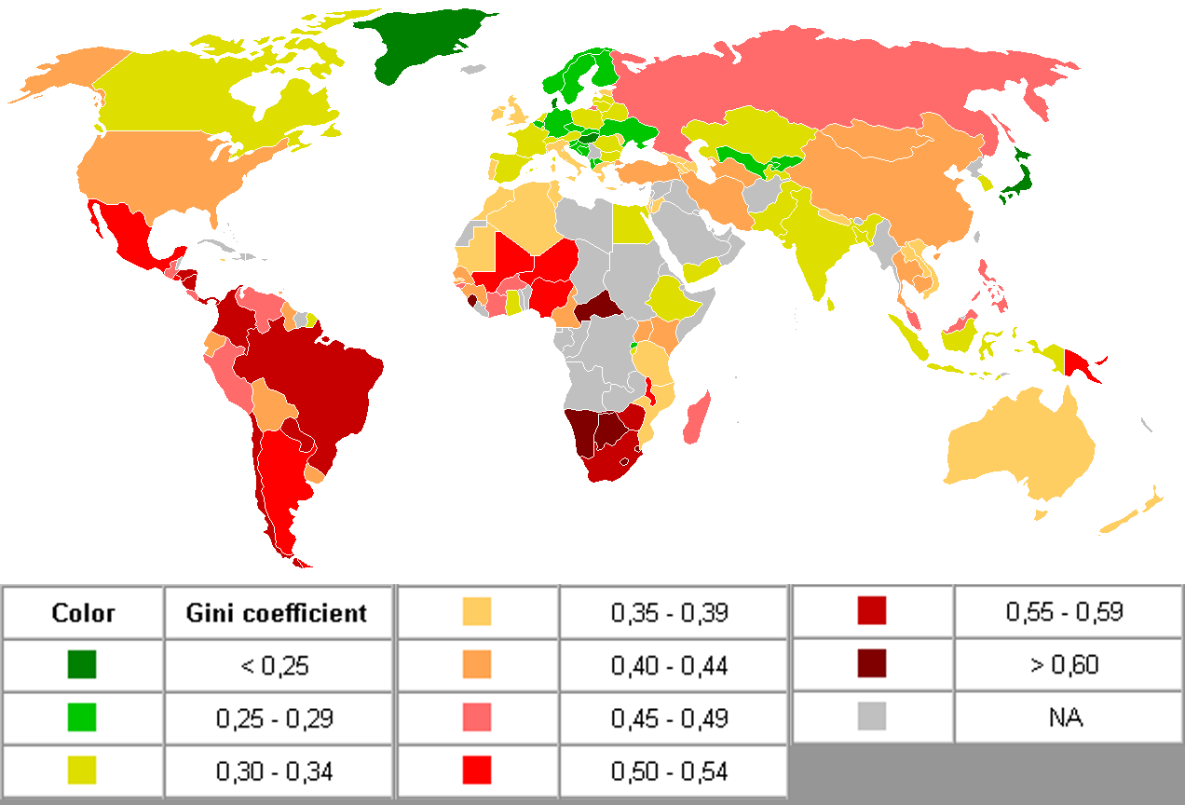
1. Measuring Development
A Country’s Level of Development = how good is the quality of life for the people living there?
How do we try to measure development?
GDP per capita = measure the country’s wealth. Calculates the total value of goods and services in a country per person.
Talk like a geographer:
HDI is used to divide countries into three categories:
Developed (richest e.g. the USA).
Emerging (middle – e.g. China)
Developing (e.g. Sudan)
Human Development Index (HDI) = combines three measures into one score between 1 and 0. 1 is good, 0 is bad. Ranks countries based on: life expectancy, average income and average years in school.
Gini Coefficient = measures the equality of wealth in a country. 1 would be extremely unequal, 0 would be completely equal.
GSE DESCRIBING A PATTERN:
GENERALLY,
[overall what does the map show?].
SPECIFICALLY, [quote some data from the map to support this].
EXCEPTIONS INCLUDE: [what doesn’t fit?]
Generally, the countries with the highest Gini Coefficient scores and therefore are the most unequal countries are in South America or Asia. Specifically, Brazil or Argentina. The lowest are in Europe e.g. Norway. Exceptions include: Japan – in Asia which has a score of lower than 0.25.

Slide 2
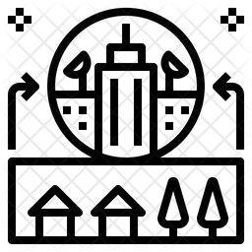
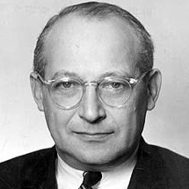
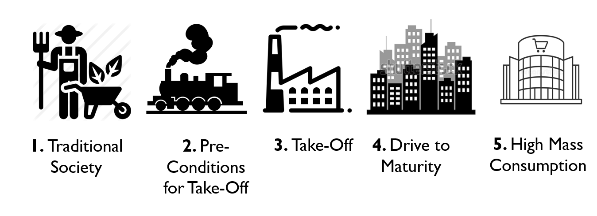
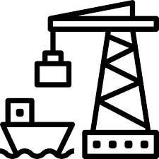
2. Modernisation Theory
Modernisation = The process whereby a place becomes more ‘modern’. E.g. better technology, infrastructure.
In 1960, Walter Rostow came up with ‘Modernisation Theory’. He said all a country needed to do to develop was to industrialise...
Talk like a geographer:
We call this the ‘multiplier effect’.
Factories generate income, which goes to the government in the form of tax. This tax can be reinvested in schools and hospitals.
WHAT IS AID?
Believing Rostow’s Theory, developed countries gave foreign aid to developing countries to spend on big development projects.
The World Bank was founded to sponsor them. E.g. Dams, railways.
Foreign Aid = money given to governments to invest in development projects.

Slide 3
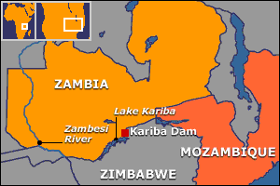
3. Development Problems
KARIBA DAM, SOUTHERN AFRICA
Many of the development projects were expensive and didn’t benefit everyone...
KEY FACTS
Built on the Zambezi River, Zambia.
Finished in 1960.
128m dam, creating the world’s largest man-made reservoir.
Potential to supply electricity to over 1m homes in Zambia and Zimbabwe.
Came at huge costs!
ADVANTAGES | DISADVANTAGES
Generates cheap, clean electricity for 1m homes. The cheap electricity has helped Zambia’s copper mining industry boom. Lake Kariba supports 4000 fisherman and supplies fresh water for farming during droughts. | It was very expensive - $480m. The skilled labour required came from France and Italy. Local workers did not benefit from most of the salary money. 6000 animals had to be moved in ‘Operation Noah’. 30,000 people had to be relocated.

Slide 4
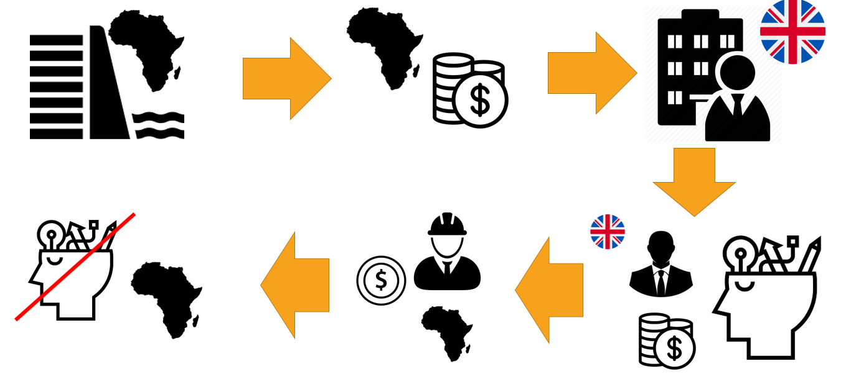
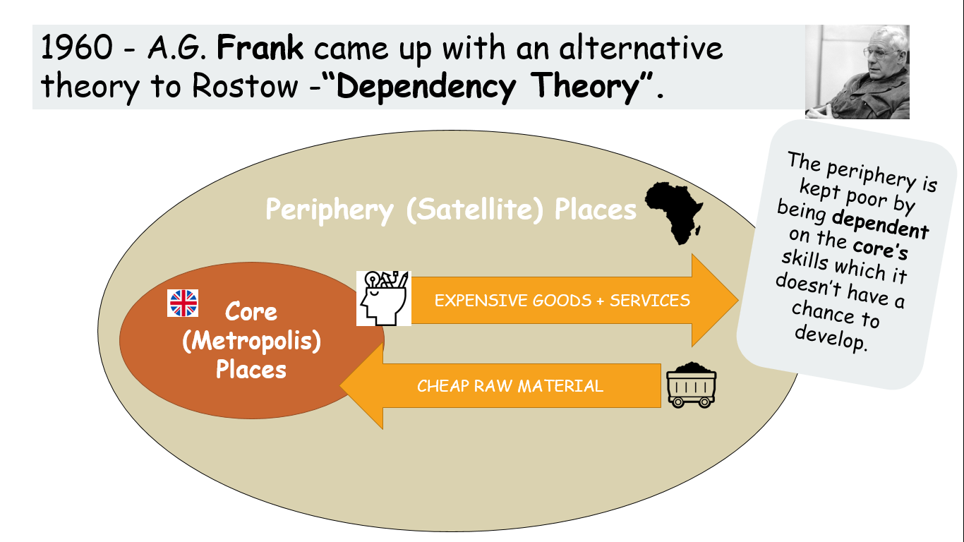
4. Dependency Theory
With large amounts of investment, many developing countries still had problems. People looked for alternative models of development.
NEO-COLONIALISM
Neo-colonialism = richer countries dominating poorer countries through ‘soft power’ – ie. controlling trade and business.
A dam is commissioned in a developing country.
The developing country uses FDI / aid to pay.
A firm in a developed country is commissioned to design and build the dam.
High-skilled, highly-paid work is done by workers in developed countries.
Low-paid, low-skilled work is done by the developing countries.
The developing country can’t develop a high skilled workforce and continues to be underdeveloped.
FRANK’S DEPENDENCY THEORY
TALK LIKE A GEOGRAPHER
When you are talking about development theories, remember to use balanced statements:
One might argue that..
Some might suggest that...

