Slide 1
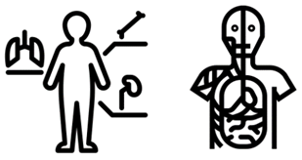
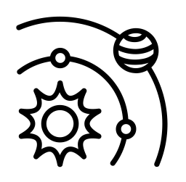
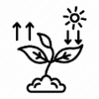
Science Learning Journey 2024-25
Preparing for our GCSE’s
Recapping required practical's, Numeracy skills, Extended writing skills
P8 "Space" (Triple only)
C10 "Using Earth's Resources"
B7 part 2 "Maintaining Biodiversity"
P7
Magnetism & Electromagnetism
C9
"The Earth's Atmosphere"
B7 part 1 "Ecology"
P6
"Waves"
C8 "Chemical Analysis"
B6 part 2 "Evolution
&
Its Evidence"
C4
Reactivity series, redox reactions and electrolysis.
P4 Density, internal energy and motion in gases.
B4
Photosynthesis
C4
Acids and Alkalis
B3
Bacterial, Viral, Fungal infections, immune system and drug development.
C3
Conservation of Mass, concentrations and quantitative chemistry.
B5
Nervous system
C6
Rate and Extent of
Chemical change
P5
Forces
B5 part 2 "Homeostasis & The Endocrine System"
C7
Organic Chemistry
P5 part 2 Newton’s
Laws
B6 part 1 Reproduction & Inheritance
B2
Leaves, transpiration and translocation.
C5R Exothermic and endothermic reactions..
C2
C2 Metals, non-metals and bonding.
B2
Part 1 Organs and health
P2
Electricity
C1 Part 2 Periodic Table
B2 Part 2 Cell Cycles
P1
Energy
C1 part 1
Atomic structure
B1 Part 1
Cells
Reactivity series
KS4
Ceramics, composites & polymers
Extracting
metals
P2 Domestic supply, supply to the home, static charges.
Catalysts
Reflection/refraction
Colours & the eye
Water waves
Introduction to science
Data
Gradients on graphs
Repeatability & reproducibility
Errors
Standard form
Percentages
Uncertainty
Industrial chemistry
Diffusion
Exothermic & endothermic reactions
Light waves
Density
Sound waves
Developing drugs
Addiction support worker
Wireless technology
Antibiotics
Issues with smoking & drinking
Misuse & addiction
Pablo Escobar case study
Legally prescribed
drugs
What are drugs?
Year
9
The Big Bang
The Universe
Life cycle of a Star
The Moon
Seasons
Properties & types of waves
Solar system
Health
& Diseases
Aerobic respiration
Exercise
Measuring fitness
Reaction
times
Health & Fitness
Non-communicable diseases
Risk factors
Bodies defences
Immune system
The
Earth &
Universe
Satellites
Insulators
Nutrients
Deficiencies
Mass vs Weight
Graphs
Significant figures
Anomalies
Variables
Results tables
Handwriting analysis
Flame testing
Pure substances
Time since death
Forensic evidence
Electricity
Resistance
Parallel
circuits
Series
circuits
Mean, mode & median
Potential difference
Chemical
Reactions (1)
Hazard symbols
Chemical changes
Word equations
Conservation
of mass
Acids & Alkalis
Indicators
Exothermic reactions
Endothermic reactions
Oxidation
Thermal decomposition
Electricity
Energy stores
Current
Respiratory system
Charge
Enzymes
Digestive system
Blood vessels
Heart
Circulatory system
Life processes
Skeletal system
Human
Body
Year
8
Experimental improvement
Llaunching a roller coaster
Pressure
Distance Time Graphs
Speed Calculations
Body changes
Contraception & STI’s
Particles
What are particles
Changes of state
Diffusion
Gases
Pressure of gases
Ssolubility
Separation Techniques
Forces
What are Forces
Resultant Forces
Hooke's Law
Gestation
Friction
Menstrual Cycle
Fertilisation
The reproductive system
Reproduction
Renewable Power Stations
Global Warming
Combustion
Infrared radiation
Convection
Conductors and insulators
Energy
Chemical Formula
Naming Compounds
Compounds
Metals and –non- metals
Infertility
How Science Works 1
Lab Safety
Equipment and Measurements
Cells
Plant and animal cell structure
Specialised cells
HSW: Using microscopes
Photosynthesis
Respiration
Single Celled Organisms
Atoms and the Periodic Table
Elements, compounds
The atom
Periodic Table
Year
7
Pollination, seed dispersal and fertilisation

