Slide 1
Level 1/2 Engineering
Knowledge Organisers

Slide 2
Drawings and calculations

Slide 3
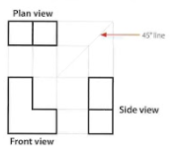
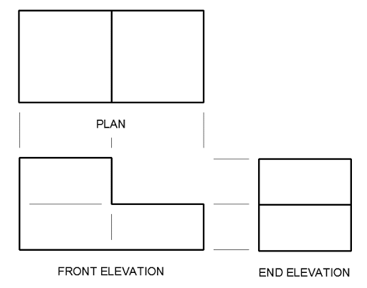
Orthographic drawings: standard drawing conventions
WJEC Engineering
Key word | Definition
BSI 8888:2017 | The name of the list of standard conventions
Elevation | View
Scale | The size of a drawing in proportion to the real object. e.g. 1:1 = full sized 1:2 = half sized 2:1 = double size
Weighted line | Thicker lines used to define the object you are drawing
Construction line | A light line used to construct the shapes you are drawing. They help you to line up views.
Dimensions | Measurements of a drawing
Diameter | (shown with ⌀) the distance across the centre
Radius | (shown with R) the distance of half the diameter of a circle. Often used to measure curves
Construction lines:
These are used to help you accurately draw all views
Construction lines are drawn very lightly and not rubbed out afterwards
Construction lines are drawn vertically and horizontally from the front view
A 45° line is drawn from the front view
Circles
The dimensions are shown with an arrow pointing to the edge of the circle in R or ⌀
Circular holes are shown with hidden lines at the edges and centre line through the centre
Section drawings show the internal details of a drawing if it was cut in half. Hatched lines at 45° are used to show parts that would have been cut. A slice line is drawn on the orthographic drawing and labelled A:A
Layout:
3rd angle
orthographic:
Front elevation is in the bottom left corner of the page
Plan(top)elevation is directly above the front elevation
End (side) elevation is directly to the right of the front
R10
Dimensions:
Extension lines lead from the corners being measured. The do not touch the drawing.
Straight, double ended arrows with solid heads are drawn with the dimension above the line in millimeters.
Line types:
Hidden line
Centre line
Construction line
Weighted line
Dimension and extension lines
Parts list
Part name
Quantity
Material
(Process)
Title block
Author
Date
Scale
Title of drawing

Slide 4
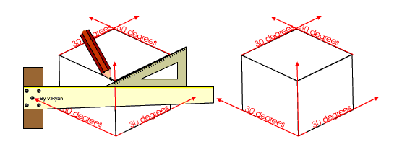
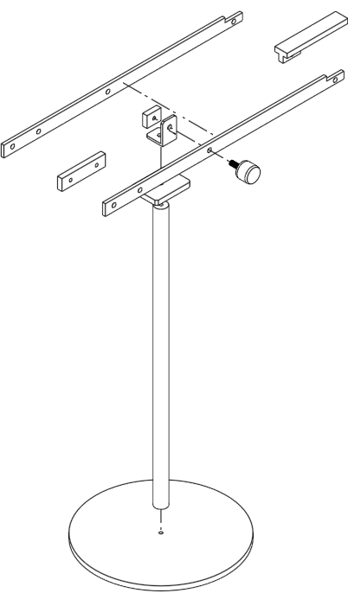
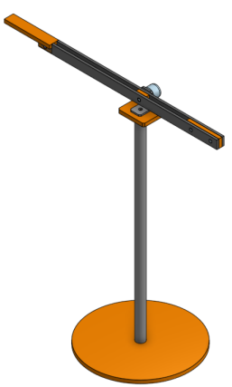
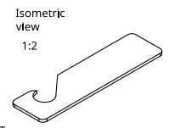
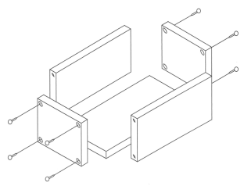
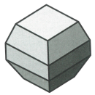
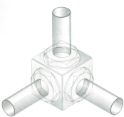
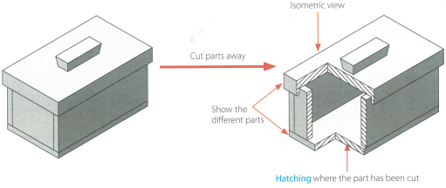
Isometric drawings:
WJEC Engineering
What are isometric drawings?
They are 3D drawing technical drawings.
There are no horizontal lines, instead they are drawn at 30° from horizontal.
How do I draw in Isometric?
Either by using isometric grid paper, or using plain paper with a ruler and 30° set square.
Exploded Isometric drawings.
This is a drawing style used to show how parts fit together. Parts are ‘exploded’ in isometric, so that they in line with their original position.
Cutaway drawings.
This is a drawing style used to show the inside of a solid object, where part of the drawing has been ‘cut away’.
The lines that have been ‘cut’ are filled with hatched lines.
Isometric grid paper (vertical lines not included)
Isometric grid paper (vertical lines included)
Isometric drawings may be done by hand or using CAD. They may be left plain, or rendered to look like the final materials.
Drawing circles and curves in isometric
In isometric, circles actually appear as ellipses.
Circles can constructed by drawing an isometric square and drawing the circle within.
Often, ellipse templates are used for drawing.

Slide 5
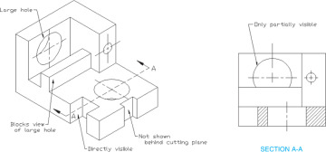
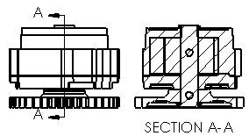
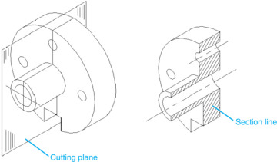
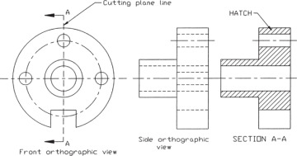
Section drawings:
WJEC Engineering
What are Section drawings?
These are 2D drawings which show the inside of a product.
They are labelled with an arrow and two letter, which then match the section drawing: as shown below A:A
The arrow shows the cutting plane section to be shown in the section view.
Cutting plane lines may also be shown on a isometric drawing.
Cutaway drawings.
This is the same principle as section drawings, but it in isometric.
The lines that have been ‘cut’ are filled with hatched lines.
How to draw a section drawing?
Section drawings are the same scale as the orthographic drawing that they accompany (unless otherwise stated)
Hatched lines are drawn on a section drawing to show solid parts that have been cut through. Different parts touching will have opposite direction hatched lines.

Slide 6
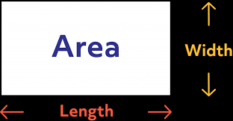
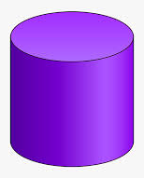
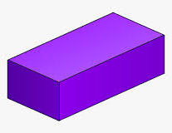
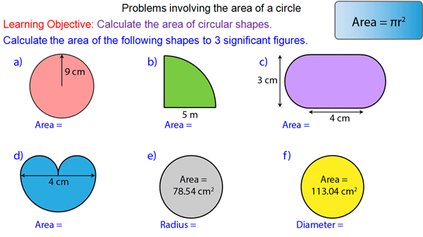
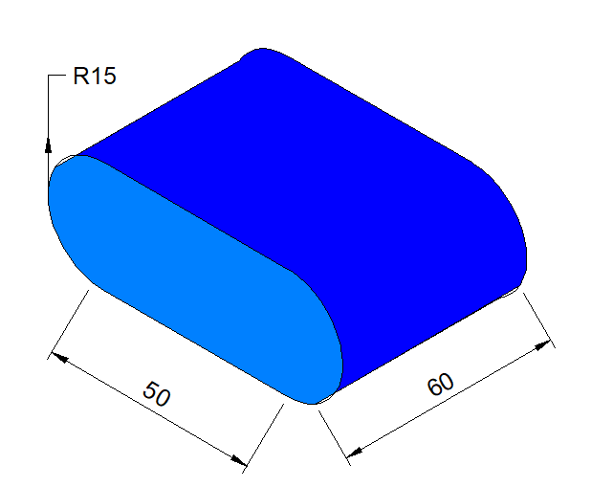
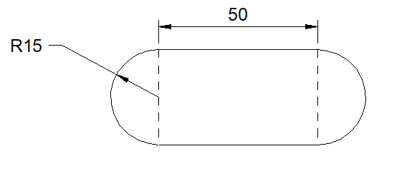
Engineering calculations Knowledge organiser
WJEC Engineering
Pg 1 of 1
Calculating areas
Calculating volumes
Area of rectangles
A = Area
L = Length
W = Width
A = L x W
Volume of prisms
For the volume of prisms, you calculate the cross sectional area, then multiply by the height.
Area of a circle
A = ℼ x r²
Area of a triangle
A = ½ b x h
Diameter Ø is twice the Radius
Calculating the area of compound shapes
To calculate the area of a compound shape, start with the formulas your know, then add or divide them to make the shape you need, e.g. for q.b below, you would calculate the area of a whole circle then divide by 4.
Cylinder
V = (ℼ x r²) x h
Cuboid
V = (l x w) x h
Calculating the volume of compound shapes
To calculate the volume of a compound shape, calculate the area by adding/ subtracting the simple areas, then multiply by the height, e.g:
For this pill shaped cuboid, we would first calculate the cross-sectional area
Semi circles = (ℼ x r²) / 2
Rectangle = 50 x (R15 x2)
= 50 x 30
Area = 706+706+1500 = 2912mm²
Volume = 2912 x 60 = 174720mm³

Slide 7
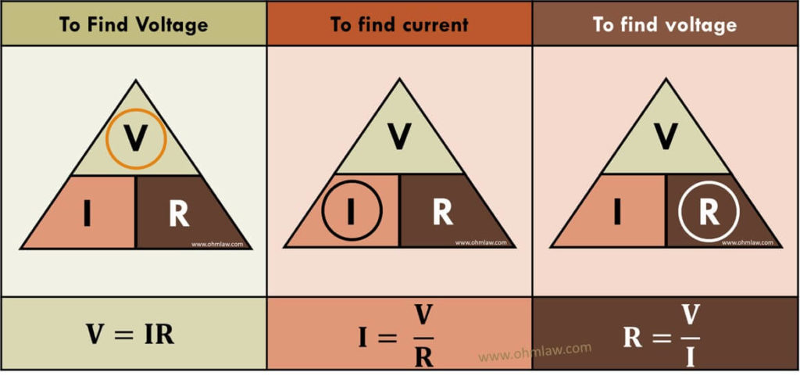
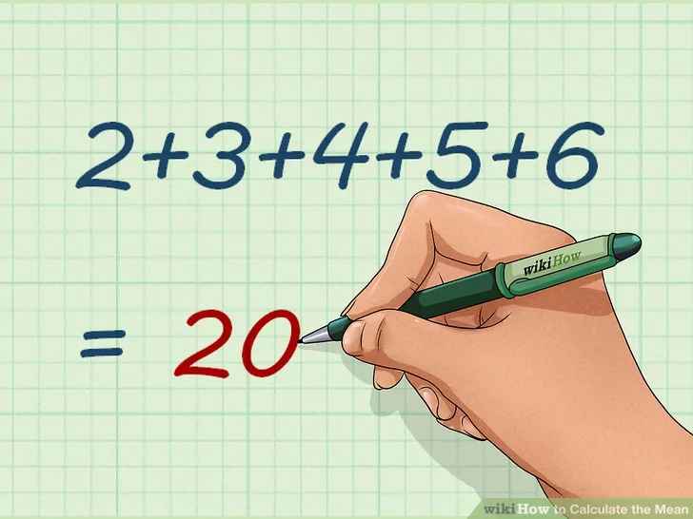
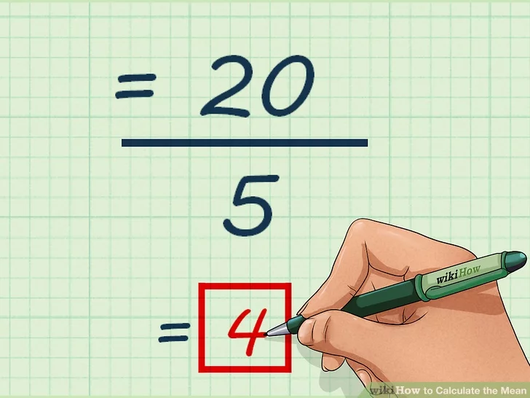
Engineering calculations Knowledge organiser
WJEC Engineering
Pg 1 of 1
Electronic calculations
Calculating mean
You may be asked to calculate voltage (V), current (I) or resistance (R)
Units:
Voltage= volts (V) Current = amps (A) resistance = ohms (Ω)
To calculate the mean, add up all the values and divide by the number of values
e.g.
To find resistance
Calculating costs
You may be asked to calculate the cost of materials etc.
For this, remember that £1 = 100 pence
Example question:
Table A lists the cost per litre of paints.
Calculate how many 5L cans of green paint you can buy for £50. Give your answer to the nearest whole can of paint.
£50 x 100 = 5000p [convert pounds to pence]
5000/5.80 = 862.068 [how many litres for cost]
862.068 / 5 = 172.41 [divide into 5 litre cans]
Nearest whole number = 172 cans
Calculating percentages:
To calculate the percentage of something you divide it by the total
E.g. You have 500mm of steel, you have cut off 3 lengths of 150mm. What percentage of the material has been waster?
150 +150+150= 450mm 500mm - 450mm = 50mm
50/500 = 0.1
0.1 x 100 = 10%
Colour | Price per litre
Green | 5.80
Red | 2.32
Blue | 1.29
Calculating ratios:
A ratio is a mathematical term used to describe how much of one thing there is in comparison to another thing.
Example:
In a bag of 20 sweets, there are 8 blue sweets and 12 pink sweets. What is the ratio of blue to pink sweets?
8 blue : 12 pink = 8:12 common factor of both is 4
8/4 = 2 12/4 = 3
Ratio is 2:3
Table A

