Slide 1
Level 1/2 Engineering
Knowledge Organisers

Slide 2
Engineering Design

Slide 3
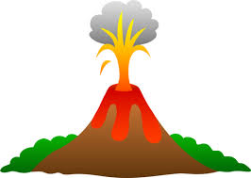
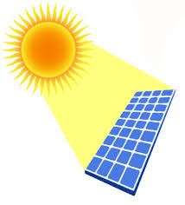
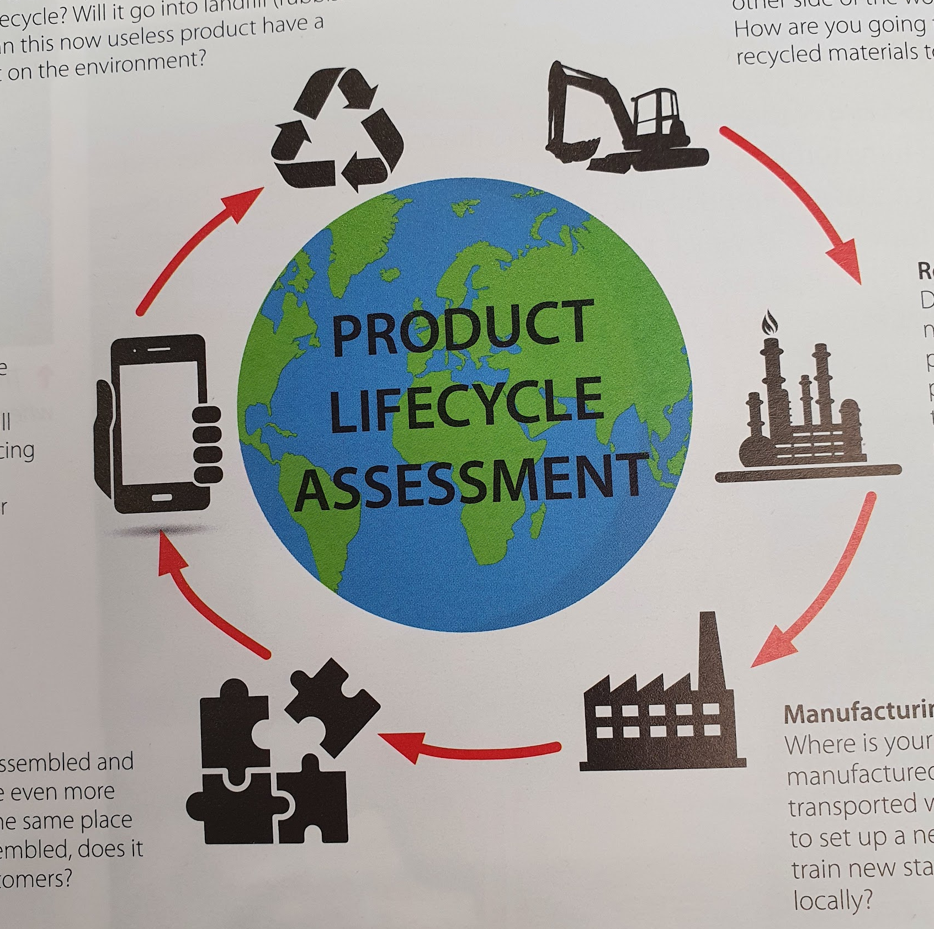
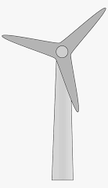
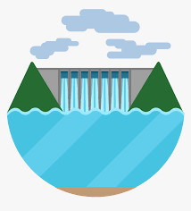
Engineering and the Environment Knowledge Organiser
WJEC Engineering
Renewable Energy
Non-renewable energy is made from fossil fuels. These are non-renewable resources which are burnt to create energy. They cannot be remade once they’ve been used. Coal, oil and natural gas are all examples of fossil fuels.
Key word | Definition
Fossil fuels | A fuel formed naturally which is non-renewable e.g. coal, oil and natural gas.
Renewable | A resource which can be replenished naturally
Non-renewable | A resource which cannot be replenished naturally
Energy source | Where electricity and energy is sourced from. This can be a renewable or non-renewable source.
Raw materials | Materials taken and converted into usable material forms
Sustainability | Meeting the needs of the present without affecting future generations
Landfill | An area of land for waste. It is either piled up or buried underground.
Slag | Waste material that is left behind when melting or refining metals
Biodegradable | Materials that can be broken down by microorganisms, such as bacteria and fungi.
Fossil fuels
Creates pollution when burned which harms the environment
Will eventually run out
Cheaper running cost
Reliable and consistent source of energy
Renewable energy
Expensive set up cost
Can be noisy and unattractive for residents (e.g. wind farms)
Energy source will not run out
Does not cause long term environmental impact
Types of renewable energy
Geothermal power
Expensive to create
Difficult to find suitable locations (volcanic land)
Clean resource (steam)
The hot reservoirs within the Earth are naturally replenished, making it both renewable and sustainable.
Solar power
Expensive set up cost
Do not work at night
Requires good air quality
Can absorb normal daylight on a cloudy day but most efficient in sunlight
Minimal impact on the environment
Makes good use of a renewable energy source
Wear out very slowly
Product life cycle is the impact that a product has on the environment throughout its life, from sourcing the materials to when it is finished being used
Extracting raw materials
Renewable/ non-renewable resources
Human and wildlife impact of mining materials?
End of product life
Recycled? Landfill? Biodegradable?
Wind power
Expensive to maintain
Can be noisy and unattractive for local residents
Is reliant on windy weather
Minimal impact on the environment
Makes good use of a renewable energy source
Can be placed out at sea or on land
Using the product
Single use product? Designed to be repaired by the user? Unnecessary packaging?
Refining raw materials
Renewable/ non-renewable energy use to refine materials into usable forms. Pollution from transporting them?
Hydro power
Can negatively impact on wildlife habitats and fish migration
Predictable water levels
Reliable = very efficient source of energy
Assembling parts
Fair working rights for workers? Pollution from transporting parts?
Manufacturing parts
Waste material from manufacturing. Energy type used, pollution from factories

Slide 4
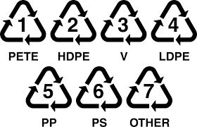
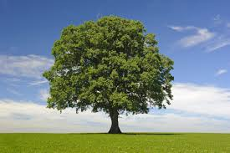
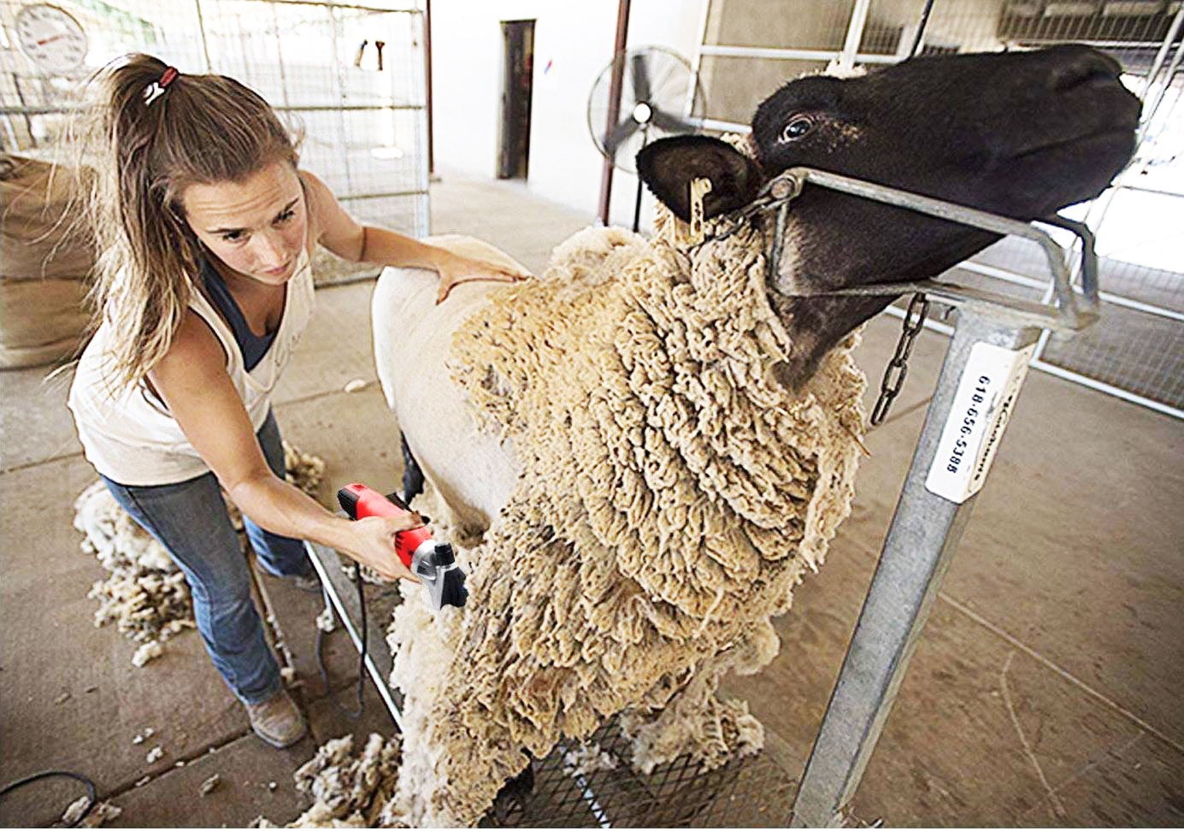
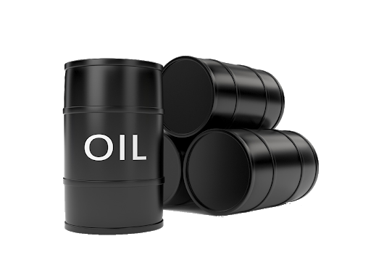
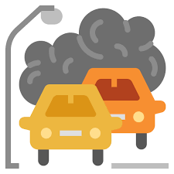
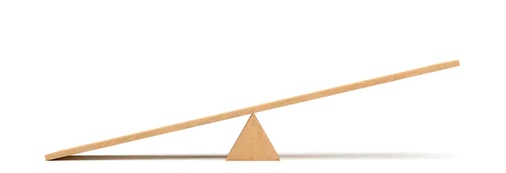
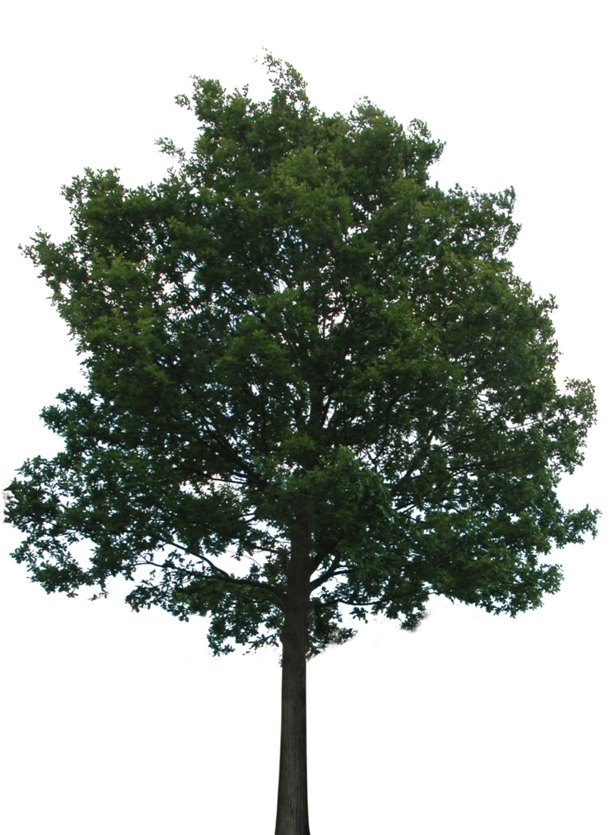
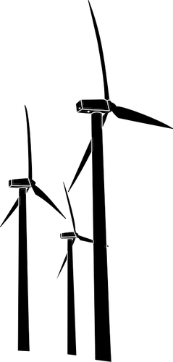
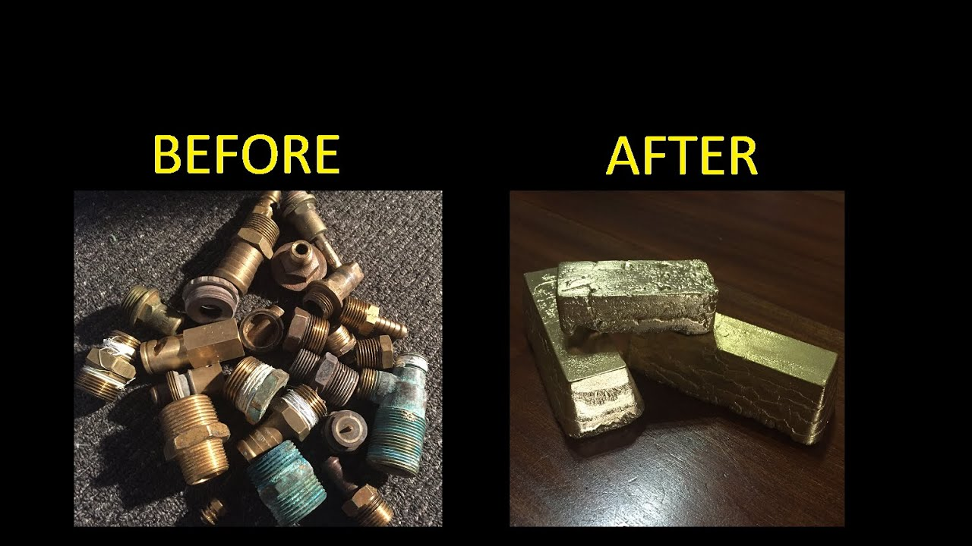
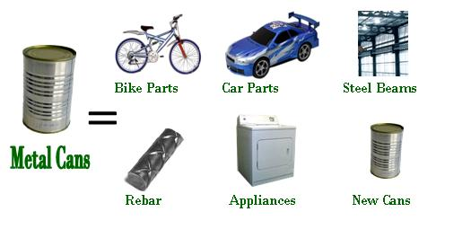
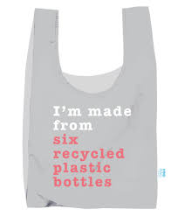
Engineering and the Environment Knowledge Organiser
WJEC Engineering
Existing and future engineering materials and processes
Engineers all over the world are constantly looking to develop new materials and processes that are more efficient, cost effective and better for the environment.
Sustainable concrete is made from fewer materials by using crushed glass, wood chips and slag to bulk it out
Pollution absorbing bricks can be used for construction and they act as air filters for the air around the building to reduce air pollution
Bioplastics instead of using crude oil to make plastic. Bioplastics are made from organic materials such as sugar cane, algae or cornstarch. They are 100% biodegradable so that they don’t affect the environment when disposed of.
Photovoltaic surfaces are an advanced use of solar panels. The can be in the form of a thin film and be applied to glass to make skyscrapers self-powering
Self-healing materials use carbon in the atmosphere to repair themselves when broken. They are still in the early stages of development but could be used for medical, structural and aeronautical materials
Smart factories use computer-integrated manufacturing and robotics to adapt and change processes through live monitoring, without human input.
Recycling
Millions of tonnes of materials are used every year to produce products, from building materials to plastic packaging
Many materials end up in a landfill or thrown into the ocean into being reused or recycled
ISO 15270:2008 deals with what percentage of plastics have to be recyclable for all new products (it is international law for all manufacturing companies)
Recycling logo (mobius loop) This shows if a product or part of the product can be recycled (plastic products, packaging)
Forest stewardship council® (FSC) Show that a forest product (e.g.wood or paper) is responsibly sourced.
Euro Ecolabel shows if a product has conformed to the European standards for sustainability (for products manufactured in Europe)
Recycling plastics:
Most plastics can be recycled
It takes a lot of energy
It is difficult to do
Plastic types have to be stamped onto the product:
Recycling metals:
Metals are 100% recyclable and reusable (except for corroded/rusted parts)
Metals can be repeatedly recycled without changing their properties
Steel is probably the most commonly recycled material.
Sustainable engineering
Creating products that are made from sustainable sources
Creating products using minimal or renewable resources during manufacture and transport
Creating products that can be recycled fully

Slide 5
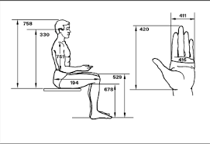
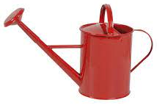
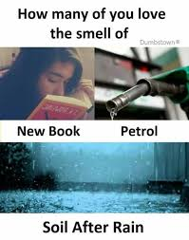
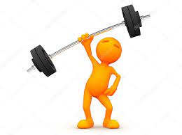
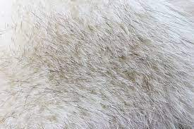
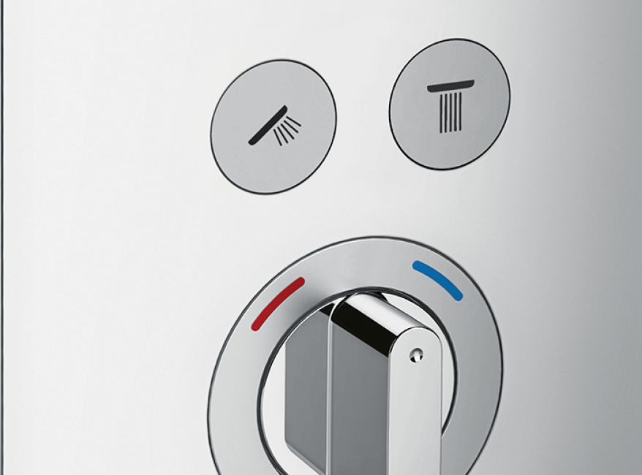
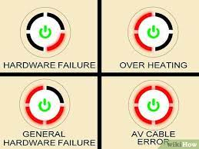
Anthropometrics and Ergonomics Knowledge organiser
WJEC Engineering
Anthropometrics is data on human body size and shape
Ergonomics is any way that a user interacts with a product.
Anthropometric data is used in the design of products to improve the ergonomics and make the product more comfortable for the user, e.g. average data on feet lengths are used to ensure that stairs are deep enough to put you feet on.
Anthropometric Data
Anthropometric data is human body sizes and shapes.
Thousands of measurements from humans in a set group (e.g. adult males) are used to calculate a mean, which is used for designing.
If it’s comfortable to use
E.g. buttons in natural hand positions
How it smells e.g. high quality leather
Easy to control e.g. not too heavy for the user or unbalanced
Ergonomics
Easy/ comfortable to lift
Intuitive design
E.g. Standard use of colours, buttons in obvious positions etc
How it feels/ texture (soft, high quality, warm etc)
E.g. metal handles may feel cold to the touch
User feedback e.g. lights, vibrations, etc tell the user that they have pressed a button

