Slide 1

Level 1/2 Engineering
Knowledge Organisers

Slide 2
Materials

Slide 3
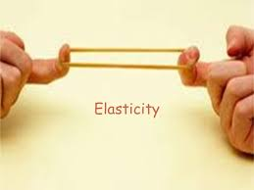
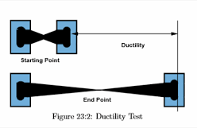
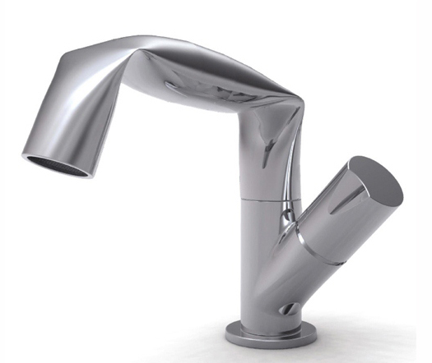
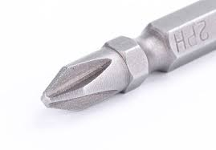
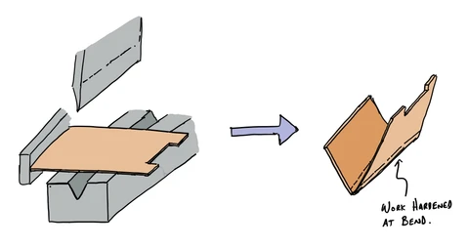
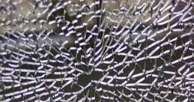
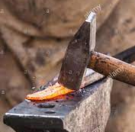
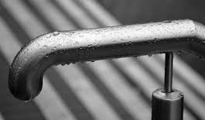
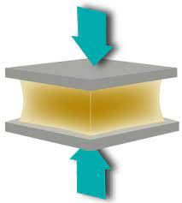
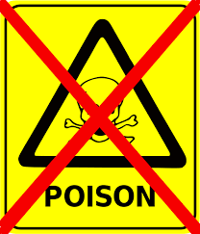
Material properties Knowledge organiser
WJEC Engineering
Pg 1 of 1
Material properties are broken down into two main categories:
Physical properties (the properties before it is used, appearance, conductivity etc)
Working properties (how the material behaves)
Elasticity
The ability to regain its original shape (e.g. rubber)
Ductility
The ability to be stretched without breaking (e.g copper stretches in wire)
Malleability
The ability to be pressed, spread out or hammered (e.g. lead can be easily shaped as it is malleable)
Hardness
The ability to resist scratching, cutting or wear and tear (e.g. high carbon steel drill bits don’t get worn down by drilling into other materials.
Ductility
The ability to be stretched without breaking (e.g copper stretches in wire)
Malleability
The ability to be pressed, spread out or hammered (e.g. lead can be easily shaped as it is malleable)
Work hardening
When the properties of a material change due to working (e,g bending a sheet will make it stronger at the joint)
Hardness
The ability to resist scratching, cutting or wear and tear (e.g. high carbon steel drill bits don’t get worn down by drilling into other materials.
Work hardening
When the properties of a material change due to working (e,g bending a sheet will make it stronger at the joint)
Tensile strength
Retains strength when stretched.
Compressive strength
Retains strength when under pressure, e.g. concrete.
Corrosion resistant
It will not corrode in its environment (e.g. doesn’t rust)
Brittleness
Will snap easily and not bend (e.g. glass)
Toughness
Is resistant to breaking and bending (e.g. cast iron)
Corrosion resistant
It will not corrode in its environment (e.g. doesn’t rust)
Non-toxic
Is not harmful to humans (e.g. non-toxic paint is used on baby toys)
Shiny/ High lustre
When a material is very shiny and reflects light well. e.g. gold or brass when polished.
Matt finish
When a material does not reflect much light and appears dull
Density
How solid a material is. (A denser material will weigh more than a another material of the same size)
Conductivity
How well a material conducts heat (thermal conductivity) or electricity (electrical conductivity)

Slide 4
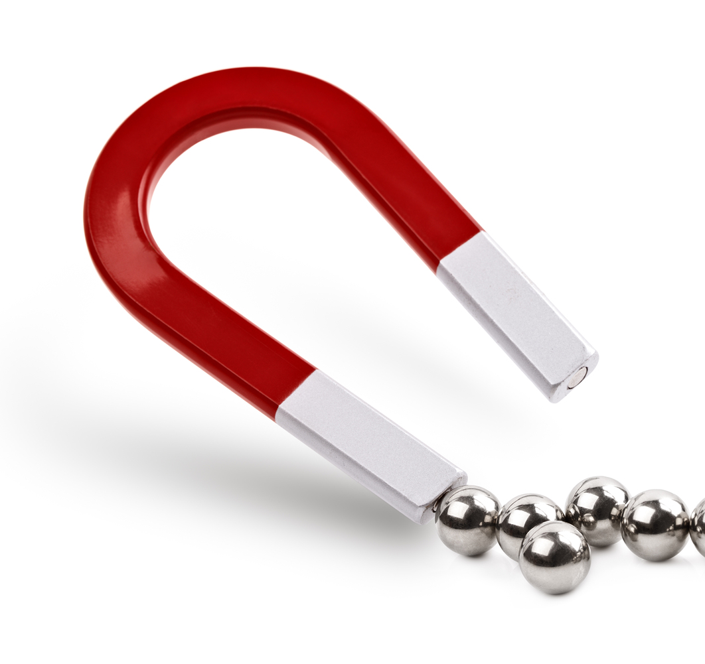
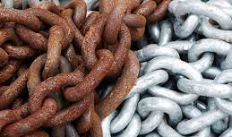
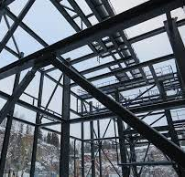
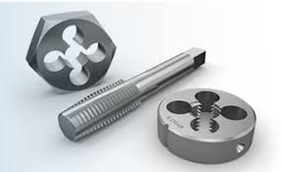
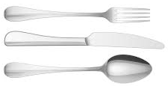
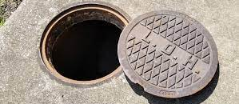
Metals Knowledge organiser
WJEC Engineering
Pg 1 of 3
Types of metal
Metals generally fit into 2 categories:
Ferrous metals
These contain iron. This means that they are magnetic and will rust (unless they have corrosive resistant properties e.g. stainless steel)
Non-ferrous metals do not contain iron
And the subcategory:
Alloys (these are made up of ferrous and non-ferrous metals)
For material property key words, see your material properties knowledge organiser.
Key word | Definition
Oxidisation | When a metal containing iron reacts with oxygen in the air. Rust on the surface of a metal is evidence of this. (When rust is present on the surface, oxidisation has occurred)
Fabricate | To shape and join materials to make a product (Mild steel is easy to fabricate using many different methods such as welding)
Extract | To remove from something else. Metals are extracted from the earth by digging them up.
Refine | Metals are refined by separating them from others into a pure metal.
Corrosion | The breaking down of a metal due to chemical reactions e.g. rust. This causes its physical appearance to change. (To corrode/is corrosive/ corrosion is visible by the evidence of rust)
Tarnish | When a surface loses its colour/brightness/shine (e.g. silver tarnishes easily so needs polishing)
Galvanise | The process of coating a ferrous metal with zinc to protect it against corrosion
Ferrous metals
Ferrous metals are never 100% iron as iron is too soft to use on its own, so other elements are mixed with it.
You can easily identify a ferrous metal as iron corrodes (rusts), so anything with rust on the surface (oxidation) must contain iron. Also, iron has magnetic properties.
 | Material | Properties | Common uses | Made up from
 | Mild steel | Good tensile strength Good toughness Corrodes easily | Used for many products such as: PC carcasses (body frames) Xboxes, etc Fences Signs Structures e.g. bridge | Iron 0.1-0.3% carbon
 | High-carbon steel (or tool steel) | Tough Hard Can be brittle | Tools such as: Saw blades Drill bits Tap and die | Iron 0.5-1.5% carbon
 | Stainless steel | Corrosive resistant (doesn’t rust) Tough | Medical instruments Cutlery | Iron Nickel Chromium
 | Cast iron | Good compressive strength | Drain and manhole covers Engine blocks | Iron 2-6% carbon

Slide 5
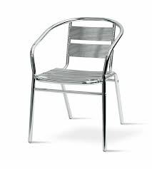
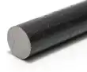
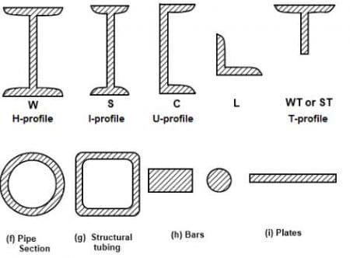
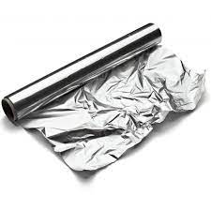
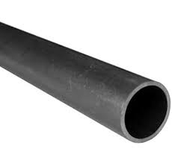
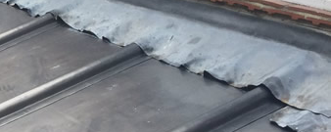
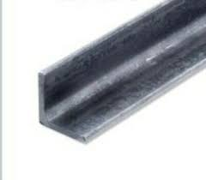
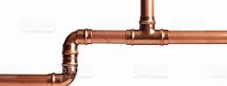
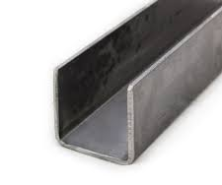
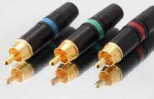
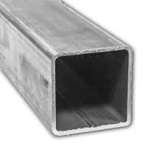
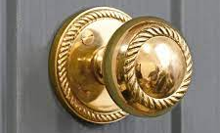
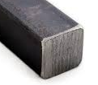
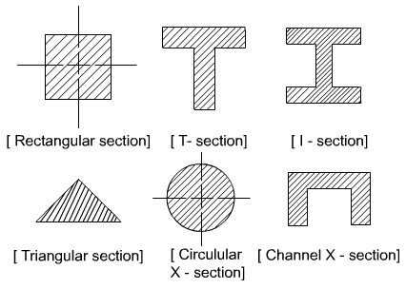
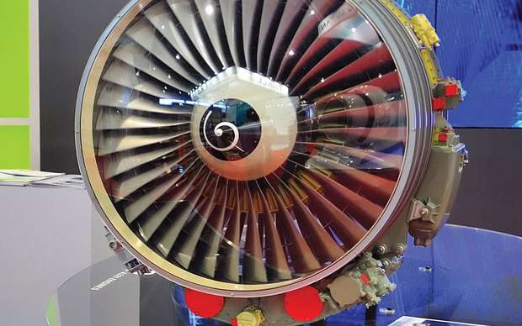
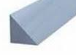
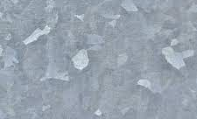
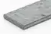
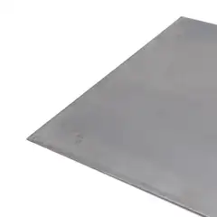
Metals Knowledge organiser
WJEC Engineering
Pg 2 of 3
Non-ferrous metals
Non-ferrous metals do not contain iron. They have different properties and many different uses. Non-ferrous metals mostly have a much greater resistance to corrosion than ferrous metals and are not magnetic. However, as they are not as common as iron (except aluminium), non-ferrous metals tend to be a lot more expensive to refine from their ore. They are also more expensive to fabricate compared to iron.
Standard forms
Metals are ordered in the shape required for manufacturing.
The most common metal forms ordered are extrusions. These are a fixed sectional shape that is continued for a long as desired:
 | Material | Properties | Common uses | Made up from
 | Aluminium | Light Soft Malleable Corrosion resistant Non-toxic Polishes well | Good for alloys Products used outside Aircrafts Ladders | Aluminum
 | Lead | Ductile Malleable Heavy | Roofing Batteries | Lead
 | Copper | Good electrical and heat conductor Ductile | Piping Electrical wiring | Copper
 | Gold | Soft Malleable Tarnish/corrosion resistant Good conductor of electricity | Jewellry High-end stereo connections Circuit boards contact points | Gold
 | Brass | Hard Corrosion resistant | Musical instruments Ornamental products | Copper Zinc
 | Titanium | High strength High corrosion resistant Low density Ductile High shine (lustre) | Aircrafts Spacecrafts Missiles Prosthetic limbs | Titanium Often alloyed with other metals
 | Zinc | High corrosion resistance Good conductor Very weak Poor strength to weight ratio Low melting point | Used to galvanise other metals (such as iron) Batteries | Zinc
Round section/ bar
Round tube section
L channel/ angle section
U channel section
Square tube/ box section
Square section
Chamfered section
Flat bar
Sheet

Slide 6

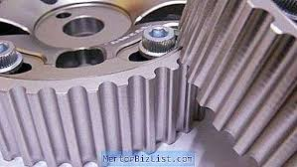
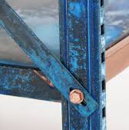
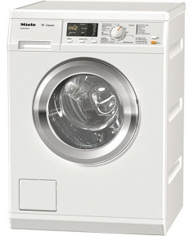
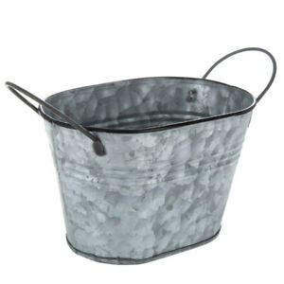
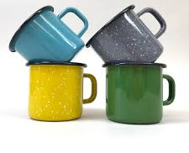
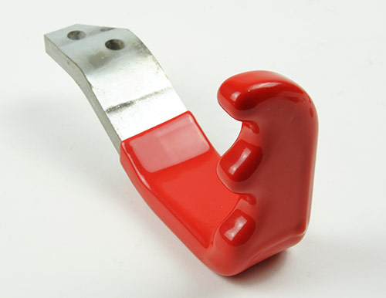

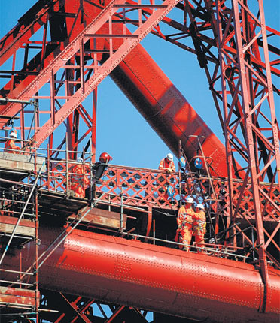
Metals Knowledge organiser
WJEC Engineering
Pg 3 of 3
Alloys
An alloy is a mixture of elements that usually have a metal as the main part (parent metal).
Alloys were developed to create different properties than those available in pure metals. By heating up and mixing different metals you can create new metals with different properties.
Alloying agents
Modern Engineers use different alloys to change the properties of materials.
These are commonly used alloying elements in modern-day practice and what properties they can add to an alloy:
Nickel:
Increases strength,hardness and resistance to corrosion
Chromium:
Increases hardness, toughness and resistance to corrosion.
Vanadium:
Increases toughness of steel and wear resistance
 | Material | Properties | Common uses | Made up from
 | Brass | Hard Corrosion resistant | Musical instruments Ornamental products | Copper (parent) Zinc
 | Bronze | Harder More corrosion resistant Easier to melt and cast | Axe heads Statues Bronze age: 2500-800 BC | Copper (parent) Tin )
 | Stainless Steel | Corrosive resistant (doesn’t rust) Tough | Medical instruments Cutlery | Iron (parent) Nickel Chromium
 | Duralumin | Lightweight Strong Extremely corrosion resistant | Car parts Air craft parts | Aluminium (parent) Copper Magnesium Magnese
Origin
Metals come from ores which are naturally occurring rocks that contain metals.
Iron ore is used to make iron and steel.
This material source is non-renewable, meaning that once it has been mined it can not be replenished and will eventually run out.
Some metals are more difficult to extract from the earth and other metals they are mixed with. This can make them much more expensive to extract and refine.
Finishes
Finishes are applied to surfaces to protect them and/or improve the aesthetics (e.g. colour, shine etc). Sometimes they are used to add texture (e.g. for grip)
Plastic dip coating
Anodising
Painting
Blueing
Powder coating
Galvanising
Enamelling
Used mainly on steel. Metal is heated and dipped into plastic powder. Good for anti corrosion and a range of colours for aesthetics.
Aluminium is placed in an acid bath and an Electric current is passed through and coloured dye added.
Creates a barrier for corrosion resistance. Is prepared first with a primer. Needs regular maintenance
Steel is heated then dipped in oil. This creates a anti-corrosion layer which is usually blue/black in colour
Similar to dip coating but the powder is sprayed on. This is used more in industry and mainly for white goods e.g. washing machines.
A ferrous metal is coated in a thin layer of zinc to protect it from corrosion. Use on street lights and fences. Has a durable and speckled finish.
High temperatures are used to melt glass onto a metallic surface for corrosion resistance and aesthetic appeal. Used for the tin mug and jewellery.
Plastic dip coating | Similar to dip coating but the powder is sprayed on. This is used more in industry and mainly for white goods e.g. washing machines.
Anodising | Aluminium is placed in an acid bath and an Electric current is passed through and coloured dye added.
Painting | Creates a barrier for corrosion resistance. Is prepared first with a primer. Needs regular maintenance
Blueing | Steel is heated then dipped in oil. This creates a anti-corrosion layer which is usually blue/black in colour
Powder coating | Similar to dip coating but the powder is sprayed on. This is used more in industry and mainly for white goods e.g. washing machines.
Galvanising | A ferrous metal is coated in a thin layer of zinc to protect it from corrosion. Use on street lights and fences. Had a durable and speckled finish.
Enamelling | High temperatures are used to melt glass onto a metallic surface for corrosion resistance and aesthetic appeal. Used for the tin mug and jewellry.

Slide 7
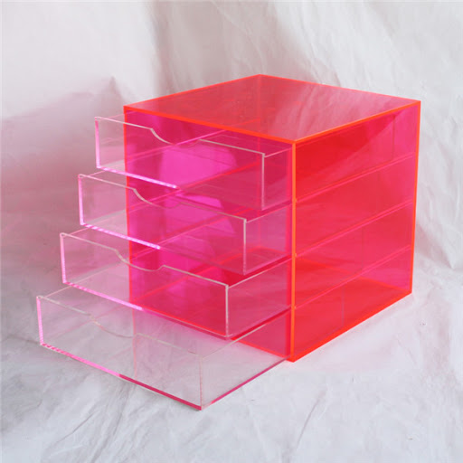
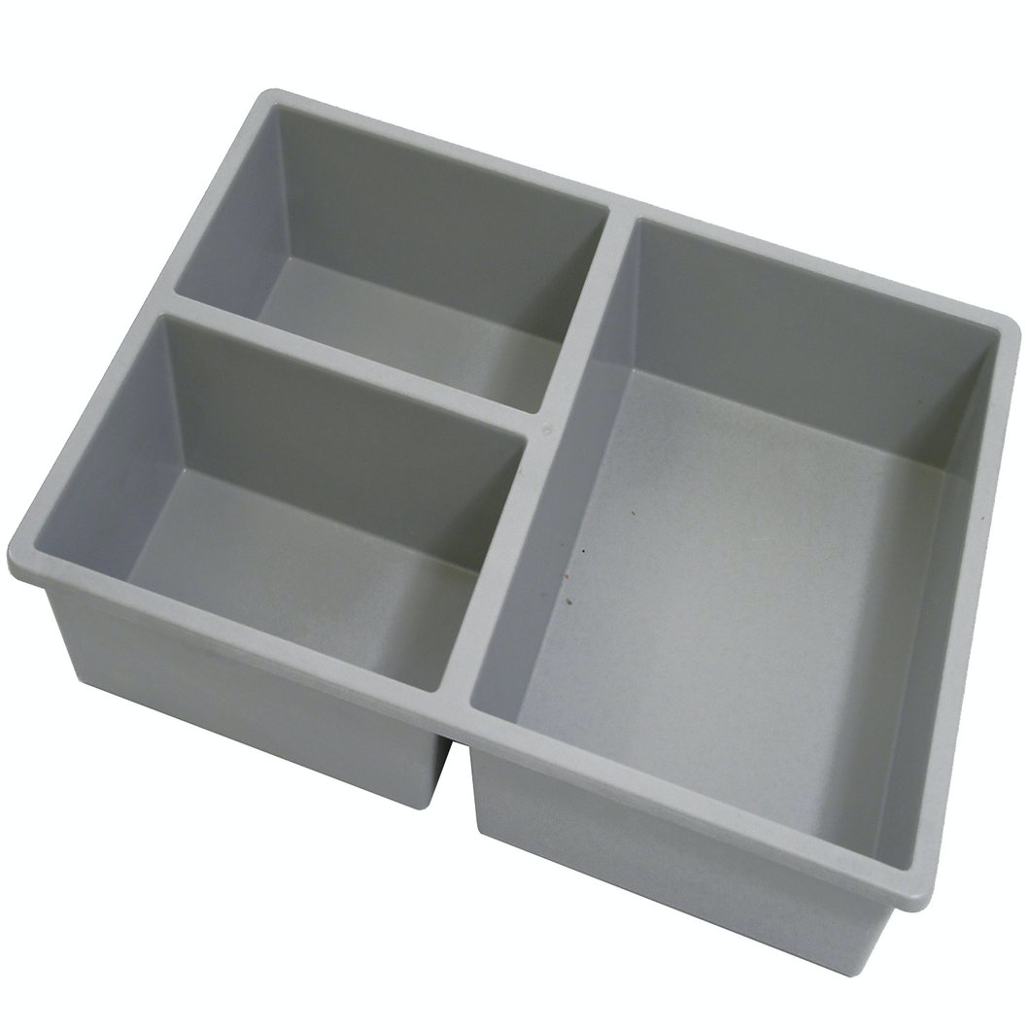
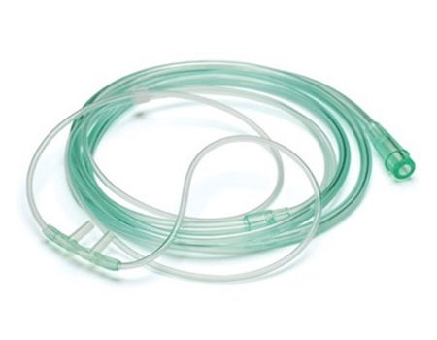
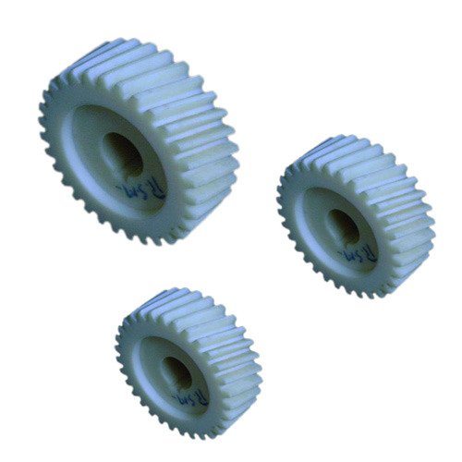

Plastics Knowledge organiser
WJEC Engineering
Textbook ref:
P48-52
Pg 1 of 2
Types of plastic
Plastics generally fit into two main categories:
Thermoforming plastics (or thermoplastics)can be re-shared when re-heated and are therefore re-mouldable. They are therefore also recyclable.
There are no links between polymer chains in a thermoplastic.
Thermosetting plastics are joined across polymer chains, which gives them a strong bond between the monomers. Thermosetting plastics cannot be re-heated and re-moulded like thermoplastics.
For material property key words, see your material properties knowledge organiser.
Key word | Definition
Crude oil | Crude oil is a finite resource that is found in the Earth's crust
Monomer | Single plastic molecules
Polymer | A chain of plastic molecules. The word ‘polymer’ often used instead of ‘plastic’
Polymerisation | The industrial process used to create plastics from naphtha
PVC | Polyvinyl chloride
uPVC | Unplasticised polyvinyl chloride. A hard form of PVC
Thermoplastics (p49-51)
Picture of use | Material | Properties | Common uses
 | Acrylic | Hard-wearing Brittle Shiny Range of colours | Signs Glass substitute phone covers Baths
 | HIgh Impact Polystyrene (HIPS) | Tough Rigid Cheap Range of colours | Toys Cutlery dividers Draw organisers
 | PVC | Hard-wearing Cheap Matt or shiny | Doors and windows Waste pipe Electric tape Plumbing fittings Medical industry
 | Nylon | Low friction | Door runners Gears washers
 | ABS | Rigid Abrasion resistant Impact resistant | Power tool casings Crates Lego
Notes:
More details on different plastics here: https://www.bbc.co.uk/bitesize/guides/z6byb82/revision/5

Slide 8
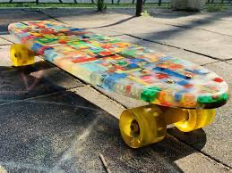
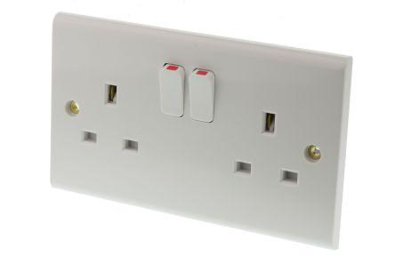
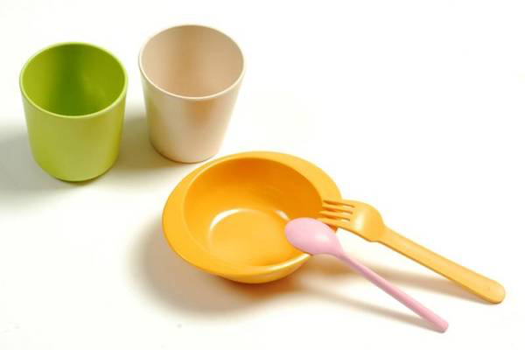
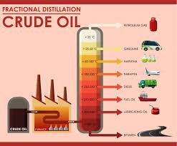





Plastics Knowledge organiser
WJEC Engineering
Textbook ref:
P48-52
Pg 2 of 2
Thermosetting plastics
Origin (p48-49)
[explanation of where plastics come from]
Chemicals derived from crude oil are used to make plastics. Crude oil is extracted from the field and transported to a refinery, where it goes through the refinement process called fractional distillation.The refining process produces a variety of chemicals, one of which is naphtha. The polymerisation process is then used to further process naphtha to manufacture plastics.
Picture of use | Material | Properties | Common uses
 | Epoxy resin | Rigid Durable Heat resistant | Laminating Skateboards Printed circuit boards
 | Urea formaldehyde | Smooth finish Range of colours Heat resistant | Electrical switches Plug sockets Door handles
 | Melamine formaldehyde | Hard Brittle | Picnic wear Laminates for kitchen worktops
Finishes
(p58)
Finishes are applied to surfaces to protect them and/or improve the aesthetics (e.g. colour, shine etc). Sometimes they are used to add texture (e.g. for grip)
Image
Self finishing
Glossy, smooth finish
Rough, textured finish
After cutting or sawing
After 3D printing
When a material does not have to go through another process to finish it
Mould with a smooth surface on interior
Mould with textured surface on interior
This process would leave a rough edge with plastic burrs and may need smoothing down.
Made from plastic wire that leaves ridges around the product.
Notes:
More details on different plastics here: https://www.bbc.co.uk/bitesize/guides/z6byb82/revision/5

Slide 9








Composites Knowledge organiser
WJEC Engineering
Pg 1 of 1
A Composite is when different materials are joined together to make a new material
Composites are made to gain and combine the properties of different materials that have been added together, e.g. to make a stronger, more lightweight material.
Note: an alloy is not a composite material as this creates a chemical change.
Keywords:
Composite: when different materials are joined together to make a new material with enhanced properties
Composite front door
These doors have a polyurethane core with steel reinforcements, sandwiched between two outer layers of GRP (see below)
Man-made / manufactured boards
Plywood, MDF and chipboard are made by combining wood sheets/chips/ dust with resin.
These manufactured boards can be made much larger than natural timber boards and have a greater resistance to warping, twisting, splitting etc ans they do not follow the natural wood grain.
Products made manufactured boards: cheap furniture, laminated kitchen worktops, underflooring, etc.
GRP
GRP is Glass Reinforced Plastic. This is where fibreglass is layered up with resin into moulds and creates a hard material when cured. As the fibreglass is flexible like fabric, it can be layered up into moulds with complex shapes
Properties: High corrosion resistance, high tensile strength (more than steel), lightweight, non-conductive and chemical resistant.
Carbon Fibre
Carbon fibre is similar to GRP, as a textile-like fibre sheet which is layered up with epoxy resin to create a complex shape when cured.
Carbon fibre is known for its black, woven, shiny appearance.
Properties: lightweight, tough, high tensile strength to weight ratio, expensive,
Products made from Carbon Fibre include: race cars, automotive and space applications, sport equipment, expensive bike frames
Products made from GRP include: boats, storage tanks, PPE

Slide 10







Smart Materials Knowledge organiser
WJEC Engineering
A Smart material is a material that changes it properties in response to an external stimuli (e.g. heat, light, sound or electrical current)
Keywords:
Thermo: From the Greek word for heat
Hydro: From the Greek word for water
Photo: From the Greek word for light
Chromo: From the Greek word for colour
Piezoelectric
Piezoelectricity is the process of using crystals to convert mechanical energy into electrical energy, or vice versa.
Thermochromic pigment
These pigments are added to materials to make them change colour when heat is applied, and change back when cool
Hydrochromic pigment
These pigments are added to materials to make them change colour when liquid is applied, and change back when dry
Shape memory alloys
These move in response to an external stimuli, e.g. they can be bent out of shape then return to original shape when heat/ electricity is applied
Products: microphones, lighters
Products: thermometers, heat warnings e.g. baby spoons
Products: Colour changing car paint. Moisture detectors
D3O
This material has high impact absorption and is used for impact protection.
Photochromic pigment
These pigments are added to materials to make them change dark when bright light is present, and change back with darker light.
Self-healing materials (e.g. self healing paint)
These are materials that can heal themselves without human influence.
Products: Glasses frames, dental braces, windows that close in the heat,
Products: Protective sportswear e.g. shin pads
Products: welding goggles, sunscreens
Products: Kawasaki motorcycle paint

Slide 11


















Electronic components Knowledge organiser
WJEC Engineering textbook p162-163
There are many electronic components that make up circuits.
These are some of the components that you may be tested on in your Engineering exam.
When designing and drawing circuits, circuit symbols are used to identify the components.
Useful websites:
Technology student
BBC bitesize
Component photo | Component name | Purpose in a circuit | Circuit symbol
 | Resistor | To limit the current and to control the flow of current to other components
 | Push switch | To turn a circuit on and off
 | Capacitor | It stores and releases electricity in a circuit.
 | Light dependent resistor (LDR) | The resistance of a LDR depends on light intensity.
 | Lamp | An electrical current heats the filament in a bulb so that it gives out light.
 | Light Emitting Diode (LED) | Produces light when electricity passes through it (in one direction only)
 | Integrated circuit (IC) | performs high-level tasks such as amplification, signal processing, or calculations
Components are often attached to a Printed Circuit Board (PCB) which is made from Epoxy resin, a thermosetting polymer which is a good electrical insulator.
Key words:
Voltage: the power supply of the circuit, the push (e.g 9 volt battery)
Current: The amount of electricity flowing around the circuit
Resistance: How the current is slowed down by econdountering things in the way e.g, wires and components.
Calculations: OHM’s law
Voltage (V)= current x resistance
Current (I) = voltage
resistance
Resistance (R) = voltage
Current
Units of measurement:
Voltage = volts (V)
Current = amps (A)
Resistance =ohms (Ω)

Slide 12






Testing materials
Materials are tested so that their properties can be identified and the correct material is chosen for a use.
WJEC Engineering
Other links:
https://technologystudent.com/joints/matsind1.html
Hardness test
Hardness is the ability to withstand scratching, wear and indentation
Workshop test:
Using a centre punch to ‘indent’ the surface of a material, is a basic test. Different materials require a different amount of force to form an indent.
Result: The harder the material is,the smaller the indentation will be
Ductility and Malleability test
Ductility is the ability of a material to change shape (deform) usually by stretching along its length
Workshop test:
A piece of tube is placed over a piece of material and used as a lever. The material is folded to 90 degrees.
Result: Cracks / damage on the outside of the bend represents a lack of ductility. Cracks / damage on the inside of the bend represents a lack of malleability.
Toughness test
Toughness is the ability of a material to absorb sudden shock without breaking or shattering.
Workshop test:
hit a sample of material with a hammer, whilst it is secured in an engineers vice.
Result: If it survives the blow, without bending too far, it can be said to be tough. If it shatters, it can be said to be brittle.
Conductivity test
Conductivity is the ability of a material to conduct electricity or heat
Workshop test (heat conductivity):
Put a bunsen burner at one end of the material and a thermometer at the other. Time how long it takes to get to a chosen temperature.
Result: The quicker it takes, the better that material is at conducting heat
Soft
Hard
Tough
Brittle
Testing in industry
Industry testing is very similar, but highly accurate machines are used to apply pressure and given numerical results that can be compared
For example, in this industrial hardness test:
A sample test material is clamped on the table. The table is moved upwards until it comes in contact with the ‘test point’. The dial is set to ‘0'.
The pressure in increased and the diameter of the indent made is measured. This gives a measure of the samples ‘hardness’.

