Slide 1
Level 1/2 Engineering
Knowledge Organisers

Slide 2
Processes, tools and equipment

Slide 3
Processes vocabulary Knowledge organiser
WJEC Engineering
Pg 1 of 1
Process: A series of steps within an activity which are followed to achieve an end goal
Preparation
Marking out: using tools (e.g. engineer’s blue, scriber, steel rule)to mark out a material from a plan
Scribing: The process of using a scriber to mark a line onto a workpiece/material
Annealing: heating a metal to change its physical properties which makes it more ductile and easier to work with.
Finishing: The process of removing swarf, scratches and imperfections from a product after manufacturing.
Polishing: Applying polish to make the material shiny
Sanding: Removing rough or scratched surfaces using sandpaper (wood) or wet and dry paper (metals and plastics)
Painting: applying a paint to a material, which can be water or oil based
Galvanising: Dipping steel into molten zinc to protect it from rusting
Anodising: Dipping aluminium into an acid bath with an electric current flowing through. This is used to add a protective and coloured layer.
Bluing: Dipping steel into hot oil to protect it from corrosion, scratching and reduce glare.
Manufacturing processes (making activities)
Wasting: Processes which remove material
Turning: Using a centre lathe to reduce the diameter of a part
Milling: using a vertical milling machine to cut or shape metal using a rotating tool
Drilling: using a drill bit (on a pillar drill or centre lathe)to remove a circular hole
Filing: removing edges of a material using a file
Cutting: removing part of a material by cutting with a tool e.g. hacksaw, junior hacksaw, tin snips, etc.
Kurling: Adding a textured finish to a cylindrical part using a knurling tool on a centre lathe to provide grip to a part.
Tapering: Reducing the diameter of a part down towards a point.
Quenching: rapidly cooling a metal to change its molecular structure and make it harder
Fabricating: Processes which join materials
Soldering: Either the joining of electronic components to a PCB (printed circuit board), or the joining of metals by melting a low temperature metal (solder) to create the joint.
Welding: joining metals together using a welding machine which is electrically powered (spot welding/ arc welding/MIG welding/ TIG welding)
Brazing: Joining steel to itself or other metals using a melted lower temperature metal e.g. brass
Joining: joining two materials together using fixings, e.g. nuts and bolts, rivets, etc.

Slide 4
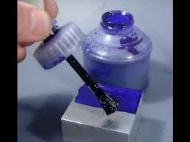
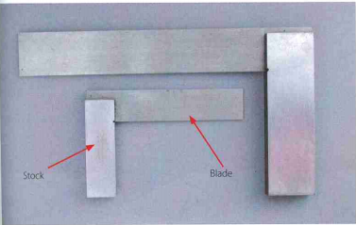
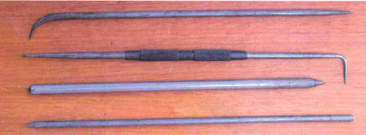
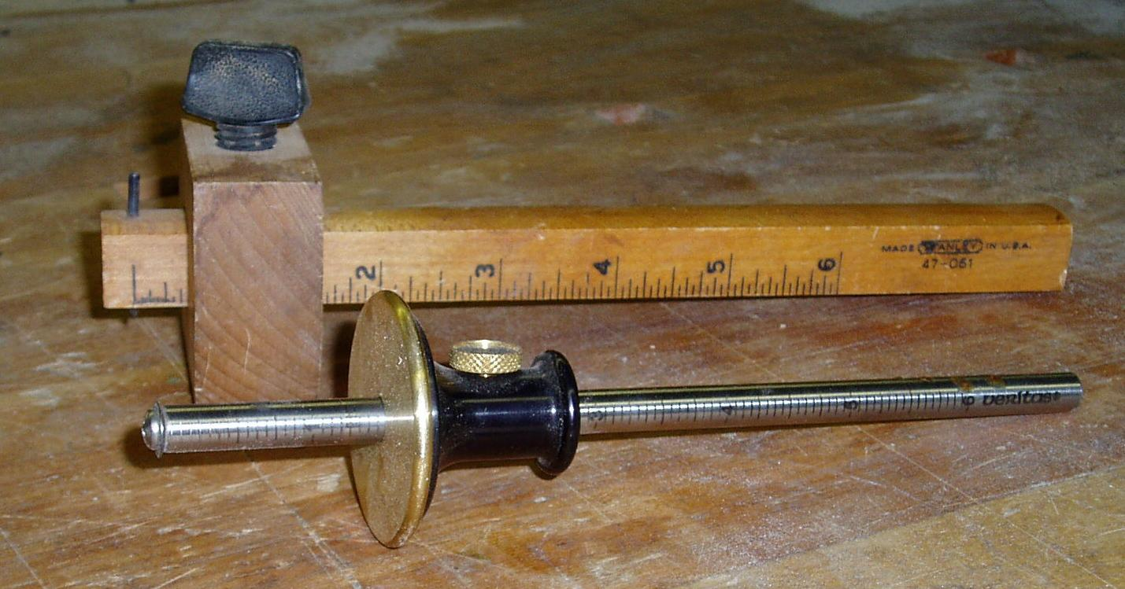
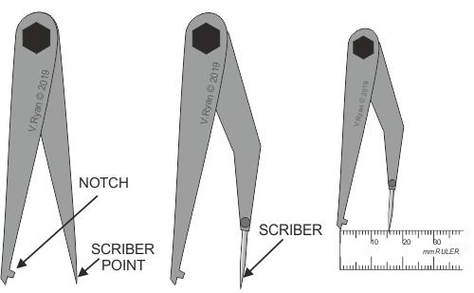
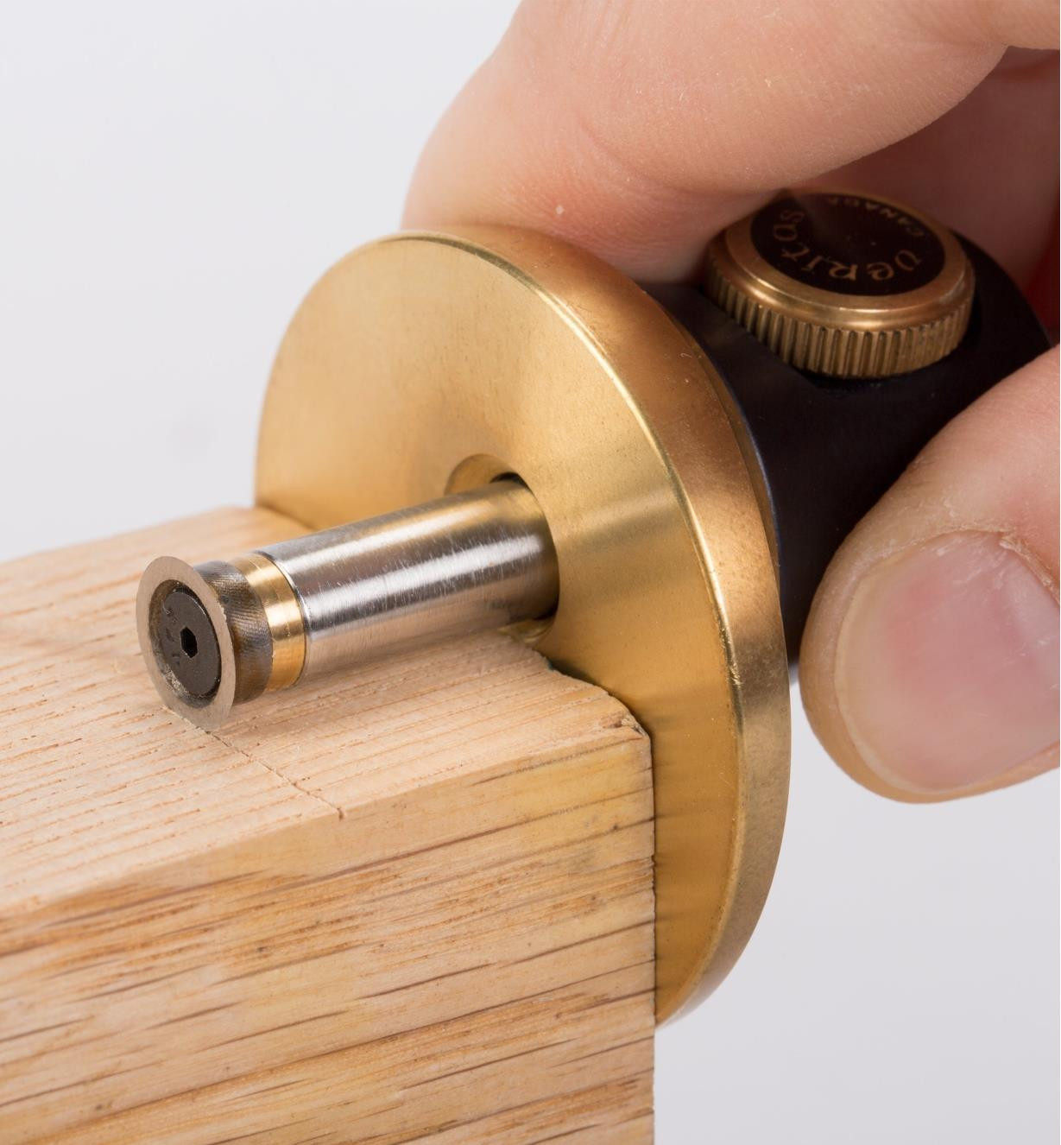
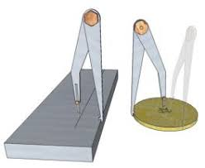
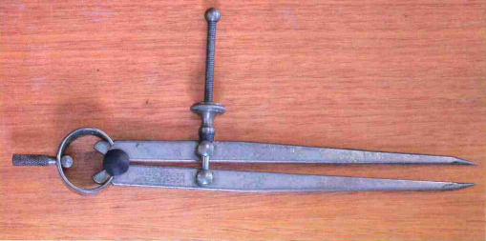
Marking out tools Knowledge organiser
WJEC Engineering
Pg 1 of 1
Engineer’s blue
A liquid that can be painted onto a surface of metal that you can scribe through to create a thin line
Engineer’s (tri) square
A tool for scribing 90° lines on a section of material. The stock is placed on the side of the material and the blade rests on top.
Key words: Scribing = to mark out
Centre punch
For marking out the centre of a hole to make it ready for drilling. This stops the drill bit from skating around the surface and accidentally drilling in the wrong place. They are used with a hammer.
Steel Scriber
These come in different shapes but are used to mark out metal for machining/ cutting/ drilling etc. The end is made from high carbon steel
Steel rule
Uses for measuring out on flat surfaces. It in has increments of 1 mm.
Odd leg Calipers / Jenny Calipers
Used for marking a line parallel to the edge of the surface or circle
Marking Gauge
Used for marking a line parallel to the edge of the surface.
Dividers
These work very similarly to compasses but instead of a pencil at one end, there is a scriber at both ends. This enables you to scribe circles onto metal. You must use a centre punch first to help the dividers stay in place at your centre of rotation.

Slide 5
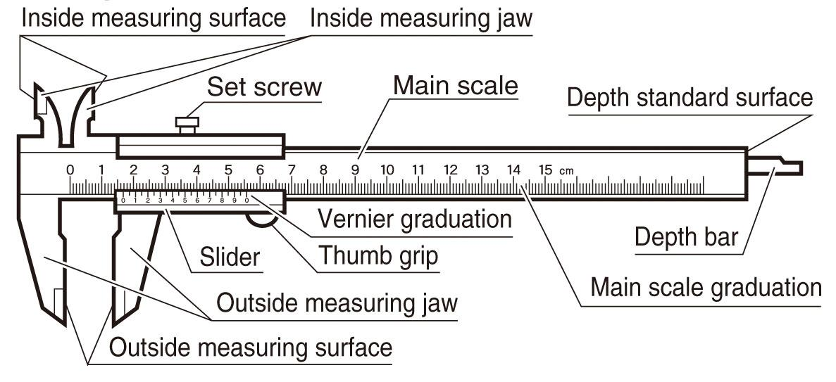
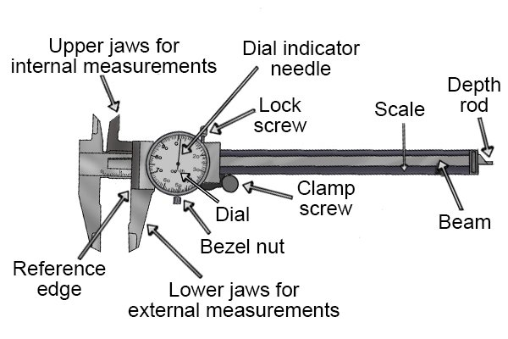
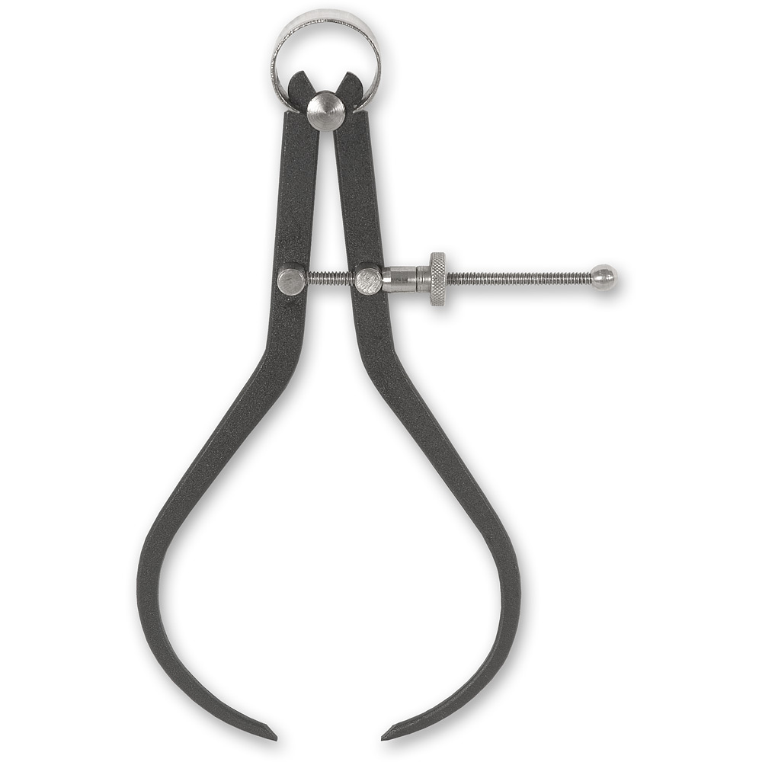
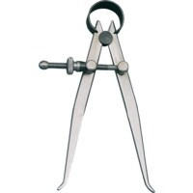
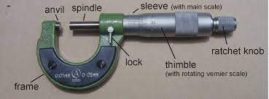
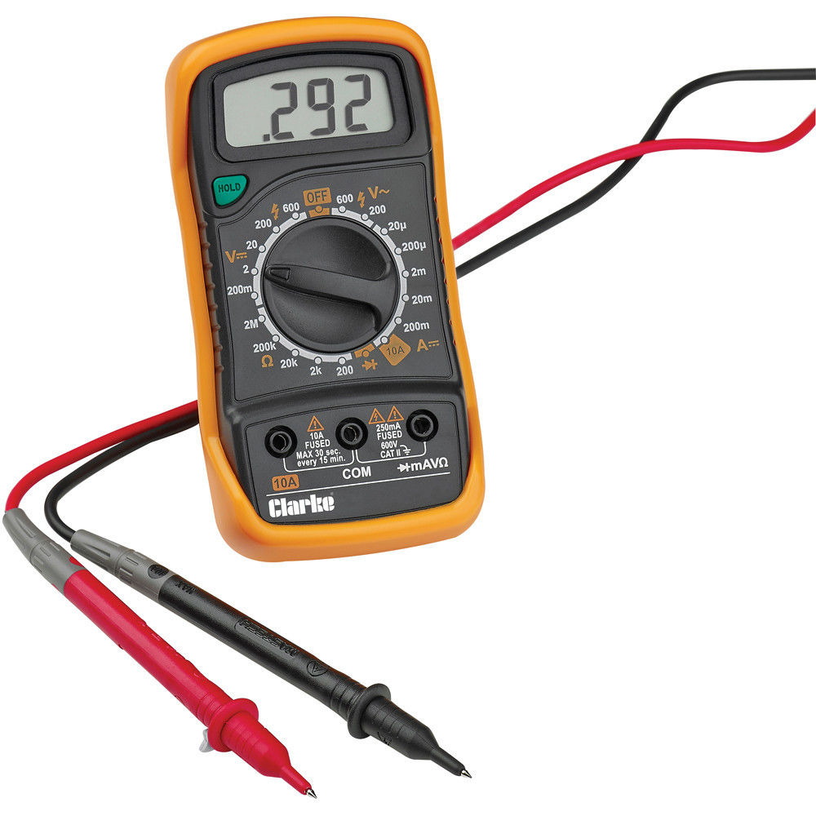
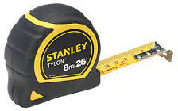
Measuring tools Knowledge organiser
All measuring tools are available in metric (mm) and imperial (inches) but in the UK for Engineering we use metric
WJEC Engineering
Pg 1 of 1
Vernier Callipers
These are used for measuring outer diameters or thickness of objects. The depth bar can also be used to measure the depth of holes. Can also be digital
Dial Callipers
Works the same as a vernier calliper but shows additional readings on a dial for each 0.2mm increment.
External callipers
is used to measure the external diameter of an object, or to measure the thickness of an object
Internal callipers
Used for measuring internal diameters. These look like dividers but have curved bottoms
Multimeter
A multimeter is a measuring instrument that can measure multiple electrical properties. A typical multimeter can measure voltage, resistance, and current
Steel rule
Used for measuring out on flat surfaces. It in has increments of 1 mm or 0.5mm.
Micrometer
Is mainly used to measure external diameters and material thickness. They can measure up to a hundredth of a millimeter
Tape measure
Uses for measuring flat surfaces in metres
Calculating tolerance
25mm +/- 0.5
This means that the 25mm measurement is allowed to be 0.5mm larger and smaller.
25mm + 0.5mm = 25.5mm
25mm- 0.5mm = 24.5mm
Key words:
metric = measurements in millimeters or metres
Tolerance = how much larger or smaller a part is allowed to be
M8 = Metric 8mm. This type of measurements is used for standard sizing, e.g drill bit sizes
M8x0.5 = This is used to show the measurement of a thread: 8mm diameter and 0.5mm thread pitch

Slide 6
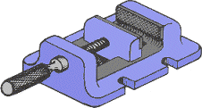
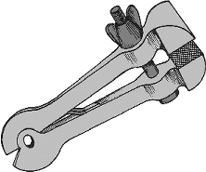
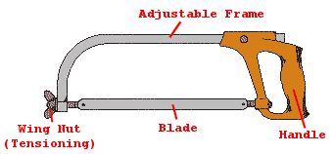
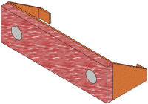
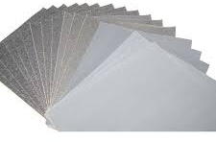
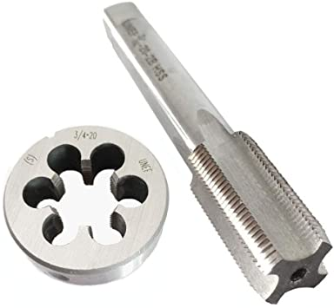
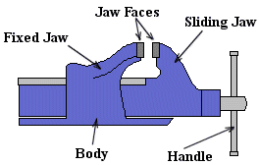
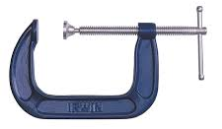
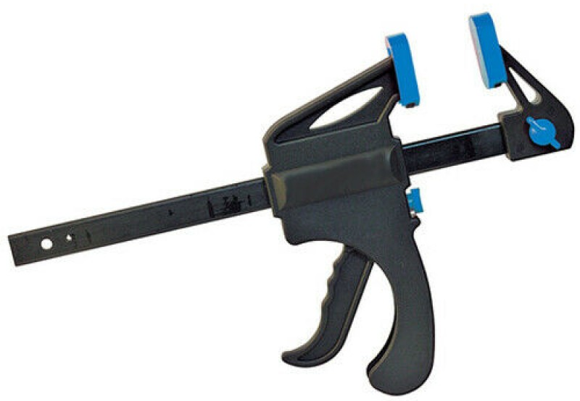
Hand tools Knowledge organiser
WJEC Engineering
Pg 1 of 1
Work holding
Cutting tools
Shaping tools
Hacksaw
The Hacksaw is used for cutting materials, and for cutting away waste parts of the work. Most Hacksaws are made from Low Tungsten Steel or Carbon Steel, however the more expensive blades are made from High Speed Steel. The tension on the blade is formed by the frame.
File
Files are used to square ends, file rounded corners, remove burrs from metal, straighten uneven edges, file holes and slots, smooth rough edges, etc. There are different shaped files: Flat file / round file / square file / etc
Flat vice / machine vice
Screwed to the pillar drill bed and used to hold work whilst drilling on a pillar drill
Hand vice
useful when working on a drilling machine, or working with small parts that need to be clamped together.
Junior Hacksaw
The Junior Hacksaw is used with a shorter blade on smaller or thinner pieces of material.
Wet and dry paper
This is available in different grades, rough to smooth and is used to sand metal and plastic.
This will remove scratches and bring it to a high shine.
Soft jaws
Slotted onto a engineers vice and used to pretect soft metals from imprints from the vice jaws.
Engineer’s vice
Attached to a work bench and used to hold work in place
Tap and die
These are used for cutting threads into materials to use with bolts and machine screws. Taps and used with a tap wrench to add a thread to a pre-drilled hole and dies with die holders are used to add a thread to the exterior of a cylinder/rod
Tap
Die
G-Clamp
Used for general clamping in the workshop. Can achieve high pressure levels
Metal Shears
Shears work by holding the metal in place and applying a downwards force with a blade. This is used to cut large sheets of thin metal.
There are different types available for different sized materials and uses
Tap wrench
Die wrench/holder
Quick release G clamp
Used for the same purpose as a G-clamp, but has buttons to allow it to quickly open and close
Shears
Tin snips
Shaped like scissors, tin snips are used for cutting through thin sheets of metal.
Hand shear

Slide 7
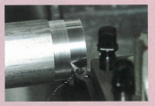
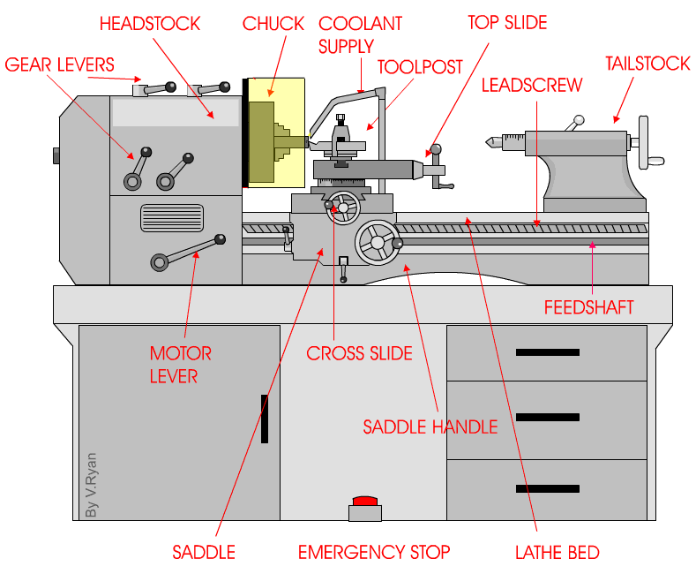
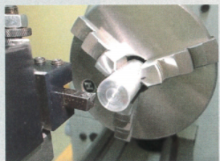
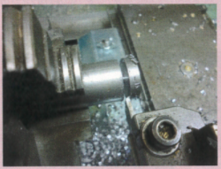
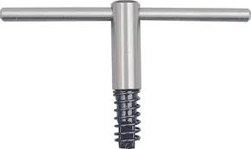
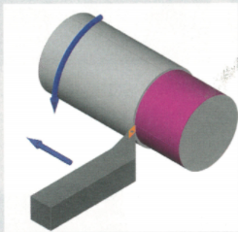
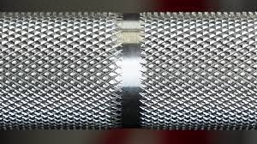
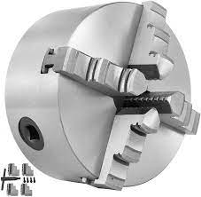
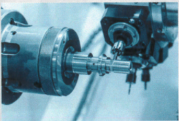
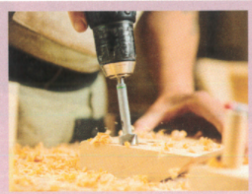
Centre lathe Knowledge organiser
Common phrases:
Turning:
Reducing the diameter of a cylindrical object.
Facing off:
Ensuring that the end of a cylindrical object is flat (perpendicular to its sides)
Parting off:
Cutting the workpiece to a specific length with a specific cutting tool (parting tool)
Taper turning:
Creating a taper down the length of the workpiece(think cone-shaped)
Knurling:
Creating a textured surface on your workpiece
Grooving/ face grooving:
Creating a groove on the external diameter or face
Boring:
Enlarging an existing hole in a workpiece using cutting tools or a ‘boring bar’
What is a centre lathe used for?
A centre lathe is used to manufacture mainly cylindrical products/ objects. Lathe can be operated both manually (in the workshop) or using CNC in industry.
Fitting tools
The workpiece (material) on a lathe is held in place using a chuck. This uses 3 or 4 jaws to self-centre the workpiece as they come together.
A chuck key is used to tighten the jaws of the chuck.
Spring loaded chuck key
This has a spring so that it cannot be left in the chuck and cause injury to the user.
Safety precautions
A risk assessment must be completed before using this machine.
Safety goggles and apron must be worn.
Long hair must be tied back
Limited persons around the machine e.g. user plus instructor only.
Workpiece must be securely closed in the chuck.
Machine guard must be set to the correct position.
Tools must be sharpened and set up correctly.
Correct machine speed must be selected.
4-jaw centre lathe chuck
Useful websites:
Technology student: centre lathe
BBC bitesize
DT online: centre lathe

Slide 8
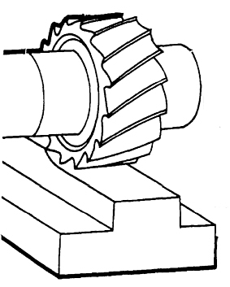
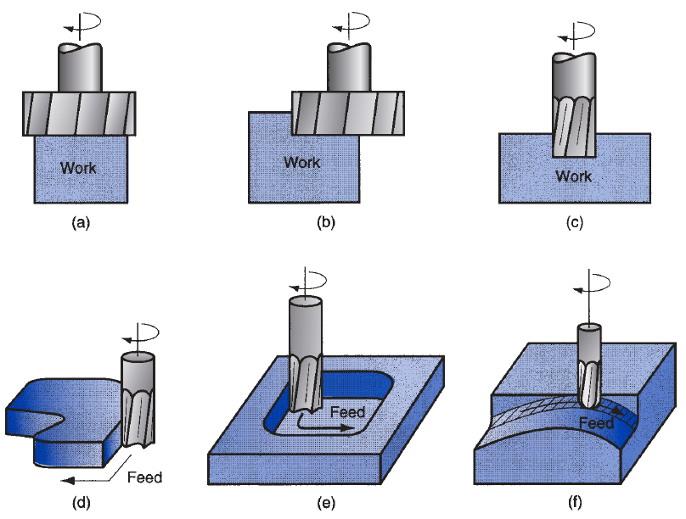
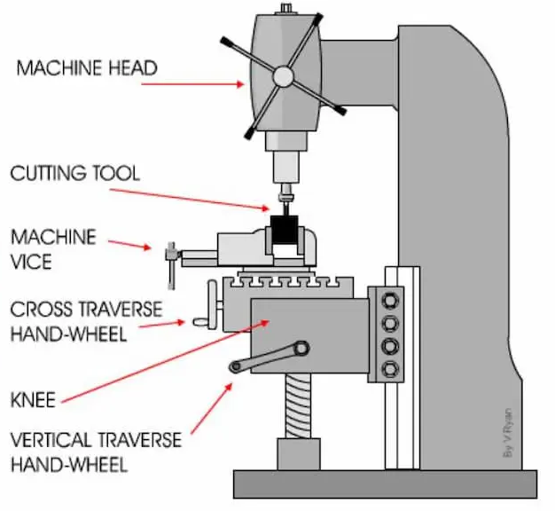
Vertical milling machine Knowledge organiser
WJEC Engineering
What is a vertical milling machine used for?
This machine uses a rotating cutting tool to produce machined surfaces by progressively removing material from a work piece.
The machine vice is controlled using handles to allow it to accurately move along 3 axis. More advance machine can be partly or fully automated.
Common operations:
Plain milling/ surface milling:
(this the the most common operation) this is performed to the flat, horizontal surface, parallel to the cutter.
Face milling
Removing material from the top face of the workpiece
Side milling
Removing material from the side of the workpiece
Shoulder milling
Removing material from the side of a workpiece
Boring/ hole expansion drilling
Enlarging an existing drilled hole
Tapping
adding a screw thread to a pre-drilled hole
Different sizes and shapes cutting tools are used to remove material as needed.
By controlling the X,Y & Z axis, the machine can be used to accurately cut out areas such as slots.
Safety precautions
A risk assessment must be completed before using this machine.
Safety goggles and apron must be worn.
Long hair must be tied back
Limited persons around the machine e.g. user plus instructor only.
Workpiece must be securely closed in the chuck.
Machine guard must be set to the correct position.
Tools must be sharpened and set up correctly.
Correct machine speed must be selected.
Useful websites:
Technology student: vertical miller
BBC bitesize
DT online: vertical milling machine

Slide 9
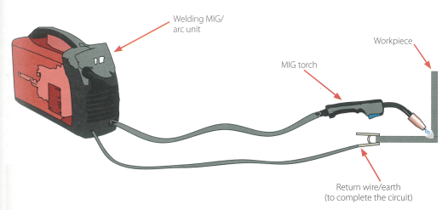
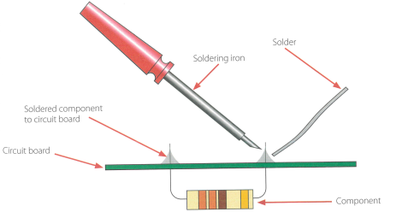
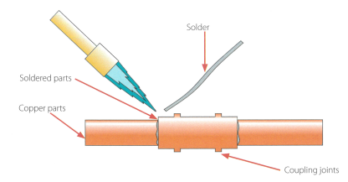
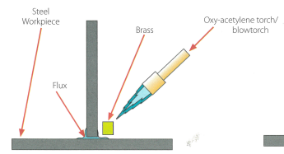
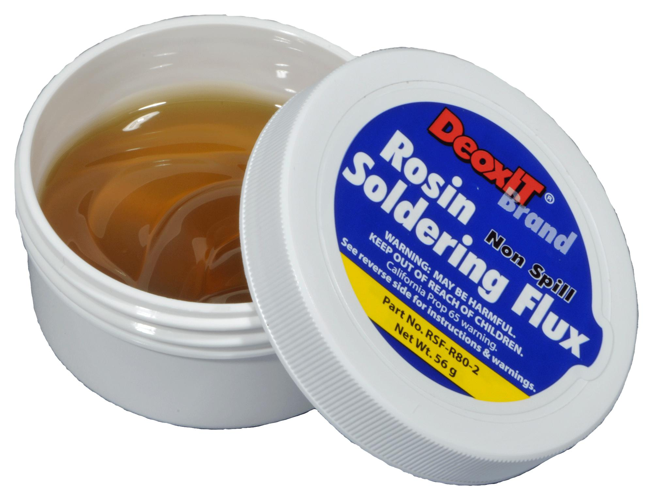
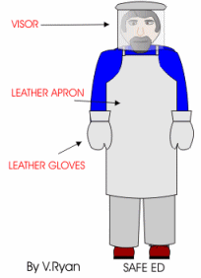
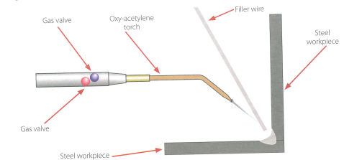
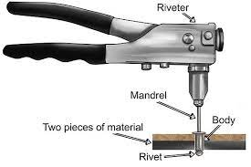
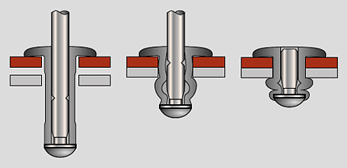
Metal Joining processes (permanent) Knowledge organiser
WJEC Engineering
MIG Welding
Metal Inert Gas welding for joining smaller, thinner pieces of steel.
Soldering
Uses a tin alloy to solder wither electronic components to a PCB (printed circuit board) or soldering copper pipe together
Brazing
Joining steel to steel or other metals. Uses a brass filler metal called a brazing rod
Arc Welding
Used to join steel in medium to large projects, with thicker material. The consumable electrode is pushed against the joint and creates a current to join the metals.
Key words:
Capillary action= Where solder flows into gaps when heated
Filler metal: the metal used to fill the joint between two materials, e.g. solder
Flux= Applied to a joint prior to welding or soldering. It chemically cleans the joint as it melts and helps the filler material to flow into the joint.
Oxy-Acetylene Welding
A high temperature welding process used to join steel by melting the two pieces together and pushing in a filler wire to the joint.
Pop riveting
Thinner metals can be joined using this process where a rivet is pushed through a hole in both materials then squeezed to expand and hold the joint

Slide 10
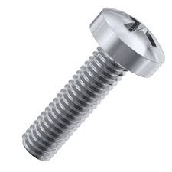
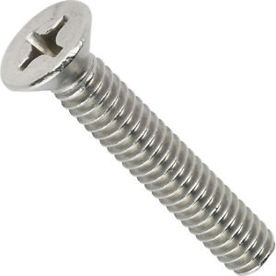
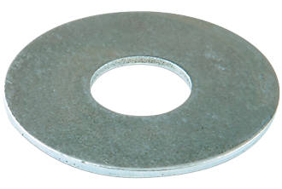
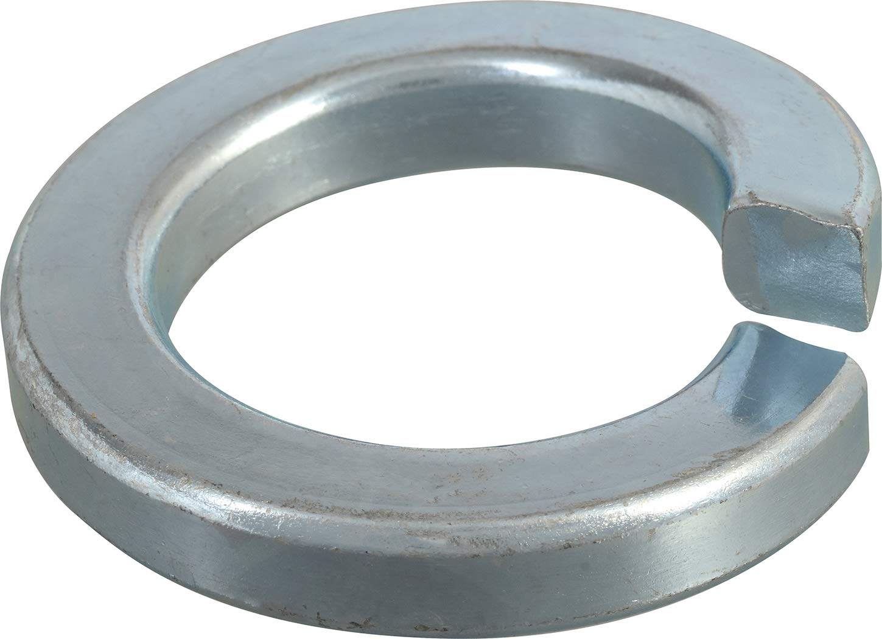
Metal Joining processes (temporary) Knowledge organiser
WJEC Engineering
Pg 2 of 2
Nuts, bolts and screws
The sizes for these are metric e.g. M8 which means 8mm
Machine screws are used in pre-threaded metal holes and have a flat bottom, unlike wood screws.
Bolts are used on drilled holes. They pass all the way through and are secured with nuts. Hex bolts are the most common
Washers are used to distributor the load/ pressure applied on a material from a nut and bolt.
Nuts are used to secure a bolt or machine screw in place. Nylon lock nuts have piece of nylon in to prevent them from vibrating loose
Temporary vs permanent joining methods
Temporary joints:
Can be dismantled without breaking the assembled parts.
Is useful when frequent assembly and disassembly is required.
Often easier and more cost-effective to carry out inspection, maintenance and repair as parts can be disassembled without breaking.
Lower strength joint
Often not a leak proof joint
Permanent joints:
Cannot be dismantled without breaking the assembled parts.
Is useful when the joint is intended to stay fixed for longer.
Maintenance and repair as more difficult as parts cannot be disassembled without breaking.
Stronger joint
Mostly create a leak proof joint
TYPES OF SCREWS
Round head
Countersunk head
TYPES OF BOLTS
TYPES OF WASHERS
Split washers are designed to stop nuts from vibrating loose
Flat washer
Split washer
Clips
There are lots of different clip fastenings. These are used to temporarily hold parts together for easy disassembly without tools,. Eg. road works signs.
Riveting
Riveting (e.g. pop-riveting) is often a permanent method, but as they are made of a dofter metal and can be drill out, they are referred to as temporary too.
Key words:
Fabrication= joining materials together
Assembly: Putting things together
Disassembly: Taking things apart
Dismantle: take apart into separate pieces.

Slide 11
Metal casting processes Knowledge organiser
The process of pouring molten metals into a mould is called casting.
Advantages of casting are:
Large hollow shapes can be produced
Intricate shapes can be produced
Little to no waste is produced
A high quality surface finish can be produced (sand casting)
Keywords:
Molten: the melted state of metal
Die: A mould made from high carbon steel used in die casting
Cavity: empty space
Sprue: Where melted material enters the cavity. This needs to be removed from the finished part.
Sand casting
Stock form used: ingots
Material used: most commonly
Die casting
Stock form used: ingots
Material used: most commonly aluminium
A pre-made die is fitted on the machine
Metal is melted then poured into the hopper
A plunger pushes the molten metal into the cavity
Mould is allowed to cool
Ejector pins push the die open and the finished part is removed
Sprue is cut off.
A wooden pattern is placed inside the drag.
Fill with petrabond sand
Turn over and remove pattern
Place runner and riser pins in the cope and fill with petrabond sand. Add core for hollow parts
Place the cope on top of the drag
Remove runner and riser pins
Melt metal and pour into cavity
Die casting is a mass production process which creates highly detailed products.
The die is made from high carbon steel and produced a self-finished product and can be used repeatedly without losing accuracy, but is very expensive to make. This means that dies casting is cost effective when used to make large batches of a product
pattern
Sand casting is a repeatable process used in batch production, but will leave a textured surface which has to be finished. More suitable for simple, solid parts
Core was placed
Products made by vacuum forming include:
Cast version

Slide 12
Plastic moulding processes Knowledge organiser
WJEC Engineering textbook
Plastics are shaped and moulded in many different ways to create complex shapes. To shape and mould plastics they must be heated until soft then they will harden when they cool.
Plastics are self-finishing which means they do not need to be sanded and polished unless they have been cut. The interior surface of the mould used in the process will determine whether the plastic has a textured or smooth finish as well as a gloss or matte finish texture.
Keywords:
Sprue: the mark on a finished product which shows where the plastic entered the mould
Injection moulding
Stock form used: thermoplastic or thermoset granules or powder
This process involved forcing melted plastic into a mould. This process is accurate, good for high volume production (e.g. mass production) and produces little waste. However it is a very expensive process to set up.
Products that have been injection moulded need minor finishing, such as trimming the sprue or the ‘bleed’( lines where the two mould meet).
Screw thread moves the melted plastic forwards
Hopper where the polymer granules are poured
Heat melts the polymer granules
Finished product when the two halves of the mould separate and the plastic sprue is cut off
Identifiers:
Detailed designs
Seam line where the moulds halves met
Varying wall thickness
Feed points or ejector pin marks
Injection moulded lego in one half of its mould.
Products made by injection moulding include
Lego blocks
Staplers
Product casings
sprue

Slide 13
Plastic moulding processes Knowledge organiser
WJEC Engineering textbook
Vacuum forming
Stock form used: thermoplastic sheets
Rotational moulding
Stock form used: thermoplastic granules or powder
Rotational moulding is inaccurate, low running cost, high set up cost and good for larger objects.
Suitable former is manufactured
The former is placed in the vacuum former
Plastic sheet is placed above the former and clamped securely
Identifiers:
Hollow objects
Seam line where the moulds halves met
Thicker walls
The heater is turned on to heat the plastic sheet
The plastic becomes flexible
The air is pumped out of the area below the plastic and former
The former used for vacuum forming must have angled side (draft angles)to allow it to be easily removed from the finished plastic shape
❌
✅
Products made by vacuum forming include:
Products made by rotational moulding include:
Car dashboards
Packaging
Vacuum forming is an inaccurate, low setup and running cost, low-volume process
Bins and containers
Cones and barriers
Toys
Suitcases

