Slide 1
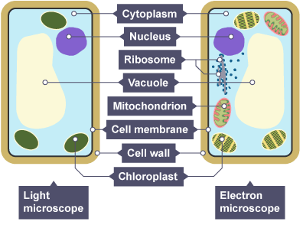
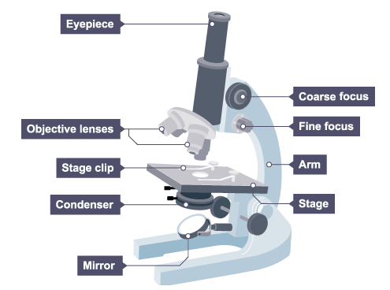
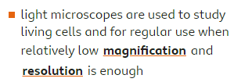

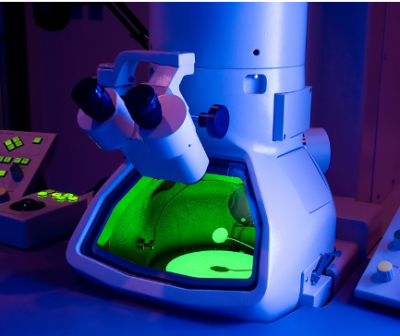


Animal Cell
Plant Cell
Microbiology
Light microscope
Sub-cellular structure | Function
Cell membrane | Controls what goes in and out of the cell.
Cytoplasm | Where chemical reactions take place.
Nucleus | Controls the cell. (DNA is found here)
Mitochondria | Where respiration takes place.
Cell Wall | Provides support to the cell.
Vacuole | Contains cell sap.
Ribosomes | Protein synthesis happens here.
Chloroplasts | Absorb sunlight for photosynthesis.
Electron microscope

Slide 2
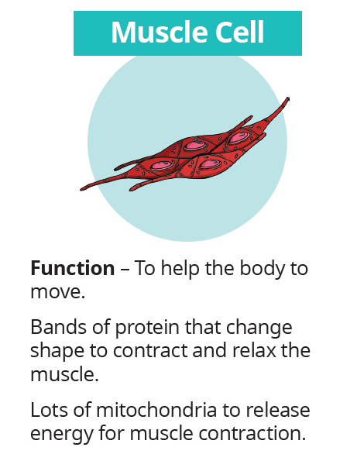
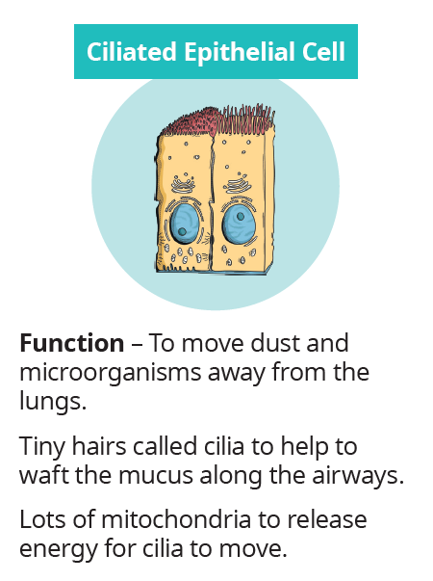
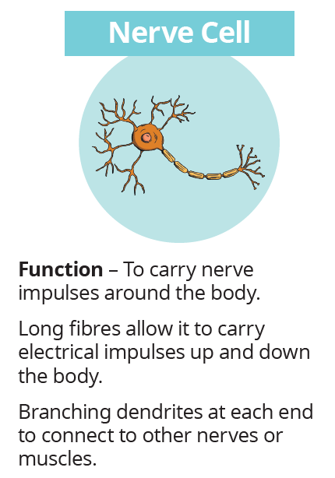
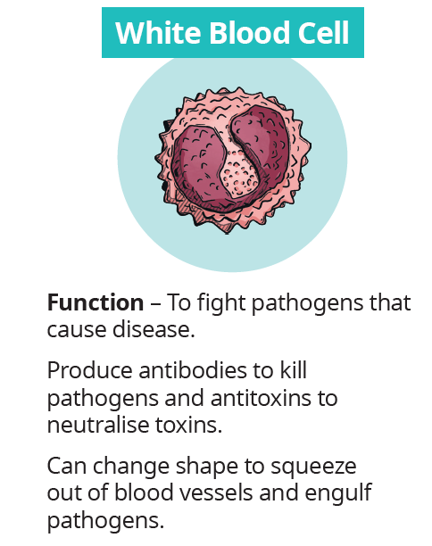
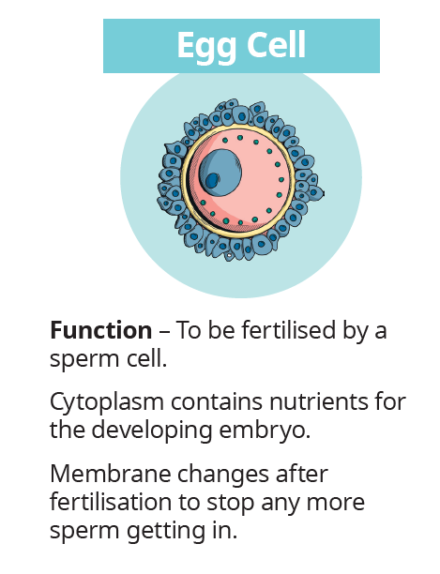
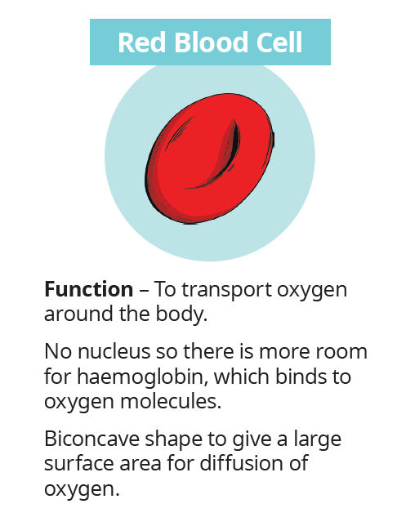
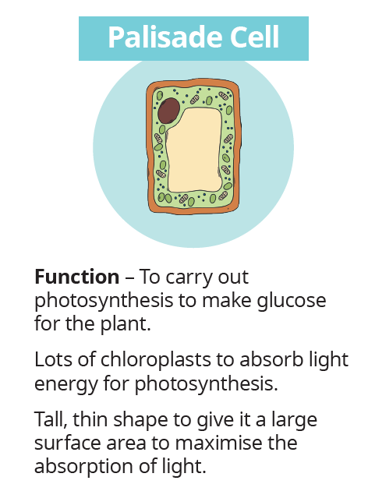
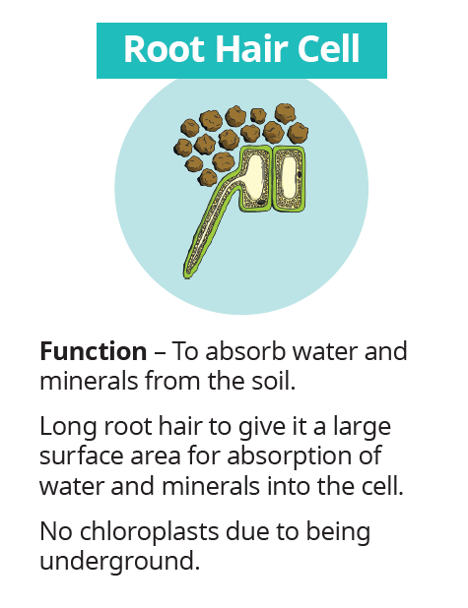
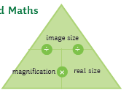
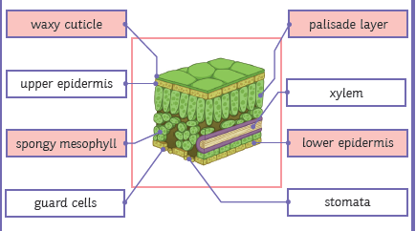
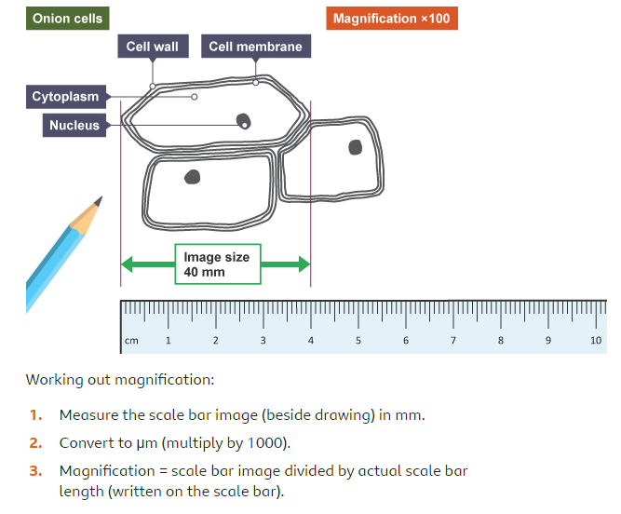

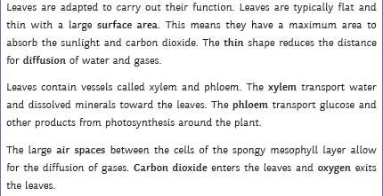
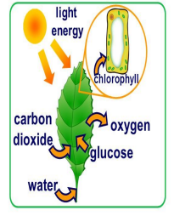

Specialised cells
Microbiology
Calculating magnification
Adaptation of a leaf
Photosynthesis

