Slide 1
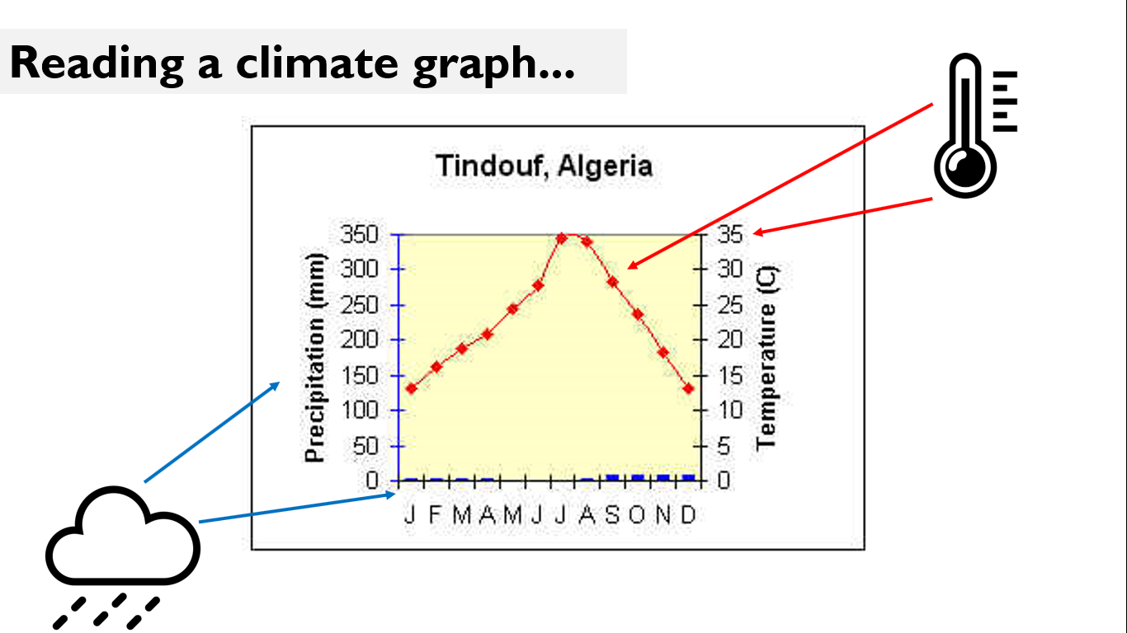
1. Weather, Climate and Biomes
What is the difference between weather and climate?
Weather is the condition of the atmosphere at a particular place over a short period of time. E.g. temperature, rainfall today.
Climate is the condition of the atmosphere in a place over a long period of time… e.g. Spain has a hot climate, England has a wet climate.
Talk like a geographer:
Generally, the graph shows...
Specifically, in August it is
Exceptions to this are...
What are characteristics of different biomes?

Slide 2
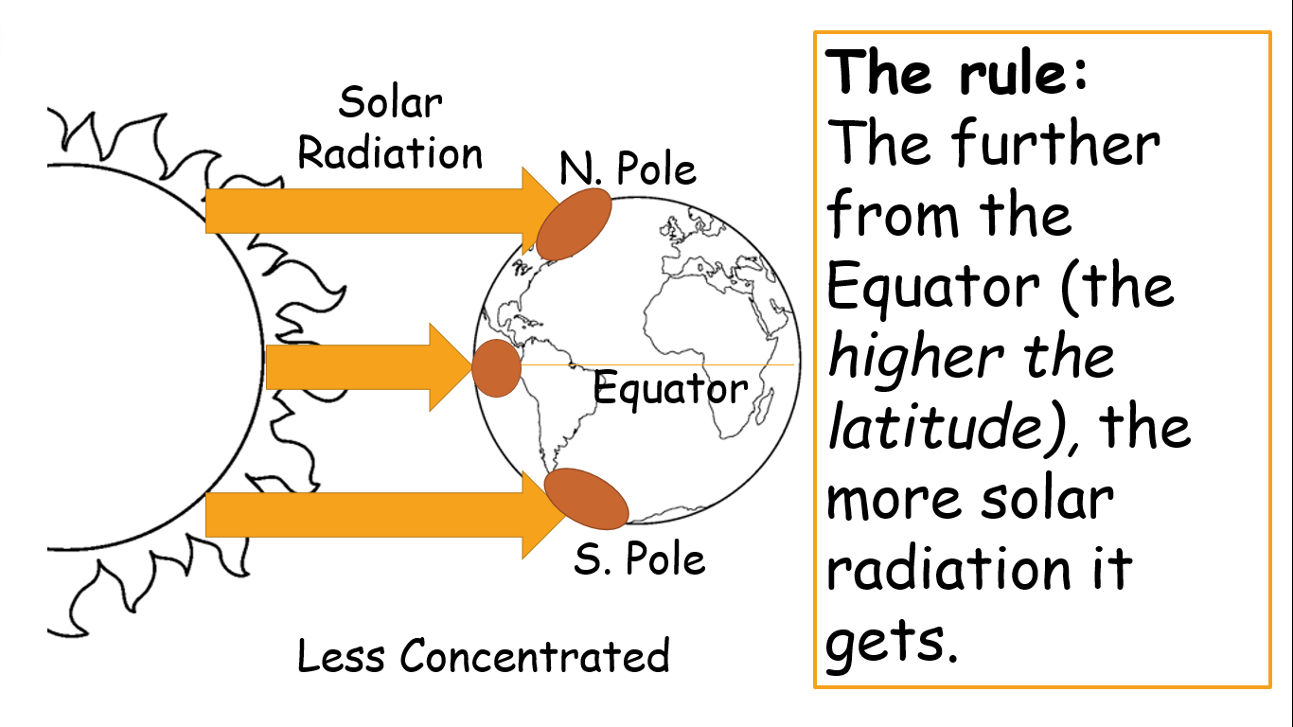
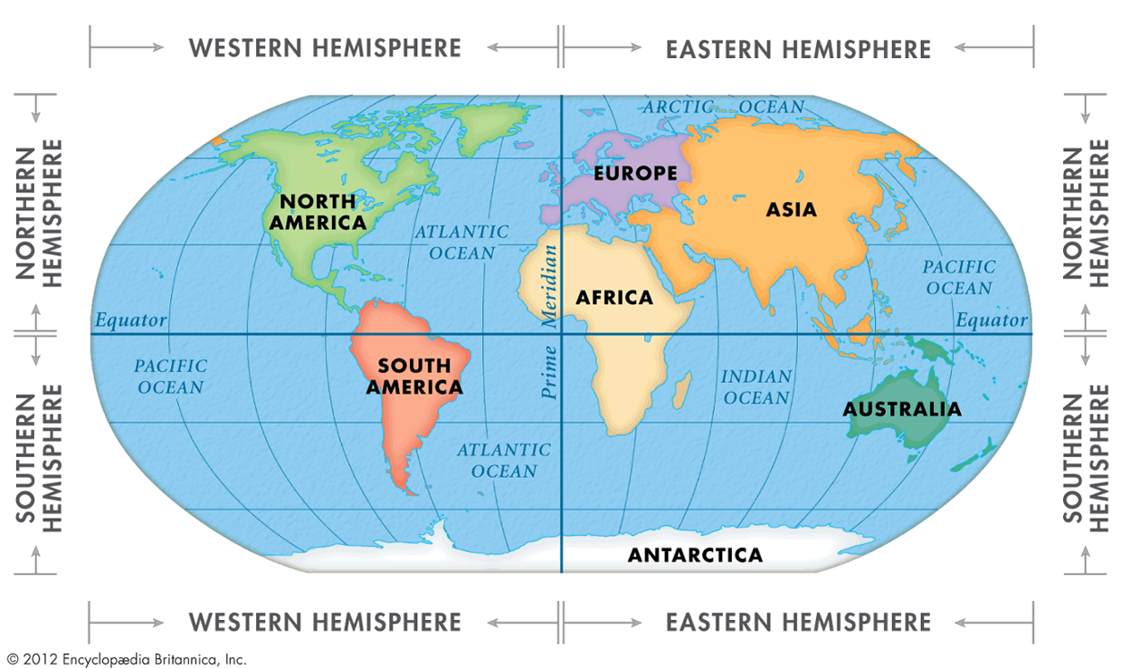
2. Hot and Cold
Solar Radiation = heat energy from the sun.
Why is the Equator hotter than the Poles?
CONNECT SKILLS: What is longitude and latitude?
Grimsby is 54°N, 0°W
Talk like a geographer:
Lines of Longitude: vertical lines – show how far east or west a place is.
Lines of Latitude: horizontal lines – show how far north or south a place is.
Latitude
Longitude

Slide 3
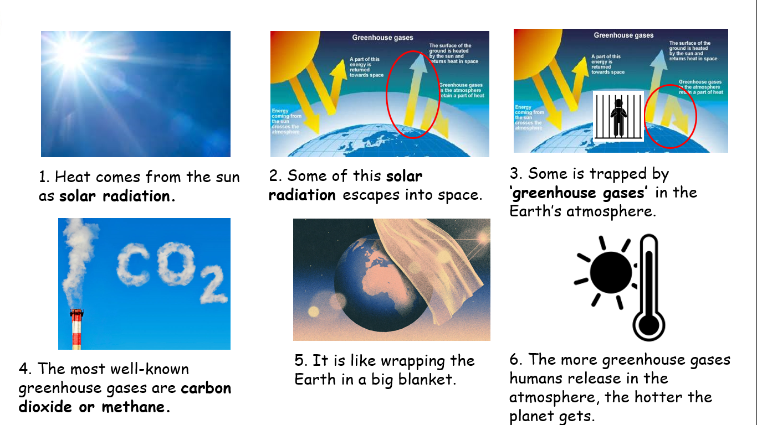
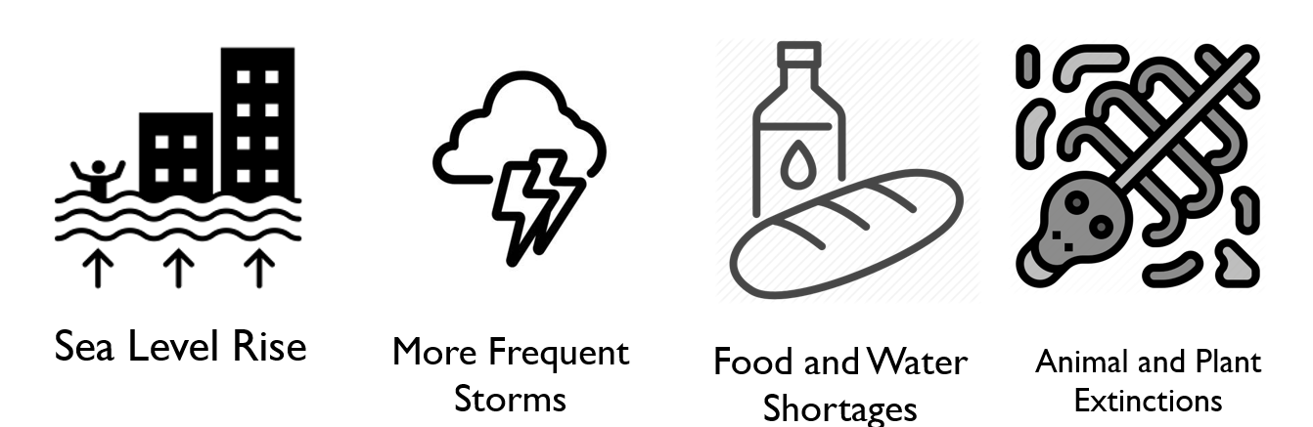
3. Global Warming
What is the greenhouse effect?
Write like a geographer:
Consequently,
As a result,
Therefore
This means that...
How are humans causing global warming?
Farming – cattle and rice production produce methane, a very strong greenhouse gas.
Energy – burning fossil fuels to produce electricity generates carbon dioxide.
Transport – flying and driving petrol / diesel cars produces carbon dioxide and nitrous oxide.
Industry – demand for goods (e.g. TVs, phones) increases use of energy / transport etc.
What are some of the possible impacts of global warming?

Slide 4
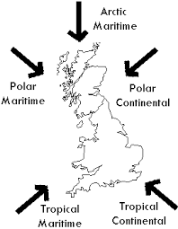
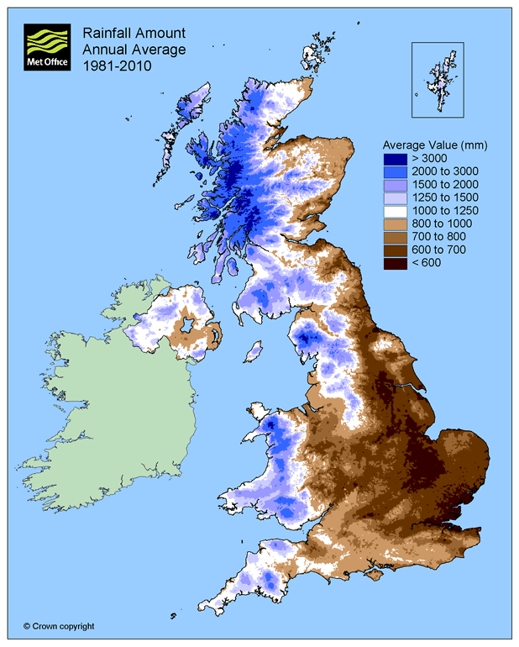
4. Wind and Rain
Keyword | Definition
Water Vapour | Water after it has evaporated and become a gas – ‘steam’.
Precipitation | Rain, sleet or snow.
Condensation | A gas turning into a liquid.
Evaporation | A liquid turning into a gas.
What is convectional rainfall?
1. When water on the surface heats up it evaporates.
2. As it evaporates, it rises as a gas.
3. It eventually cools, and precipitates – forming clouds.
4. Eventually the water vapour in these clouds condense and it turns back into water droplets.
5. These droplets fall back to the ground in the form of rain.
How do air masses affect the UK?
The Golden Rule: Air moves from an area of high pressure to an area of low pressure. It wants to spread out.
Artic / Polar = Cold
Tropical = Warm
Continental = Dry
Maritime = Wet

