Slide 1
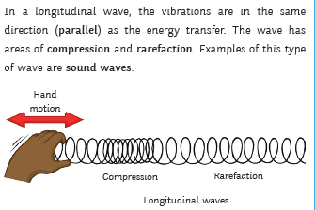
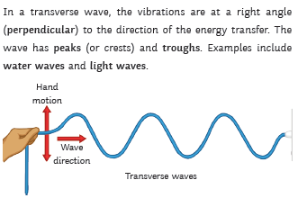
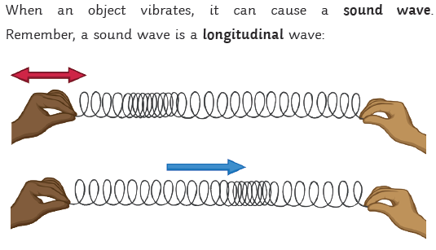
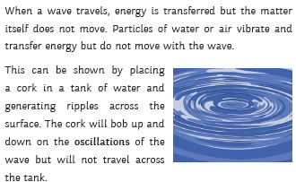
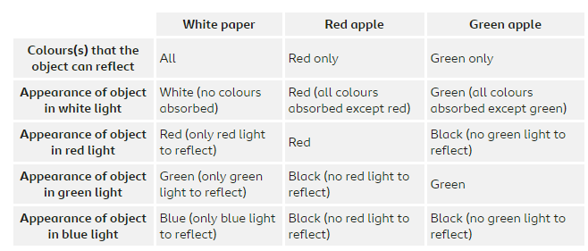
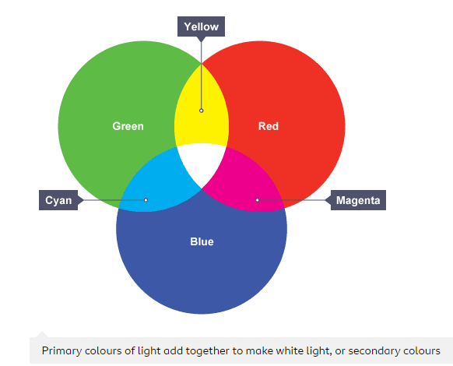
Keywords
Longitudinal
Transverse
Wave | A disturbance that transmits energy but not matter
Medium | The material a wave passes through
Vacuum | A space with no particles in it
Frequency | The number of waves per second
Oscillation | A motion that repeats itself
Period | The time taken to complete one wave
Ultrasound | A sound with a frequency higher than a human can hear (more than 20 kHz)
Waves
Waves
Filters

Slide 2
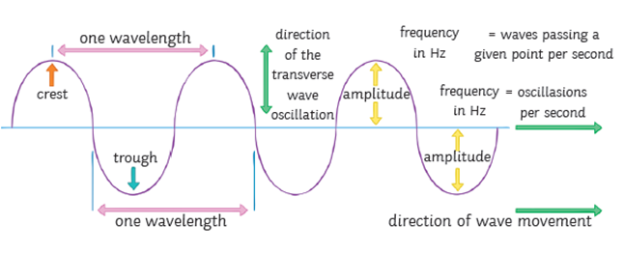
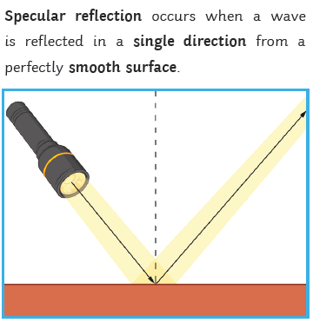
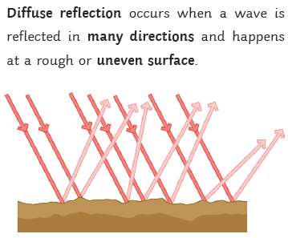
Wave equation
Sound waves are longitudinal.
They travel through the air by making the particles vibrate.
The speed of sound in air is approximately 330 - 340 m/s.
Sound waves
Visible light is a transverse wave. It does not need a medium. It travels at 300 000 000 m/s through a vacuum. It is part of the EM spectrum.
White light can be split into colours traditionally labelled as red, orange, yellow, green, blue, indigo, and violet.
Waves
Visible Light
The EM Spectrum
Reflection

Slide 3
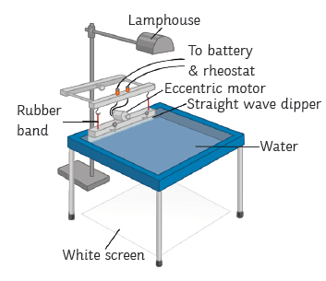
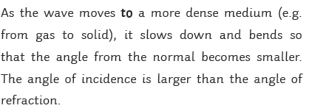
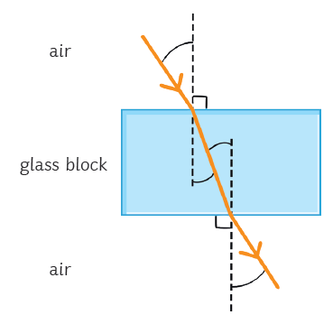
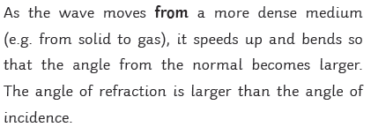
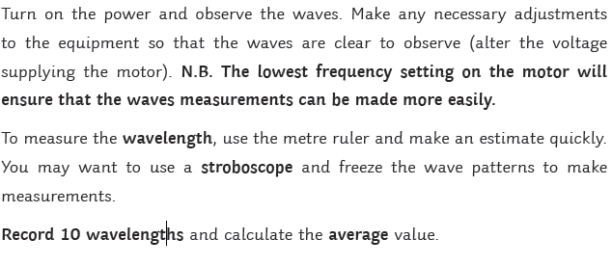
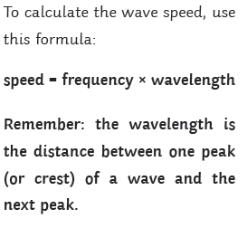
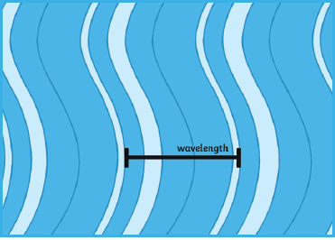
The Ripple Tank
Refraction
Waves

