Slide 1
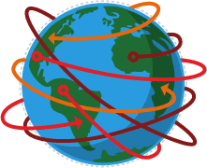
Year 7 – Global fashion industry
Global trade
Globalisation
The world is now a very small, interconnected
place, as a result of globalisation. This term is used in human geography and refers to physical and human processes that extend across the world.
Global trade is the result of uneven distribution of materials and resources across the world. No single country has everything it needs and so countries need to trade with each other. Countries that rely on each other to trade goods and services are interdependent
Sometimes, countries group together to help increase the volume of trade.
Globalisation is not a new term. People have travelled, traded and shared ideas for
thousands of years and there are many global linkages,
ie people in one country are connected in many ways with people in other countries.
In recent years the impact of globalisation has become very clear. It can be seen in the following ways:
communication between people in different parts of the world can be instant
improved transport and communication links have
increased trade, the sharing of ideas and the spread of cultures
The European Union is one example of a trading group (or trading bloc).
The global pattern of trade is uneven because:
Most of the valuable trade happens between more economically developed countries (HICs)
HICs generally import low-value goods from less economically developed countries (LICs)
There is little trade between LICs, partly because they may trade similar products
Newly industrialised countries (NICs) are playing a larger role in world trade
A lot of trade happens through multilateral companies (MNCs) with a head office in one country, operating in many countries.
Transnational corporations
Factors that encourage globalisation include transport
and ICT developments.
Transport developments:
Container ships make transporting bulky goods quick and easy.
Air transport means people and goods move quickly from one place to another. In recent years the cost of air travel has reduced.
ICT developments:
The internet allows people and businesses to communicate instantly.
Satellite communications allow a global view and communications links even in very remote areas. They enable TV and telephone communications.
Mobile phones enable people to communicate and to access the internet wherever they are.
Social networking brings people from all around the
world in contact with one another.
TNCs or multinational corporations (MNCs) are companies that operate in more than one country. They often have factories in countries that are not as economically developed because labour is cheaper. Offices and headquarters tend to be located in the more developed world. Unilever, McDonalds and Apple are all examples of TNCs/MNCs.
Variations in the level of development
LICs | Poorest countries in the world. GNI per capita is low and most citizens have a low standard of living.
NICs | These countries are getting richer as their economy is progressing from the primary industry to the secondary industry. Greater exports leads to better wages.
HICs | These countries are wealthy with a high GNI per capita and standards of living. These countries can spend money on services.

Slide 2
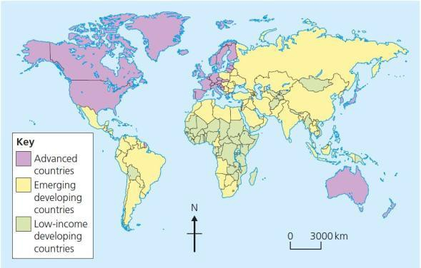
Multinational Companies/Transnational Corporations (MNC/TNC) can have both positive and negative effects on different people in different parts of the world; Advantages of TNCs locating in a country include: creation of jobs stable income and more reliable than farming improved education and skills investment in infrastructure, eg new roads - helps locals as well as the TNC help to exploit natural resources a better developed economic base for the country Disadvantages of TNCs locating in a country include: fewer workers employed, considering the scale of investment poorer working conditions damage to the environment by ignoring local laws profits going to companies overseas rather than locals little reinvestment in the local area factories are often footloose and jobs insecure. If labour costs increase, the company may move elsewhere natural resources being over-exploited |  | Key Geographical Terms
 |  | Economic | To do with money
 |  | Social | To do with people and services, like water and health care.
 |  | Environmental | To do with the surroundings, wildlife etc.
Impact of global trade Some developing countries have benefited more than others from global trade. Developing countries welcome global trade because it brings jobs and investment. The World Bank suggests that trade reforms have reduced poverty in some countries, eg China, India, Uganda and Vietnam. In other parts of the world, there have been fewer benefits of global trade. For example, many countries in Africa have failed to benefit from globalisation because of unfair terms of trade, the actions of MNC/TNCs, poor government or unfavourable physical geography, eg landlocked countries. | Ethics of global trade Current trading arrangements can mean some producers are disadvantaged when trading globally. They may not be able to receive a fair price for their products, or may be working in conditions that compromise their basic living needs. To try to develop a fairer trading system, many organisations have adopted the principles of fair trade. They aim to ensure: a fair price is paid for their product there are opportunities to improve living standards a stronger position for the product in the global market opportunities to invest in their local community The global supply chain is complex, and it may be difficult to ensure that every layer in the production meets ethical and environmental standards.

