Slide 1
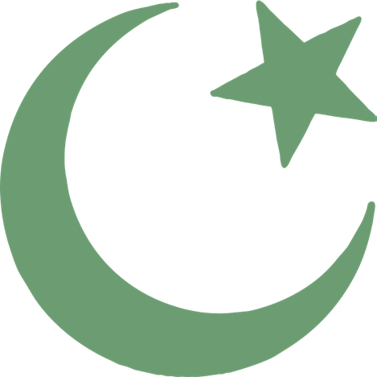
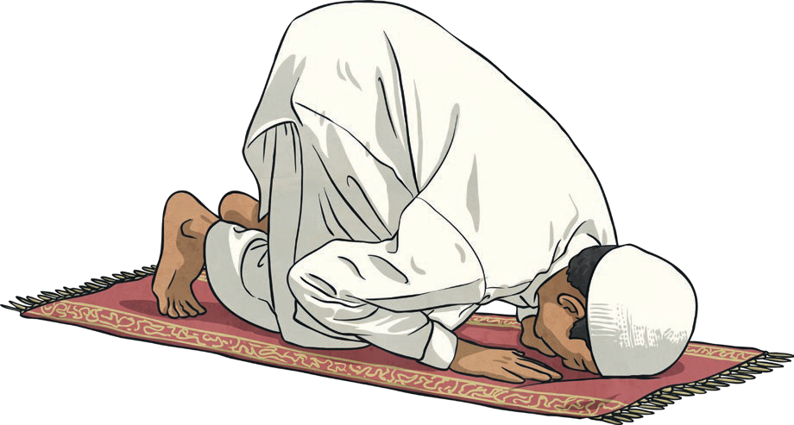
Islam Knowledge Organiser
Year 9
Key Vocabulary
Islam | Islam is the second most popular religion in the world.
Muslim | A follower of the religion of Islam.
Allah | The Arabic name that Muslims use for God.
Five Pillars of Islam | The five things that Muslims are expected to do.
Prophets | Special messengers sent from Allah.
Muhammad | The last prophet and the key prophet in Islam.
Key Beliefs
Muslims believe that there is only one God called Allah. They believe Allah is the only ruler of the universe. The word ‘Islam’ means submission and obedience to Allah.
Muhammad is so highly respected by Muslims that they will say “peace be upon him” after his name is spoken.
The Six Main Beliefs | The Five Pillars of Islam
Belief in Allah as the one and only God. Belief in angels. Belief in the holy books. Belief in the prophets and that Muhammad was the final prophet. Belief in the Day of Judgement (the day when Allah decides if a person goes to heaven or hell). Belief in predestination (the belief that Allah has already planned out what will happen). | As well as the six main beliefs, there are Five Pillars of Islam. Shahadah: Muslims say a declaration of faith. Salah: Muslims pray five times a day. Before prayer, they must wash themselves and then face Mecca whilst praying. Zakat: Muslims must donate to charities. Sawm: Muslims fast for one month during a time called Ramadan. Hajj: Muslims have to travel to Mecca once in their lifetime, if they can afford to.

Slide 2
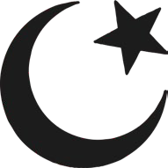
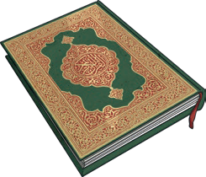
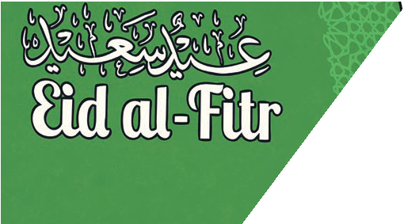
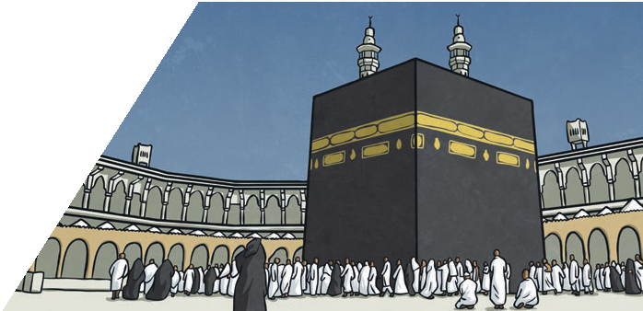
Islam Knowledge Organiser
Islam
Year 3
Key Vocabulary
Mecca | Mecca is an important place to Muslims. It is where Muhammad was born. Muslims face Mecca to pray and try to visit it sometime during their lives.
Hajj | The name Muslims give to the special pilgrimage to Mecca.
The Qur’an | The holy book of Islam.
Ramadan | A Muslim festival where Muslims fast during the daylight and only eat after the sun has set.
fast | A period of time when Muslims do not eat.
mosque | Muslim place of worship.
pilgrimage | A journey to a special place of religious meaning.
Place of Worship
The Muslim place of worship is called a mosque. Services are held in mosques every day. The most important service for Muslims is on a Friday. Mosques often have a domed roof. There are no images of people or animals in mosques. They are decorated with patterns and words from the Qur’an. Muslims take off their shoes before going into the mosque and wash before they pray. Muslims pray kneeling on the floor on a prayer mat. The wall of the mosque which faces Mecca is called the qibla wall. It has an empty arch to show the direction of Mecca.
Symbol of Islam
There is no official symbol of Islam, but the star and crescent symbol is the symbol most commonly associated with Islam.
The Qur’an
The Muslim holy book is called the
Qur’an. Muslims believe that it is a record of the exact words that Allah said.
The main Muslim festivals are: Ramadan, Eid-al-Fitr, Eid-al-Adha, Dhu al-Hijja. During Ramadan, Muslims try to give up bad habits
and become better Muslims by praying more.
Muslim Festivals
Mecca
Mecca is an important place to Muslims. It is where
Muhammad was born and the direction that Muslims face when they pray five times a day. Muslims are expected to make a pilgrimage to Mecca once in their lifetime.

