Slide 1
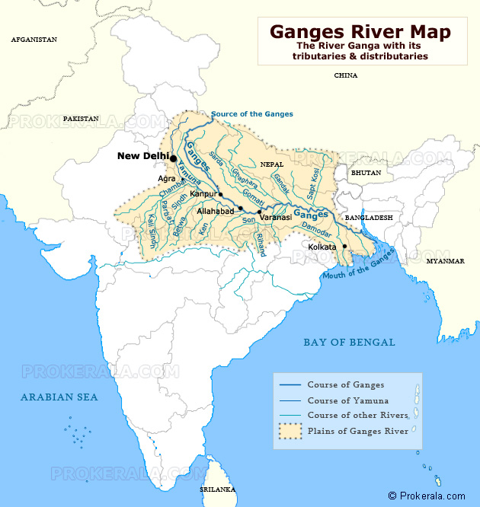




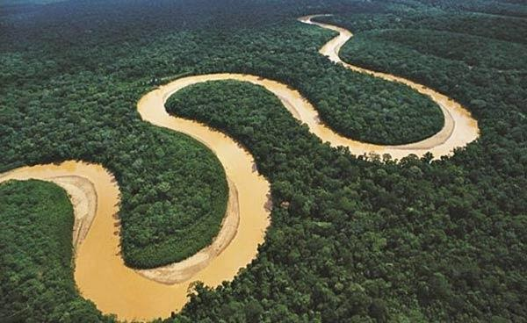
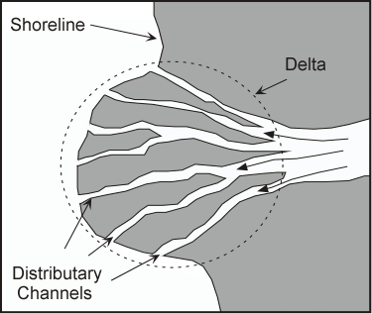

1. Locating the Ganges
The River Ganges travels 2510km across Asia.
The drainage basin covers a huge part of India, Nepal and Bangladesh.
It splits into a number of other rivers known as distributaries – the Padma and Hooghly rivers are the most famous.
It meets the Indian Ocean just past Kolkata. This area is known as the Bay of Bengal.
CLOCK: Describing Locations
Continent
Longitude / Latitude
Ocean / seas
Countries
Knowledge
Drainage Basin: the area in which water is collected and drained into a single river –like a massive sink!
THE JOURNEY OF A RIVER
SOURCE
UPPER COURSE
MIDDLE COURSE
LOWER COURSE
WIDER, DEEPER, FASTER, MORE ENERGY, BIGGER LOAD
SPEAK LIKE A GEOGRAPHER:
Speed = velocity, volume of water in a river = discharge, material carried by a river = load, power = energy (kinetic).

Slide 2
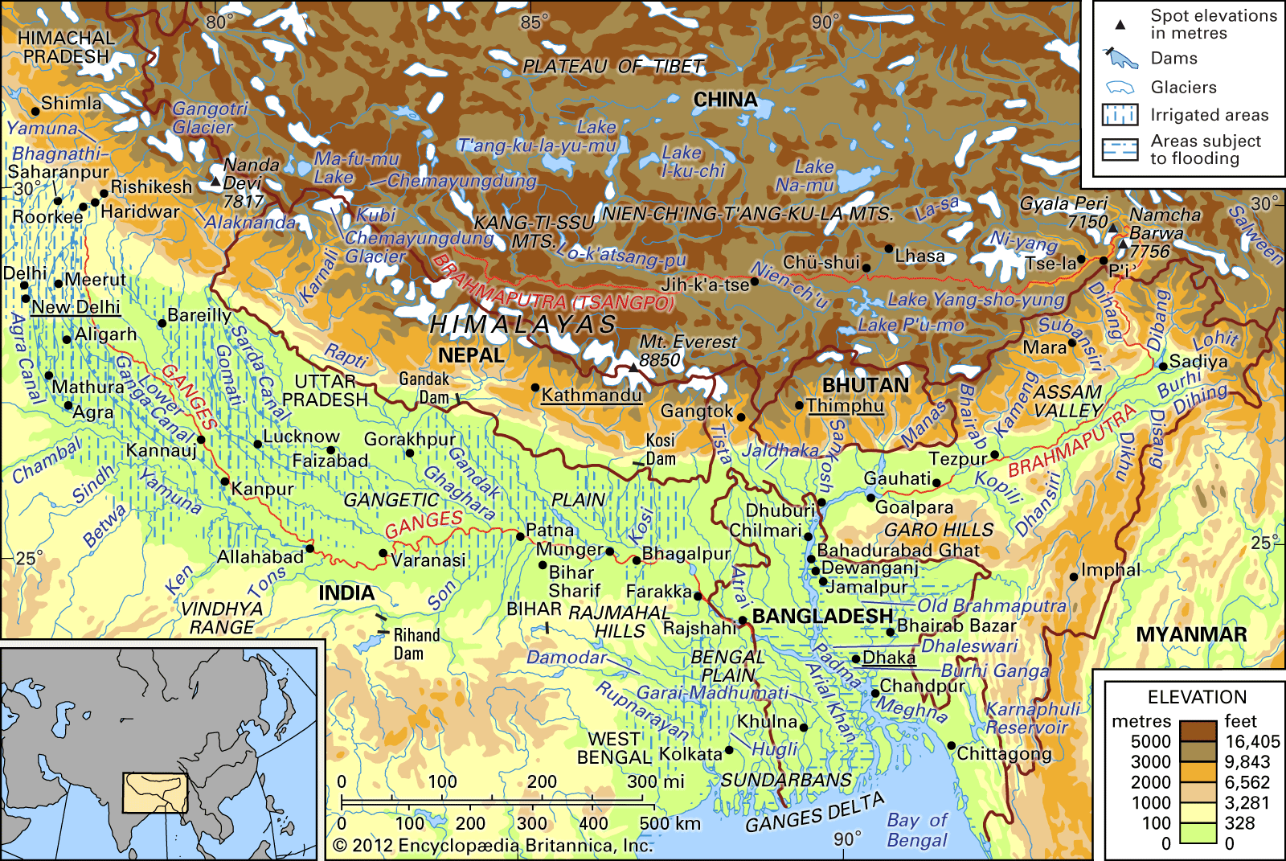
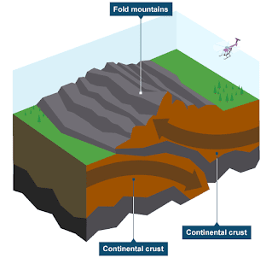
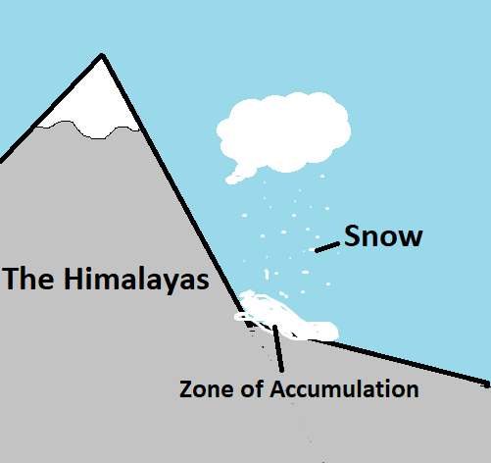
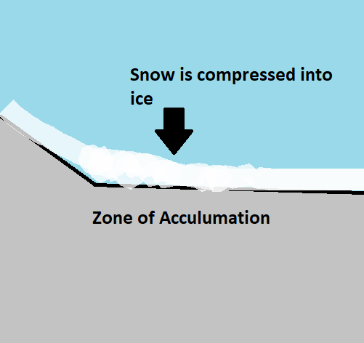
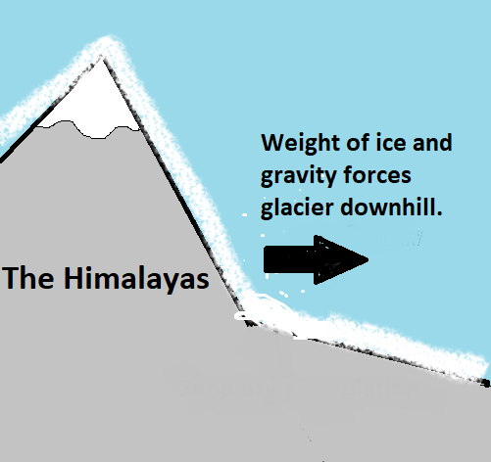
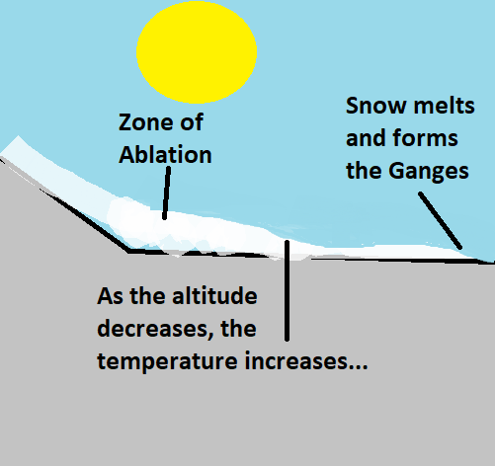
2. The Upper Course of the Ganges
The source of the River Ganges is believed to be Gangotri Glacier in the Himalayas.
The Himalayas are the world’s tallest mountain range – passing through India, China, Nepal, Bhutan, Afghanistan and Pakistan.
They are the a great example of fold mountains!
FORMATION OF FOLD MOUNTAINS
Fold mountains are formed on a convergent plate boundary.
They are formed by continental (thick) plates.
The two plates collide and are forced upwards.
The land above fractures and is pushed up forming a mountain range.
The Himalayas was formed by the collision of the Eurasian and Indian Plates.
FORMATION OF GLACIERS
1. Snow collects in a hollow. It gathers quicker than it melts.
2. Snow is compressed over years into ice. This area is the zone of accumulation.
3. The weight the ice forces the glacier to move downhill – like a slow moving ice river.
4. At the base of the glacier, it is warmer so ice melts faster than it gathers. This is the zone of ablation.

Slide 3
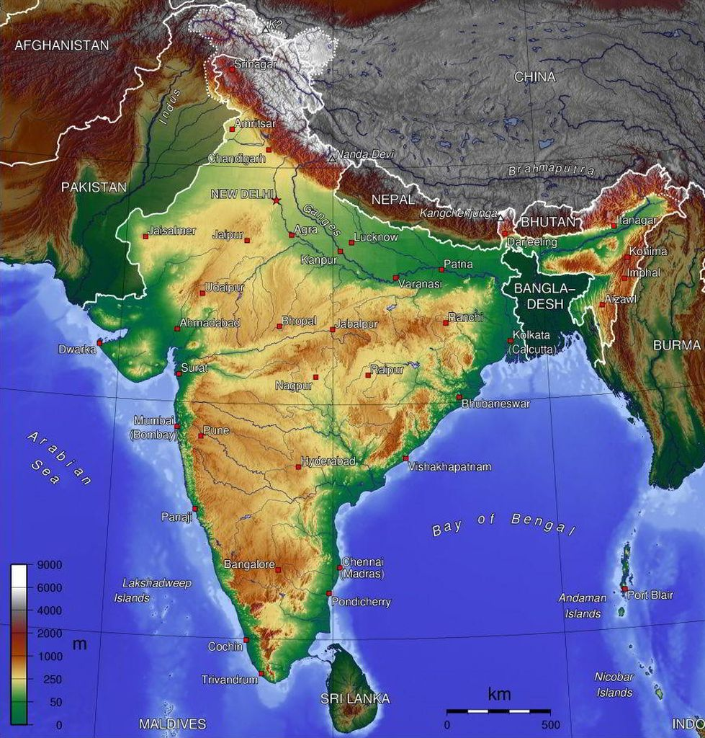
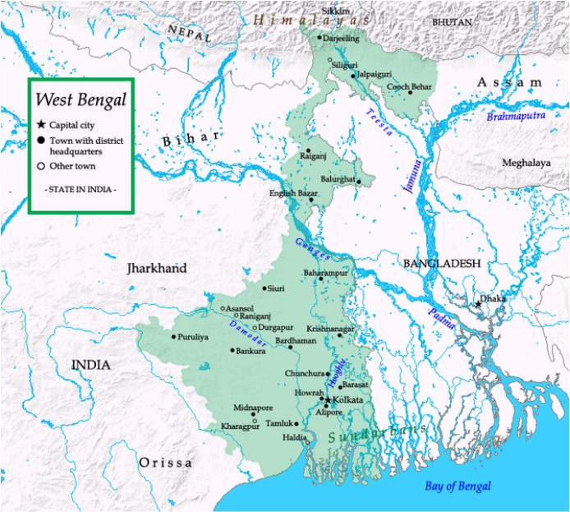
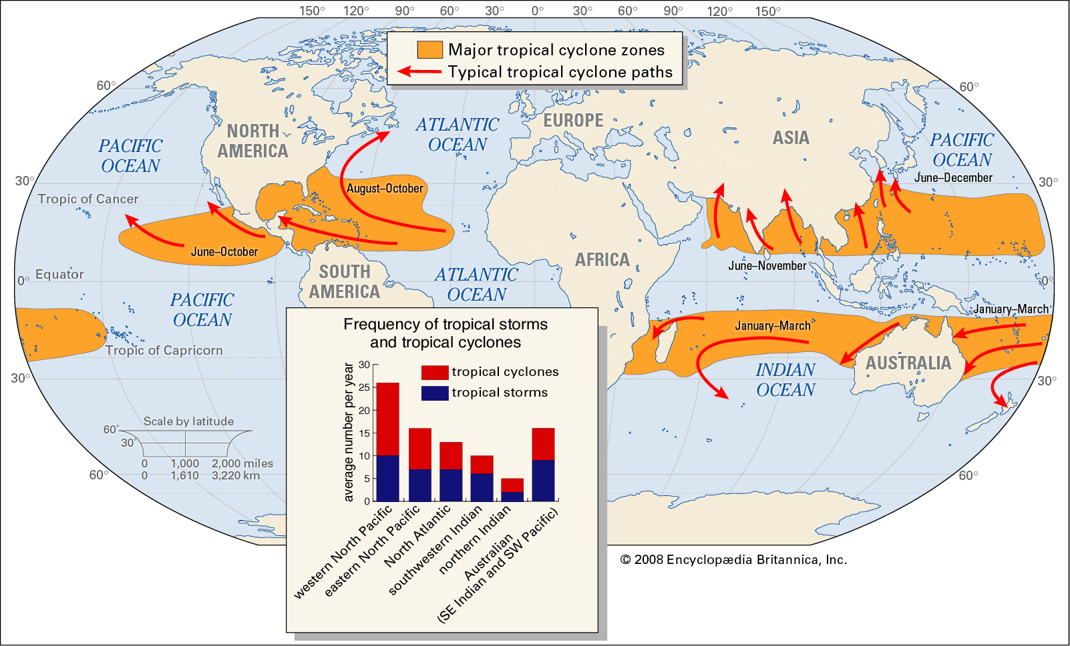



4. The Lower Course of the Ganges
Agriculture is very important to India.
53% of the population work in agriculture.
However, they tend to be India’s poorest workers – in rural areas.
Agriculture only generates 18% of the country’s GDP.
More Indians are leaving farms and moving to the cities than ever before.
CLIMATE CHANGE AND THE GANGES
The Indian Monsoon is caused by the difference in temperature between the ocean and the land.
With warming oceans, this difference is changing – making the Summer Monsoon more unpredictable. This causes a huge problem for the farmers.
The Ganges Flood Basin is extremely low-lying as shown by the relief map on the left.
Major cities such as Kolkata sit on the flood-plains of multiple rivers- making them vulnerable to flooding.
With more intense tropical-cyclones (due to climate change), this area is at risk of flooding.
People are talking about ‘climate refugees’ – people having to move home due to climate change.
GSE: DESCRIBING A PATTERN ON A GRAPH OR MAP
Generally, -
Specifically,
Exceptions include:

Slide 4


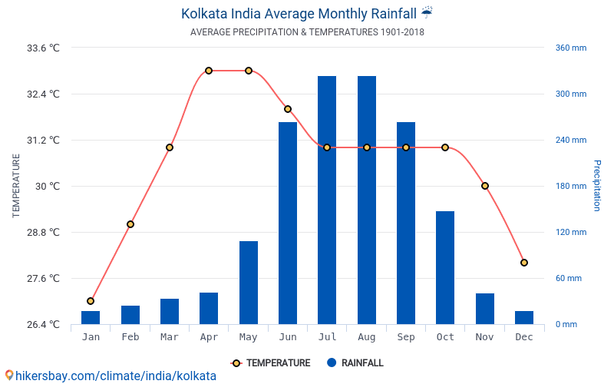
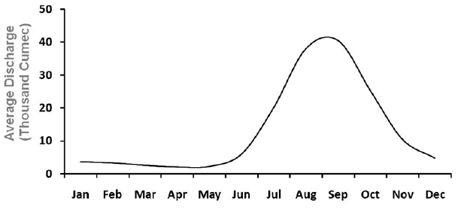
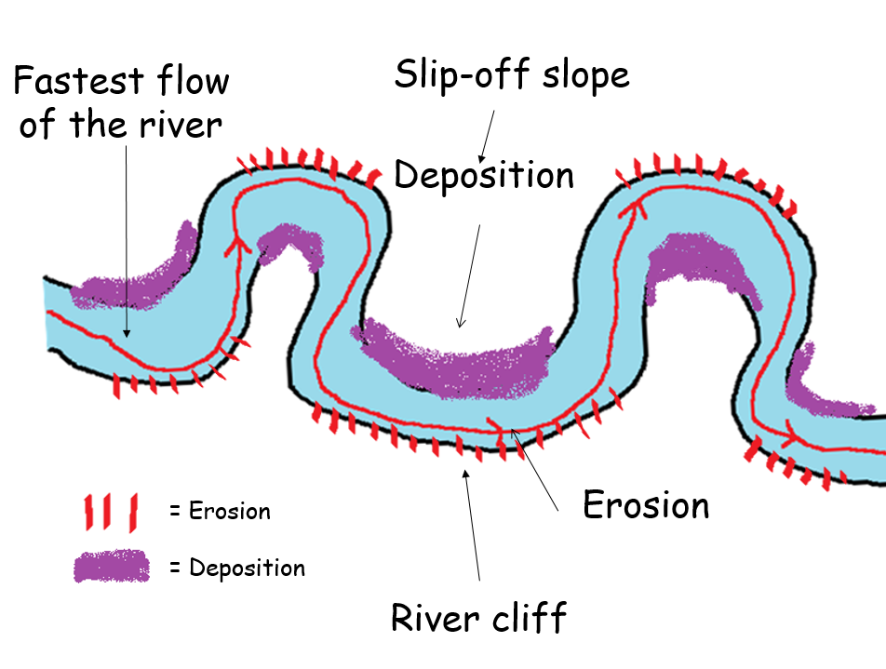


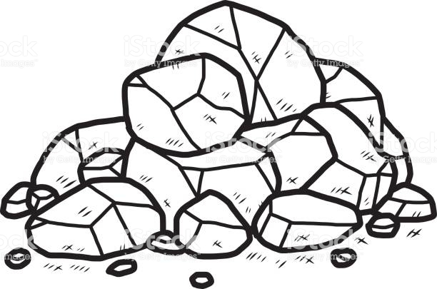
3. The Middle Course of the Ganges
Flood Plain = the flat area in the middle course of a river that spills onto during a flood.
THE INDIAN MONSOON AND THE GANGES
Monsoon = a seasonal changing of the wind. Bringing a wet and a dry season to an area.
Red = temperature
Blue = precipitation
Over 150m people live on the Ganges’ flood plain. Most are agricultural farmers who rely on the water to feed their crops.
The amount of water (discharge) in the Ganges relies on the arrival of the Indian Summer Monsoon – a warm, wet period (Jun-Oct).
The seasons are governed by the direction of the wind. If the wind blows off the sea, the air is wet. If it comes from the land, it is dry.
THE FORMATION OF A MEANDER
Meanders are when the river wiggles in the middle course.
Erosion
Transportation
Deposition

