Slide 1
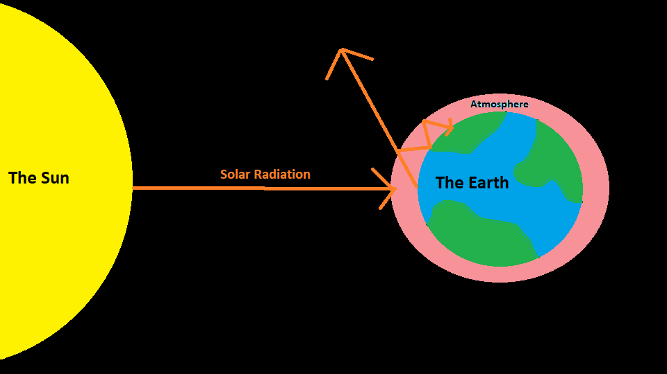
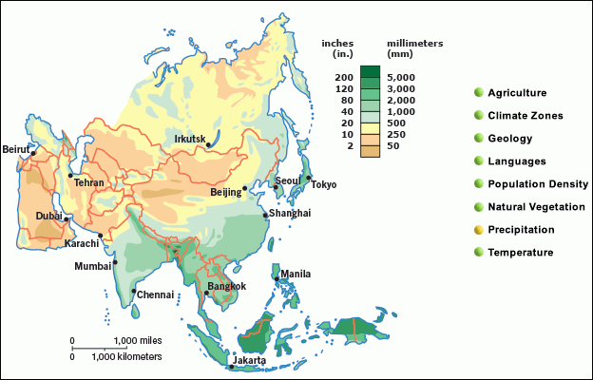
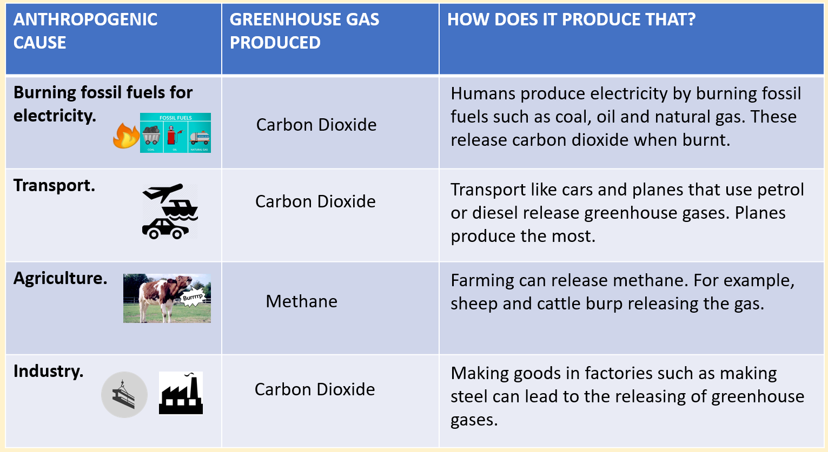
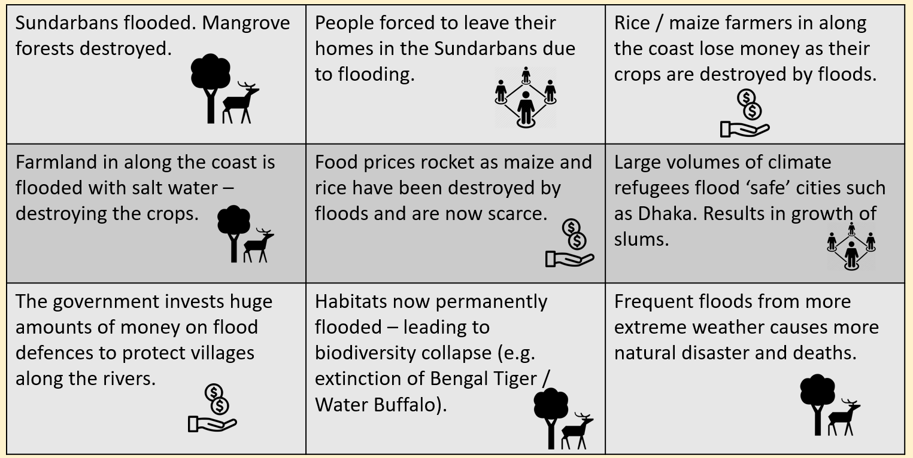
1. KO Causes + Impacts of Climate Change
What are the global impacts of climate change?
The Anthropocene = the period of geological time where human activities are the main influence on the climate.
Sea Level Rise
As water heats up, it expands. This is known as isothermal expansion. This will cause sea levels to rise around the world.
The Greenhouse Effect: Why is the Earth getting hotter?
Extreme Weather
Climate change will cause extreme weather. We will see droughts in dry areas and increased rainfall in others.
Most heat on Earth comes from the sun as solar radiation.
Some is reflected by the Earth’s surface.
Some is trapped by greenhouse gases in the Earth’s atmosphere.
More greenhouse gases = hotter temperatures.
Ecosystem Collapse
Extreme weather will cause break downs of food webs. As the environment changes, plants and animals wont be able to adapt to the new conditions fast enough.
Solar Radiation = heat energy from the sun.
Atmosphere = the gases that surround the Earth.
Reflect = when something bounces off the surface of another object.
What are the impacts of climate change on Bangladesh?
Bangladesh is a low-lying, EDC country in Asia.
It experiences heavy rainfall and flooding. This will get worse as sea levels rise and climate change causes more extreme rainfall.
As an LIDC, Bangladesh has struggled to keep up with the demands to adapt to the problems.
What are the anthropogenic causes of climate change?
Humans carry out four key activities that enhance the greenhouse effect by releasing greenhouse gases that cause climate change (Carbon Dioxide, methane). These are known as the anthropogenic causes of climate change.

Slide 2
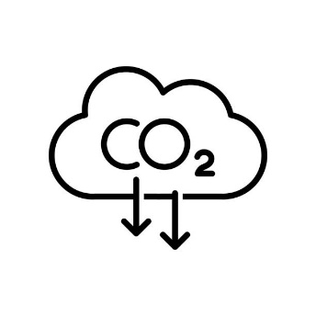
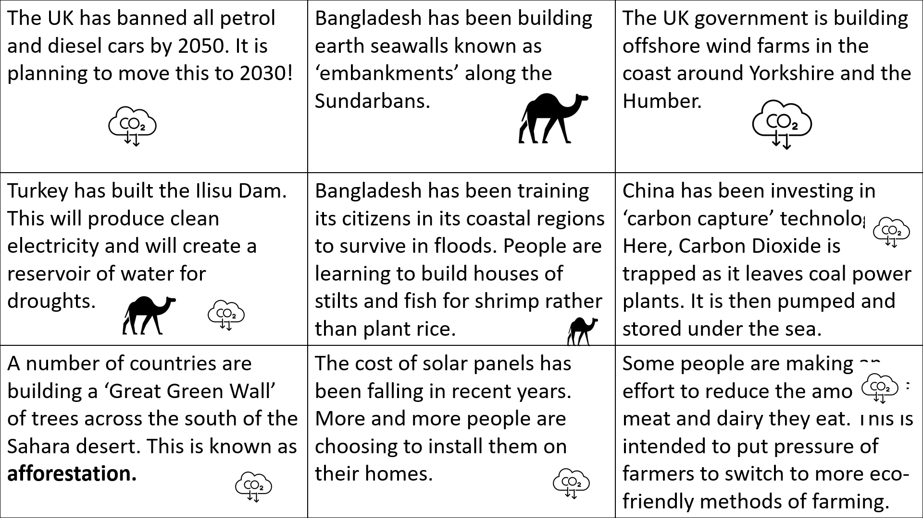
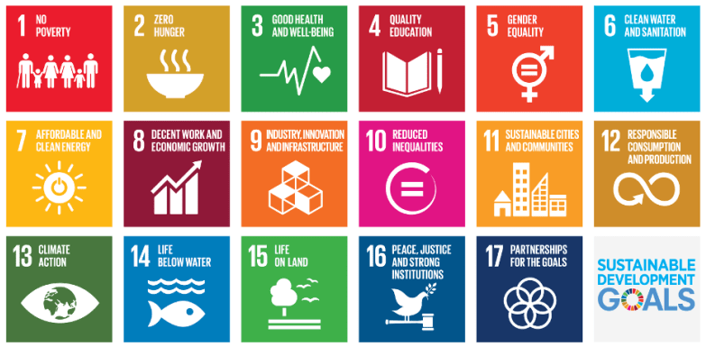
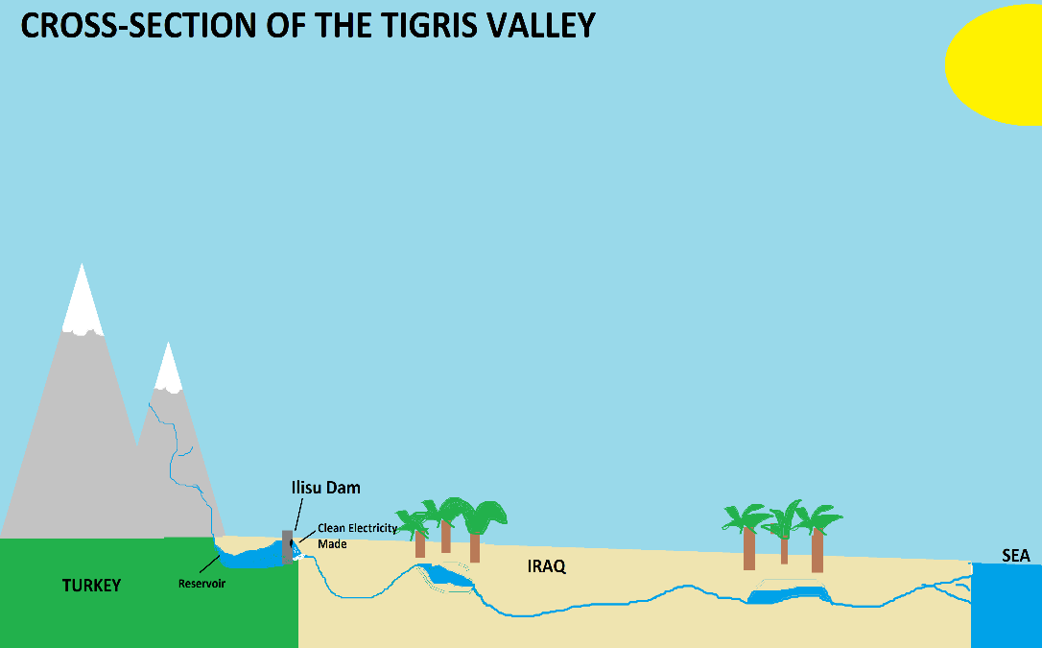
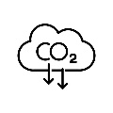
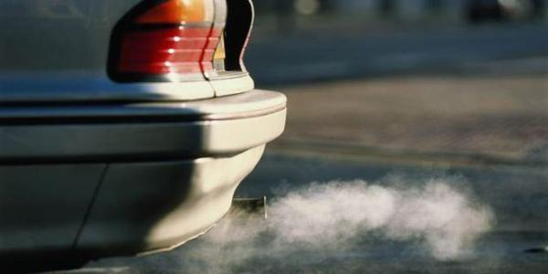
2. Solutions to Climate Change
How can we deal with the impacts of climate change?
International agreements to mitigate climate change…
Mitigation = reduce or prevent the impacts of something.
Adaptation = change to survive in the new conditions.
One attempt was the Paris Agreement in 2015. Countries from all around the world agreed to do various things to tackle climate change.
The other were the Sustainable Development Goals which took a broader approach and looked at how we can improve the whole planet at the same time. SGD 13 looked specifically at ‘taking urgent action on climate change’.
Adaptation? Turkey’s Ilisu Dam…
The Middle East is a region which has a number of dry regions. Due to climate change, water is becoming scarcer.
Turkey has built the Ilisu Dam on the Tigris River to provide a source of drinking water during droughts. But it is not all that popular…
Mitigating climate change in the UK?
The UK has pledged to ban all petrol and diesel car sales in the UK by 2030. The government hopes to reduce these cars on the road and therefore cut down on the levels of carbon dioxide emissions.
The dam will increase Turkey’s water reserves in the area by 25%. | The dam has reduced Iraq’s water income by as much as 50%.
Farmers in Turkey’s poorest region will have more reliable access to water. | 60,000 people have been moved as the dam has flooded a number of cities and villages to build the reservoir.
The hydro-electric dam could supply a huge amount of clean energy for Turkey. | Habitats will be destroyed as river banks will be destroyed by the reservoir.
This would drastically cut the UK’s carbon emissions. 22% currently comes from transport.
However, some people don’t think electric cars are reliable enough. Batteries don’t last long and there are not enough charging sockets around the UK.
Notes:
Impacts, Treaties, Solutions.

