Slide 1
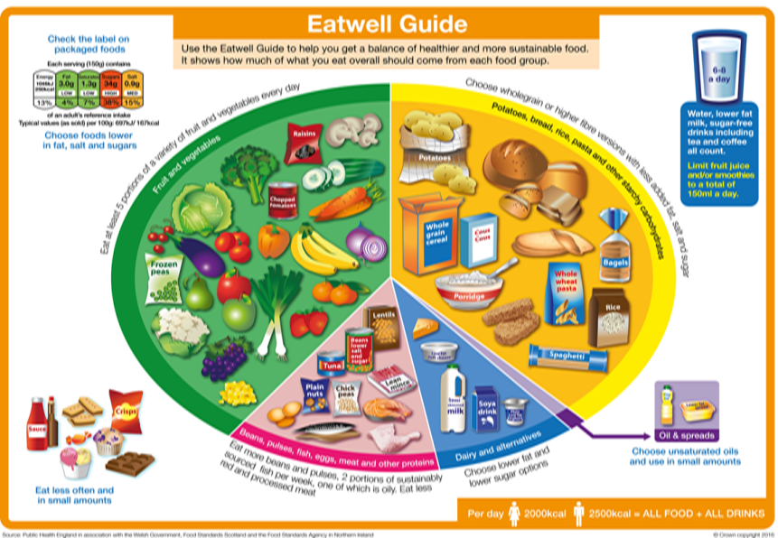
Knowledge Organiser
Explain what is meant by a balanced diet
Portion Control!
Healthy diets not only have the correct balance, but have the right portion sizes. Here is a ‘handy’ guide… Vegetables = double cupped palm. Grains/Starches = clenched fist. Protein = palm of hand. Fruits = clenched fist. Thumb = fats.
Fruits & Vegetables
Eat 5 portions s a day!
Choose a variety
Provides fibre for healthy digestion
Provides vitamins and minerals for healthy body functions and immune system
Starchy Foods
Provide slow release carbohydrate used by the body for energy
Choose wholegrains for increased fibre (good digestion, reduced risk of heart disease)
Fatty and Sugary Foods
These are the danger foods!
They are not part of a healthy diet
Eat them only occasionally
Eating too much fatty and sugary processed food is linked to increased risk of weight gain/obesity, diabetes , tooth decay and cardiovascular disease
Water Intake
A balanced diet must include water, it is required for nearly all brain and other bodily functions
See slide 2 for more details on water
Fats, Oils & Spreads
Provide fat soluble vitamins A,D,E & K
Are high in calories & energy so keep use to a minimum
It is recommended to choose unsaturated oils like olive oil
Beans, Pulses, Eggs, Meat, Fish
Provide protein for growth, repair and maintenance of body cells
Choose a combination of plant proteins
Avoid eating too much processed meat like bacon and sausages as these are linked with increased risk of bowel and stomach cancer
Dairy Foods
Provide calcium for healthy bones, teeth and nails
The body needs Vitamin D to absorb calcium effectively
The Eatwell Guide is the UK Healthy Eating Model. It shows what we should eat as a balanced diet. The size of the sections represents the proportion of our diet that particular food group should make up. The Eatwell Guide was updated in 2016 to take into account scientific opinion and public opinion. The main change was that sugary and fatty foods are shown off the plate as they are not part of a healthy diet.
Notes:
Portion control, water intake, fibre, RI/GDAs etc

Slide 2
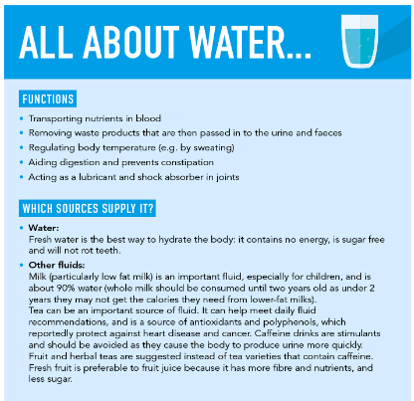
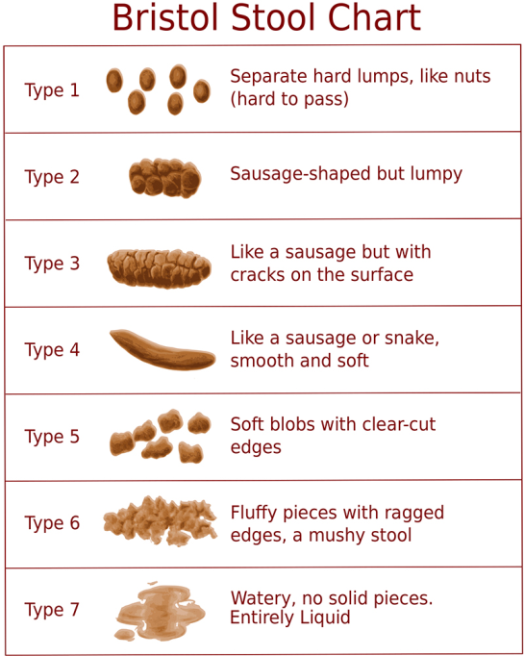
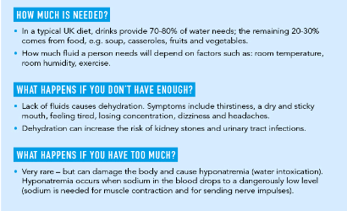
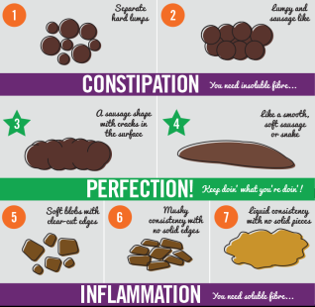
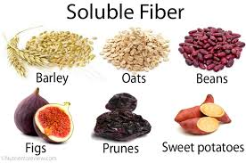
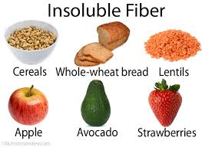
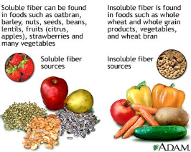
Knowledge Organiser
FIBRE
What is it? Fibre is found in fruits and vegetables, nuts, seeds, wholegrain cereal flours and products. It is not digestible and passes through the digestive system, forming the bulk of our stools (poo). Dietary fibre has many health benefits: It can reduce your risk of heart disease, diabetes and some cancers, and also help weight control. Fibre is also important for digestive health - fibre bulks up stools and holds water in them, making them softer and easier to pass. It also makes waste move through the digestive tract more quickly, which is better for the gut and can help to prevent constipation. Some types of fibre can be fermented by gut bacteria, producing substances that appear to be good for gut health. Providing ‘food’ for gut bacteria can also help increase the number of healthy bacteria in the gut.
How Much do we Need? 30g a day for adults 2-5 years 15g per day, 5-11 years 20g per day, 11-16 years 25g per day, 16-18 years 30g per day
To increase your fibre intake you could: Choose a high fibre breakfast cereal e.g. bran flakes, or porridge Choose wholegrains like whole-wheat pasta, bulgur wheat or brown rice, wholemeal bread Go for potatoes with skins For snacks try fruit, vegetable sticks, rye crackers, oatcakes, unsalted nuts or seeds Include plenty of vegetables with meals – either as a side dish or added to sauces, stews or curries Add pulses like beans, lentils or chickpeas to stews, curries and salads Eat fruit! Add nuts and seeds to recipes
The Bristol Stool Chart
The Bristol stool chart shows how the shape of different stools (poos) on a continuum. Both dietary fibre and water play a HUGE role in keeping the digestive system functioning properly. Too little water and/or fibre can result in constipation (the Type 1 and 2 stools)

Slide 3
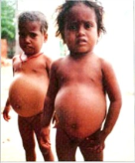
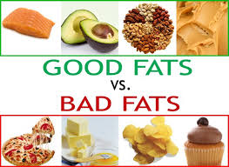
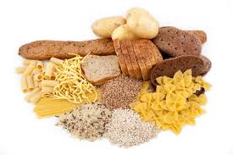
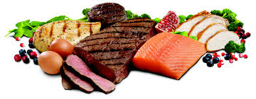
Knowledge Organiser
Describe the nutrients that make up a balanced diet - MACRONUTRIENTS
 | Nutrient | Source | Function | Effects of deficiency
MACRONUTRIENTS | Carbohydrates | Starches – found in cereal grains such as rice, wheat, oats, plus starchy tubers (potatoes and sweet potatoes) and vegetables (carrots, beets, corn) Sugars – lactose found in milk and dairy, fructose found in honey, fruits and some vegetables (peppers, tomatoes etc.) | Starches provide energy when broken down – slow release energy to the body (wholegrain provide slower release carbohydrates) Sugars provide quick release energy to the body's’ cells. | Deficiency of carbohydrates is extremely rare in the UK. Long term lack of carbohydrates in the diet can cause Ketosis – a condition where the body switches to using protein as an energy source.
 | Proteins | High Biological Value (HBV) protein: Meat, fish, poultry, eggs, Low Biological Value (LBV) protein: Tofu, beans, nuts. | Protein is digested by the body into its component parts – called amino acids. There are 8 which are essential for adults and 12 for children. HBV protein foods contain all the essential amino acids. | Protein deficiency can cause: Wasting of muscle & muscle loss Oedema – build up of fluids in the body Slow growth in children Severe deficiency leads to kwashiorkor →
 | Fats | Butter, cheese, dairy foods including yogurt, crème fraiche, milk Oils, lard, suet, dripping. | Fat is a term used to describe lipids – this can refer to solid fats and oils. Fat is broken down by the body and used for energy, Also used to provide warmth when stored under the skin. Is a dietary carrier of fat soluble vitamins A, D, E & K. | Lack of fat in the diet can lead to deficiencies of fat soluble vitamins A, D, E & K.

Slide 4
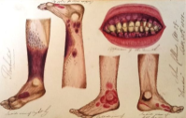
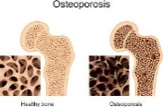
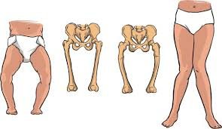
Knowledge Organiser
Describe the nutrients that make up a balanced diet - MICRONUTRIENTS
 | Nutrient | Function | Source | Effects of deficiency
VITAMINS | Vitamin A | Required for a healthy immune system Keeps mucous membranes of eyes, digestive system and lungs healthy | Dairy products, fortified spreads, Egg yolk, oily fish, yellow and orange fruits and vegetables, | Deficiency is rare in developed countries but can lead to night blindness and a compromised immune system Dry mucous membranes
 | Vitamin B Group | Needed to release energy from foods Needed to keep the skin, eyes and nervous system healthy | Meat, Liver, Eggs, Wholegrain foods, yeast/yeast extract | Severe deficiency rare in developed countries. Lack of B Group vitamins can cause dry, cracked skin
 | Vitamin C | Helps the body absorb iron from food Essential for the formation of collagen (the body's scaffold tissue) Aids wound healing Supports a healthy immune system & fights infection | Fruits including – kiwi, strawberry, citrus fruits Peppers, tomatoes Dark green vegetables including cabbage, broccoli | Extreme deficiency is called scurvy. This is very rare however symptoms include bleeding gums, wounds not healing properly, tiredness. Lack of vitamin C can also be linked to iron-deficiency anaemia as absorption of iron will be affected by lack of vitamin C
 | Vitamin D | Essential for absorbing calcium from foods | Sunlight in UK summer Food sources – oily fish, eggs, liver, fortified cereals | Poor absorption of calcium – rickets (soft bones) in children and osteomalacia in adults (See picture below)
MINERALS | Iron | Iron is needed to make haemoglobin in red blood cells | Haem iron found in meat, offal Non-haem iron found in wholegrain foods, leafy green vegetables, fortified breakfast cereals Iron is only absorbed in the presence of vitamin C. | Iron deficiency anaemia is the most common dietary deficiency in the UK. Symptoms include tiredness, paleness, lethargy
 | Calcium | Calcium is needed by the body to build strong bones and teeth. Essential for blood clotting process Essential for nerve signal transmission and muscle contraction | Dairy foods including milk, yogurt, cheese, butter Dark leafy green vegetables, Fish with edible bones including sardines and pilchards Non-dairy milks fortified with added calcium | Lack of calcium in children can cause rickets Osteoporosis (brittle bones) in adults Rickets →

Slide 5
AC 1.3 Nutrient requirements for different groups of people – Age Groups
Nutrition through life differs mainly due to the need for energy and protein for growth and development – in younger age groups, growth and development occurs, in older age groups only maintenance of the body is required, therefore protein and energy requirements are reduced.
GENDER affects nutritional requirements after puberty – before puberty male and female requirements are the same. Puberty causes girls to begin menstruation, increasing their iron needs, which remain higher than men until the menopause which occurs around 50 years of age. Generally males are physically larger than females and therefore need to consumer more energy and protein on a daily basis.
PHYSICAL ACTIVITY LEVEL affects a person's’ energy requirements. The more active a person is, the more energy they need. It is recommended that extra energy requirements come from extra starchy carbohydrate in the diet,. Increased PAL could be from having an active job or from playing lots of sport.
Babies and Toddlers Milk only for first 4-6 months Weaning occurs from 6 months – introduce a wide variety of textures and colours Avoid nuts (choking hazard), salt and sugar | Pre-school children Balanced diet needed – in line with Eatwell Guide from 12 months High needs for energy and protein due to rapid growth and constant movement Full fat dairy products should be consumed Salt and sugar should be avoided | Children Balanced diet needed – in line with Eatwell Guide from 12 months High needs for energy and protein due to rapid growth and constant movement 5-a-day is recommended
Teenagers Increased needs for iron in teenage girls due to menstruation Calcium intake & vitamin D are really important to ensure Peak Bone Mass is reached – setting up bone health for life Many UK teenagers are lacking in calcium, iron and vitamin A. | Adults No more growth means less energy is needed for adults than teenagers Well balanced diet modelled on the Eatwell Guide essential. Many UK adults eat too much fat, too much salt and not enough fruit and vegetables. | Elderly Sedentary older people will have reduced energy requirements. Calcium and vitamin D are still very important to prevent osteoporosis. Some elderly people do not get outside much and can be at risk of Vitamin D deficiency Sometimes elderly people may have issues getting access to food due to mobility issues, they may also be at risk of lack of variety of nutrients due to poor absorption.
Pregnancy & Lactation Because the body becomes more efficient at absorption during pregnancy, normal nutritional requirements apply until the last third of pregnancy, when some extra energy and calcium is required. Pregnant and lactating ladies should eat a varied diet rich in fresh fruit and vegetables and wholegrains (in line with the Eatwell Guide). There are some foods to avoid: Unpasteurised milk products and undercooked meats/cured meat products – they may contain listeria which is harmful to unborn babies Pate, liver and liver products – due to high vitamin A content (Vitamin A is harmful to unborn babies if eaten in large quantities) Swordfish, marlin and shark as they are high in mercury which can be harmful to unborn baby,

Slide 6
AC 1.3 Nutrient requirements for different groups of people – Special Diets (Religious, Medical, Ethical)
Medical Diets | Religious Diets | Ethical Diets
Nut & other allergies Must avoid particular allergen, otherwise an allergic reaction may occur. Serious allergic reactions can result in anaphylaxis and even death. The 14 common allergens which must be declared on menus and food packaging are: Celery, Gluten, Crustaceans, Eggs, Fish, Lupin, Milk, Molluscs, Mustard, Nuts, Peanuts, Sesame, Soya, Sulphites. | Halal (Muslim) Halal is Arabic for permissible. Halal food is that which adheres to Islamic law, as defined in the Koran. Haram is the opposite to Halal and describes food which is not permitted under Islamic law. Haram items that Muslims will not consumer include pork and all pork products as well a alcohol. | Vegetarian Vegetarians do not eat any flesh – they do not eat meat, poultry or fish/shellfish. Vegetarians do eat dairy products and eggs (lacto-ovo-vegetarian).
Lactose intolerance People who are lactose intolerant do not make the digestive enzyme which is needed to digest lactose (a milk sugar found in dairy products). If they consume lactose, they will experience digestive discomfort including cramps, excess wind and diarrhoea. Lactose intolerant people can consumer lactose free milk and dairy products or dairy alternatives. They must be careful to ensure they get enough calcium in their diet. | Kosher (Judaism) Judaism instructs its followers to observe a kosher diet, this means no pork. Kosher food also does not mix dairy products and meat in the same meal/course. Foe example, a burger must be served without cheese. | Vegan Vegans avoid consuming any animal products – including milk and dairy products, Protein is a nutrient which can be lacking in a badly planned vegan diet – vegans can eat wholegrain cereals, nuts, beans, lentils and tofu. Calcium may be lacking in a vegan diet – some vegans replace dairy with calcium fortified alternatives such as soya milk or almond milk.
Coeliac Coeliac disease sufferers react to the presence of gluten, a protein found in wheat flour and wheat flour products. They must avoid consuming gluten. Gluten is present in any wheat flour – alternatives such as | Hindu Followers of the Hindu religion do not eat Beef, as they believe it is a sacred animal. | Pescetarian Pescetarians do not eat meat, but will eat fish and shellfish.
Coronary Heart Disease People who are diagnosed or at risk of Coronary Heart Disease are currently recommended to adopt a low sugar, low saturated fat, high fibre and fruit and vegetable Mediterranean style diet. | Buddhist Buddhists are usually vegetarian and do not consume meat or fish. | Flexitarian This is a new concept – followers of a flexitarian diet choose vegetarian or vegan diet meal choices for some parts of the week, in order to reduce their carbon foot print. Meat-Free Mondays campaign spearheaded this movement.

Slide 7
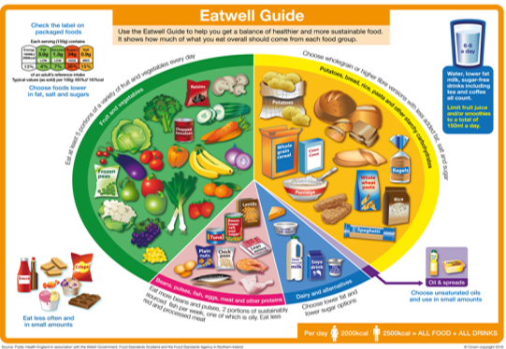
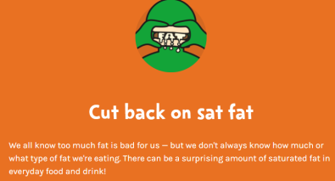
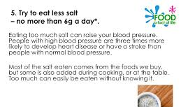
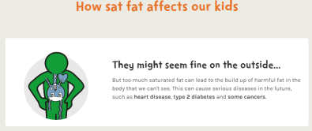
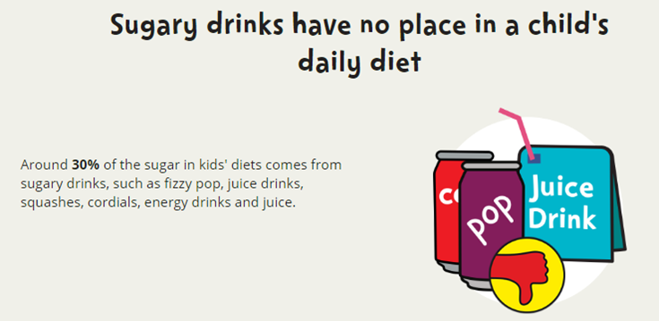
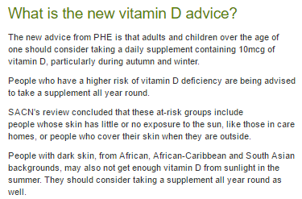
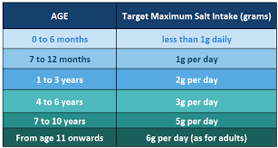
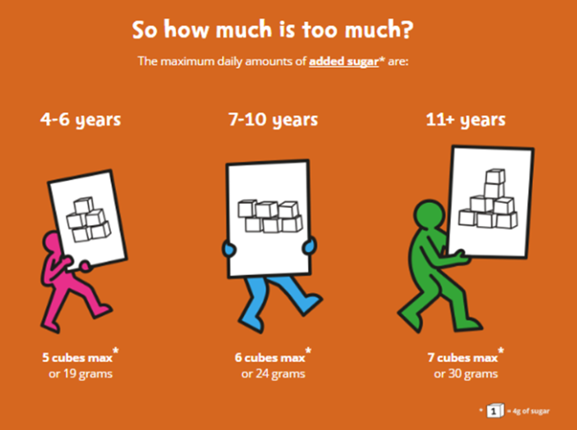
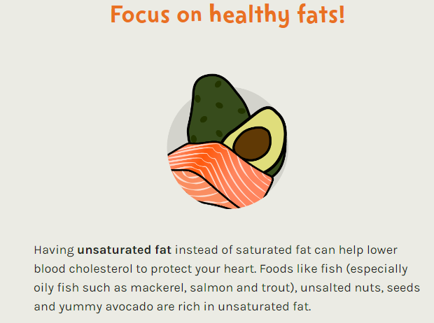
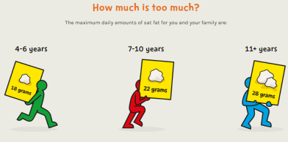
AC 1.4 Current Healthy Eating Advice
Healthy Eating Guidelines in the UK are set by Public Health England
Sugar Facts!
8 Tips for Healthy Eating!
Eat more fibre Eat more fruits and Vegetables Eat more oily fish Eat less salt Eat less fat Eat less sugar Choose wholegrains Drink 6-8 glasses of water per day
2016 Update from Public Health England - The latest advice on Vitamin D intake
Salt intake
Fibre intake

Slide 8
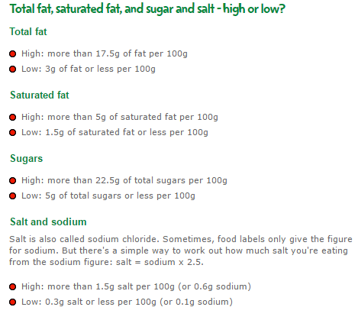
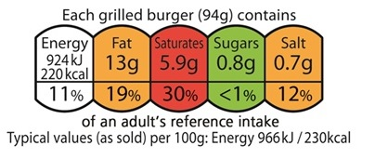
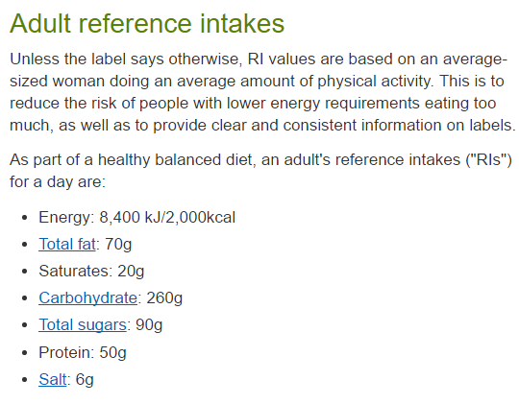
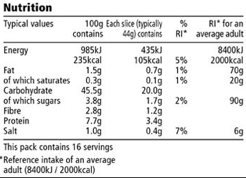
AC 1.5 Explain how nutritional information on food labels can inform healthy eating – Front & Back of Pack Labelling
Traffic light system indicates with colour how much of intake is needed.
Easy to see, quick to take in
Portion/Serving size is indicated on the label.
This is NOT always the whole pack!
Front of pack nutrition labelling is optional
Most pre-packed foods have a nutrition label on the back or side of the packaging. These labels include information on energy in kilojoules (kJ) and kilocalories (kcal), usually referred to as calories.
They also include information on fat, saturates (saturated fat), carbohydrate, sugars, protein and salt. All nutrition information is provided per 100 grams and sometimes per portion of the food.
Supermarkets and food manufacturers now highlight the energy, fat, saturated fat, sugars and salt content on the front of the packaging, alongside the reference intake for each of these.
You can use nutrition labels to help you choose a more balanced diet
Energy intake as a percentage of RI
Reference Intakes used on Labelling
Energy Values of Nutrients
A kilocalorie (kcal for short) is an energy measurement used in food - it is the amount of energy needed to heat 1 litre of water by 1℃.
Carbohydrates provide 4 kcal per gram | Protein provides 4 kcal per gram | Fat provides 9 kcal per gram
All macronutrients provide energy and eating them in excess will result in the body storing the extra energy as fat (new research suggests this is most true with refined starchy carbohydrates and sugars) .
More detailed information on back of pack labelling :
Details of food per 100g
Plus info on fibre and protein
Front of Pack label
Back of Pack label

Slide 9
AC 1.6 Assess a food diary and make recommendations
“Emma’s diet does not reflect the balance of the Eatwell Guide
Look at the overall balance of the diet – does it fit the Eatwell Guide? Is there any food group which is featuring in food diary too heavily? Any which is lacking? Identify this and recommend adjustments/replacements
Recall the 8 tips for healthy eating – are they being applied to this diet? Discuss, if they are not being applied, make recommendations for change based on this.
“Emma’s diet does not fit with the overall balance recommended by the Eatwell Guide.
WAGOLL
Actions Emma should take to have a more balanced diet:
At breakfast reduce ‘free’ sugar intake by swapping orange juice for slices of orange, swap chocolate spread for marmite, or a olive oil spread
Reduce sugar in tea – use whole milk as it has a naturally sweet taste
At lunch replace pizza and chips with jacket potato, beans, cheese and salad – this includes lots f fibre, lots of protein
Swap takeaways for ‘fakeaways’ – cooking homemade version of these dishes will reduce fat, sugar and salt content of her evening meal
Replace white rice and naan bread with wholemeal chapati and brown rice
Reduce the chocolate intake – for snacks, choose nuts or dried fruit/fresh fruit to snack on instead as this is high fibre
Swap the diet coke for water
Emma’s FOOD DIARY
Breakfast | 2 slices of thick white toast with chocolate spread Glass of concentrated orange juice Cup of tea with 2 sugars
Lunch | Slice of pizza Chips Bar of Dairy Milk
Dinner | Takeaway Creamy chicken and vegetable curry Boiled white rice Garlic naan bread
Snacks | Packet of crisps Can of Diet Coke
8 Tips for Healthy Eating!
Eat more fibre Eat more fruits and Vegetables Eat more oily fish Eat less salt Eat less fat Eat less sugar Choose wholegrains Drink 6-8 glasses of water per day
WAGOLL
“Emma’s diet is lacking in fibre. Fibre is needed for effective digestion and lack of fibre can cause constipation. To increase fibre in this diet, choose wholegrains – swap the white toast in the morning for wholemeal/granary bread, ditch the naan bread and choose a wholemeal chapati. Emma also needs to include more fresh fruit and vegetables in her diet– there is only 1/5 of the recommended daily fruit and vegetables portion present! She could swap the chips at lunch for a side salad, and a banana or some strawberries for dessert. She could also swap some dried fruit for her crisps as a snack. Emma does not have any oily fish in her diet – she could have a salmon salad at lunch instead of the pizza. Emma’s diet includes lots of processed food, which is high in salt. Emma could try cooking food from scratch to help her reduce her salt intake to below recommended 6g per day. Too much salt in the diet can increase blood pressure. Emma’s diet is high in fat, too much fat is linked to risk of coronary heart disease – the chocolate spread could be replaced with honey on toast – this is natural and not processed, although does still contain sugar. Emma could also reduce fat by ditching the chocolate bar and choosing some nuts and dried fruit instead, this would also reduce Emma’s free sugar intake .

Slide 10
AC 2.1 Assess a recipe in terms of its contribution to healthy eating
Is the recipe providing wholegrain starchy carbohydrates?
Is the recipe providing fruits and vegetables at roughly 1/3 of its whole?
Is the recipe high in salt?
YES
YES
NO
NO
Recommend a way to change the carbs – can wholegrain /wholemeal option be used instead?
Can the skins be left on potatoes instead?
YES
NO
Adjustments not necessary
Recommend a way to reduce the salt content.
Can it be reduced?
Could it be replaced with spices or herbs for flavour?
Adjustments not necessary
Adjustments not necessary
Recommend a way to increase the vegetable content.
Make recommendations based on complimenting the existing appearance, flavour and textures of the dish – remember contrast of colours and textures create interesting dishes!
e.g. add chopped red peppers
Points to include when assessing a recipe for its contribution to healthy eating
Is the recipe high in fat?
NO
YES
Adjustments not necessary
Recommend a way to change the fat content…
Can the cooking method be changed to reduce the fat?
Can the amount of fat added to the recipe be reduced? E.g. use fry-light low cal cooking spray instead of frying in oil?
Is the recipe providing oily fish?
NO
YES
Can the protein source be changed to oily fish?
e.g. salmon, mackerel, tuna, sardines?
Adjustments not necessary
Is the recipe high in sugar?
Is the recipe providing calcium from dairy, or a vegetable source?
Is the recipe providing heart healthy oils?
NO
YES
NO
YES
Adjustments not necessary
Recommend a way to change the sugar content.
Could less sugar be used?
Can fruit be added to improve sweetness instead?
NO
YES
Recommend a way to change the fat content…
Can you change from a saturated fat to a heart-healthy unsaturated fat? E.g. olive oil instead of butter?
Adjustments not necessary
Recommend a way to increase the calcium content. Can a dairy food, dairy alternative or a leafy green vegetable be added to the recipe to boost the calcium content?
Adjustments not necessary
Is the recipe high in sugar?

Slide 11
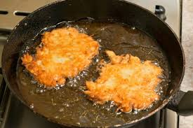
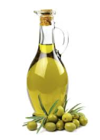
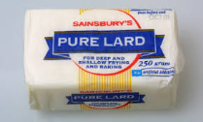
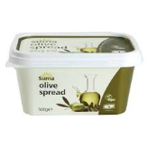
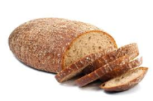
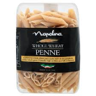
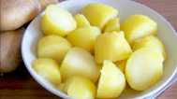
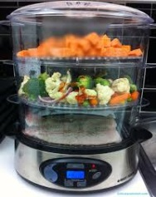
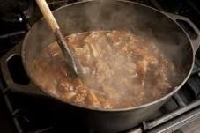
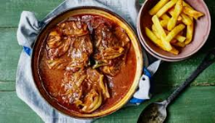
AC 2.2 Explain how to change recipes to make them healthier
Preparation methods
Do not add too much extra fat when preparing/marinating or cooking
Trim fat off excess fat from meat where possible (leaving some is fine for flavour)
Do not add too much extra salt when seasoning/marinating foods before cooking
Do not add too much sugar when marinating foods
Cooking methods
Some cooking methods add fat, adding too much fat to food increase the calories (energy content) drastically and is also thought to be a risk factor in cardiovascular disease. Cooks should be minimise their use where possible. These include:
Frying - deep (submerging food in hot fat)
Frying – shallow (frying food in 1cm or less of fat in a pan)
Roasting (cooking in fat in the oven)
Healthier cooking methods only add small amounts of fat, or do not add fat to food at all. They can be dry (cooking without the use of water) or moist (cooking with water or steam). Healthier cooking methods include:
Stir frying (cooking quickly in a small amount of oil at v high temps)
Poaching (cooked gently in simmering liquid)
Boiling (cooking food submerged in vigorously boiling ‘rolling boil’ water
Steaming (holding food above boiling water to be cooked by the steam)
Grilling – on a cooker or on a BBQ (food cooked by radiant heat from a flame or glowing element)
Baking in the oven (dry heat)
Stewing (slow-cooking on hob or in slow-cooker with liquid)
Casseroling (slow-cooking in oven with liquid)
Braising (slow-cooking pre-sealed meat and vegetables in oven with liquid)
CHANGE THE INGREDIENTS USED:
Avoid saturated fats such as butter, lard and dripping - Use heart healthy unsaturated fats such as olive oil, avocado oil
Avoid using white flour where possible – use wholegrain or brown versions for extra fibre and B vitamins
Leave the skin on potatoes for extra fibre and vitamin C
Replace cream in recipes with reduced fat crème fraiche
Replace mild cheeses with stronger ones, and use less
REDUCE sugar content of recipes by using naturally sweet ingredients such as fruits
Add extra VEGETABLES, FRUITS, NUTS and SEEDS into recipes where possible, for extra fibre, vitamins and minerals - these can be blended into sauces to ‘hide’ them for fussy eaters

Slide 12
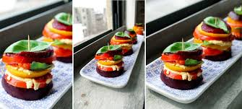
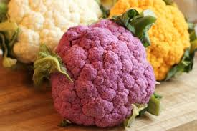
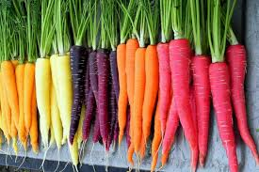
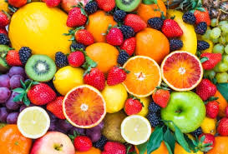
AC 2.3 Describe other factors which can affect the finished dishes
Changes to make dishes healthier can affect OTHER aspects of the finished dishes in several ways….
Appearance and presentation of the meal Adding vegetables to a dish to increase fibre, vitamins and minerals may also affect the colour of the dish. Adding greens such as green peppers or green beans will create a fresher, more vibrant look. Adding tomatoes/red peppers to a dish will make it look brighter. Remember – contrast in colours within a dish is good, makes dishes look more appealing and delicious! Changing carbs to wholegrain or skin-on versions may also change the colour of the dish, however this time may increase the presence of brown in the dish, which is considered a ‘dead’ or dull colour, and will need brightening up in other ways… | Taste Reducing fat content in recipe may alter the taste – it can reduce creaminess aka ‘mouth feel’ Reducing the fat content of baked goods can also alter the taste – making them taste less rich. Adding vegetables to dishes can alter the taste in many ways depending on what fruit/vegetables is added – e.g. red peppers will bring sweetness, adding kale will bring an earthy taste, adding broccoli will add a fresh taste etc… Changing carbs to wholegrain or skin-on versions will affect the taste, making the dish have a more ‘nutty’ flavour Adapting the cooking method may also change the taste of a dish – steaming or poaching will preserve the flavours of the original food whereas barbecuing or grilling food will also impart charred flavours
Texture Reducing fat content in recipe may alter the texture, making it drier or more brittle. Adding vegetables or fruits to dishes can bring crunchiness, softness, chewiness. Changing the cooking method will also alter the texture – frying or roasting food in fat creates crispy crunchy textures, whereas replacing frying/roasting with the healthier methods of steaming, boiling, stewing etc will create soft textures. Grilling and barbecuing will also create chewy/crispy textures. | Appeal Making dishes ‘healthier’ may also change their appeal – depending on the combinations of ingredients, preparation and cooking techniques selected. Remember - consider your choices, even though the change will make the dish healthier, will it create a desirable flavour/texture/appearance combination???

