Slide 1
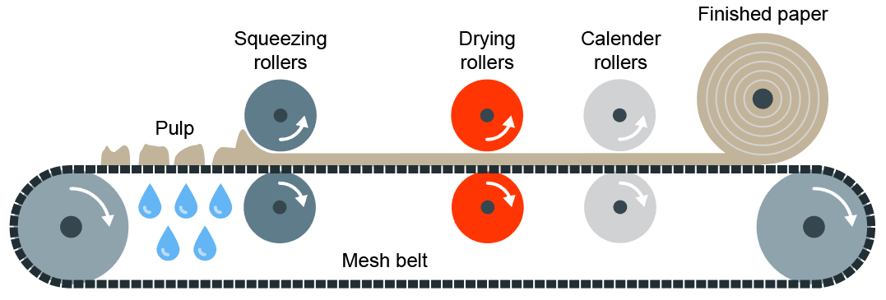
Modern and Smart Materials
Papers and Boards
Modern Materials are materials that have been developed recently
Material | Key info | Examples
Corn-starch Polymers | These are plant-based polymers that are a replacement for plastics that are biodegradable but cannot be recycled. | Plastic bottles, tubs, food containers, etc
Flexible MDF | Made in the same way as normal MDF but with grooves cut into the surface so it is flexible. Flexiply is the same but for Plywood. These can easily be shaped into curves | Modern furniture, interior walls and room dividers
Titanium | High strength to weight ratio. Doesn’t corrode or rust. Suitable for medical use as its hypo-allergneic | Prosthetics, medical applications, sports cars, etc
Kevlar | A woven polymer with a high strength to weight ratio. | Bullet-proof vests, tyres, helmets, etc
Papers and Boards come from trees. The Stock forms for papers are: rolls, sheets, A4, A3, etc
Material | Key info | Uses/ Examples
Cartridge Paper | Thick white paper, completely opaque and more expensive than photocopy paper | Sketching, ink drawings
Layout Paper | Light, semi-translucent, good for blending inks and artist markers | Sketching, drawing and some tracing
Corrugated Cardboard | Strong but light. Rigid triangles of card sandwiched between a top and bottom layer. | Outer packaging, food packaging
Duplex Board | Light card with white outside layers. Waxy coating can be added | Cheap packaging. If waxy coating is applied, can be used for food
Foil-lined Board | White card coated with a thin aluminium layer. Foil is great for insulation and water resistance | Takeaway containers
Solid White Board | High-quality white card with a smooth finish. Stiff and holds colours well | Greetings cards, packaging and advertising
Smart Materials are materials that change and react to the stimuli
Material | Key info | Examples
Thermochromic Pigments | Change colour in reaction to heat | Kettles, baby bottles, etc
Photochromic Pigments | Change colour in reaction to light | Colour changing glasses, windows, etc
Shape Memory Alloy | Returns to its original shape, in reaction to heat | Braces and glasses
Polymorph | Granules that once exposed to hot water, become a modelling material (like a dough or clay) | Modelling and repairs
Primary Processing of Papers and Boards
Paper is made by first making pulp. Pulp is a mix of tree fibres and water. This is cooked and bleached white, and adding any other additives.
The pulp is then drained and goes through Calendering where the pulp is drained and goes through rollers to convert it to its stock forms

