Slide 1
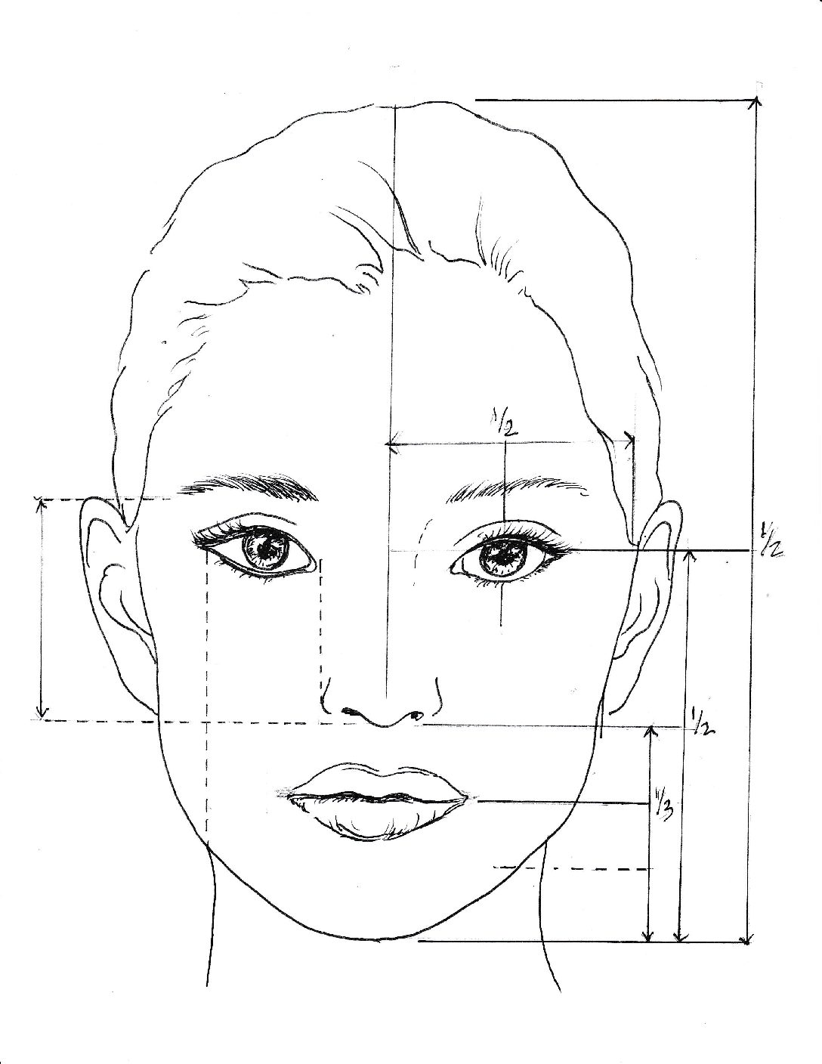
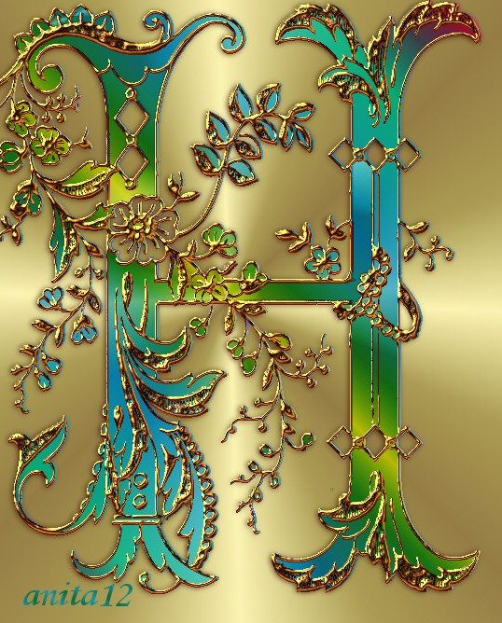
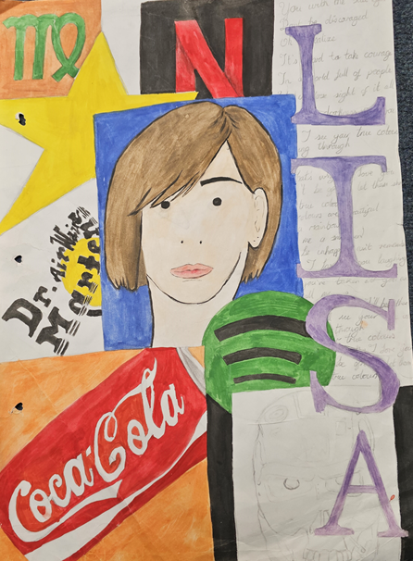
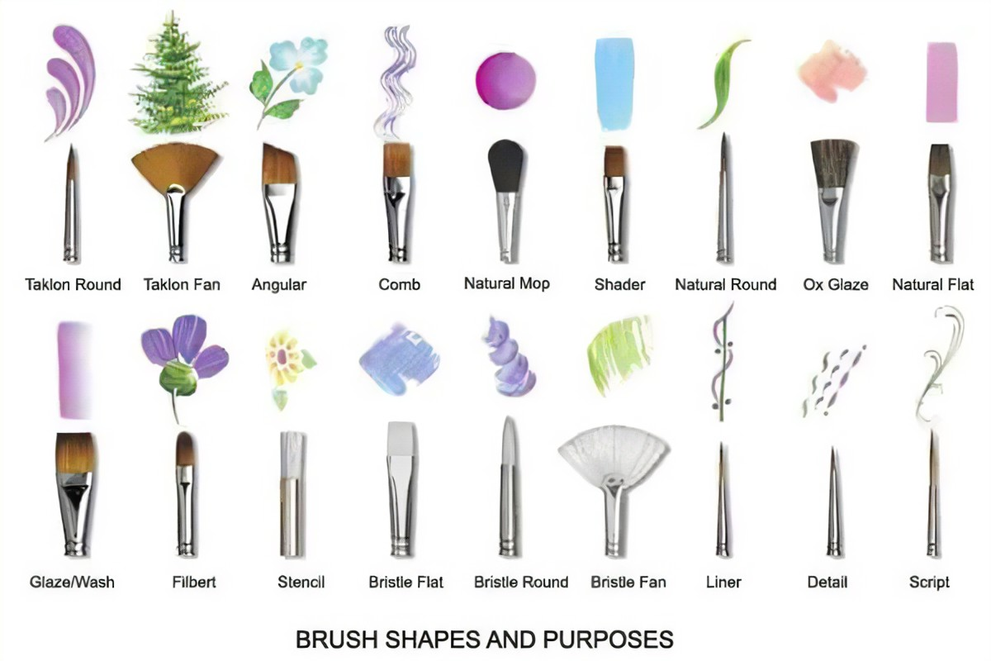
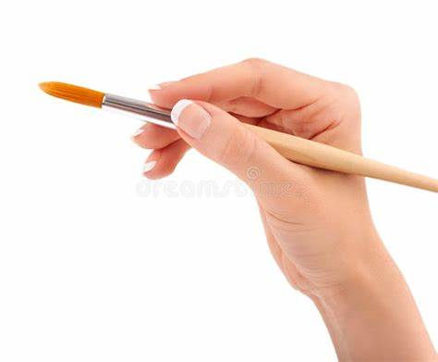
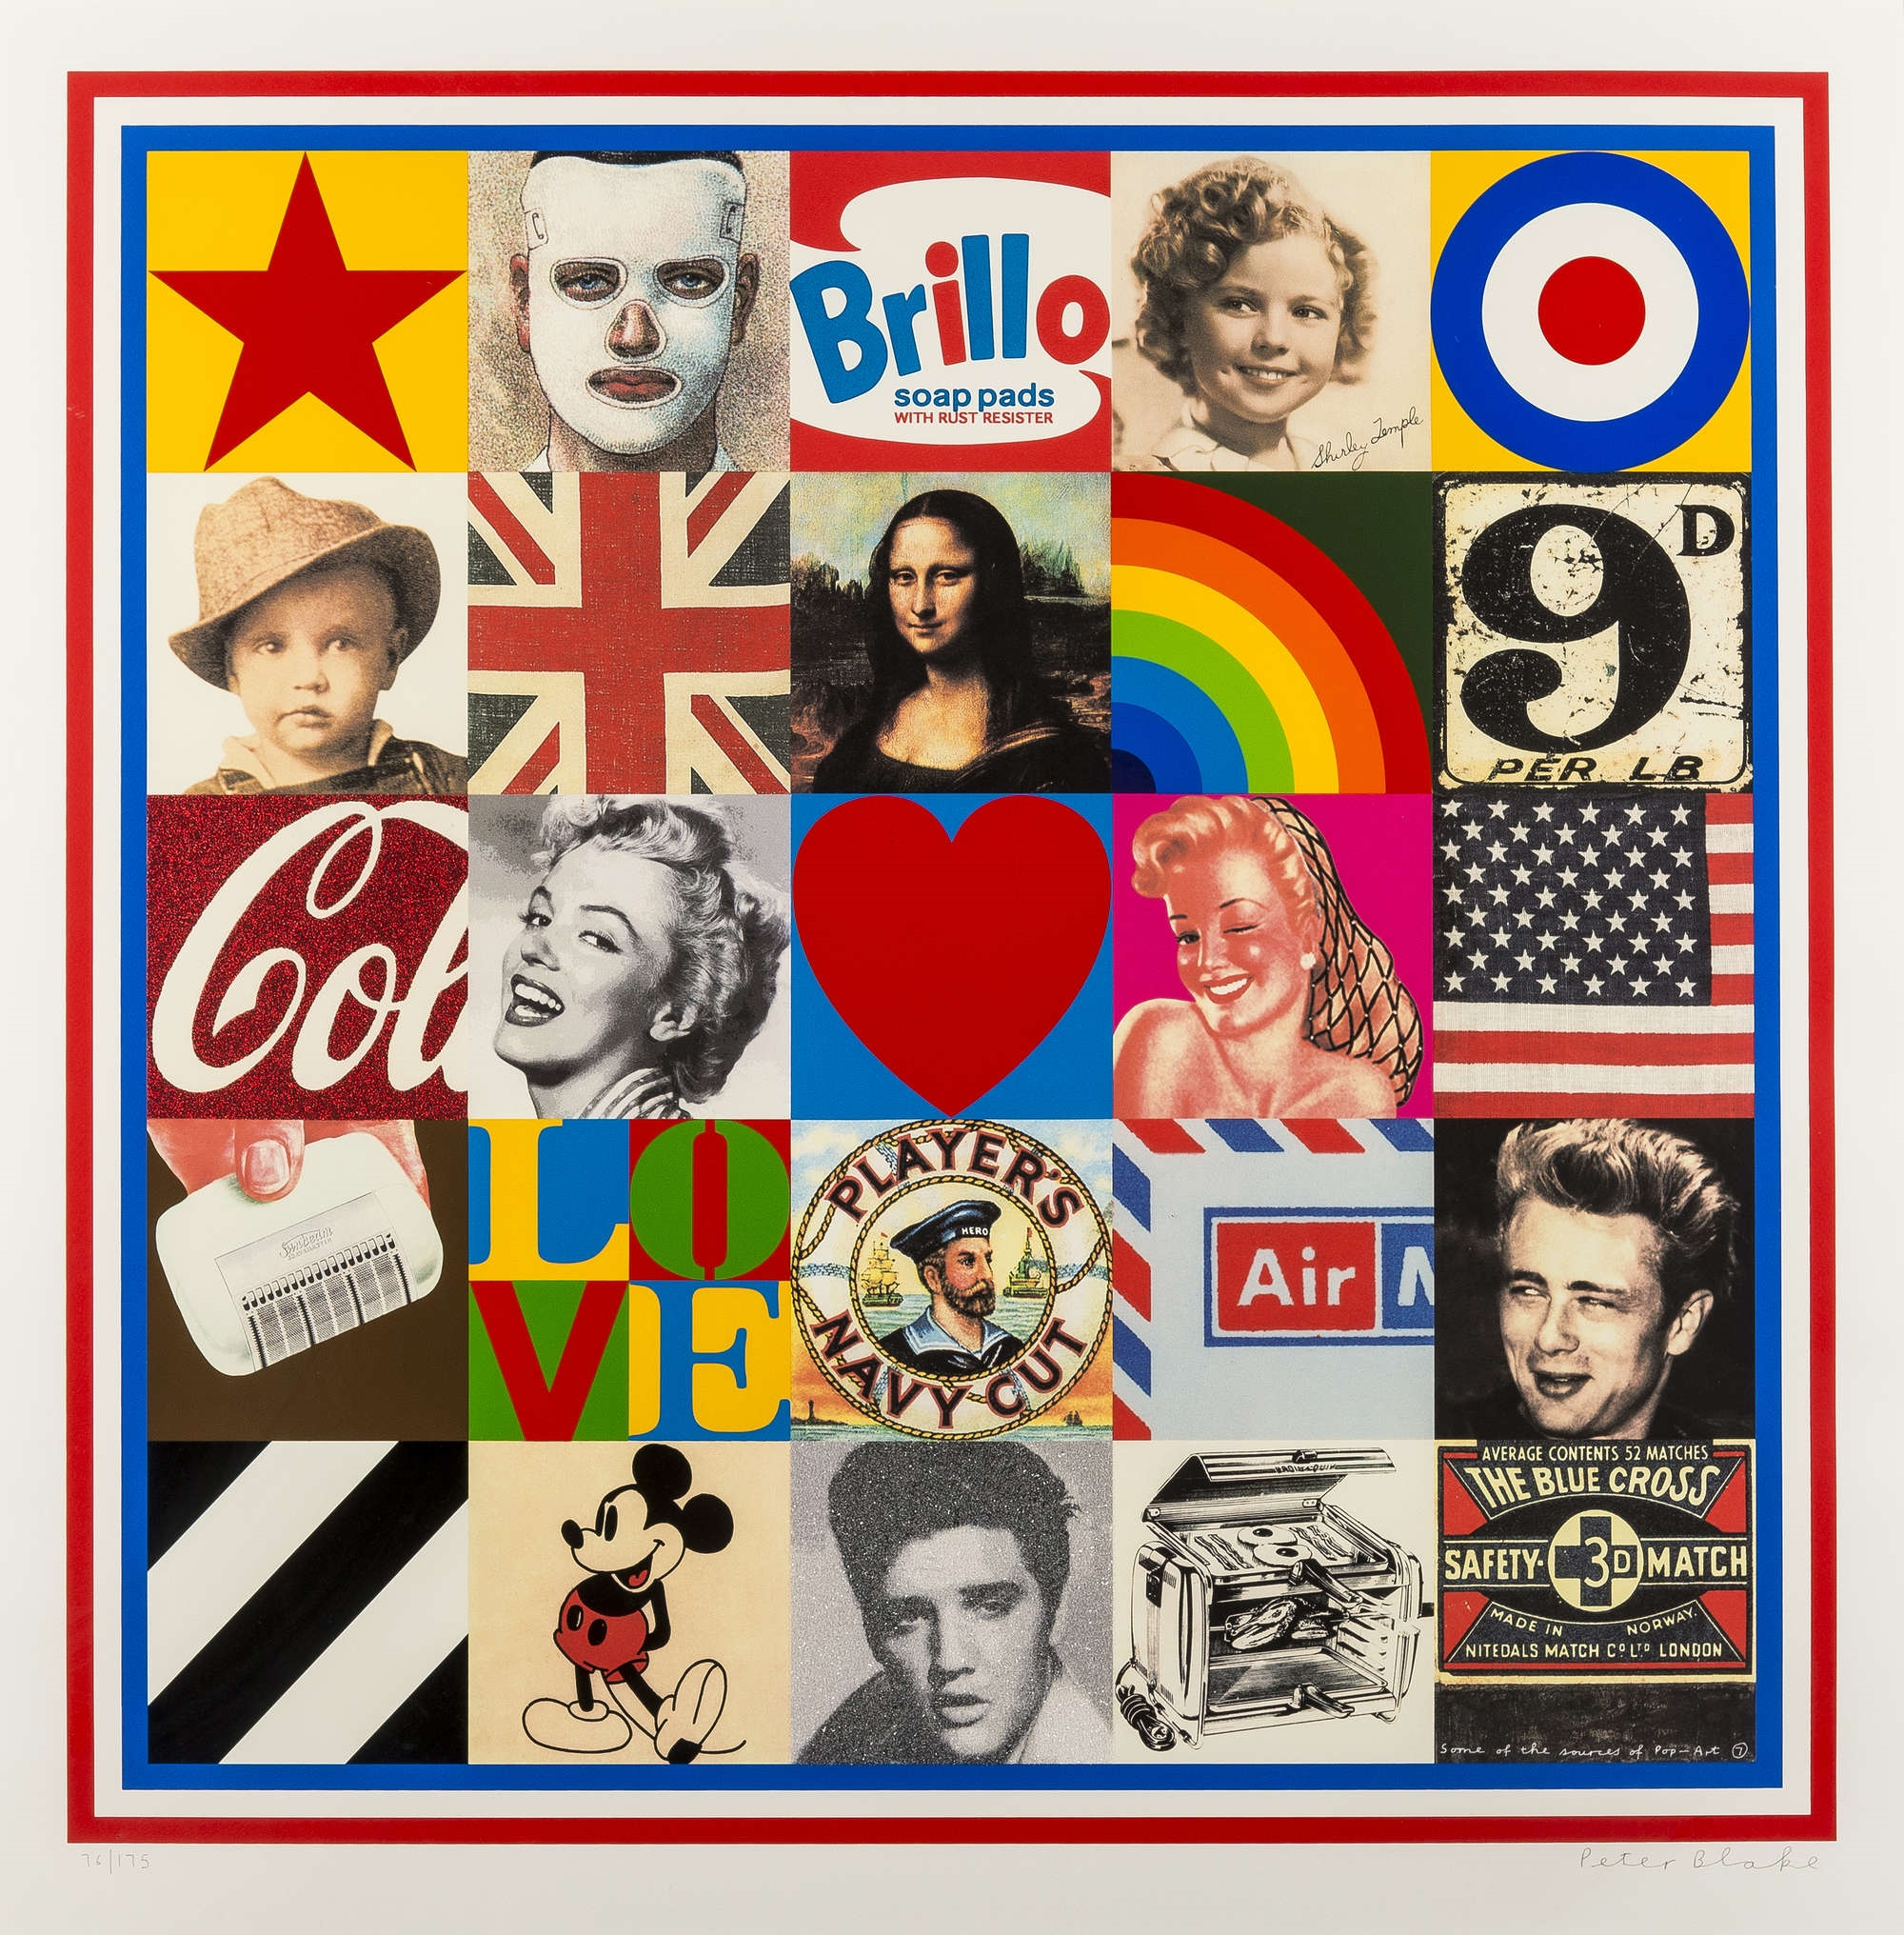
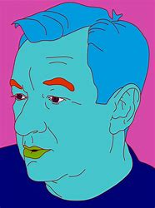
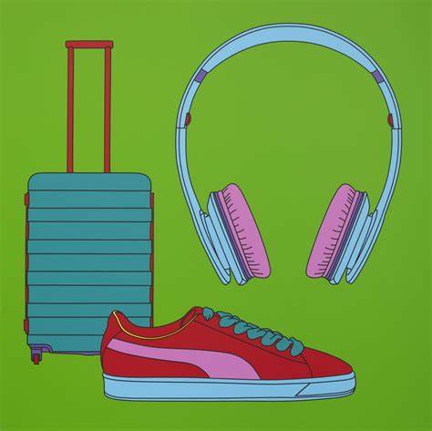
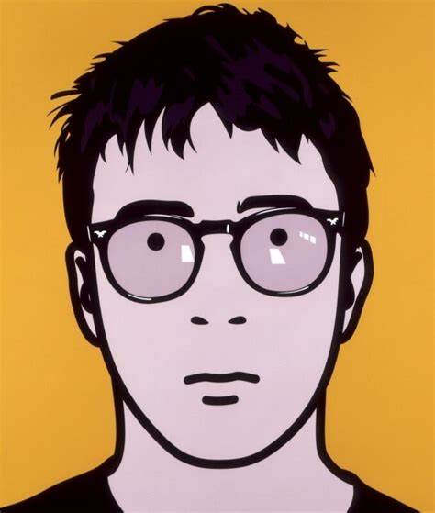
Art – Knowledge Organiser – Year 7 ‘All About Me’
Producing a final outcome ‘All About You’
Portrait in Proportion:
Draw an oval
Using the measurements shown, everything in your face has it’s place and can be measured.
Eyes = ½ way
Nose ½ way between eyes and chin
Eyes fit 5 times into your face.
Nose is the width of your eye.
Lettering Fonts:
The difference between Serif and Sans-Serif.
Script and Decorative.
Artists covered:
Michael Craig Martin, Julian Opie, Peter Blake.
Creating tones, tints and shades:
Tint = Hue + White
Shade = Hue + Black
Water colours = Mute the Hue by using more water.

Slide 2
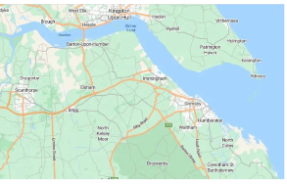
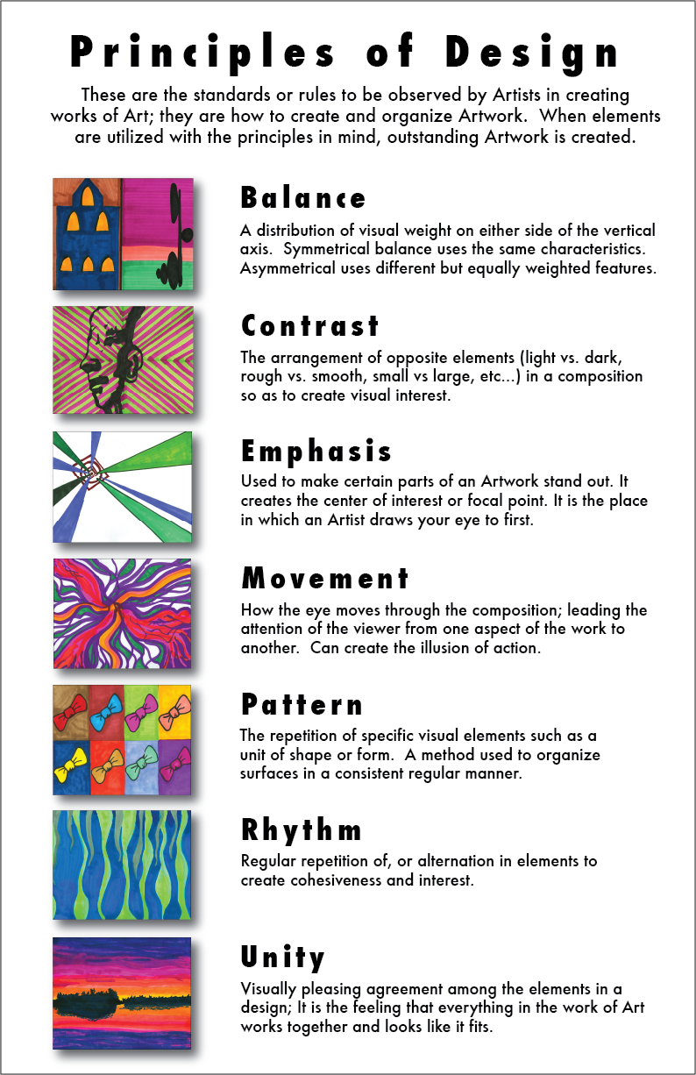
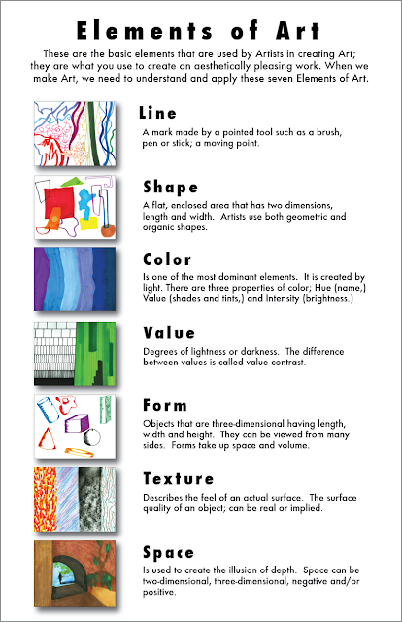
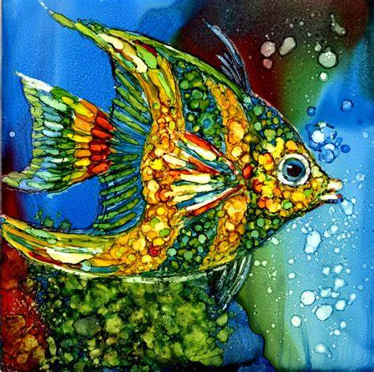
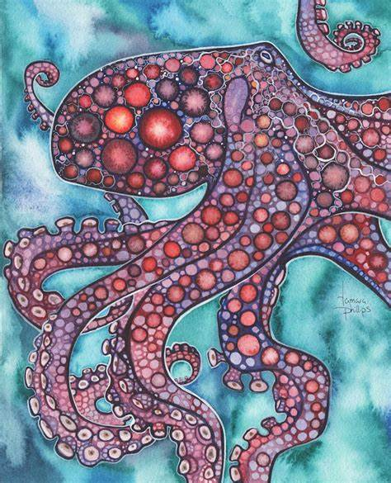
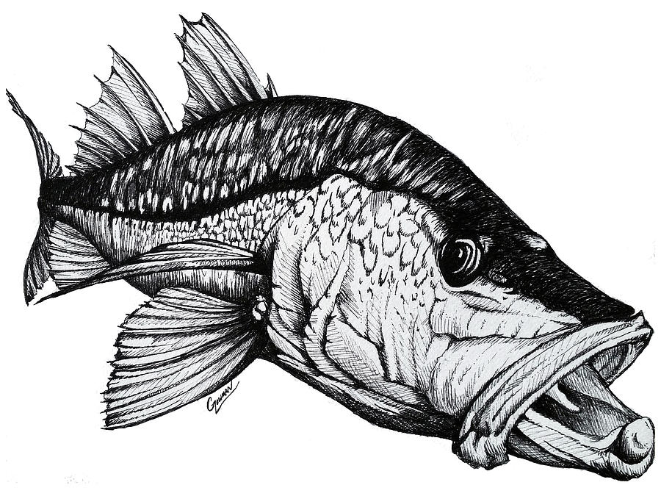
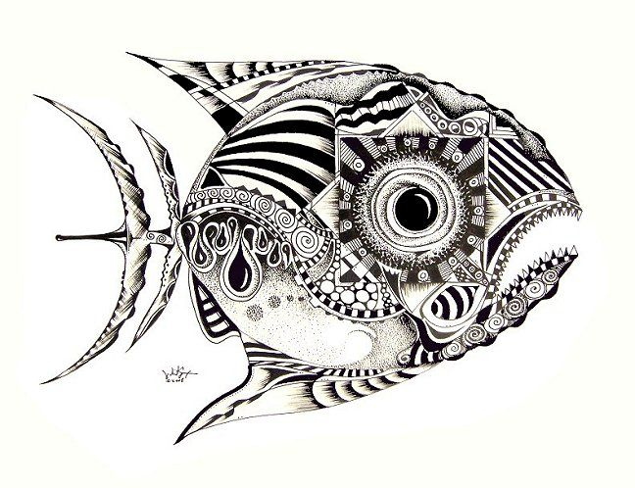
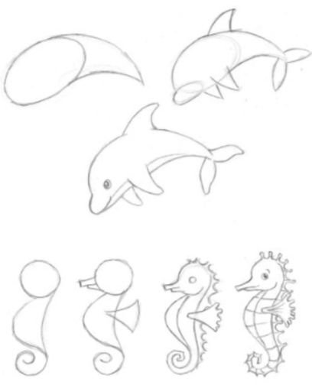
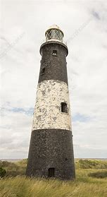
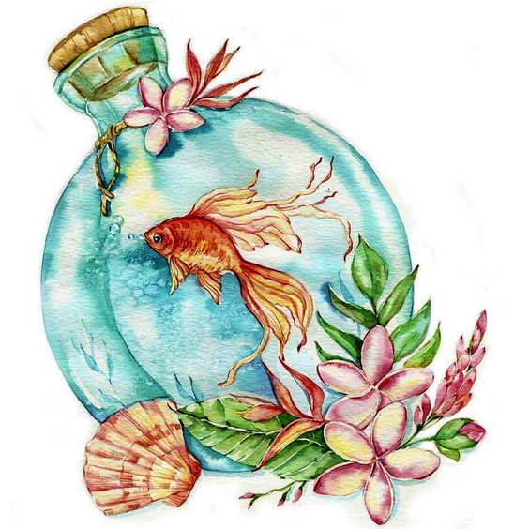
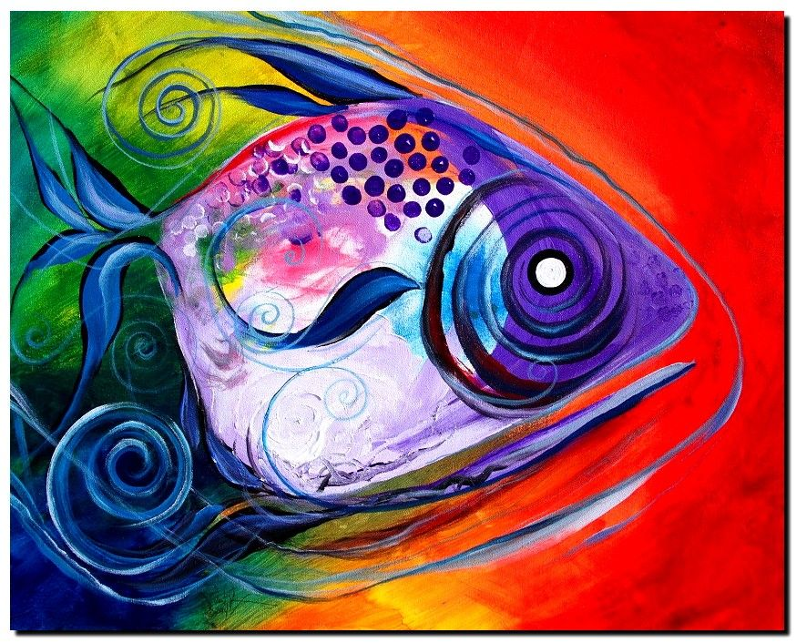
Art – Knowledge Organiser – Year 7 ‘Maritime Futures’
Media:
Pen
Water-colour paint
Water-colour crayons
Oil pastel
Soft pastel
Techniques:
Resist
Pen wash
Blending
Painting
Cross-hatching

