Slide 1
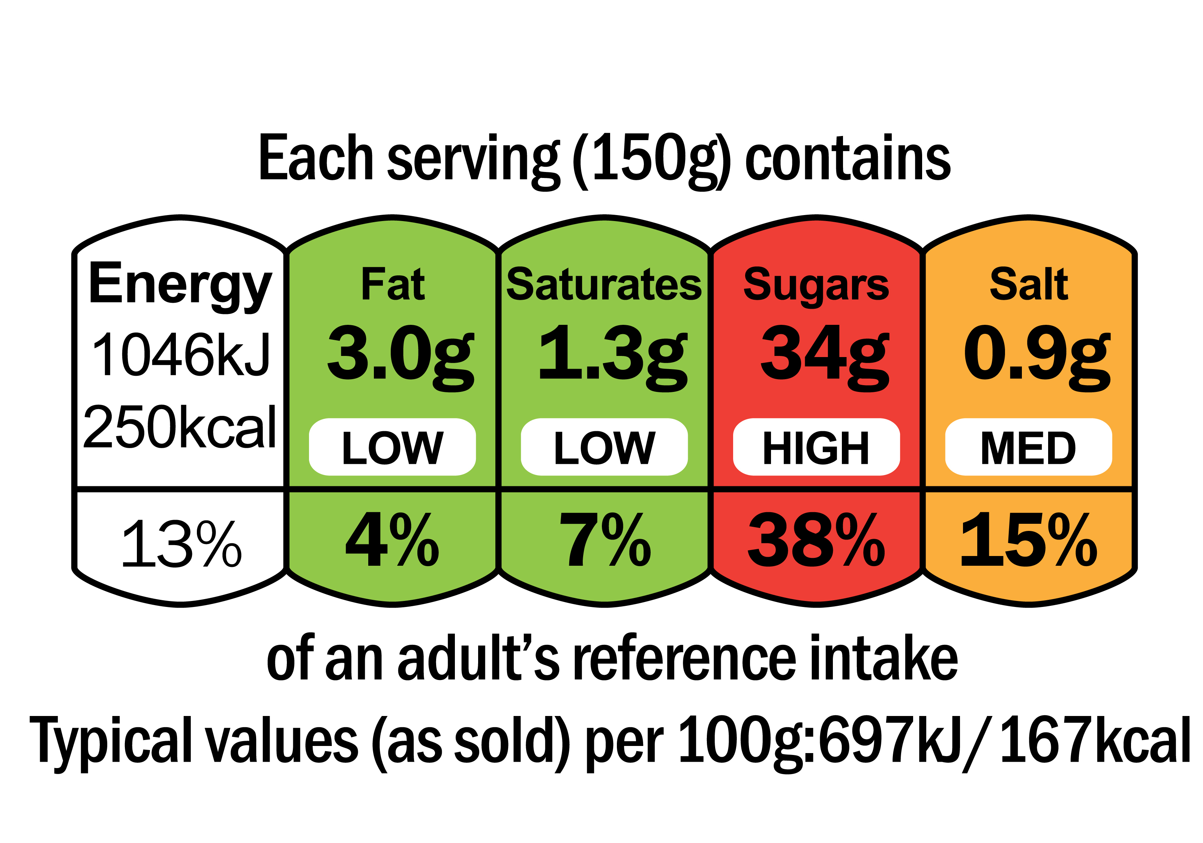
LO3 Knowledge Organiser
Food & Cookery NCFE
SOURCES OF WATER:
Found in virtually all foods, from very small to significant amounts
Recommended intake is 1.75 to 2 litres every day to prevent dehydration.
FUNCTIONS OF WATER:
Regulates body temperature at 37°C
Helps eliminate waste products
Helps the body to absorb nutrients
Transports nutrients, oxygen and carbon dioxide around the body

