Slide 1
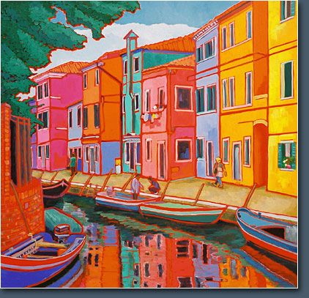
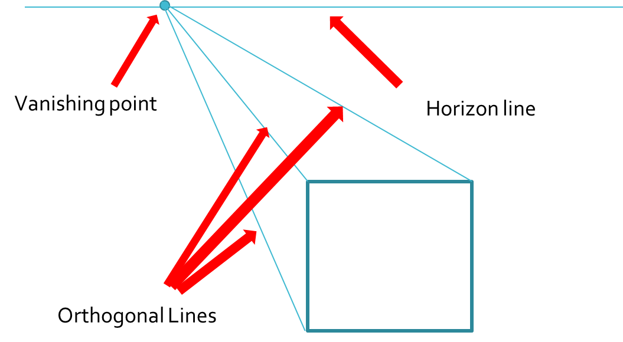
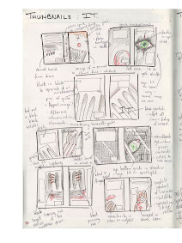
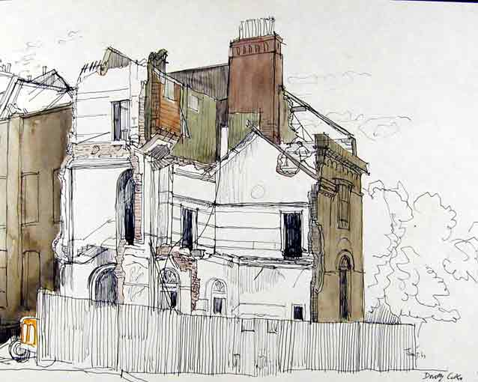
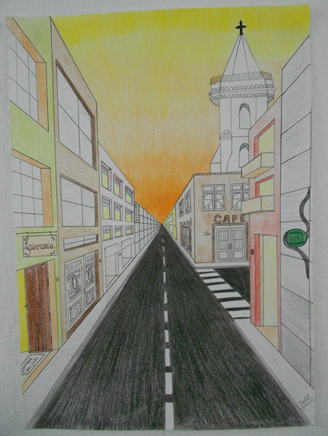
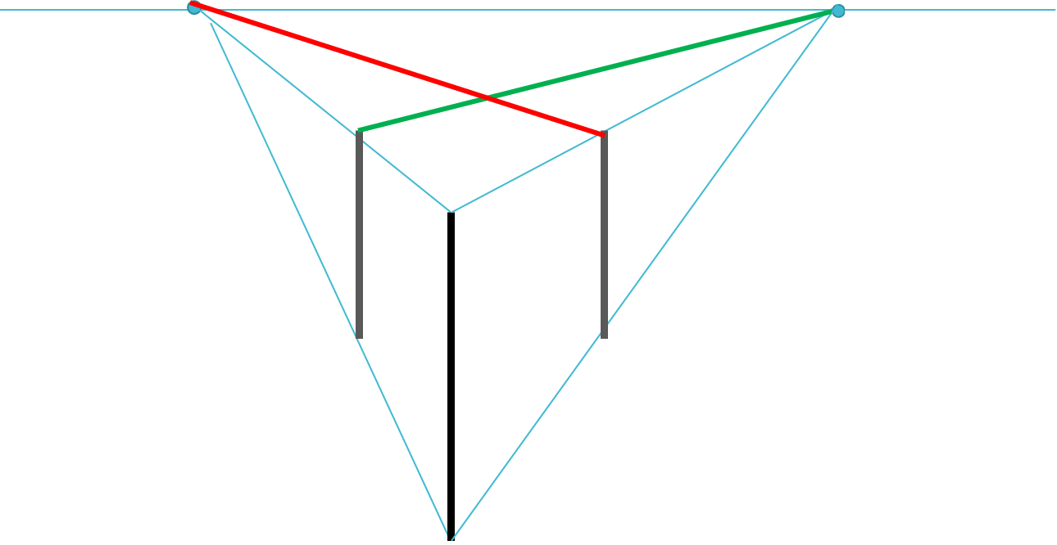
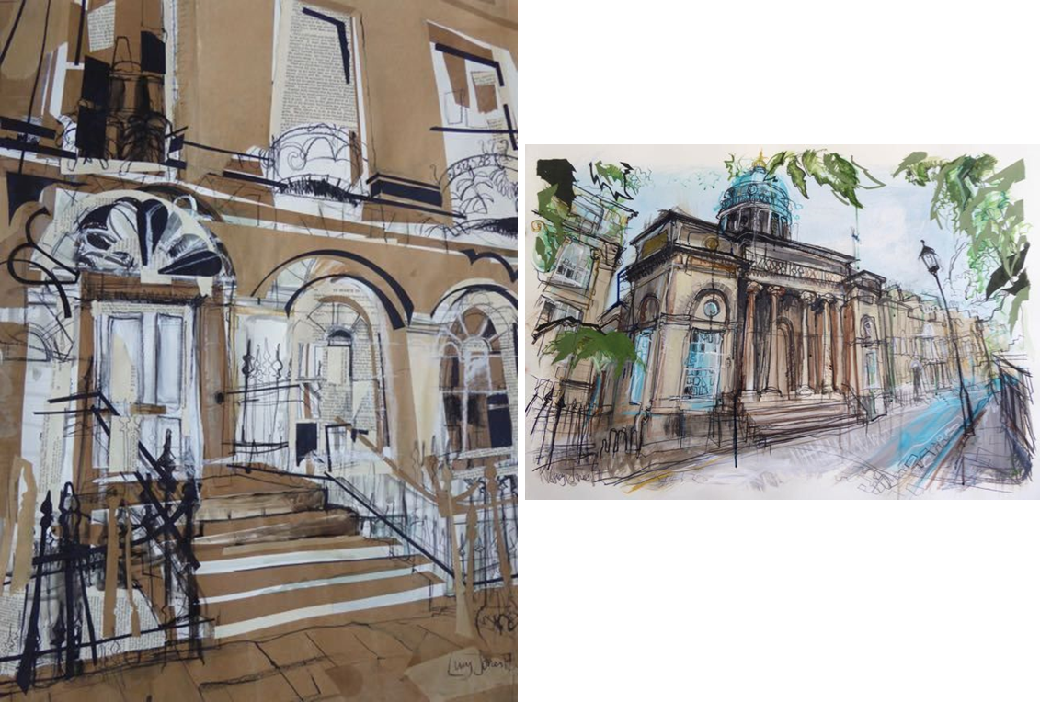
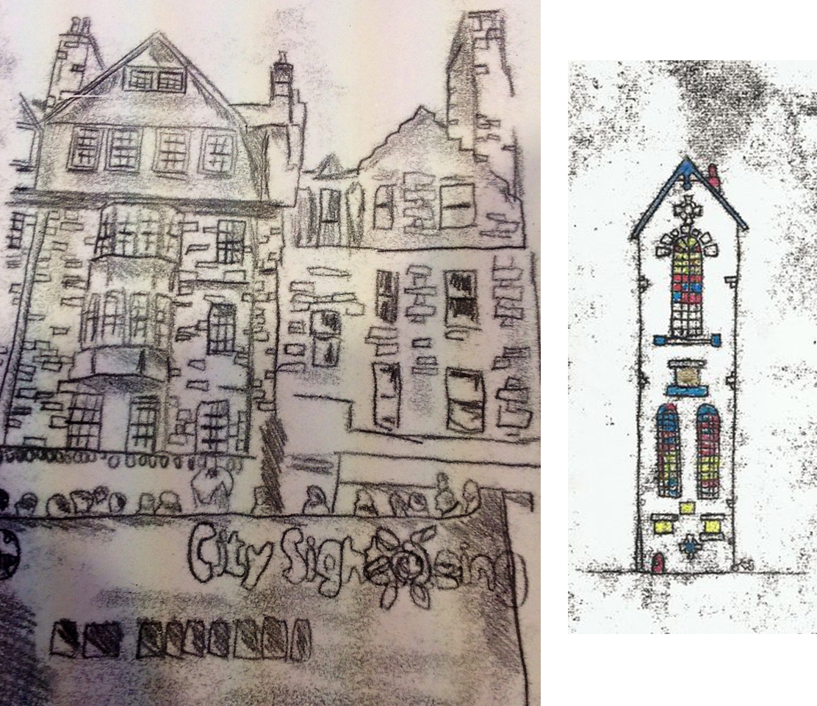
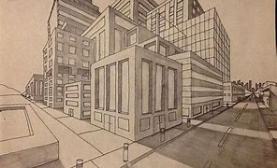
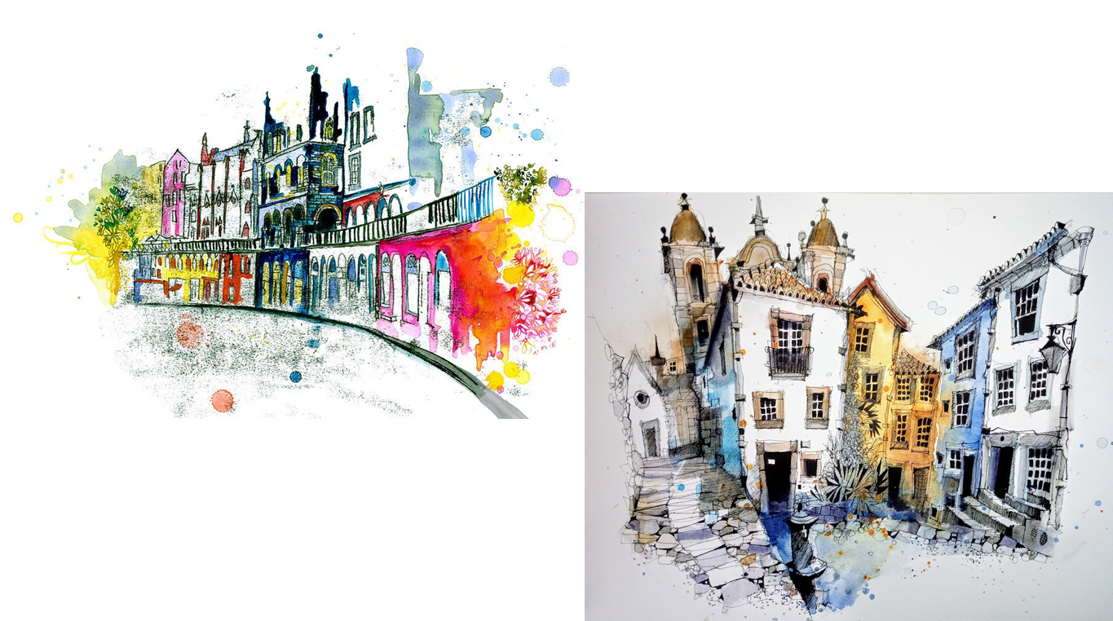
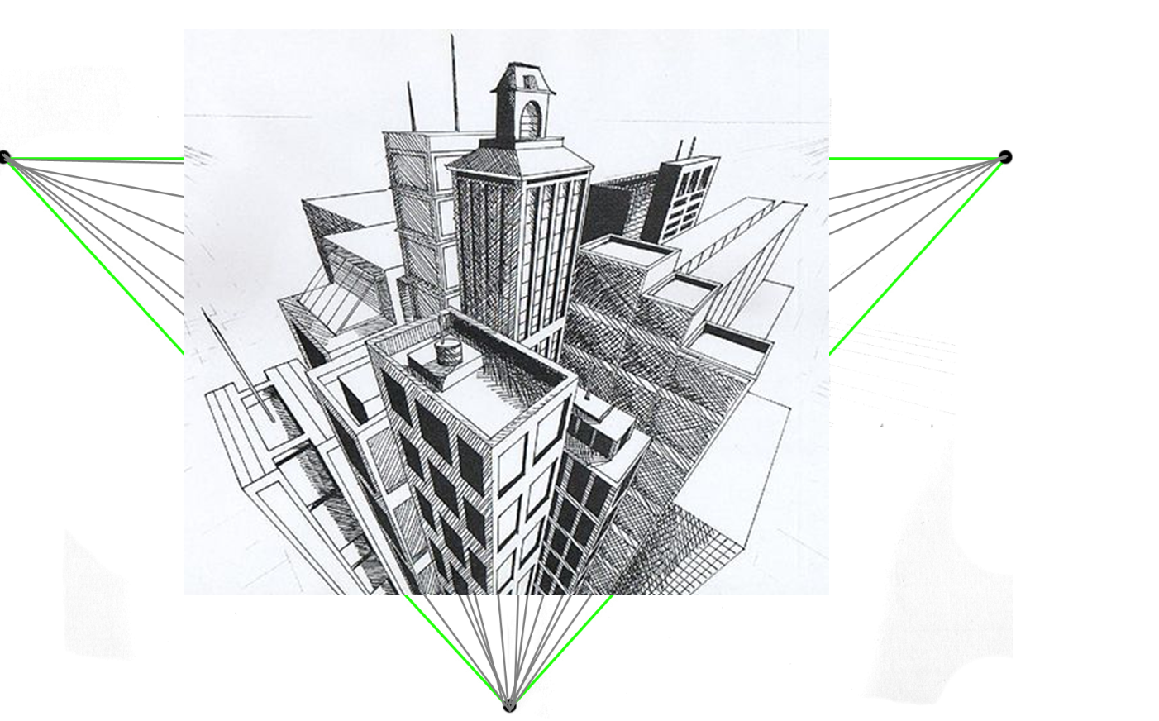
Art – Knowledge Organiser – Year 9 Architecture
Key terms covered through practice.
Composition
Layout of the imagery on your page – Use of space
Personal response.
Final realisation of work, a demonstration of your skills and understanding.
Artists, techniques and media used.
Drawing in perspective
The fauves
Oil Pastel
Blending
Thumbnail sketches
Ideas generation for your personal response. Usually the size of your palm, including annotation and colour.
Dorothy Coke
Pen wash
Watercolours
Painting
One-point perspective
Two-point perspective
Rowan Leckie
Lucy Jones
Mixed Media
Collage
Three-point perspective
Monoprinting
Ian Fennelly

