Slide 1
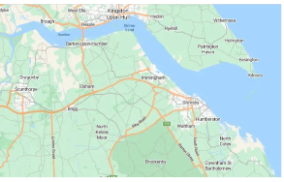
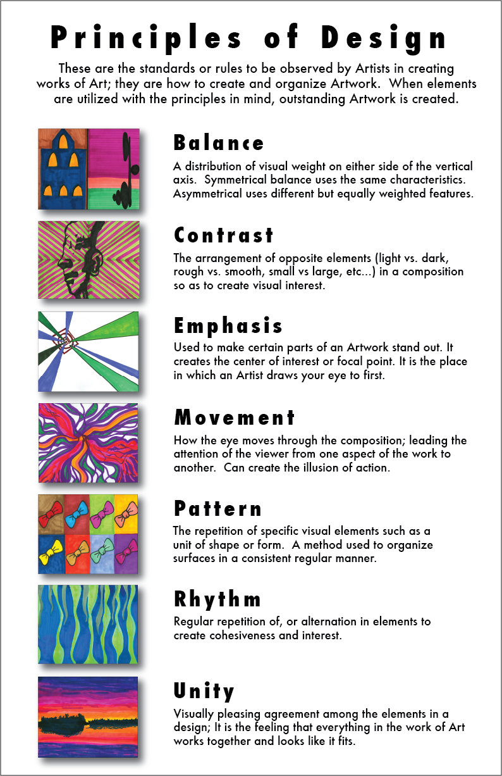
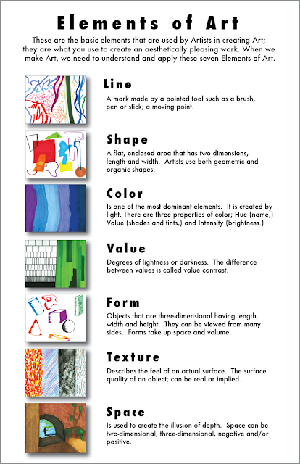
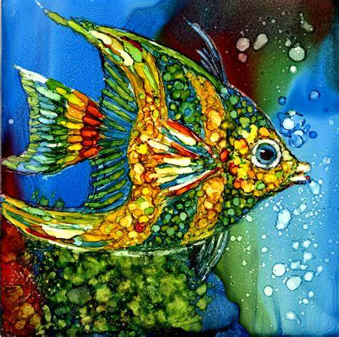
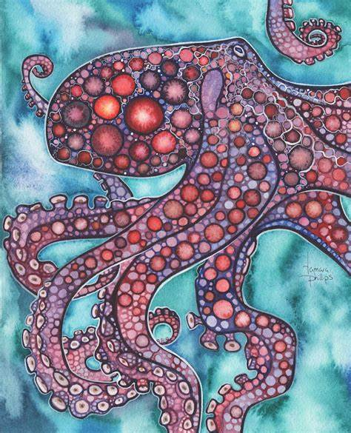
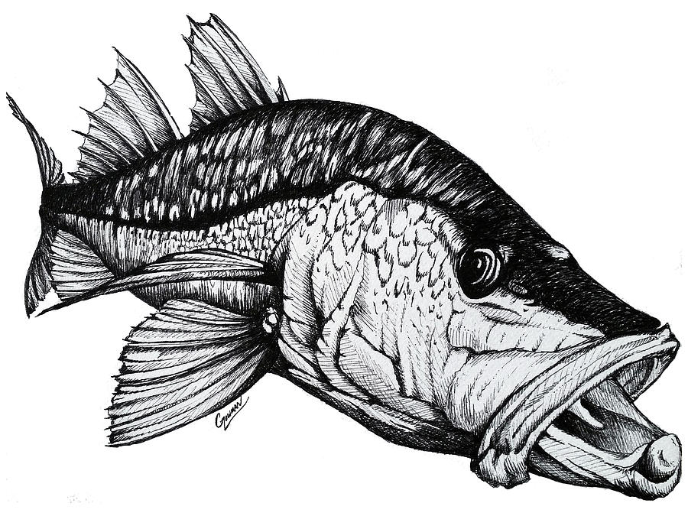
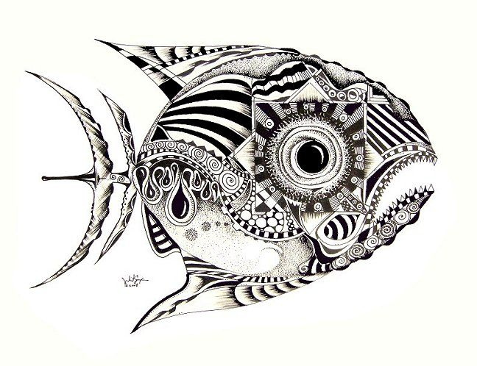
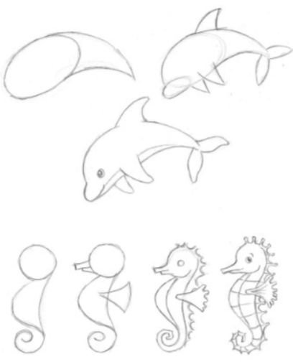
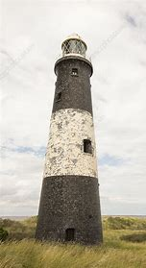
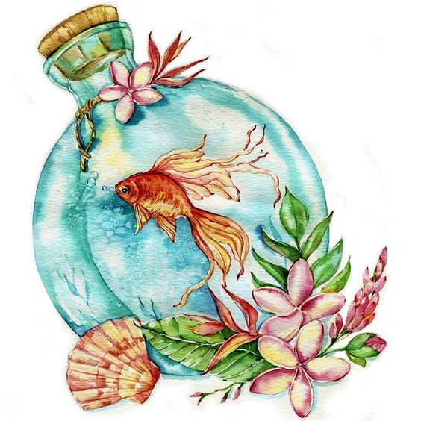
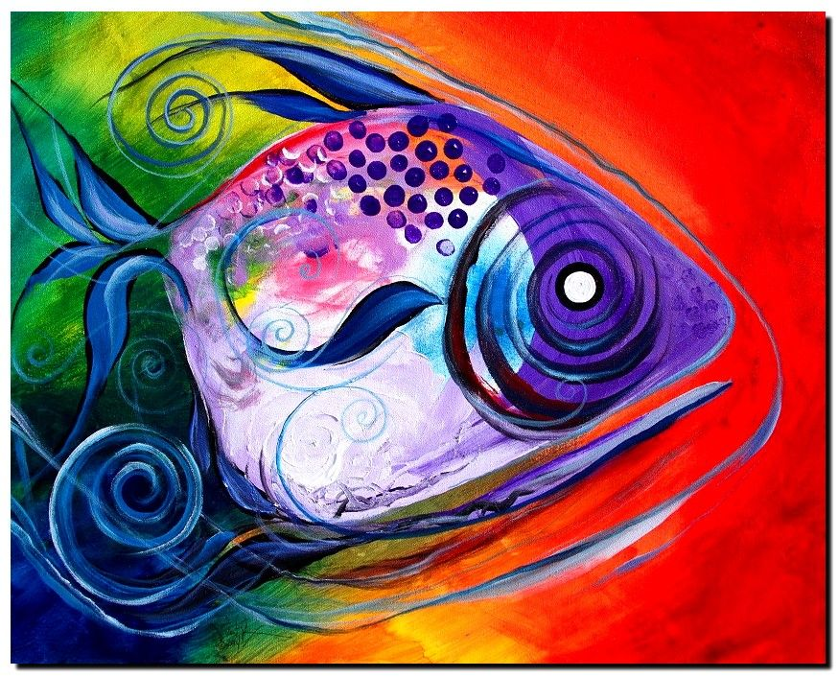
Art – Knowledge Organiser – Year 7 ‘Maritime Futures’
Media:
Pen
Water-colour paint
Water-colour crayons
Oil pastel
Soft pastel
Techniques:
Resist
Pen wash
Blending
Painting
Cross-hatching

Slide 2
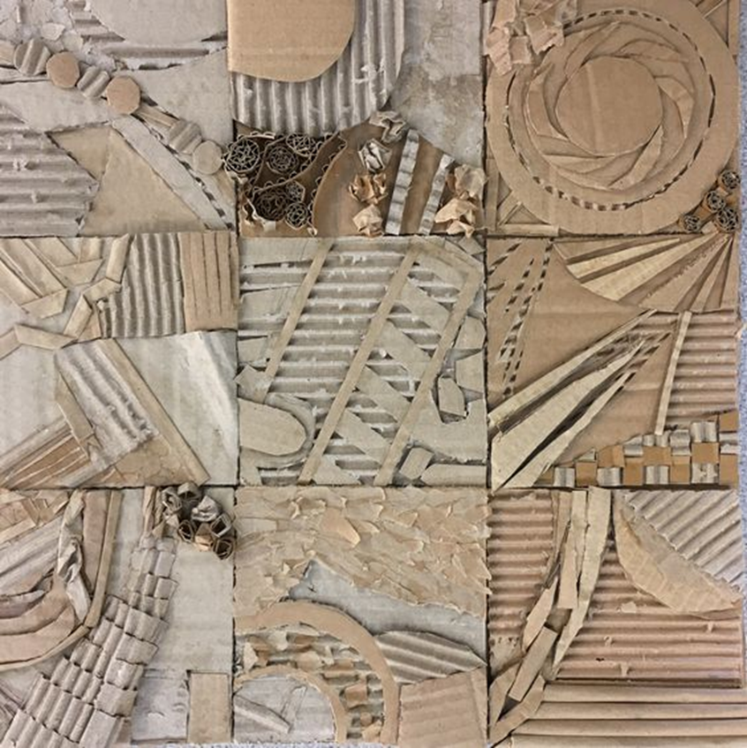
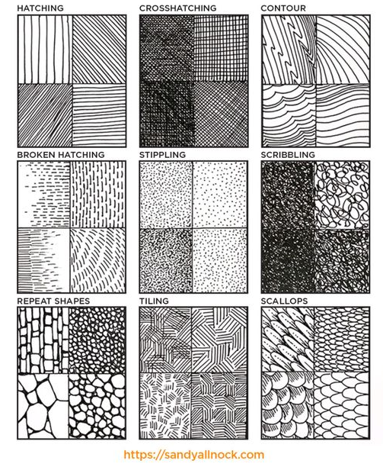
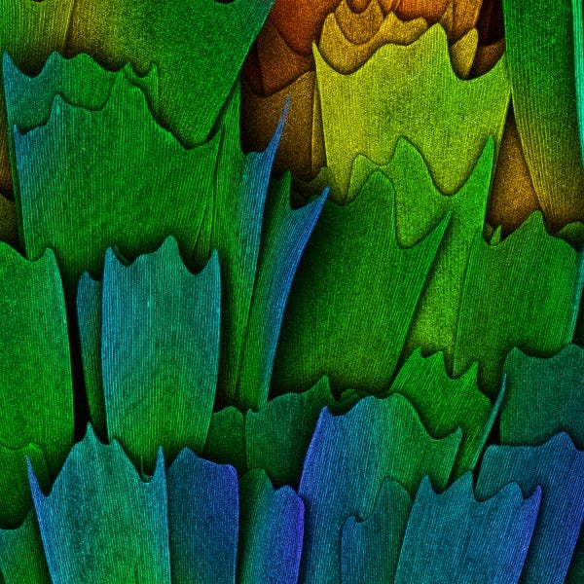
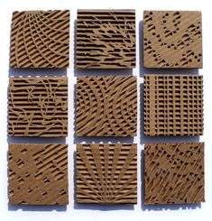
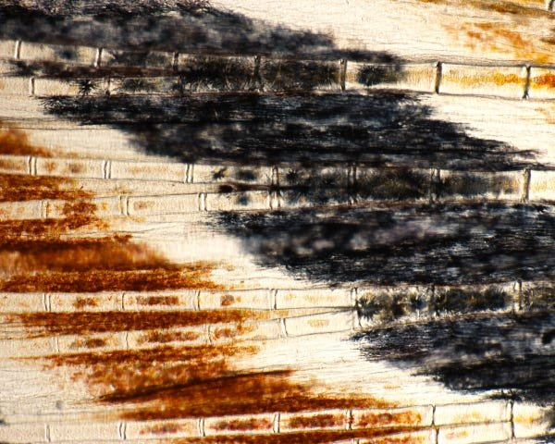
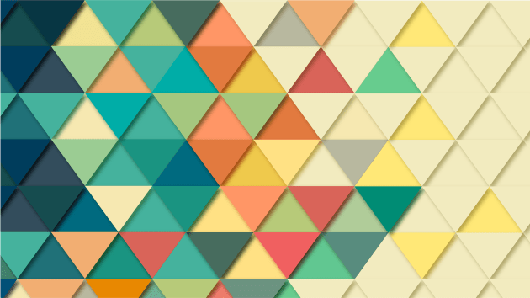
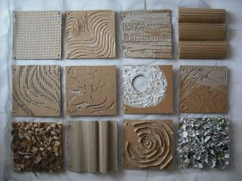
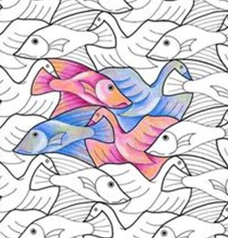
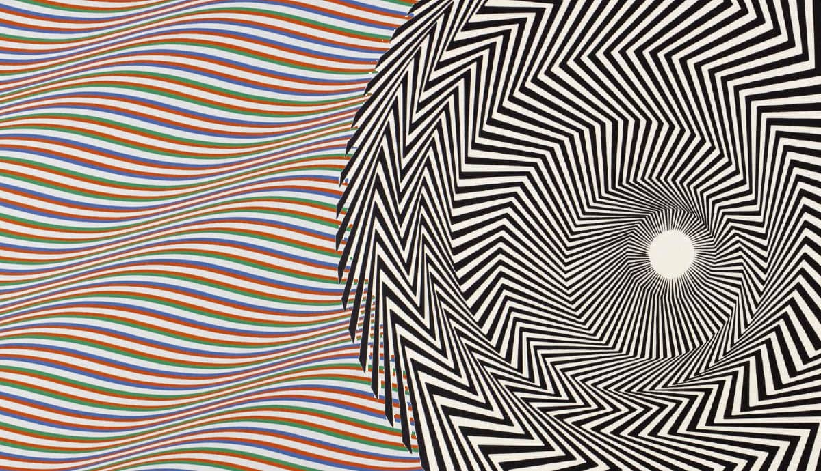
Art – Knowledge Organiser – Year 7 ‘Texture’
Mixed media
Working with layers.
Mark Making
Tessellation:
Ability to combine shapes without leaving any gaps between them.
This is explored through the Art produced by M C Escher.
Patterns in Nature
Butterfly Wings
Pattern &Texture:
Explorations of patterns in nature taken both from flora and fauna.
Patterns and texture will be created using a variety of media from mark making using charcoal, pens and pencils, moving through to Relief work using recycled materials.
Tessellation
Bridget Riley M C Escher

