Slide 1
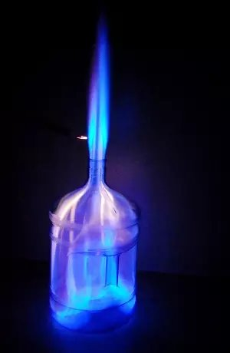
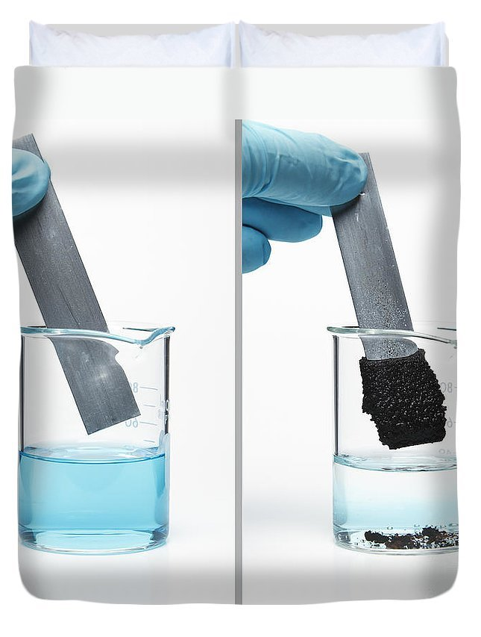
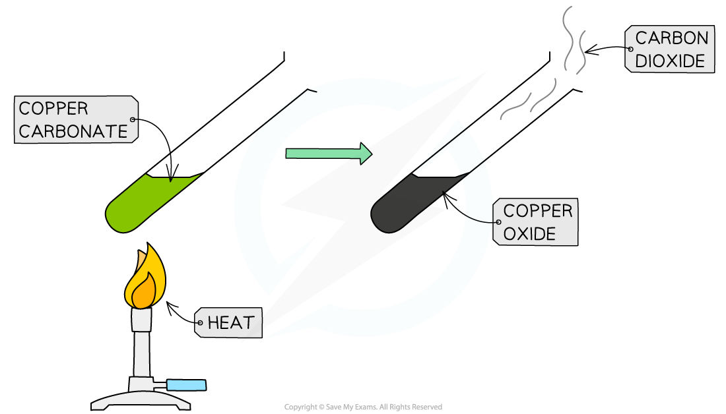
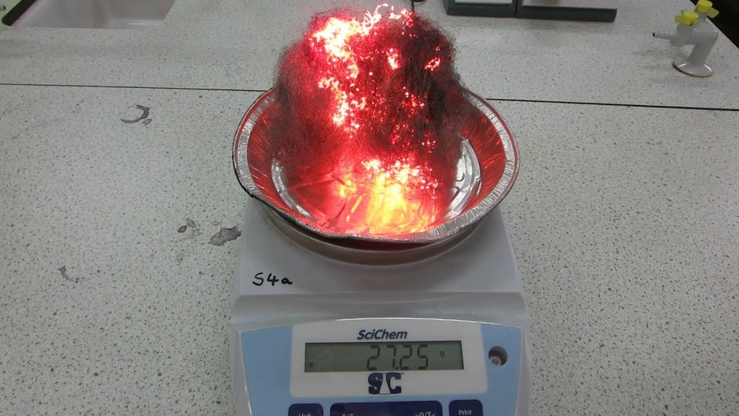
Chemical Reactions as the Rearrangement of Atoms
Atoms in Reactants and Products: In a chemical reaction, atoms in the reactants rearrange to form new products.
Conservation of Mass: The total number of each type of atom remains the same before and after the reaction.
Representing Chemical Reactions Using Formulae and Equations
Chemical Formulae: A chemical formula shows the types and numbers of atoms in a molecule
(e.g., H₂O for water).
Chemical Equations: A chemical equation uses symbols to show the reactants and products in a reaction
(e.g., 2H₂ + O₂ → 2H₂O).
Combustion Reactions
Combustion is a reaction where a substance reacts with oxygen to produce heat and light (e.g., burning wood).
Word Equations
Word equations describe chemical reactions using the names of the reactants and products
(e.g., hydrogen + oxygen → water).
08 Types of Reaction
Oxidation Reactions
Oxidation is a reaction where a substance gains oxygen
(e.g., iron rusting when it reacts with oxygen to form iron oxide).
Examples of Chemical Reactions
Combustion Example:
Methane + Oxygen → Carbon Dioxide + Water.
Thermal Decomposition Example:
Calcium Carbonate → Calcium Oxide + Carbon Dioxide.
Oxidation Example:
Magnesium + Oxygen → Magnesium Oxide.
Displacement Example:
Zinc + Copper Sulfate → Zinc Sulfate + Copper.
Thermal Decomposition Reactions
This is a reaction where a compound breaks down into simpler substances when heated (e.g., heating calcium carbonate to form calcium oxide and carbon dioxide).
Displacement Reactions
In a displacement reaction, a more reactive element displaces a less reactive element from a compound
(e.g., zinc displacing copper from copper sulfate solution).

