Slide 1
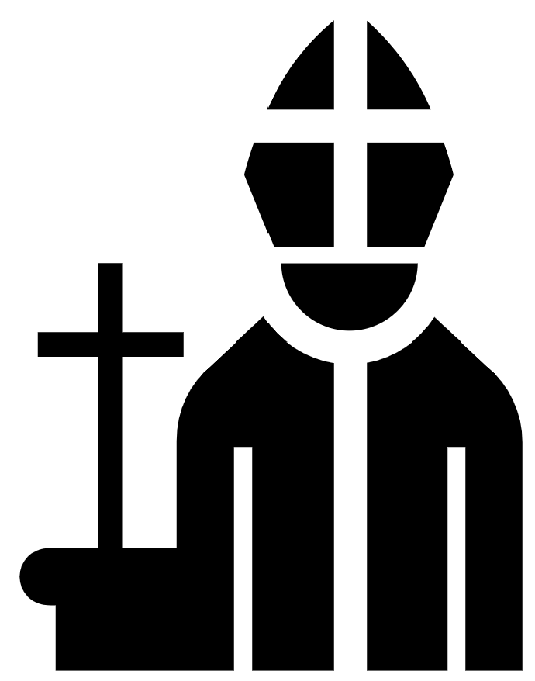
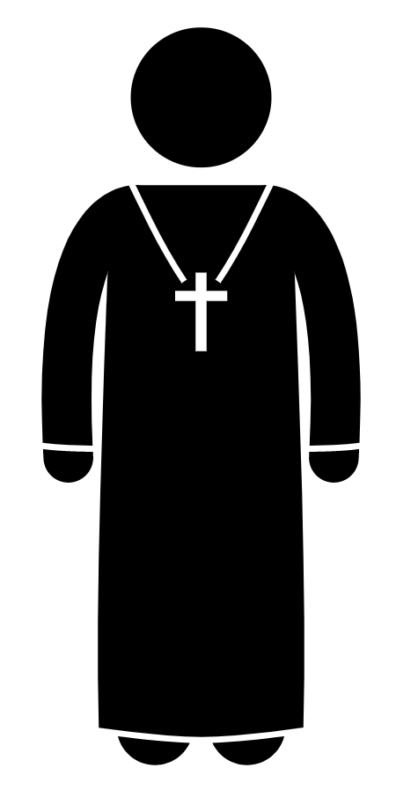
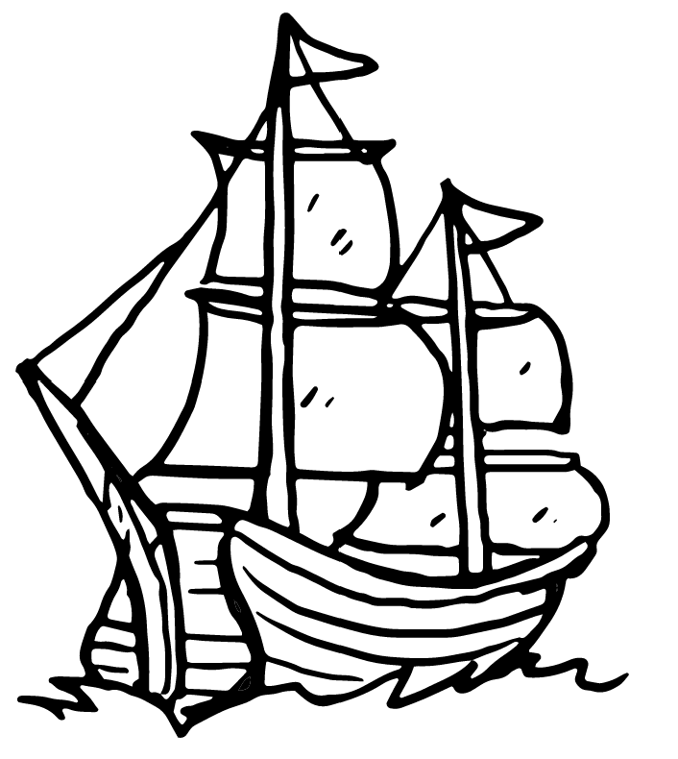
GCSE History – Elizabethan England
Part three: Threats from home and abroad
Key people
Key terms
Key events
Act of Supremacy – gives Elizabeth power of Church Elizabeth as Supreme Governor of Church; all clergy must swear loyalty to her Act of Uniformity – establishes consistency in churches Book of Common Prayer used, in English Wording of prayer book deliberately unclear so it can be interpreted differently by Catholics and Protestants Everyone had to attend church on Sunday – fined 1 shilling for every absence Elizabeth is initially very tolerant of Catholics, who she allows to worship in secret. This changes from 1580s because; Jesuit Missions are sent to convert to Catholicism Papal Bull in 1570 encourages Elizabeth’s assassination Mary, Queen of Scots arrives in England in 1568 and becomes a Catholic figurehead for plots Northern Rebellion (1569) started when Elizabeth would not give permission for the Duke of Norfolk to marry Mary Queen of Scots. The Earl of Westmorland and the Earl of Northumberland took control of Durham Cathedral and celebrated Catholic mass. They attempted to march to London but were defeated. Northumberland was executed. Westmorland fled and Norfolk was sent to the tower. The Ridolfi Plot (1571) was organised with the Duke of Norfolk. Ridolfi was a Catholic Italian banker living in England. He planned invasions from both the Netherlands and the North. It was stopped when spies captured a message. The Duke of Norfolk confessed and was executed. Throckmorton Plot (1583) was backed by the Spanish and the Pope to invade England. Francis Throckmorton acted as a go between linking Mary Queen of Scots to the Spanish ambassador. Once again Walsingham’s spies found out about the plot. Throckmorton was tortured and confessed. Babington Plot (1586) to murder Elizabeth and put Mary on the throne, again with the help of the French Duke of Guise and the support of Philip II of Spain and the pope. Letters to Mary were intercepted by Walsingham and the evidence against her was so strong that Mary was finally tried for treason by the Privy Council and found guilty. She was executed in 1587. Following Mary’s execution, Phillip II of Spain launched an armada of approximately 150 ships to dethrone Elizabeth. A series of beacons warned of the Armada’s arrival and the English navy engaged them at Portsmouth. The Battle of Gravelines lost 1000 Spanish soldiers and 3 ships. The wind changed, meaning Spanish ships were blown off course towards Scotland where almost half of the Armada were destroyed. This “Protestant Wind” was a propaganda victory for Elizabeth and there was not another major foreign challenge to her reign.
Elizabeth’s allies
Francis Walsingham (1532-1590) Elizabeth’s spymaster. Walsingham was responsible for a network of spies across England, who’s aim was to uncover plots against the Queen.
Mary, Queen of Scots (1542-1587) Elizabeth’s Catholic second cousin, has legitimate claim to the English throne. Seeks refuge in England after being driven out of Scotland. Has produced an heir (future King James I). At the centre of plots to depose Elizabeth. Executed for treason after Babington plot is uncovered. Earls of Northumberland (1528-1572) and Westmorland (1542-1601) Catholic northern earls who rebelled in 1569 at loss of power under Elizabeth. Duke of Norfolk (1536-1573) English Protestant noble with links to Catholics. Involved in plots to marry Mary and depose Elizabeth. Executed in 1572 after being involved in Ridolfi Plot. Pope Pius V (1504-1572) Pope responsible for excommunicating Elizabeth. In his Papal Bull published in 1570, he encouraged English Catholics to assassinate and depose Elizabeth. Philip II of Spain (1527-1598) Catholic King of Spain, also ruled over the Netherlands. From 1580, became king of Portugal. Was married to Elizabeth’s sister, Mary. A staunch Catholic, Philip wanted to eradicate the Protestant faith from Europe. Jesuit and Seminary Priests Catholic priests who were smuggled into and around England with the aim of converting English Protestants to Catholicism.
Religious Settlement
Catholics Loyal to Pope Bible and services in Latin Belief in saints and pilgrimages Clergy can’t marry Elaborate decoration | Protestants Church headed by monarch Bible and services in English Fewer decorations Clergy can marry | Puritans Strict protestants No head of the Church No decorations Live by the words in the Bible
Clergy |  | Religious leaders such as priests and bishops.
Council of the North |  | Set up after the Papal Bull to enforce government authority and policies in the North of England.
Divine Right |  | The belief that a monarch’s right to rule came from God.
Excommunication |  | A severe punishment, imposed by the Pope, where a person is expelled from the Catholic church.
Jesuits |  | Roman Catholic missionaries whose aim was to destroy heresy (Protestantism).
Papal Bull |  | A written order issued by the Pope.
‘Protestant Wind’ |  | Wind that blew the Spanish Armada off course. Some argued that God sent the wind to show he favoured Elizabeth and Protestants.
Recusants |  | Catholics who are unwilling to attend Protestant church services.
Religious Settlement |  | Set of laws passed by Elizabeth to try and unify the country and heal the religious divisions.
Seminary Priests |  | Priests trained in Roman Catholic Colleges.
Treason |  | The crime of betraying one's country, especially by attempting to kill or overthrow the monarch.
Threats to Elizabeth
Plots against Elizabeth
Mary,
Queen of Scots is imprisoned in England
Papal Bull
and Elizabeth’s excommunication
First Jesuit Priests arrive in England
The Babington Plot
The
Spanish Armada is defeated
Elizabeth
passes the Religious Settlement
Northern Rebellion
The Ridolfi
Plot
The Throckmorton Plot
Mary,
Queen of Scots is executed
Spanish Armada
Timeline
1559
1568
1569
1570
1571
1580
1583
1586
1587
1588

