Slide 1

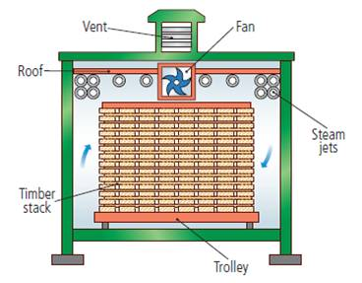
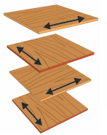
Woods and Boards
Natural Timbers
Softwoods are generally cheaper than hardwoods as they are more available, since they grow quicker.
But because man-made boards are manufactured they are cheaper than timbers.
Man-made boards also come in a better variety of sizes since they don’t depend on tree growth.
Stock forms for both include; sheets, dowel, planks, etc
Man-Made Boards
Manufactured boards are made from wood chips/dust/ layers and glue.
Material | Key info | Examples
Chipboard | Prone to chipping but good compressive strength. Not-water resistant | Flooring, low-end furniture, flat-pack
MDF | Rigid and stable. Easy to finish. Absorbs liquid easily | Flat-pack furniture and kitchen unites
Plywood | Very stable. Exterior veneer can be used from more expensive woods | Shelving, furniture, toys
Hardwoods come from Deciduous Trees. These trees loose leaves in winter and grow fruit and flowers in spring
Material | Key info | Examples
Ash | Flexible, tough and shock resistant | Sports equipment Tool Handles
Beech | Fine finish, tough and durable | Toys, furniture and veneers
Mahogany | Easily worked, durable, high quality finish | High-end furniture
Balsa | Very soft and spongy. Light | Modelling
Oak | Tough, durable and hard | Flooring, furniture and veneers
Primary Processing of Papers and Boards
Trees are cut then converted into planks by cut using saws
It is then seasoned to reduce the moisture in the wood. This is done by either:
Air-drying – Planks are stacked and air allowed to circulate; causing evaporation
Kiln-drying – Where planks are put into a kiln and dried rapidly. This process is more costly than air-drying
Softwoods come from Coniferous Trees. These have thin, needle-like leaves and grow all year round. Often have pine cones and sometimes nuts and seeds
Material | Key info | Examples
Larch | Durable, tough, good water resistance and finishes well | Furniture, flooring and used outdoors
Pine | Light, easy to work with but can split | Cheap furniture, construction and decking
Spruce | Easy to work with, high stiffness but can decay quickly | Furniture, musical instruments and construction
Manufactured boards can be either be made by lamination or compression
Lamination – Layers of woods and adhesive are layered and compressed together. Usually with a more expensive wooden veneer on the top
Compression – Wood is shredded, heated and compressed with adhesive under extreme pressure

