Slide 1



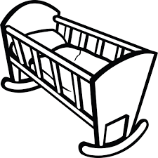
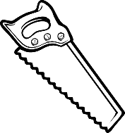

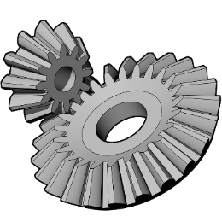
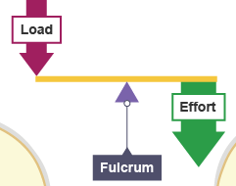
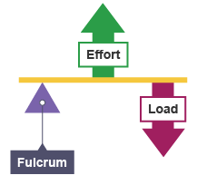
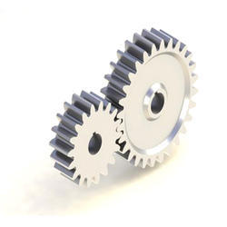
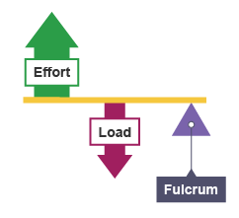
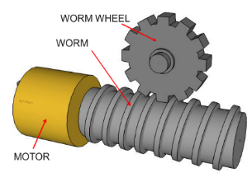
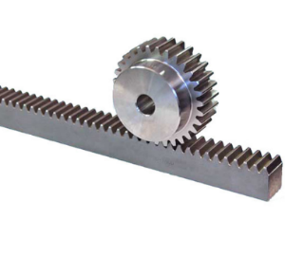
Mechanical Systems
Forces
Motion
Compression
Rotation
Ten
sion
Linear
Torsion
She
Oscill ating
ar
Recip rocating
Levers
Gears and Pulleys
Bevel Gear
Gears have teeth that mesh together with each other (like teeth on a zip)
They mainly focus on rotary motion on tools and machinery e.g. car steering and pillar drills
2nd Class Lever:
Load in the centre
E.g. wheelbarrow
Spur Gear
1st Class Lever:
Fulcrum in the centre
E.g. Scissors
3rd Class Lever:
Force in the centre
E.g. Lifting a dumbbell
A Pulley is a grooved wheel, that has a belt running through it
This uses rotary motion and is often used to help with heavy loads, and transfer force from a motor to a tool in machines like drills, etc
Worm and Wheel
Rack and Pinion

