Slide 1

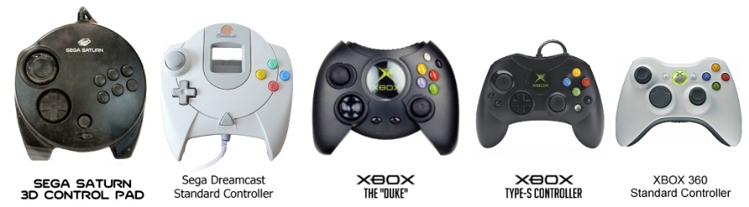
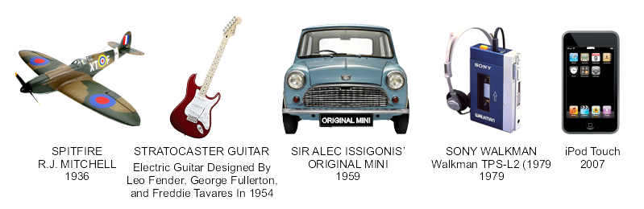
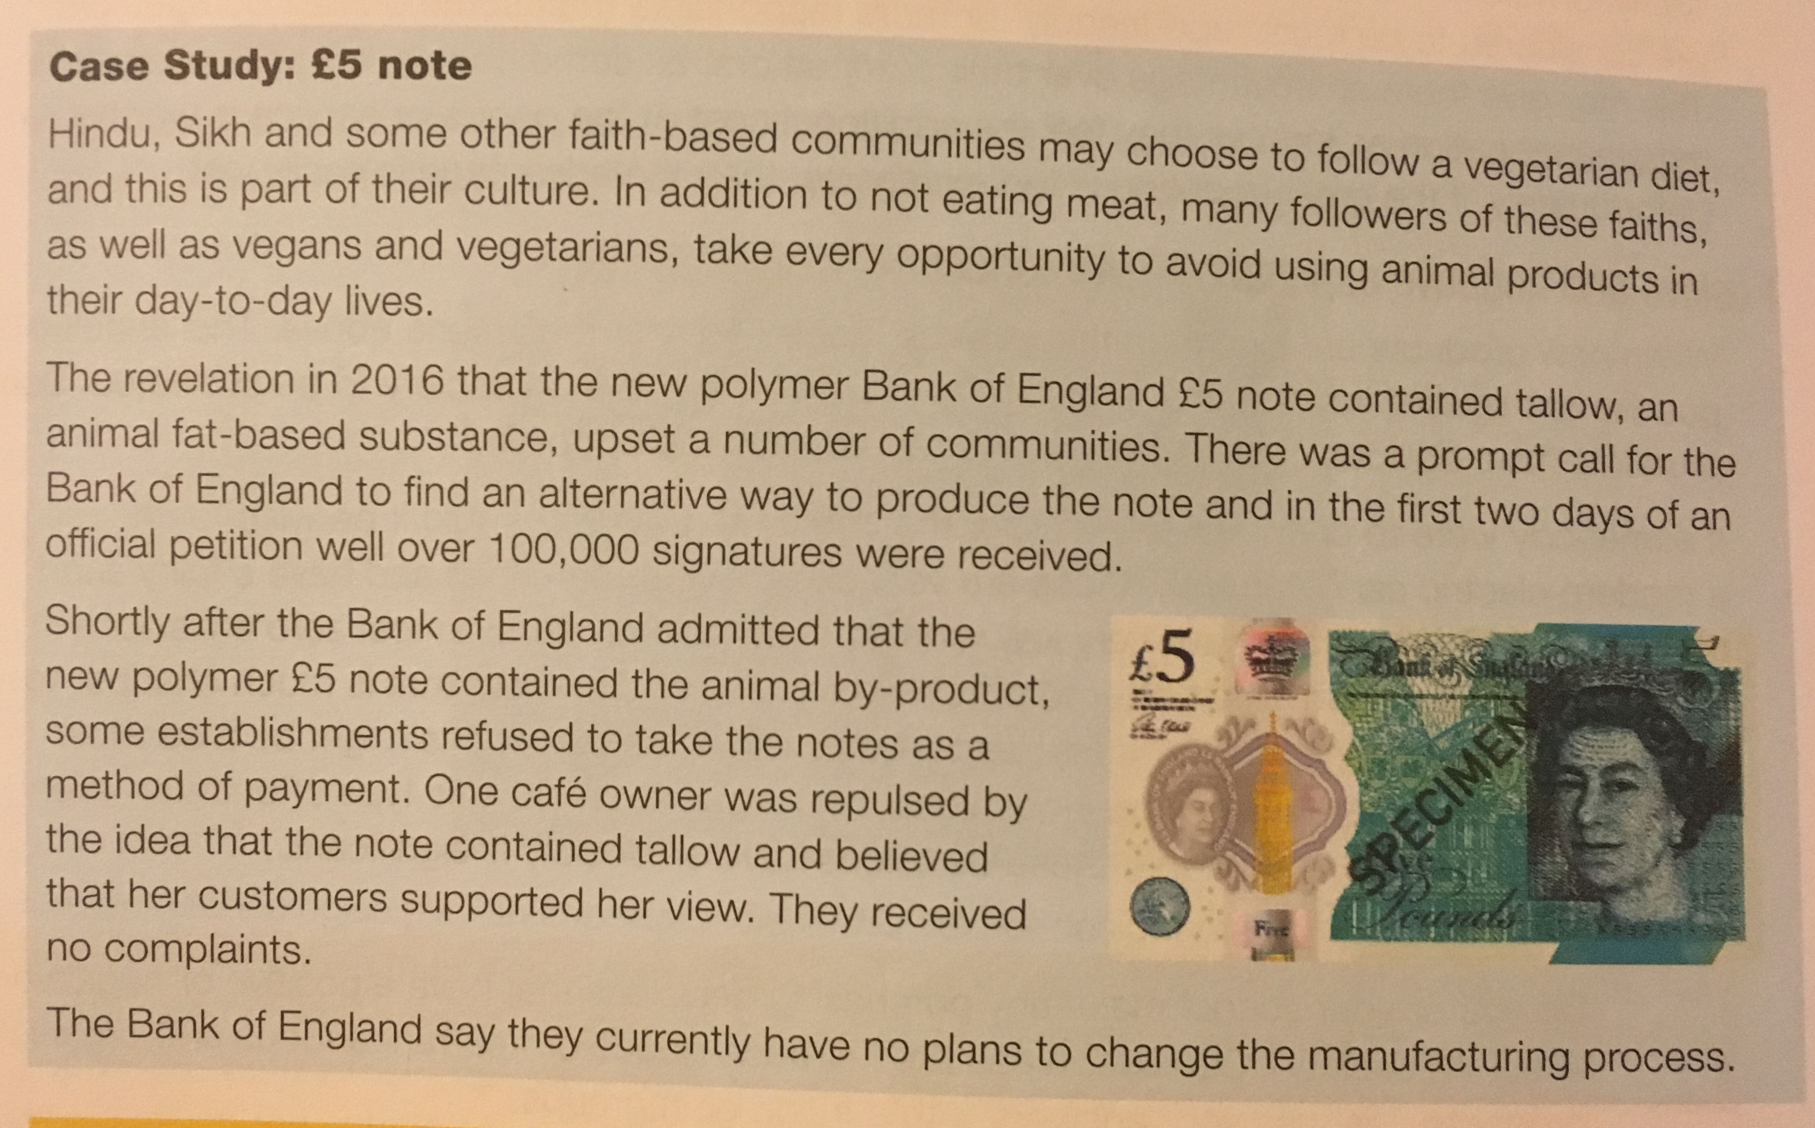
People. Society and Culture
Market Pull and Technology Push
Technology Push is the development of new technology, materials and manufacturing methods to create new products or improve old ones. Examples include; Smart Phones, Electricity, Mass Production, etc Market pull is the demand from consumers for new products and improvements in old ones; this is often found via reviews, polls, surveys, etc Examples include; Product Aesthetics, making products easier to use, etc
Fashion and Trends
Fashion and Trends will change quickly, and you can see major differences in fashions over decades. Designers have to make sure their products meet the fashion and trends of the area they are designing and selling the product to. The change of products over time is called Product Evolution. This is caused by Market Pull, Technology Push and Fashion and Trends. Some products are seen as timeless. These products are called Iconic Designs. These products are timeless because they were innovative, set a bench mark for following products, changed their industry and are often copied. Examples include; iPod, iPhone, Angle-Poise Lamp, Swiss Army Knife, Converse Shoes, Levi’s Jeans, Classic Mini Cooper
Cultures, Faith and Belief
Different groups of people have different interests and have to be catered for. Different countries and cultures also react to products differently. E.g. In India McDonalds don’t sell beef burgers as it has a large Hindu population, and cows are seen as sacred – in contrast the UK sells its most amount of fish and chips on a Friday as it is a Christian tradition to not eat meat on that day.
Inclusive vs. Exclusive Design
Inclusive Design: The aim to create a product that as many people as possible can use Examples include; Cars, Doorframes, Adjustable Products, etc Exclusive Design: The aim to create a product for a particular group and their needs Examples include; Car seats for babies, Wheelchairs, Stair Lifts

