Slide 1

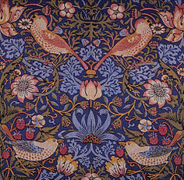
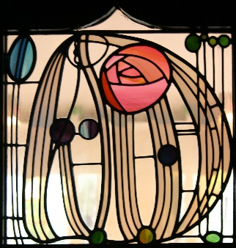
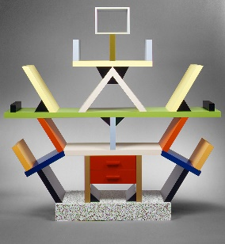
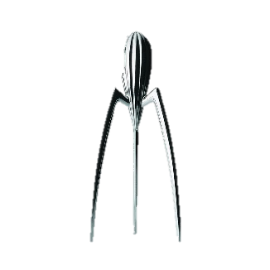
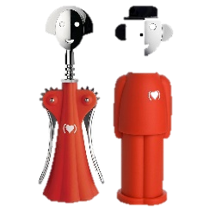

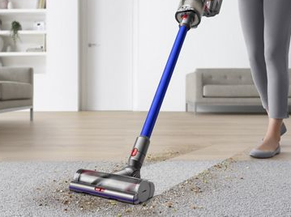
Work of others and Customer Research
Work or Others
Image/ Example | Designer | Design Movement | Key info
 | William Morris | Arts and Crafts | British designer in 1880s Simple natural crafts Useful and beautiful products (wallpapers, cushions, etc)
 | Charles Rennie Mackintosh | Art Nouveau | Scottish designer in 1860s – 1920s Known for light and shadow Created stained glass and furniture Inspired by nature and geometric lines
 | Ettore Stottas | Memphis | Italian designer in the 1950s/60s Enjoyed making everyday objects wacky and bold Used lots of bold colours and black lines
Research
Product Analysis
Case studies
Interviews
What methods of research can be used to find information?
Questionnaires and surveys
Materials testing
Social media and email
Research can be divided into 2 categories; Primary Research and Secondary Research.
Primary is research you complete yourself.
Secondary is research from resources others can gathered e.g. books, magazines and internet
Primary research is generally more reliable as it is done by the person using it and can double-check the data
Image/ Example | Brand | Key info
 | Alessi | Italian Design Company Homeware and kitchen utensils “Post-modern” style Phillipe Starke is a major designer
 | Apple | USA-based tech company Famous for iconic designs of iPod and iPhone Steve Jobs and Johnathon Ive are major designers Known for innovative and modern design
 | Dyson | British engineering company Famous for vacuum cleaners and innovative technology James Dyson is a major designer
Another key piece of research, is Anthropometrics and Ergonomics. This helps develop the sizes of products, etc to make sure it fits the User
Anthropometrics | The study of measurements of the human body. E.g. Knowing the grip width of a palm, if designing a new travel coffee cup
Ergonomics | The application of anthropometrics to ensure products are safe and comfortable to use. This can also include; size, material, appearance, brightness, sound and texture. E.g. making sure the travel cup is the correct size, and an insulating smooth material to make it comfortable to hold for long periods

