Slide 1
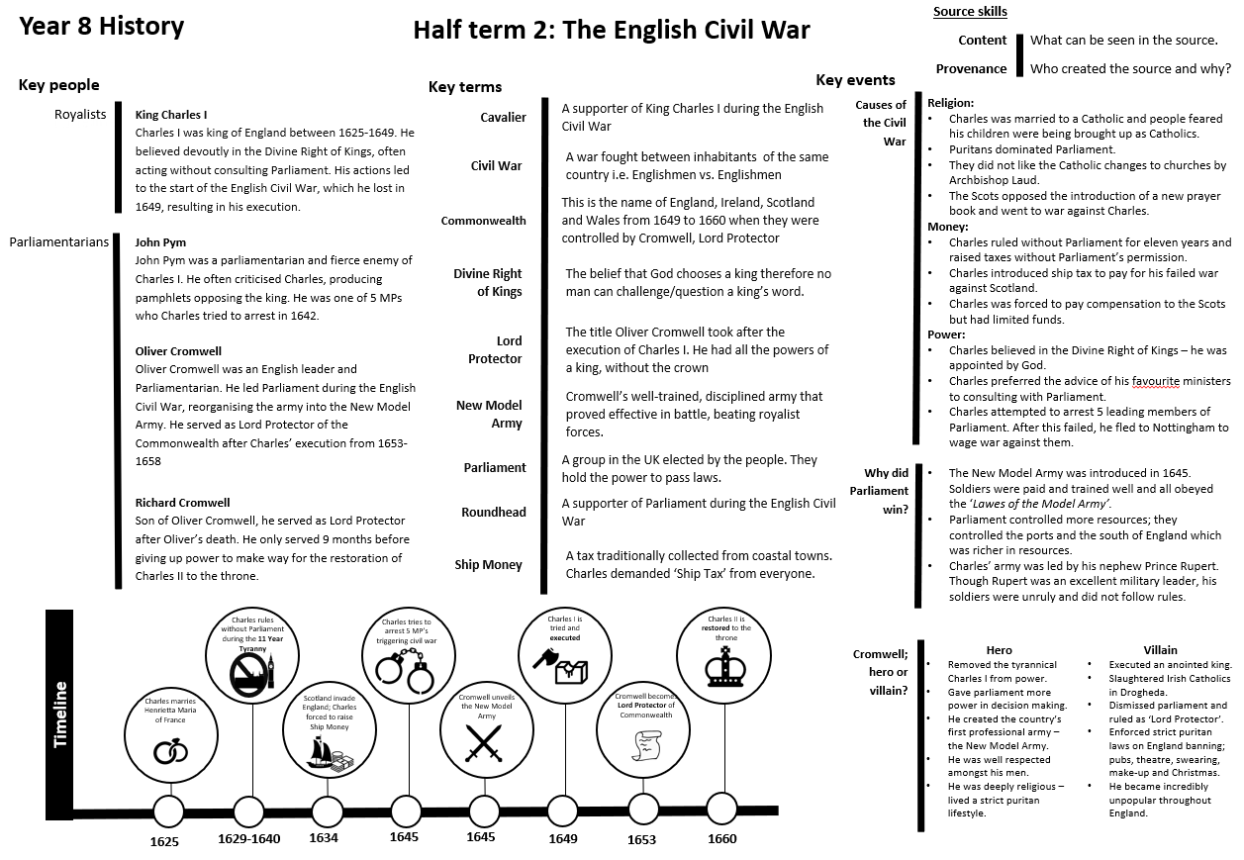
Year 7 – Civil War

