Slide 1
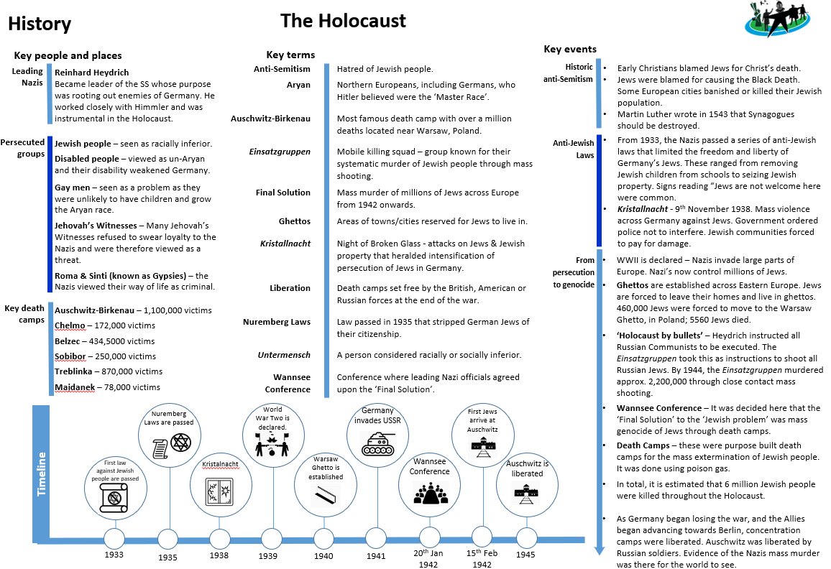
YEAR 9 – THE HOLOCAUST

