Slide 1
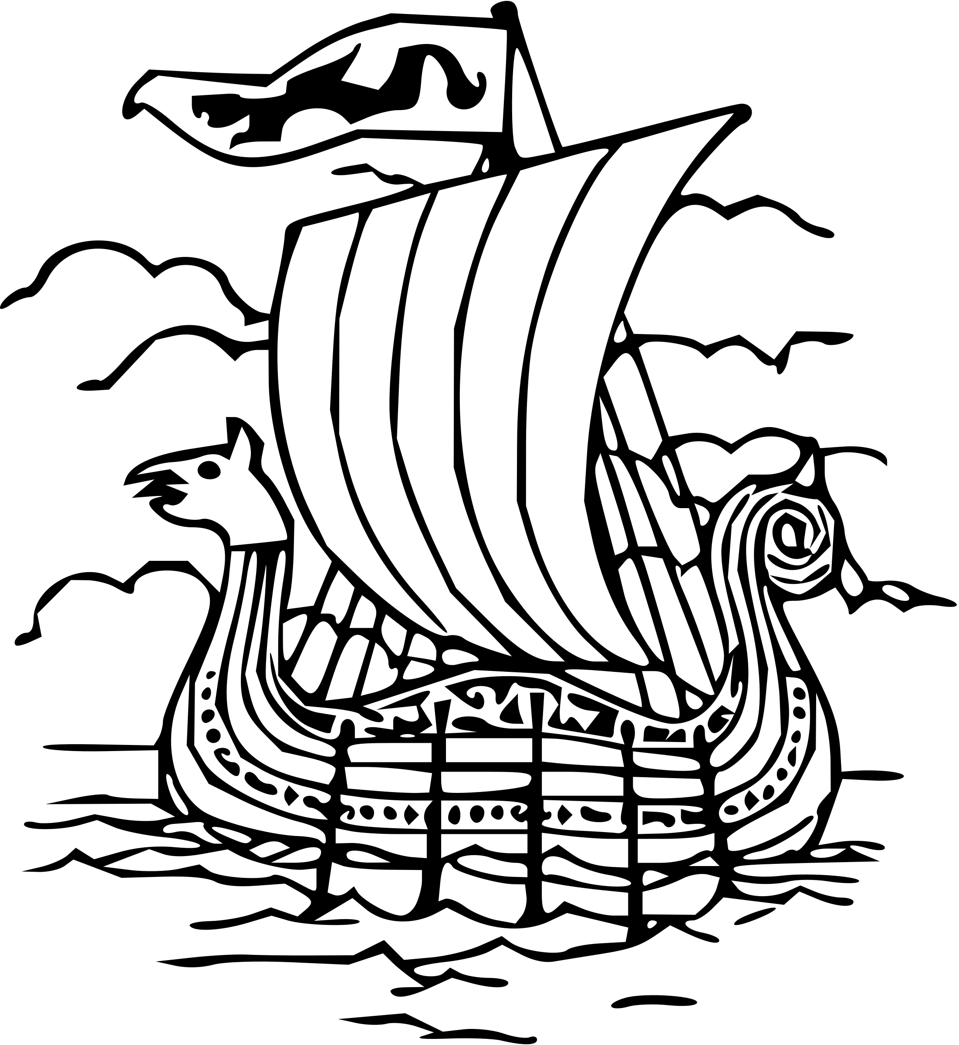
Year 8 History: Local History
Key people
Key words
Key events
Legend | A popular story regarded as historically true, but not proven
Domesday Book | A survey of land ordered by William the Conqueror
Motte and Bailey Castle | Castle used by the Normans with a stone keep on a hill or motte
Romanesque | A style of architecture favoured by the Normans
Magna Carta | A charter signed by King John
Siege | A military operation in which a building or town is surrounded and supplies cut off t o make them surrender
Pilgrimage | A religious journey
Reformation | Religious movement to reform the Catholic Church and establish Protestantism
Industry | A particular branch of making products
Resort | A place often visited for holidays or recreation
Entrepreneur | A person who takes risks to set up a business to make profit
Battalion | A large body of troops creating a unit
Lochnagar Crater | Created by a large mine detonated beneath the German front line
Dam | A barrier to hold back water which forms a reservoir
Raid | A surprise attack by enemy troops.
RAF | Royal Air Force
Founding of Grimsby | A legend of a Viking called Grim who carried Prince Havelock to the safety of the East coast. The suffix ‘by’ meaning town was added to his name to create Grimsby or Grim’s town
Norman Lincoln’ | William the Conqueror orders the building of a castle in Lincoln A cathedral is built using the Romanesque style Jewish Merchants arrive in the city Lincoln begins to thrive aa a centre
Pilgrimage of Grace | Commissioners arrive in Louth to assess the abbey and church The Vicar Louth preaches a sermon warning of the dangers A rebellion starts with 3000 men marching on Louth Word spreads through the county and 40,00 marched to Lincoln Cathedral and sent their demands to the king The traitors are executed
Grimsby Grows | The population of Grimsby develops rapidly during the 19th century New docks are opened for imports and exports The fishing industry grows and Grimsby becomes one of the largest ports in the world
Cleethorpes Resort | The railway arrives in Cleethorpes and thousands flock to the new seaside resort A new pier is built, an outdoor swimming pool, Ross Castle and a fairground are also built
Grimsby Chums | A battalion formed at the start of WW1 Saw first action at the Battle of the Somme They became trapped in the Lochnagar Mine and suffered 502 casualties
Dambusters Raid | The Raid took off from RAF Scampton and succeeded in destroying two of the targets
Grim Havelock Lady Nicola De La Haye Nicholas Melton Edward Watkin Guy Gibson | A legendary Viking who helped to save Prince Havelock. Grimsby is named after him A legendary Viking Prince saved by Grim Defended Lincoln Castle during 3 sieges One of the key figures in the start of the Pilgrimage of Grace Railway entrepreneur responsible for bringing the railway to Grimsby and Cleethorpes Wing Commander who led the Dambusters raid
Grimsby founded
Battle of Lincoln
Railway arrives in Grimsby
Battle of the Somme
Lincoln Castle built
Lincolnshire Uprising
Cleethorpes Pier Opens
Dambusters Raid
Timeline
800s
1068
1217
1536
1848
1873
1916
1943

