Slide 1
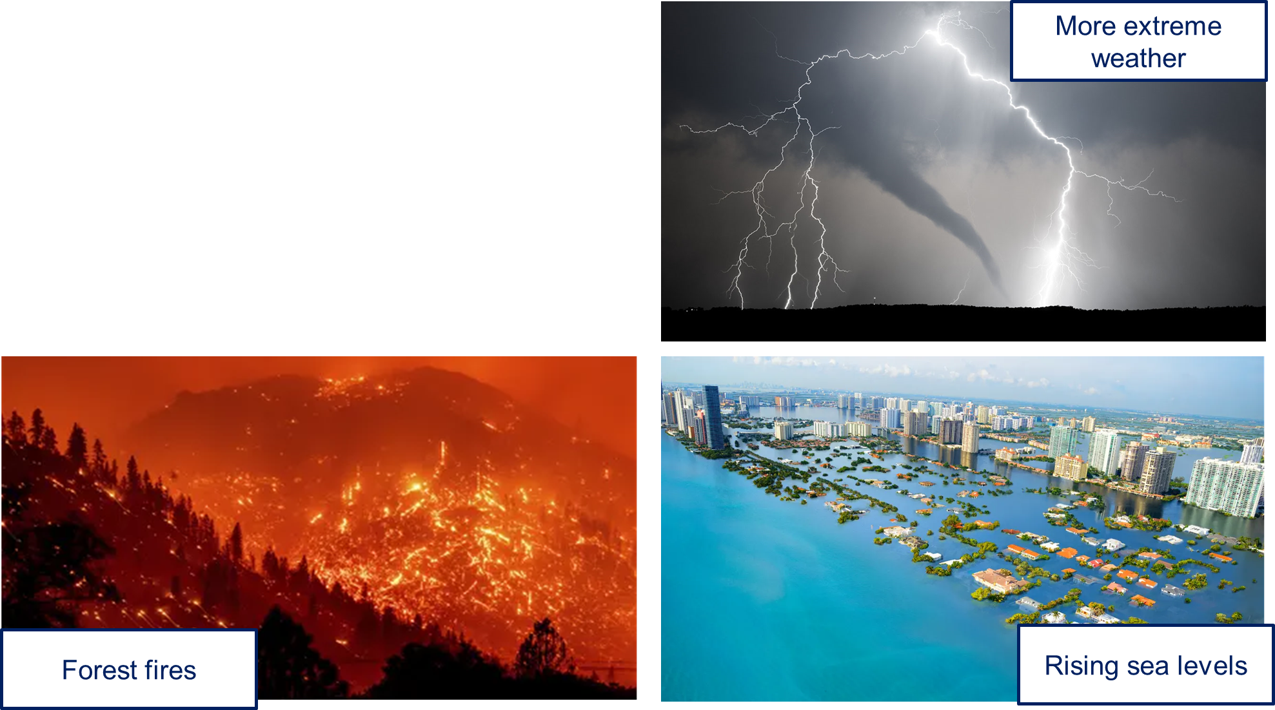
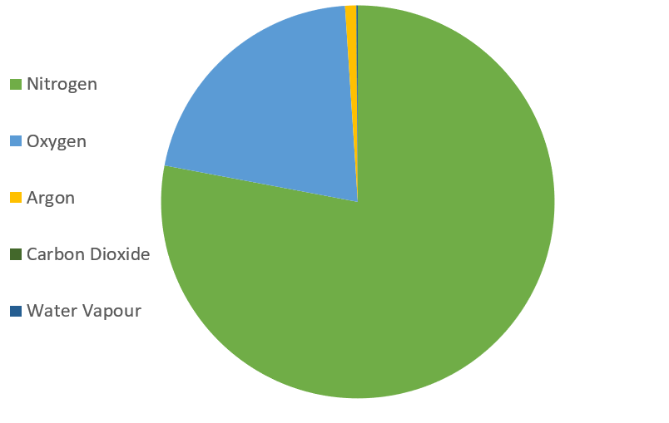
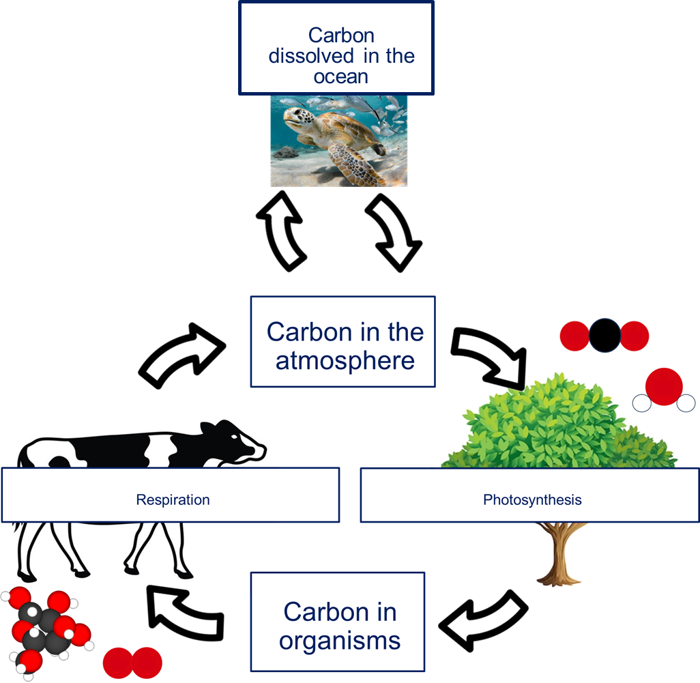
OE 04 Our Atmosphere
Atmospheric carbon dioxide composition is increasing due to the combustion of fossil fuels causing the planet to increase in temperature.
This is causing climate change.
Some of the effects are…
The Earth’s atmosphere is a layer of gas that surrounds the planet and protects it from harmful rays from the sun.
It stretches to approximately 10 000 km above the Earth’s crust.
The percentage of carbon dioxide in the atmosphere is maintained by the carbon cycle.
The carbon cycle returns carbon from organisms to the atmosphere as carbon dioxide to be used by plants in photosynthesis.
Humans use the Earth's resources for warmth, transport, shelter and food.
Many of the resources that are extracted from the Earth are finite.
Recycling is one way we can reduce the extraction of finite resources.
The atmosphere is a mixture of gases made up of:
Approximately 80% nitrogen.
Approximately 20% oxygen.
Small amounts of argon, Carbon dioxide and water vapour.

