Slide 1
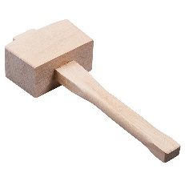
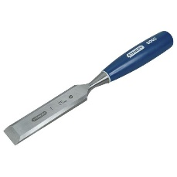
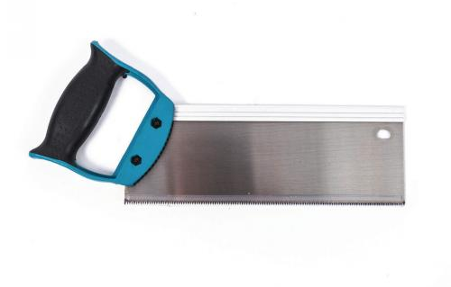
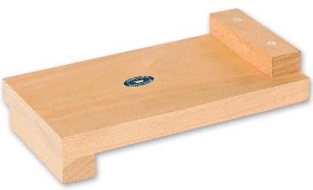
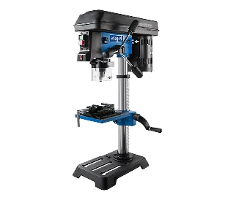
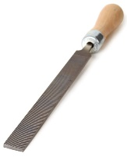
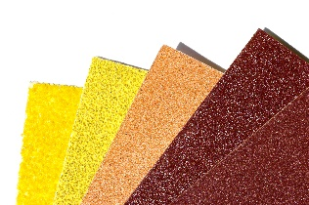
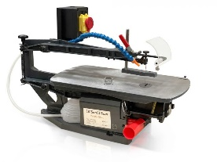
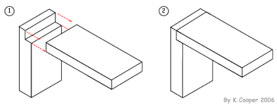
RSPB Birdhouse Project
Year 7
Tools list
Health & safety
Hazard: Anything likely to cause harm and/or damage to property or an individual
Risk: The potential danger caused by the hazard.
Assessment: Look at a situation/ place or activity and judge what the likelihood is of harm or damage occurring to property or people as a result
Control: Look at a situation/ place or activity and remove the hazard/ risk...
Mallet
Chisel
Tenon saw
Bench hook
Pillar drill
Scroll saw
Wood file
Sand paper
A – Aesthetics = What it looks like
C – Cost = How much it costs
C – Customer = Who is the target market
E – Environment = How does it affect the environment
S – Size = What is the size of the product
S – Safety = Is it safe to use
F – Function = What is it used for
M – Material = What materials are used to produce the product
Lap Joint
The process of creating the lap joint is to create an overlap of the material on one or more sides of the wood.
The 6 R’s
Reduce
What parts can you reduce in size to save material?
Are all the parts needed to make the product function the way you designed?
Refuse
What materials could you refuse to use?
Could you refuse to use materials that have not been responsibly sourced?
Rethink
How could you rethink the design to use less material?
Could you chose more environmentally friendly materials to use?
Recycle
Could parts be made from recycled material?
Could you use materials that can be recycled?
Reuse
Could the product have another use?
Could its parts be used in other products to extend the products life?
Repair
Is the product easy to repair when it’s broken?
Can fixings be easily accessed?

