Slide 1
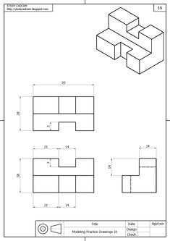

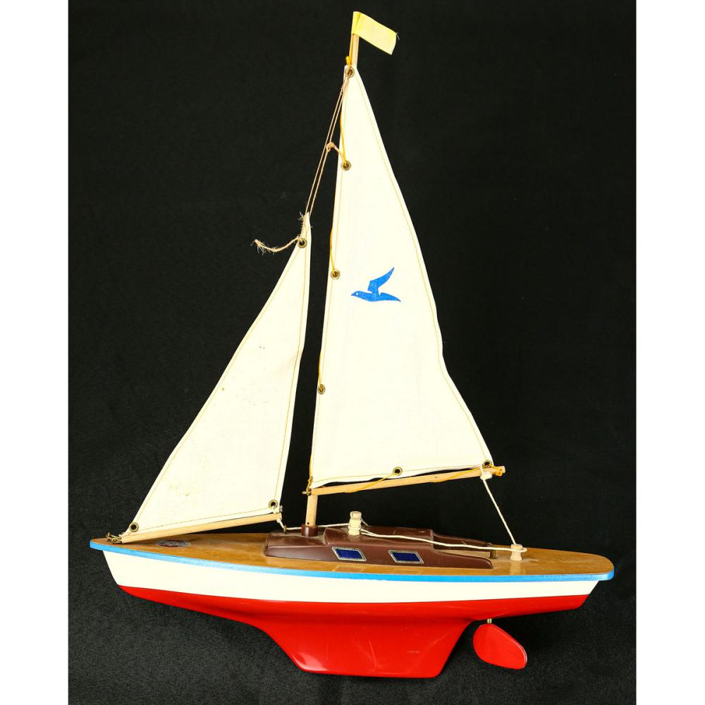
MYA Model sailing boat project
Year 8
Rainbow Annotation
Orthographic Projection
Negatives – What are the negatives and the design
Environment – What impact would your design have on the environment
Positives – What parts of the design work well?
Manufacture – How would your design be made
Improvements – What could you change and improve in your design?
Target Market – Who would this design appeal to?
Materials – What materials would you use to create this?
Production Planning
1 – Understand design brief and requirement
2 – Identify key information in the design brief
3 – Research existing products
4 – Design initial design ideas
5 – Annotate and develop final drawings
6 – Identify materials, tools and processes required to make the product
7 – Step by step guide on how to product the product
8 – Product analysis
Product research
Identify research criteria
Research existing products
Select key design features to use
Identify 3+ designs and annotate
Essential parts for sailing boat
Sail
Boom
Mast
Rudder
Main deck
Centre board

