Slide 1

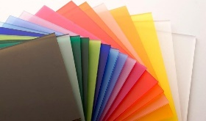
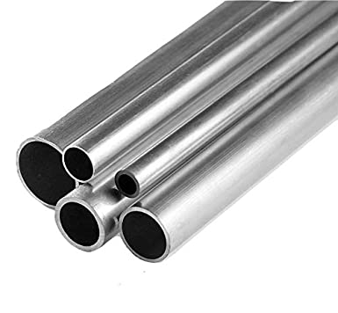
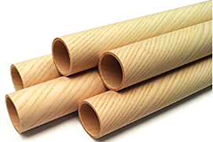
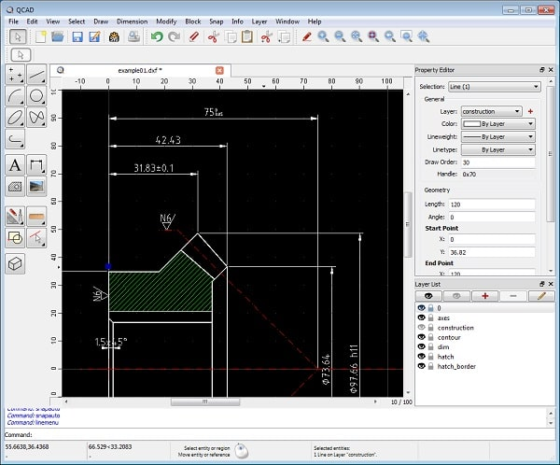
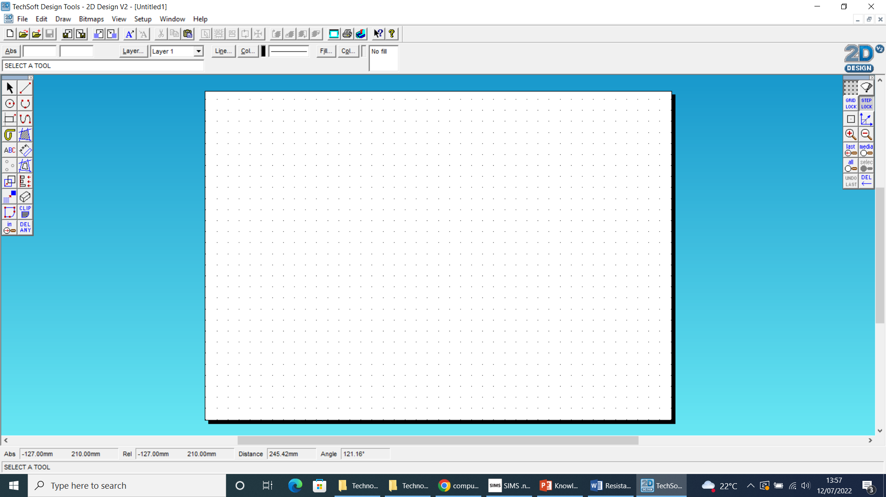
Year 9
ENGINEERING SKILLS
Materials used
Environmental costs
A life cycle assessment (LCA) looks at each stage of the life of a product. This is from the raw materials to when it is disposed of.
Manufacturing – Manufacturing products uses a lot of energy (pollution).
Using the product –
Using the product can also damage the environment
Product disposal –
Majority of disposed items are often go to landfill sites
Acrylic plastic sheets – To be designed on CAD and produced through the laser cutter
Aluminum pipes – To be measured and cut using hand tools
Wooden pipes – Measured and cut using scroll saw.
Design Brief
1 – Physical requirements = Can the product survive in the environment with the daily wear and tear.
2 – Aesthetics = How does the client want the product to look?
3 – Size = what are the overall measurements of the product and does it match the clients demands
4 – Function = What does the product need to be able to do?
5 – Performance requirements = can the product repeatedly perform the same function without breaking
Material properties
Strength
Strength is the ability to withstand forces without breaking
Hardness
The ability to withstand scratching, rubbing or denting
Plasticity
Its ability to change shape permanently and remain ductile
Brittleness
This is how much a material can withstand stretch without breaking
Toughness
A materials ability to absorb impacts without breaking or snapping
Durability
The materials ability to repeatedly withstand usage and corrosion
Scaled drawings on 2d design
Scaled drawing:
This is used to show the true size of a product. The drawing can either be to scale, scaled down or scaled up. The scaled drawing also allows the laser cutter to understand the commands for cutting the materials used
Select
Line
Radius
Arc
Shape
Path
Text
Dimension lines
Transform
3D effects

