Slide 1
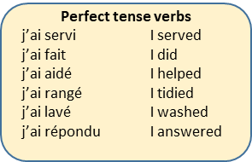
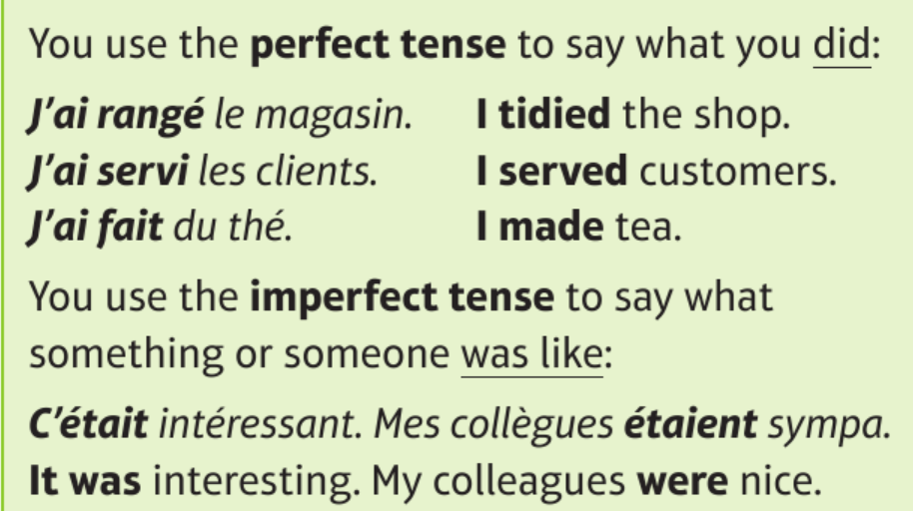
Year 11 Knowledge Organiser Module 1 – Bon Travail – Future plans & jobs Core Knowledge – Vocabulary and Grammar
Les métiers – Jobs
Tu as un petit boulot? – Do you have as part-time job?
Lieux de travail – Workplaces
Complex Phrases
je dirais que – I would say that
à mon gré – in my opinion
bien que ce soit – although it is
Lorsque/quand j’étais plus jeune… - When I was younger
Si j’avais la chance/le choix, je voudrais/j’aimerais… - If I had the chance/the choice, I would like…
High Frequency Words:
aussi – also
très – very
car/parce que – because
si – if
bien – well
mal – badly
vraiment – really
je vais vous écrire au sujet de… - I am going to write to you about…
Mes projets d’avenir – My plans for the future
Complex Phrases
je dirais que – I would say that
à mon gré – in my opinion
bien que ce soit – although it is
Lorsque/quand j’étais plus jeune… - When I was younger
Si j’avais la chance/le choix, je voudrais/j’aimerais… - If I had the chance/the choice, I would like…
C’était une bonne expérience? – Was it a good experience?

