Slide 1


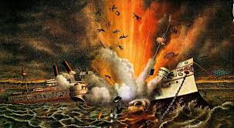

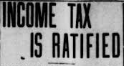
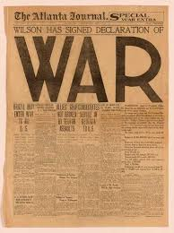

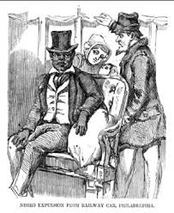
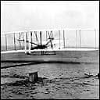
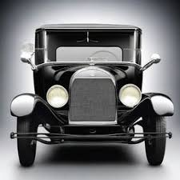
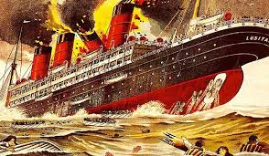
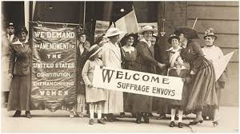
The USA before 1920
Key people
Key terms
Key events
1896 – Plessy V Fergusion Case legalises racial segregation in Southern states. It won't be overturned until 1954. 1898 - Spanish-American War which ushers in 'Big stick' foreign policy of American expansion. 1903 – Wilbur and Orville Wright succeed in flying the Wright Flyer at Kitty Hawk – the world's first aeroplane. 1903 – Ford Motor Company established in Detroit, Illinois 1906 – Federal Drug Administration established. 1908 – Ford Model T first built...over 15 million will be built by 1927. 1909 - N.A.AC.P founded to fight for black civil rights. 1912 – Woodrow Wilson elected 28th President of the USA. 1913 – Federal Income Tax introduced. 1914 Clayton Anti-trust Act ends monopolistic abuses by large corporations. 1915 Passenger Liner Lusitania is sunk by a German U boat. 128 Americans are killed. 1916 – Child Labour Act passed Woodrow Wilson re-elected President of the USA. 1917 Zimmerman telegram leads to USA declaring war on Germany. Nov 1918 – World War One ends 1919 –Treaty of Versailles signed. 1919 Volstead Act introduces Prohibition. 1920 - 19th amendment grants women the vote.
Wright Brothers' – Seventh President of the USA who signed the Indian Removal Act in 1830. Henry Ford – Pioneer of the assembly line production method and popularised mass car ownership with the Model T. Theodore Roosevelt – 26th US President who followed an aggressive foreign policy abroad and progressive domestic policy at home. W.E.B. Du Bois - Founder of the National Association of the Advancement of Coloured People (N.A.A.C.P.) Howard Taft – 27th US President who followed a 'Dollar Diplomacy' in the Americas. Woodrow Wilson - 28th US President who followed a progressive domestic policy at home and tried to keep the USA out of World War One, which was ultimately unsuccessful.
Assembly line production American dream | Large scale production of cars and consumer goods developed by Henry Ford and copied by other industries. 'The pursuit of happiness'.
Big stick diplomacy | A more imperialistic policy of foreign policy under President Roosevelt.
Dollar diplomacy | Use of economic power to influence and control South and Central American countries to America's benefit.
KKK Plessy V Ferguson Progressive Era Wright Brothers' | Racist organisation that terrorised black Americans and immigrants. Supreme Court judgement legalising racial segregation in the USA. Period of social and political reform between 1890-1920, addressing issues like poverty, unsafe working conditions, political corruption. Pioneers of the first powered flight in 1903.
spanish-American War
F.D.A. established
Federal Income Tax
USA enters WW1
Plessy V Ferguson
First plane flight
Model T Ford starts production
Lusitania sunk
Women granted the vote
Timeline
1896
1898
1903
1906
1908
1913
1915
1917
1920

