Slide 1


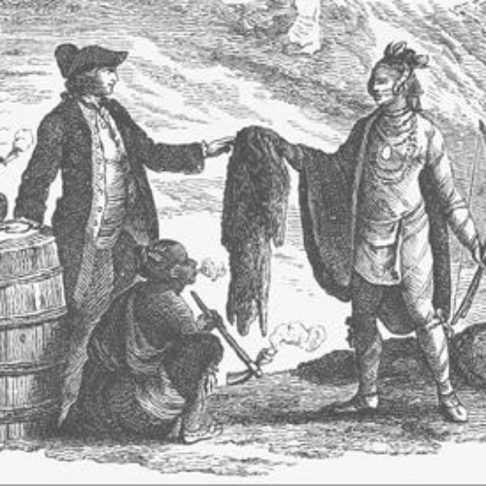
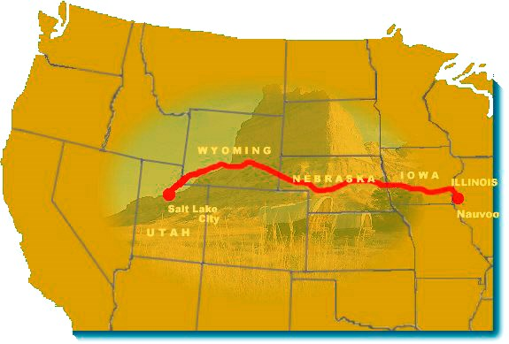
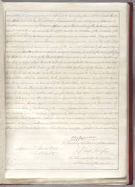
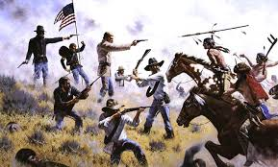

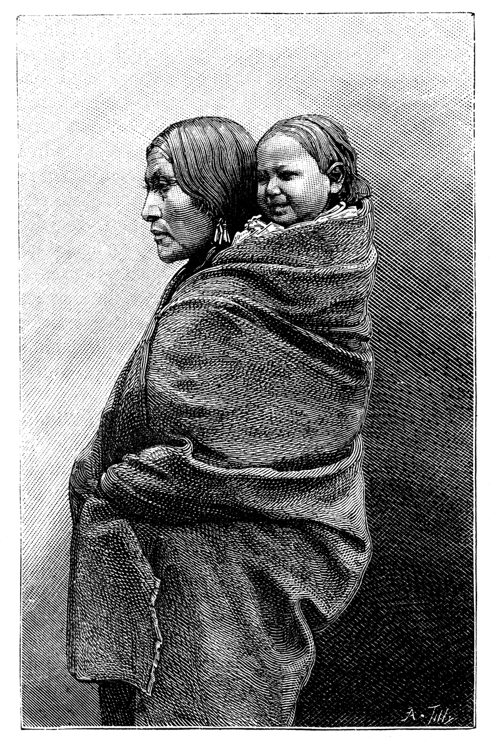
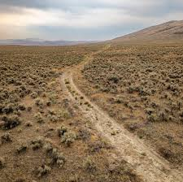
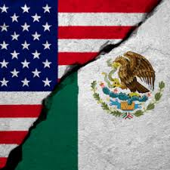
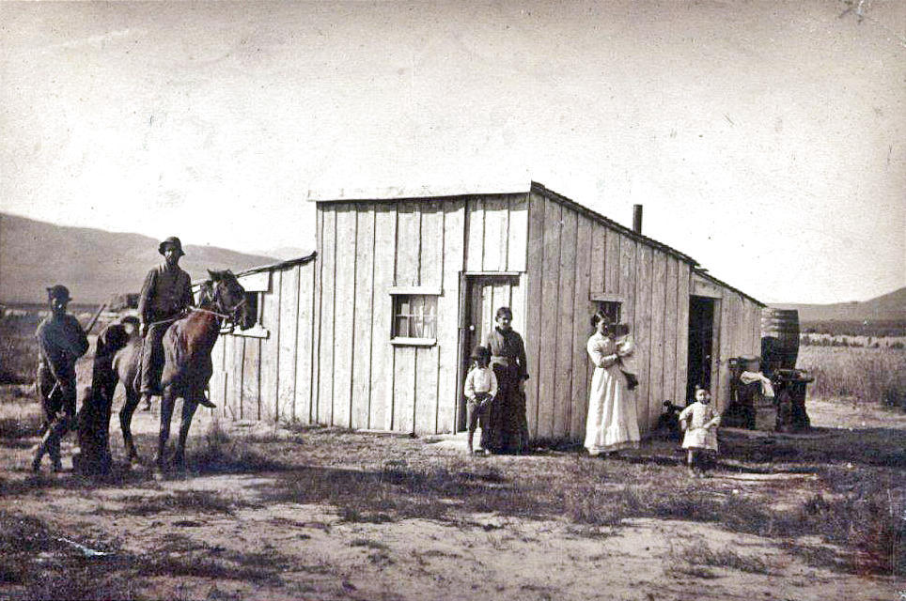
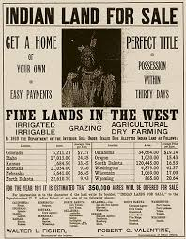
The American West
Key people
Key terms
Key events
President George Washington – First President of the USA and General of the Continental Army, which won the War of independence against Britain. President Andrew Jackson – Seventh President of the USA who signed the Indian Removal Act in 1830. Lewis and Clark –explorers who mapped the Oregan trail, allowing westward migration across the Great Plains and Cascade mountains to the Pacific Ocean. Sitting Bull - leader of the Lakota nation who resisted US government policies. Defeated General Custer at the Battle of the Little Bighorn in June 1876. Crazy Horse - A Lakota war leader who fought the US army in the Black Hills War in 1866, and at the battle of the Little Bighorn.
Declaration of independence | Constitution of the USA, promulgated in 1776.
Great Plains | Area of central north America
Buffalo | Main source of food and shelter of the native American Plains Nations.
Manifest Destiny | Belief of white Americans that it was their ‘god given’ right to populate the entire continent of North America.
Westward migration | Period of time in the 19th century when white settlers moved across the Great Plains towards the Pacific coast of America.
Reservations | Enforced resettlement areas for Indian nations of the Great Plains.
Treaty of Fort Laramie The Battle of the Little Bighorn | U.S. government recognised the black Hills as part of the Sioux Reservation (1868). Cheyenne and Lakota warriors defeat the US Army forces in battle (1876).
1830 – Indian Removal Act. 46,000 Indians are forced to leave the Easter states by the US government to re‐locate to the Great Plains. 1834 – Indian Trade Act. Sets out the Permanent Frontier which divided Indian territory from the eastern States, running from the Appalachian mountains. 1836 – Oregon Trail opened for migrants to travel to the Oregon territory and the Pacific coast.
1846 –7 – The Mormon Migration. Migration led by Brigham Young from the eastern states to Salt Lake City, Utah. 1848 – America wins the war against Mexico. Gave the Americans new territory to the south and west of Indian Territory; included California.
1848 – America wins the war against Mexico. Gave the Americans new territory to the south and west of Indian Territory; included California. 1851 – Indian Appropriations Act. Government created reservations so whites could take Indian lands and farm. Indians paid to move to smaller areas n reservations where they could be ‘civilised’ and farm the land. 1851 – First Fort Laramie Treaty. Agreement between Indians and the white government that Indians would not attack those travelling on the Oregan Trail in return for land. 1862 -- The Homestead Act - 160 acres for farming the land. 1869 -- Transcontinental Railroad completed – connecting East-West. 1876 -- Battle of Little Bighorn 1890 -- Massacre at Wounded Knee - Chief Big Foot & followers killed. 1890 -- Closure of the Indian Frontier by the government.
Indian Trade Act
Mormon Trail Utah
Indian Appropriations Act
Battle of the Little Bighorn
Indian Removal Act
Oregon Trail opened
Mexican – American War
Homestead Act
Indian Frontier closed
Timeline
1830
1834
1836
1846-7
1848
1851
1862
1876
1890

