Slide 1
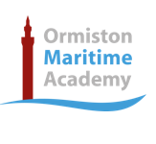
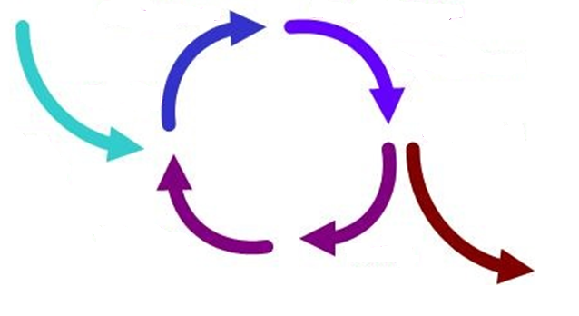
Design Strategies
Design Strategies are used to solve Design Fixation, and help develop creative design ideas.
Iterative Design
A Proposal is made
It is then planned and developed to meet the brief
It is analysed and refined
It is then tested and modelled
Systems Approach
Usually used for electronic products
Often uses diagrams to show systems in a visual way
Planning the layout for the correct sequences e.g. inputs, outputs, timings, etc
Electronics and mechanical systems need an ordered and logical approach
Then evaluated against the brief – many versions fail but that then informs development to make the idea better
The cycle then repeats and if the product is successful it is then made and sold on the market
Systems Approach
Advantages | Disadvantages
Does not need specialist knowledge Easy to communicate stages Easy to find errors | Sometimes over-simplifies stages Can lead to unnecessary stages
Iterative Design
Advantages | Disadvantages
Consistent testing helps solve problems earlier Constant feedback Easy evidence of progress | Designers can loose sight of “the big picture” Time consuming
Collaborative Approach
Working with others to share data and solving problems and coming up with design proposals can help with creativity
User-Centred Design
This is when designs are based on fulfilling the needs and wants of the Users/ Clients at every stage of the design process
Numerous companies work in teams, and has been shown to improve the range and quality of ideas produced
Questioning and testing is ongoing and is often found through interviews, questionnaires, surveys, etc
Collaborative Approach
Advantages | Disadvantages
Gets multiple opinions and a range of views Working in groups can produce more ideas | Can be difficult to design ideas with opposing views Can be difficult to find time to communicate with multiple people
User-Centred
Advantages | Disadvantages
User feels listened to Makes sure the product meets their needs | Requires extra time to get customer feedback If focused on just one person it can limit appeal to others

